Slide 1
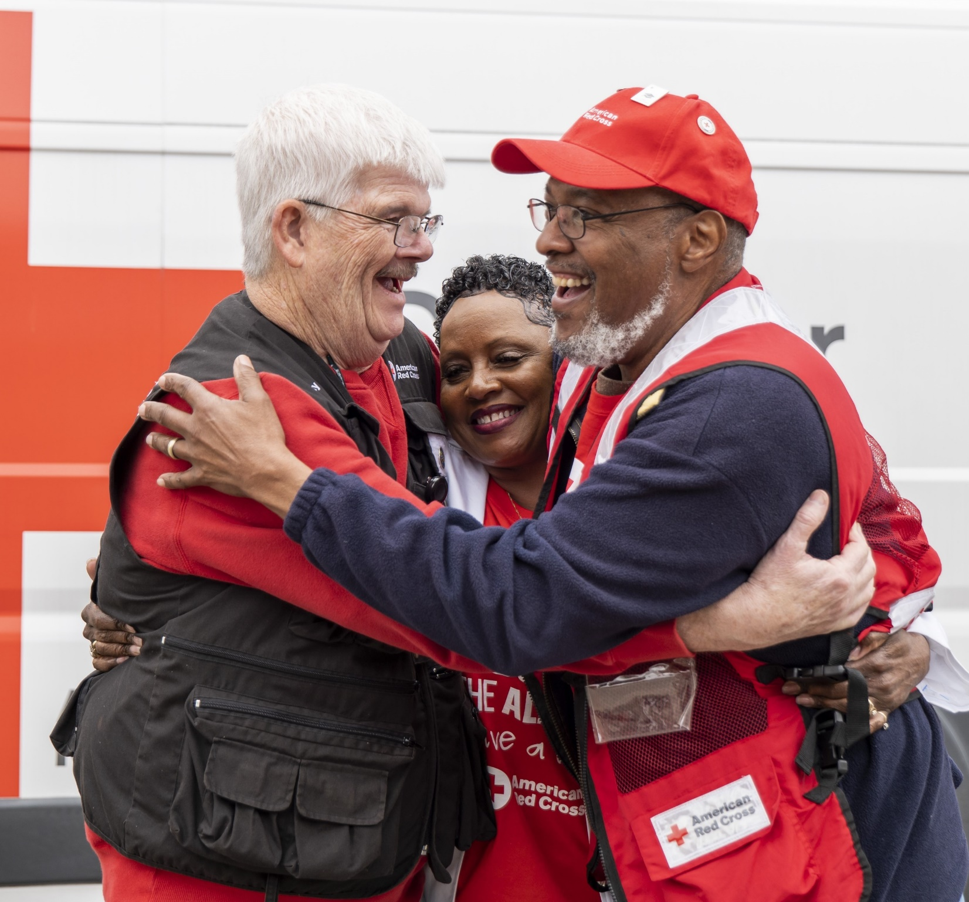

Workplace Giving
PLAYBOOK

Slide 2

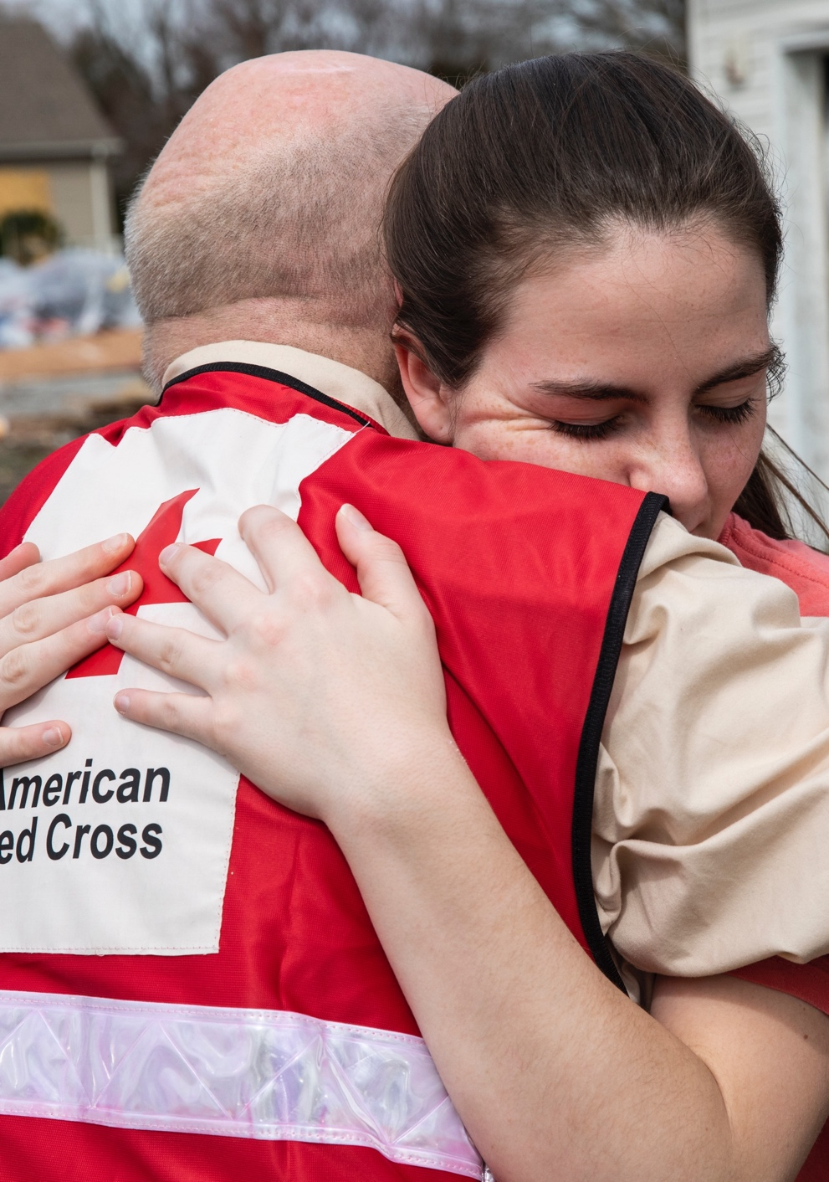
Table of Contents
American Red Cross Mission
Workplace Giving Best Practices
Workplace Giving Tools
Digital Templates

Slide 4





Every day, we alleviate suffering for thousands of people:
With the power of volunteers, we are incredibly efficient.
Helping 175 families affected by home fires
or other disasters.
Collecting 12,000 blood donations to help
people facing medical crises.
90%
Providing 1,400 services to military members, veterans and their families facing emergencies.
of our workforce
is volunteer.
Delivering measles and rubella vaccinations to
320,000 children worldwide.
90¢
Training 14,000 people in lifesaving skills.
of every dollar
we spend
delivers care.

Slide 5


American Red Cross is the nation’s best-known nonprofit.
The charity that Americans trust
the most.
Most favorable brand impression among U.S. adults.
Nonprofit with the most reported buzz.
Source: Morning Consult Brand Intelligence, a global data intelligence company delivering insights on what people think in real time. January 2024.

Slide 6
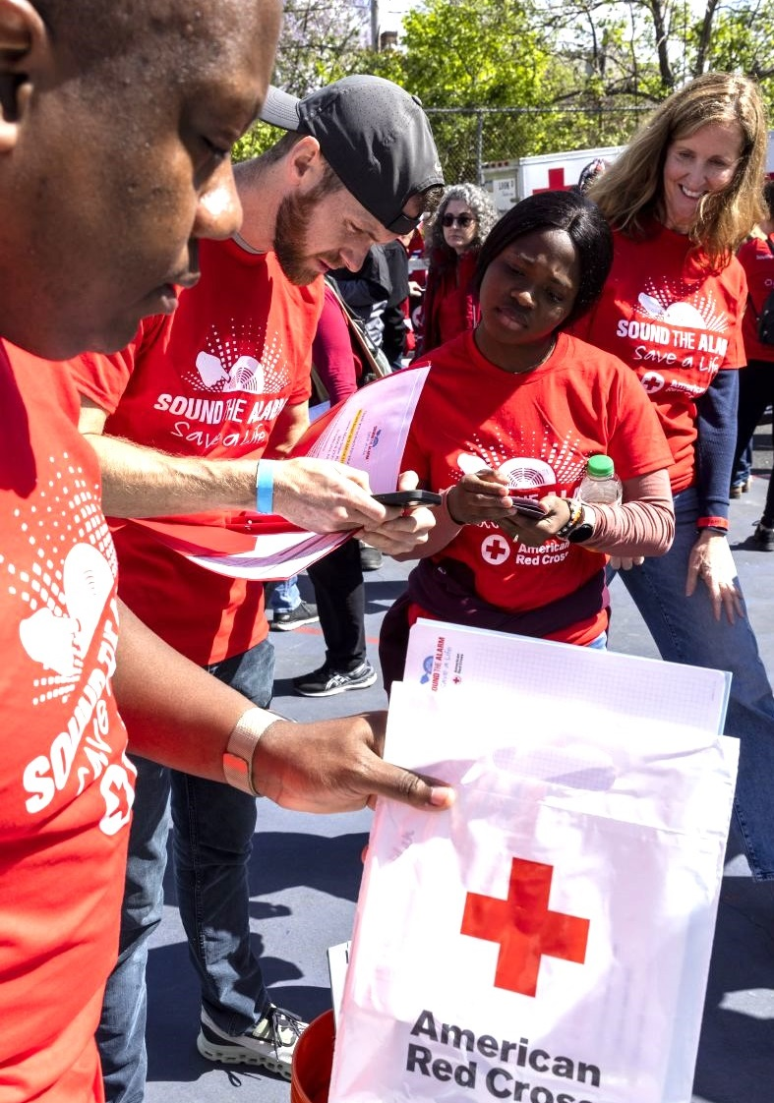
We Make Workplace Giving Easy
The Red Cross can support your workplace giving strategy through a variety of online tools, which allow employees to easily make charitable gifts as one-time contributions or payroll deductions.
Red Cross-hosted giving platforms include:
Co-branded donation microsites.
Third-party giving platforms include:
Benevity, Cybergrants, YourCause and more.
We can also work with your company’s existing platform.

Slide 7







Making Your Campaign a Success
Share your vision of a successful campaign with your Red Cross relationship manager. Together, we will develop a strategy to meet your revenue and impact goals.
Create a plan. At the Red Cross, we LOVE preparedness and plans! How can we help you plan your campaign?
Build a calendar
targeting important campaign dates and events.
Recruit internal champions to support your campaign and engage their networks.
1)
2)
3)
Ask your company’s leadership to set campaign priorities and send out communications.
Use Red Cross tools
and resources to raise awareness of our partnership and your campaign.
Share fundraising results and impact
stories with your workforce.
4)
5)
6)
Schedule the Red Cross to present during “lunch and learns” or preparedness meetings. We can attend virtually or in-person.
Send a thank you to employees at the end of the campaign.
7)
8)

Slide 8

Engaging Employees
Encourage participation in workplace giving with fun activities that engage employees at all levels of your organization.
Raffle off lunch with executives and allow leadership to connect with employees over a lunch of their choosing. (Lunch can be in-person or virtual.)
Create a leadership challenge with prizes. When a team reaches its fundraising goal, everyone is treated to a special snack, receives a bonus day of PTO or gets a casual dress day in the office.
Create donation goals to unite campaign volunteers, leaders and employee participants.
Double the impact of employee donations by offering a company match.
Show the impact of employees’ donations with Red Cross template resources.

Slide 9
Tools for Your
Workplace Giving Campaign

Slide 10
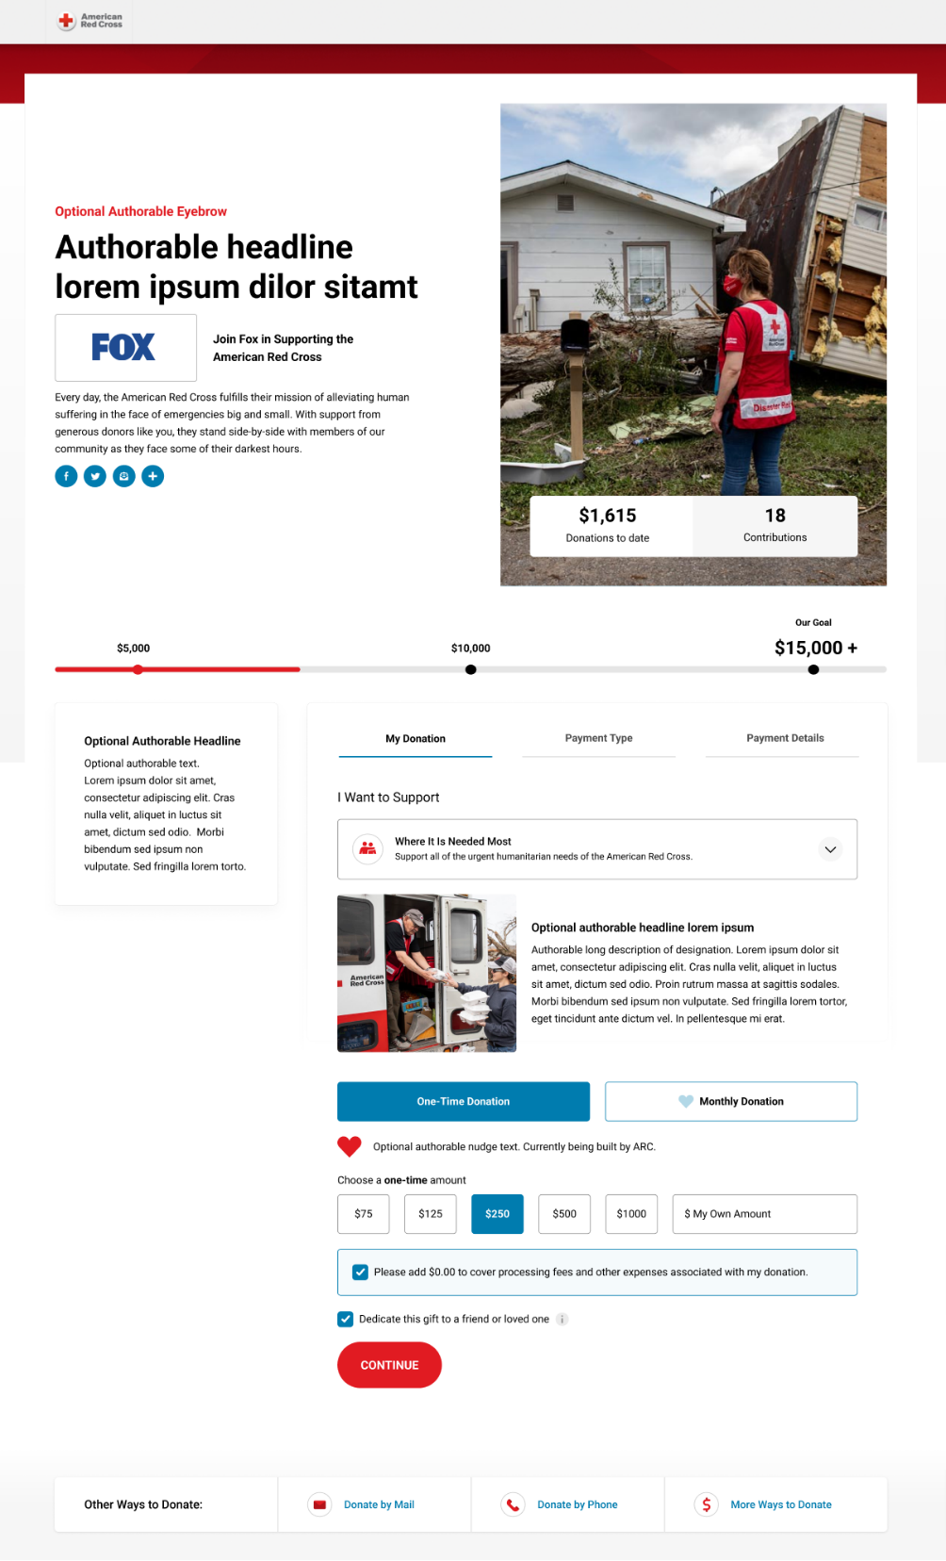
Donation Microsites
Secure and turnkey, Red Cross microsites are ideal for fundraising after disasters or for annual campaigns. They can be used with employees and the public.
Customized Microsite:
Available to current corporate partners.
Co-branded with your logo, custom welcome message, goal thermometer, and donation tracker.
Reporting available to track the donations made by your employees/customers.
Disaster-Only Microsite:
  Available to all corporate partners.
  Raise money for named disaster designations.
Reporting available to track the donations made by your employees/customers.
  Request any of the above through your Red Cross representative.

Slide 11
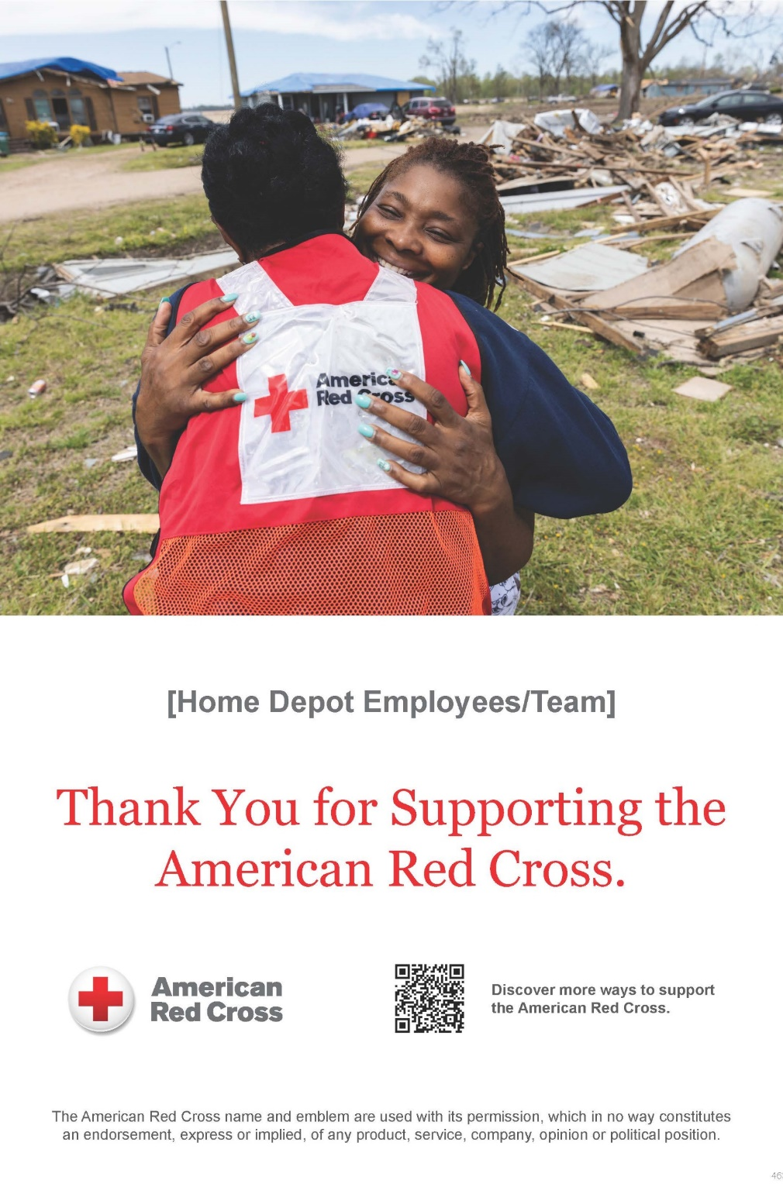
Campaign Tools
The Red Cross offers templates and tools to support your workplace giving efforts, including:
Posters and stickers to distribute to employees.
Red Cross stories and photos.
Email templates to engage internal stakeholders.
Template copy for your social media, company intranet and more.
You can find these tools on our Workplace Giving Resources page.

Slide 12
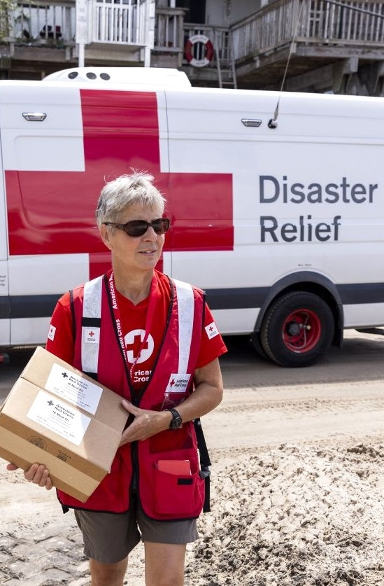
Beyond Employee
Donations
Show your employees the power of their fundraising with well-timed updates and resources.
Campaign reports can be created monthly if you use a microsite or Corporate Vanity URL and may be requested from your Red Cross representative.
  If you use a third-party or in-house fundraising platform, please consider sharing the data with the Red Cross so we can help steward your donors.
Thank-you emails make it easy to appreciate donors.
Impact stories bring the Red Cross mission to life.
Preparedness tools and tips help employees keep themselves and their loved ones safe.

Slide 13
Communications Templates

Slide 14
Email Template: Promote Your Workplace Giving Campaign to Employees
The Red Cross is there during some of life’s darkest moments — when a family’s home burns, when a child with cancer needs lifesaving blood, when a service member’s parent dies half a world away.
They help people through every imaginable emergency, and we’re proud to say that [COMPANY] does, too. Through our Red Cross partnership, we’re able to give back in some incredible ways, including [INSERT FORMS OF SUPPORT].
Please join us in this lifesaving support. Simply make a donation online [ADD LINK] today. Our company goal is to reach [$#] in Red Cross contributions by [TIMEFRAME]. [IF YOU’RE MATCHING DONATIONS, PROVIDE INFORMATION HERE].
Watch for inspiring stories and updates in the coming weeks as we all learn more about the ways our donations help through the Red Cross. Thank you for all you do to give back here in [COMMUNITY] and nationwide!
“
”

Slide 15
Email Template: Thank You to Employees
On behalf of [COMPANY], I want to extend a heartfelt thank you for contributing to the American Red Cross. Your generosity has taken us even closer to meeting our company goal of [$#]. So far, we’ve raised [$#], and the number is still climbing!
Know that your donation is helping people when they need it most — after disasters, during medical emergencies and more.
To learn more about the lifesaving Red Cross mission, visit the Red Cross website.
And again, thank you. We are so proud to have you as part of the [COMPANY] family.
“
”

Slide 16



Social Media Templates
Join us in supporting the American Red Cross. Your gift will help people whose lives have been upended by wildfires, storms, floods and countless other crises. Donate at [insert link to platform].
Every day of the year, the American Red Cross is there for people in need, and through this special campaign, you can be, too. Give at [insert link to platform].
Join us in helping the American Red Cross prepare for disasters large and small. Donate at [insert link to platform].
“
”

Slide 17
Brief Descriptions for Campaign Communications
25-Word Description:
The American Red Cross prevents and alleviates human suffering in the face of emergencies by mobilizing the power of volunteers and the generosity of donors.
50-Word Description:
The American Red Cross prevents and alleviates human suffering in the face of emergencies by mobilizing the power of volunteers and the generosity of donors. Survivors of disasters, patients needing lifesaving blood, members of the military and many more turn to the Red Cross every second of every day.
150-Word Description:
The American Red Cross prevents and alleviates human suffering in the face of emergencies by mobilizing the power of volunteers and the generosity of donors. As the nation’s premier emergency preparedness and response organization, the Red Cross is there to help and comfort people through devastating crises — from home fires to earthquakes and much more. Families in the aftermath of disasters, patients needing lifesaving blood, members of the military and many others turn to the Red Cross every second of every day. With about 230 chapters across the U.S., we have a presence in every community. Alongside our global Red Cross partners, we are part of the largest humanitarian network in the world. For more than 140 years, the American Red Cross has been helping neighbors down the street, across the country and around the world. Join us today by making a donation, volunteering, giving blood or taking a class.
“
”

