Slide 1
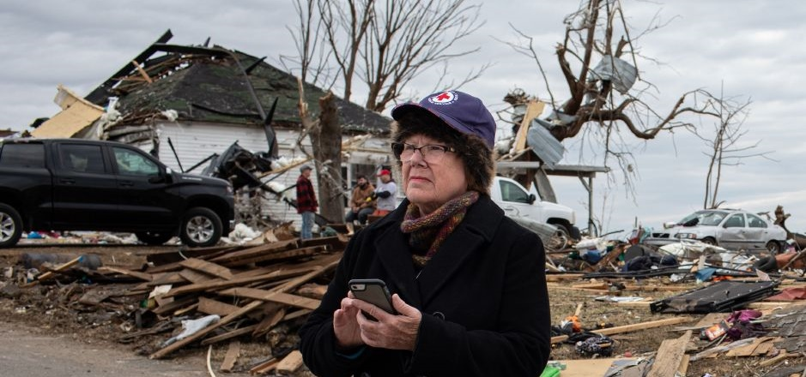
Quarterly Disaster Update
FY22 Q2 (Oct. – Dec. 2021)
Prepared for ADGP Members

Slide 2
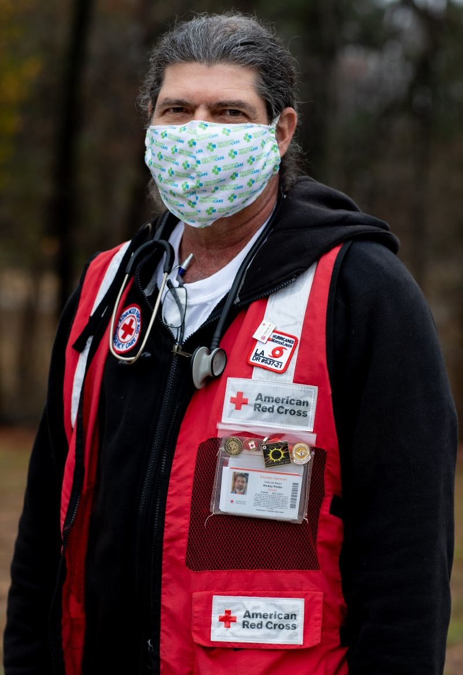
Quarterly Disaster Update
FY22 Q2 (Oct. – Dec. 2021)
CONTENTS
Slide 3 Domestic Response
Slide 9 Home Fire Campaign
Slide 11 International Services
Slide 15 Your Partnership

Slide 3
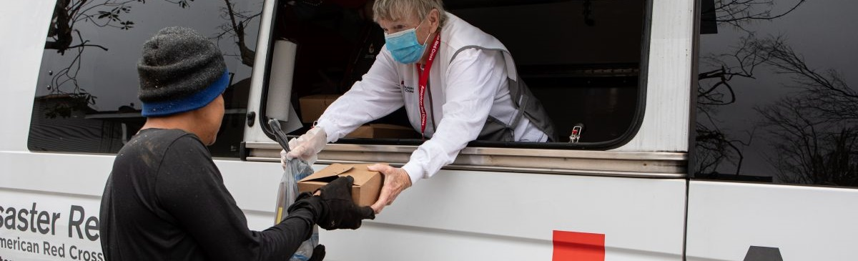
For many families, what should have been a season of joy has been a season of despair.
Emergencies don’t take a break — not even during the holiday season. As 2021 came to a close, the need for disaster relief was as strong as ever. Weather-related disasters like extreme storms, ferocious wildfires, dangerous flooding and a record-breaking tornado outbreak left thousands of people in dire circumstances. Their needs were, of course, exacerbated by the COVID-19 pandemic.

Slide 4
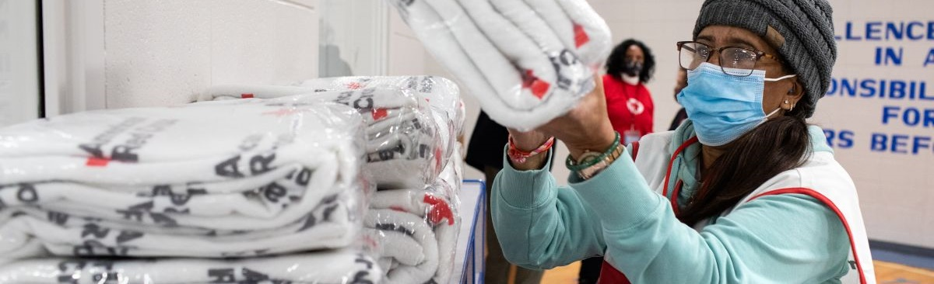
The nation relies on the Red Cross during these dark moments, and through ADGP, you help us deliver in such a big way.
As December’s unprecedented tornadoes demonstrated, life can truly change in an instant. Your ADGP commitment enables the Red Cross to respond at a moment’s notice, and the immediate aid you help provide means everything when families are facing some of the most difficult days of their lives.

Slide 5
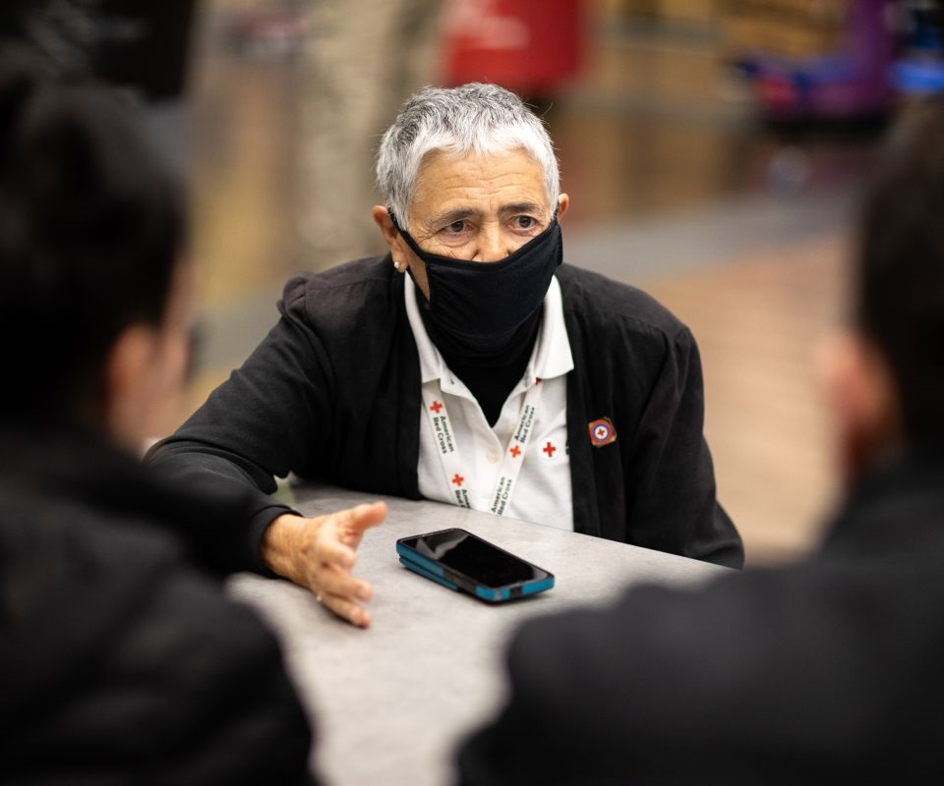
“She … explained what she could do for us. She was very caring, comforting and genuine.”
Tornado survivors Norma and Robert Valdivieso, speaking about Red Cross spiritual care volunteer Deane Oliva
After losing their home and all their possessions to a tornado, Bowling Green, Kentucky residents Robert and Norma Valdivieso emerged from the protection of their bathtub and made their way to a Red Cross shelter. Spiritual care volunteer Deane Oliva was the first to greet them, acknowledging the horror they experienced and providing needed comfort and emotional support. Both Robert and Norma expressed that “it takes a very special person” to do what Deane did that night, reinforcing the crucial role our volunteers play during extraordinarily difficult times.

Slide 6
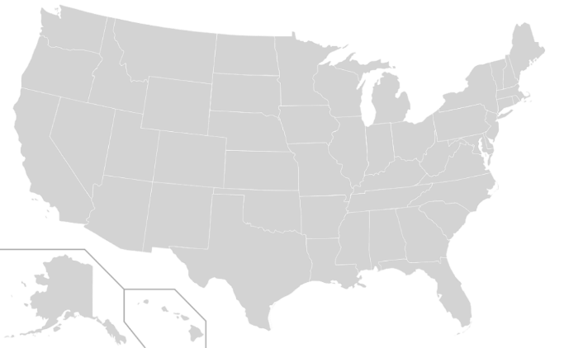
Domestic Response Quarterly Totals
The Red Cross responded to 68 large disasters across the country, including 9 very large events.
AL Floods (Level 3)
LA Hotel Fire (Level 3)
MO Tornadoes (Level 3)
Disaster Services Operational Support for Blood Services (Level 5)
WA Floods (Level 4)
KY Tornadoes (Level 6)
TN Tornadoes (Level 4)
MO/AR Tornadoes (Level 4)
CO Wildfire (Level 4)
5
4
9
3
6
8
7
1
2
“Large” includes domestic disaster operations with costs of $10,000+ (i.e., level 2 and higher).
“Very large” includes domestic disaster operations with costs of $50,000+ (i.e., level 3 and higher).

Slide 7





Domestic Response Quarterly Totals
This quarter, over 1,100 Red Cross disaster workers provided
critical services in lockstep with our partners across the U.S.
101,700
meals and snacks served with partners
26,400
overnight stays in emergency lodging provided with partners
59,600
relief items distributed
13,300
individual care contacts made
11,200
households provided recovery support
FY22 Totals
95,500
1.7 million
2.5 million
73,000
27,700
Includes domestic disaster operations with costs of $10,000+ (i.e., level 2 and higher).

Slide 8
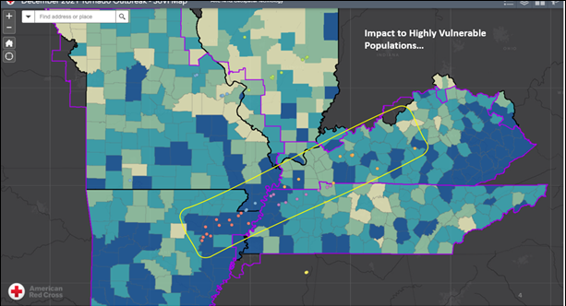
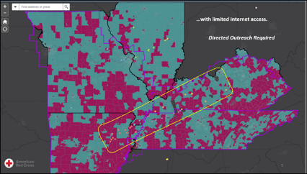
Domestic Response Spotlight
SOUTHERN AND MIDWEST TORNADOES
Using RC View, our cutting-edge disaster event management system, we mapped impact areas and pre-disaster vulnerabilities, making sure people were not overlooked.
The system created visualizations of displacement, power outages and communications challenges. Laying that over existing broadband deficits, we decided that in-person outreach would be critical to reaching and serving those with the greatest needs.
With this lifesaving intelligence, we directed our people and resources where they were needed most.

Slide 9
Home Fire Campaign

Slide 10
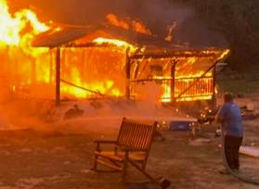
This quarter, ADGP members also helped families devastated by nearly 14,800 home fires.
Plus, fires spike in colder months. In December 2021, we responded to nearly 10% more than our monthly average.
After each fire, we provided affected families with essentials — everything from warm places to sleep to nourishing meals to replacement eyeglasses and prescriptions.
At the same time, we continued to safeguard communities nationwide through Sound the Alarm. Our volunteers and partners have now placed over 2.2 million smoke alarms for free in at-risk homes.

Slide 11
International Services

Slide 12
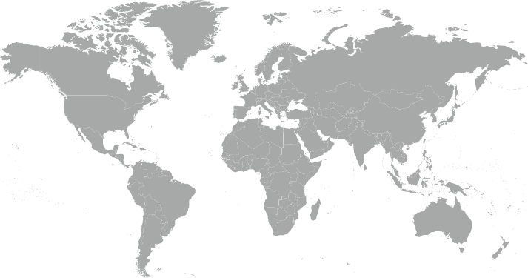
International Services Quarterly Totals
The American Red Cross began or continued responses to 13 major emergencies around the world.
Global Coronavirus Outbreak
Afghanistan Humanitarian Crisis
Lebanon Port Explosions
DRC/Rwanda Volcano Eruption
Mediterranean Population Movement
Philippines Typhoon Chanthu
St. Vincent and Grenadines Volcano Eruption
Haiti Earthquake
Nepal Floods and Landslides
Europe Floods
Indonesia Floods, Landslides and Earthquake
Croatia Earthquake
Mozambique Cyclone Eloise
10
12
5
2
3
8
9
6
7
4
11
13
1

Slide 13
International Services Quarterly Totals
The American Red Cross actively supported
disaster preparedness, relief and recovery work in 17 countries.
$6 million
donated to Red Cross and Red Crescent efforts*
2
American Red Cross specialists deployed
317
families
reconnected after disasters/conflicts**
19
preparedness/ risk reduction projects
FY22 Totals
$10.2 million
4
11,503
21
*Reflects funds donated by American Red Cross to the International Federation of Red Cross and Red Crescent Societies, the International Committee of the Red Cross, and Red Cross Red Crescent national societies following specific disasters.
**This figure is lower than our actuals due to delayed data entry in areas of international conflict and disasters.

Slide 14
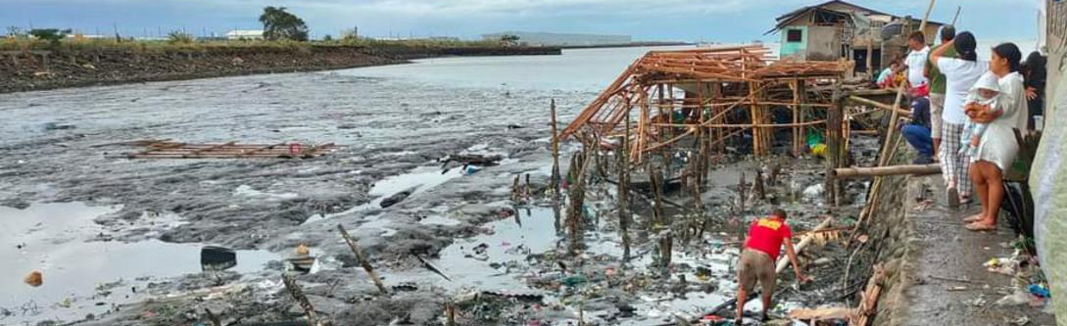
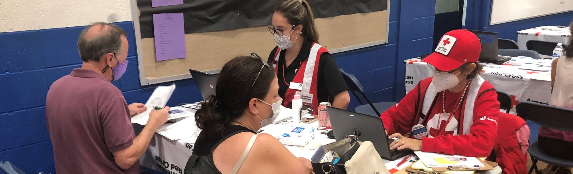
International Services Spotlight
Typhoon Rai slammed into the eastern Philippines in December. It was one of the most powerful storms to hit the region. The American Red Cross already had a delegation there, working with local teams to prepare families for disasters. They pivoted to help the Philippine Red Cross provide urgent relief — including food, drinking water, blankets, first aid, medical care and shelter — after people’s lives were turned upside down.

Slide 15
Your Partnership

Slide 16
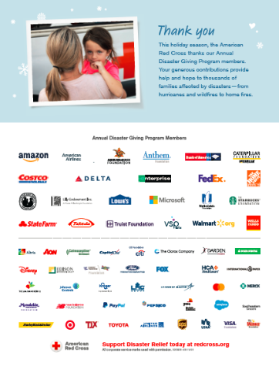
Benefits and Resources
We were pleased to provide valuable recognition and engagement this quarter.
Logo in one full-page ad in Businessweek on Dec. 6, generating more than 230,000 impressions
Acknowledgement in 2021 Red Cross response recap news story on redcross.org posted Dec. 7
Two videos highlighting the disaster work your ADGP membership helped to power
Template communications materials, including social posts and articles, provided to align partnership with timely home fire and holiday safety messages
  During major disaster responses:
  Acknowledgment in national news story and national press release about tornadoes response on redcross.org, generating nearly 56,200 total page views
  Recognition in 4 Disaster Information Update emails shared with Red Cross supporters

Slide 17
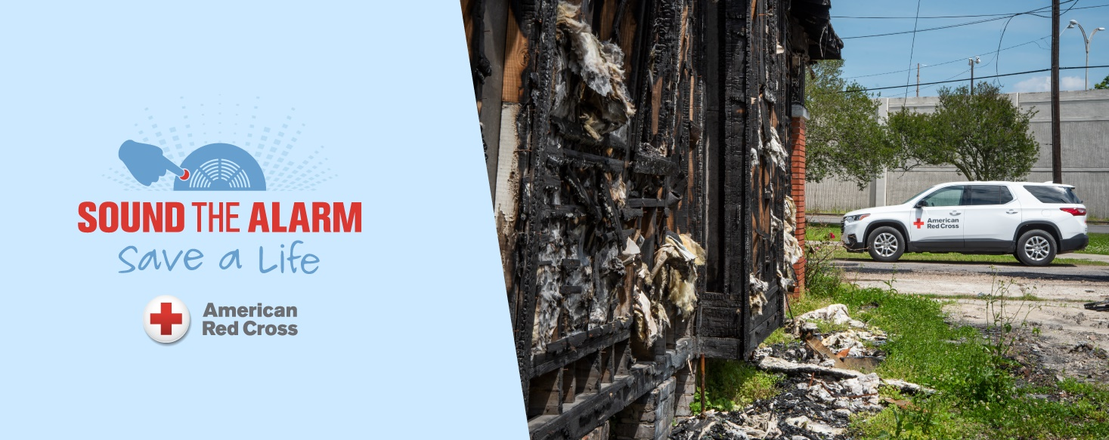
Join Us!
Sound the Alarm is back for 2022. We’ll install 50,000 free smoke alarms this May, across high-risk neighborhoods in 50 signature cities.
As an ADGP member, you can engage your employees through Sound the Alarm.
Invite employees to volunteer to install smoke alarms through your trackable registration page.
Encourage employees to prepare for home fires using a self-guided, co-branded “Pledge to Prepare” page.
Offer Be Red Cross Ready presentations that help employees prepare for and prevent home fires.
Review this resource to learn more and let your relationship manager know which interest you.

Slide 18
