Slide 1
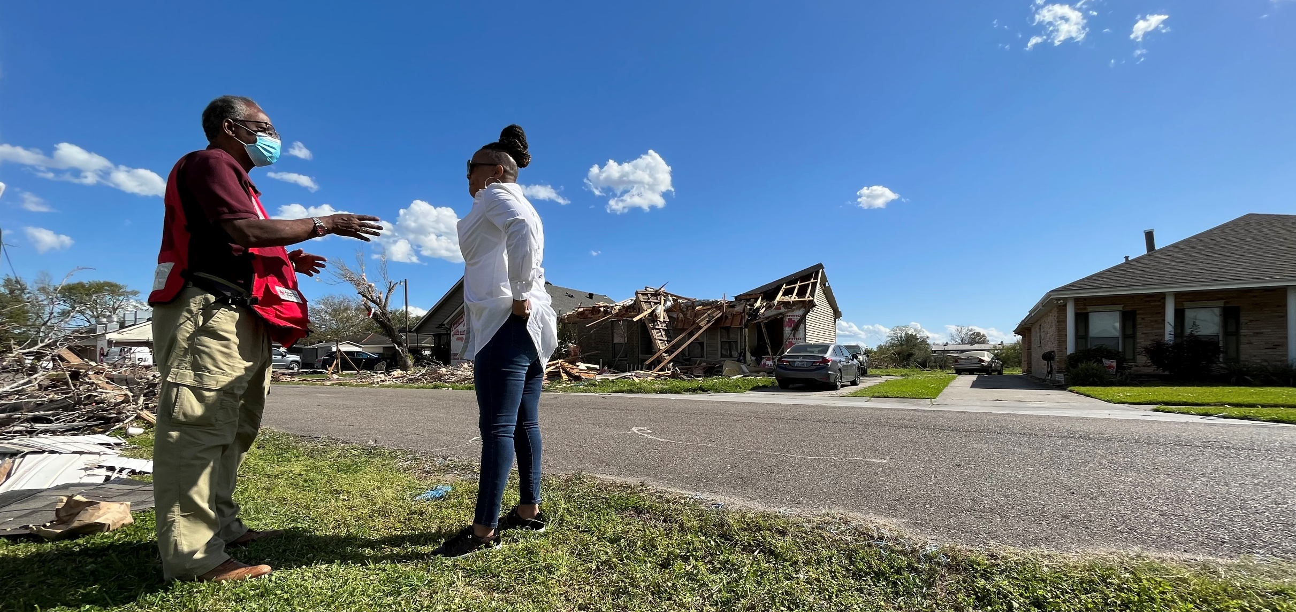
Quarterly Disaster Update
FY22 Q3 (Jan. – Mar. 2022)
Prepared for ADGP Members

Slide 2
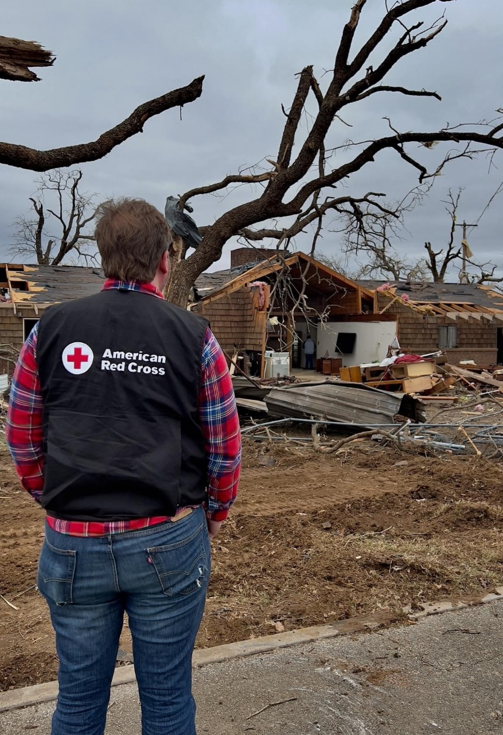
Quarterly Disaster Update
FY22 Q3 (Jan. – Mar. 2022)
CONTENTS
Slide 2 Domestic Response
Slide 8 Home Fire Campaign
Slide 11 International Services
Slide 16 Your Partnership

Slide 3
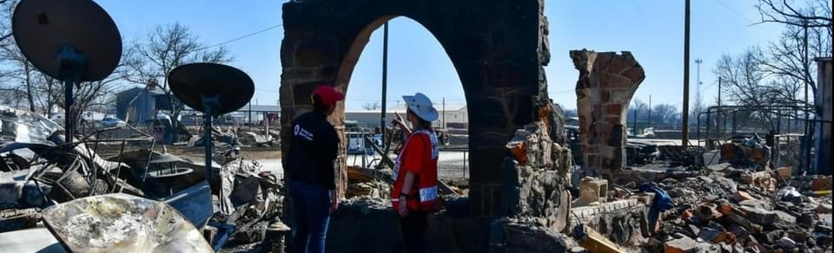
Between January and March 2022, calamitous weather once again called the American Red Cross into action.
Extreme weather across the country kept Red Cross workers in a constant state of response. From crippling floods in Puerto Rico to record-breaking storms and tornadoes lashing southern states – all while drought-fueled wildfires raged coast-to-coast – life was upended for thousands of families in the path of disasters.

Slide 4
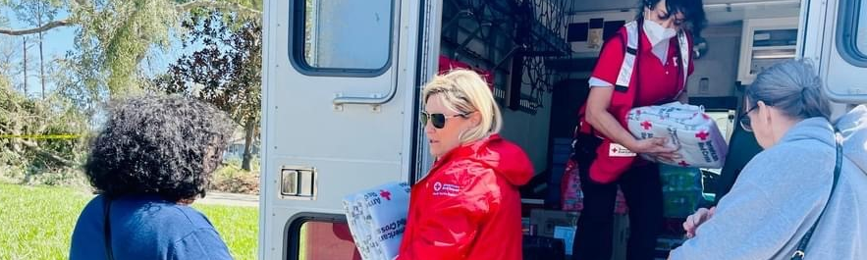
Powered by your donations through ADGP, Red Cross disaster workers answered the call, rushing essential aid to people in need.
At a moment’s notice in communities across the country, we were there providing safe places to sleep, hot meals, relief supplies, emotional support and resources to assist families as they recovered. This critical work is only possible because of advance contributions from compassionate and committed ADGP members like you.

Slide 5
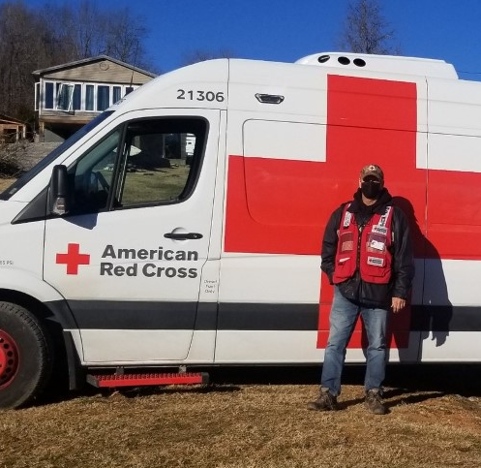
“I’ve really grown in two ways. I’ve learned that simple acts of kindness, like being present during someone’s time of need, can really make a difference. And I’ve come to realize just how much every day matters. You never know when your life can change dramatically.”
Pat Shields, speaking about his experience as a Red Cross volunteer
During March, Red Cross Month, we recognized those who make our lifesaving mission possible — including our remarkable volunteers like Pat Shields. As an Emergency Response Vehicle (ERV) driver, Pat delivers hot meals and extra supplies to communities that need them following a disaster. Pat deployed to Kentucky to help those impacted by devastating tornadoes. On top of providing relief and nourishment, his warm and comforting presence gave families a break from the stress and someone to rely on for help.

Slide 6
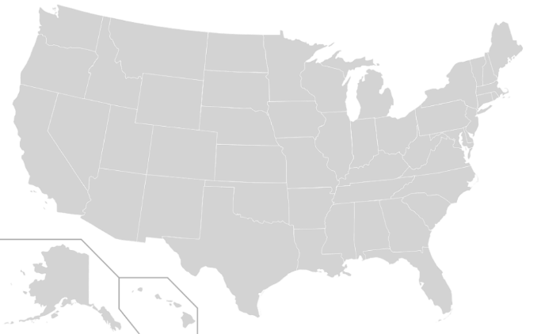
Domestic Response Quarterly Totals
Philadelphia, PA Multi-Family Fire (Level 3)
WA Floods (Level 3)
Austin, TX Multi-Family Fire (Level 3)
TX Border Operations (Level 4)
Bronx, NY Multi-Family Fire (Level 3)
Southern FL Tornadoes (Level 3)
Wilkes-Barre, PA Multi-Family Fire (Level 3)
TN Blizzard (Level 3)
PR Floods (Level 3)
New Rochelle, NY Multi-Family Fire (Level 3)
Cedar Rapids, IA Multi-Family Fire (Level 3)
Silver Spring, MD Explosion (Level 3)
IA Tornadoes (Level 3)
Northeastern NY Multi-Family Fire (Level 3)
Central FL Tornadoes (Level 3)
TX Forest Fire (Level 3)
OK Tornadoes (Level 3)
Central TX Tornadoes (Level 3)
TX Gulf Coast Tornadoes (Level 3)
AL Storms (Level 3)
North TX Tornadoes (Level 3)
LA Tornadoes (Level 4)
The Red Cross responded to 91 large disasters across the country, including 22 very large events.
2
14
5
13
11
7
1
10
12
8
17
21
20
16
3
22
4
18
19
15
6
9
“Large” includes domestic disaster operations with costs of $10,000+ (i.e., level 2 and higher).
“Very large” includes domestic disaster operations with costs of $50,000+ (i.e., level 3 and higher).

Slide 7




Domestic Response Quarterly Totals
This quarter, over 1,700 Red Cross disaster workers provided
critical services in lockstep with our partners across the U.S.
60,700
meals and snacks served with partners
3,100
overnight stays in emergency lodging provided with partners
9,700
relief items distributed
6,500
households provided recovery support
FY22 Totals
2.6 million
35,700
1.8 million
138,800
Includes domestic disaster operations with costs of $10,000+ (i.e., level 2 and higher).

Slide 8
Home Fire Campaign

Slide 9
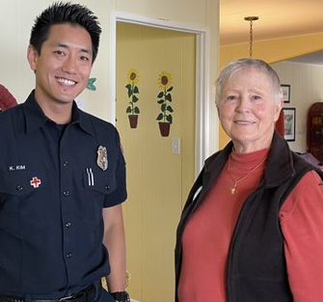
“Thank you, thank you, thank you – for probably saving my life, certainly saving my home and maybe my neighbors’ homes from a fire.”
Joan Quinn, who experienced a home fire just months after she had smoke alarms installed
In February, Joan Quinn was meditating in her home when her toaster oven caught fire and started spewing smoke — unbeknownst to her. Thankfully, just months earlier, the San Marcos Fire Department, in partnership with the Red Cross, had installed smoke alarms in her house as part of our Sound the Alarm initiative. The alarms alerted Joan to the fire, and she credits them with saving her house and possibly her life. “When there’s a fire in the house, literally every second matters,” said San Marcos fire inspector Kenneth Kim, pictured above with Joan.

Slide 10




Home Fire Campaign Quarterly Totals
We’re also committed to making families safer from home fires —
and helping when they do happen.
36,400
smoke alarms installed
16,100
homes made
safer
17,100
home fire
responses
71,100
individuals received financial assistance
38,400
youth reached with preparedness education
FY22 Totals
40,500
44,100
184,000
115,900
91,200
Includes domestic disaster operations with costs under $50,000 (i.e., level 1 and 2 disasters).

Slide 11
International Services

Slide 12
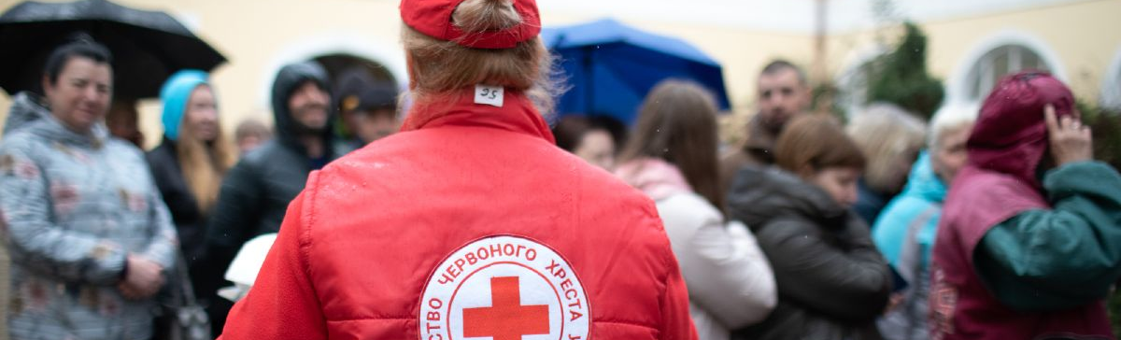
Red Cross and Red Crescent teams are working tirelessly in Ukraine and surrounding countries to help people impacted by conflict.
More than 11 million people have been displaced by this conflict, four million of whom have fled Ukraine to nearby countries to seek safety. At least 12 million people are in need of humanitarian assistance. As the fighting continues and the dire situation evolves, the global Red Cross network is providing around-the-clock support, care and comfort to help people affected by this devastating crisis.
Learn more about how Red Cross teams are providing aid.

Slide 13
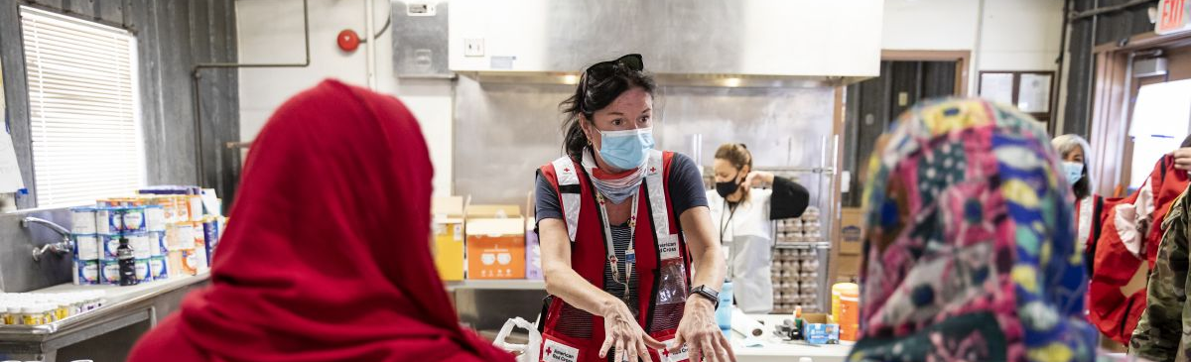
Our global network allows us to reach the world’s most at-risk communities during humanitarian crises.
Our work to help people forced from their homes is taking place all over the globe — from hunger crises throughout Africa to population movements resulting from violence or economic insecurity in Central America, Europe and the Middle East. By partnering with local Red Cross and Red Crescent societies, whose volunteers live in the very communities they serve, we’re able to mobilize support for the world’s most vulnerable populations in their darkest hours.
.

Slide 14
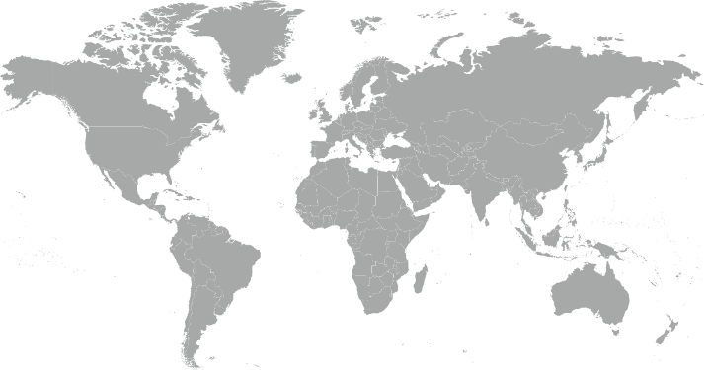
International Services Quarterly Totals
The American Red Cross began or continued responses to 13 major emergencies around the world.
Kenya Drought Hunger Crisis
South Sudan Floods
Haiti Earthquake
Nigeria Hunger Crisis
Somalia Drought Hunger Crisis
Philippines Typhoon Rai
Global Coronavirus Outbreak
Ethiopia Tigray Crisis
Colombia La Mojana Floods
Ukraine and Impacted Countries Crisis
Hurricanes Eta and Iota
Panama Population Movement
Mediterranean Population Movement
10
13
11
3
2
8
6
12
9
4
1
5
7

Slide 15
International Services Quarterly Totals
The American Red Cross actively supported
disaster preparedness, relief and recovery work in 19 countries.
$13.9 million
donated to Red Cross and Red Crescent efforts*
10
American Red Cross specialists deployed
19
preparedness/ risk reduction projects
FY22 Totals
$24.1 million
16
25
*Reflects funds donated by American Red Cross to the International Federation of Red Cross and Red Crescent Societies, the International Committee of the Red Cross, and Red Cross Red Crescent national societies following specific disasters.

Slide 16
Your Partnership

Slide 17
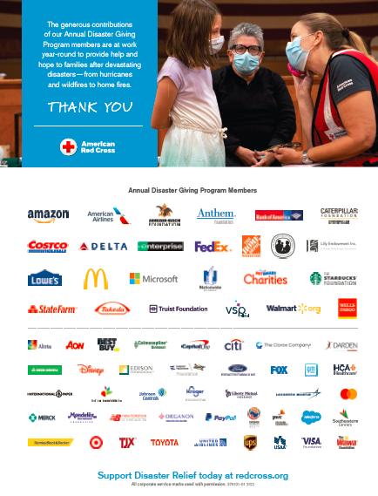
Benefits and Resources
We were pleased to provide valuable recognition and engagement this quarter.
Logo in one full-page ad in Businessweek, generating more than 230,000 impressions.
Acknowledgement in Red Cross FY21 Annual Report and FY21 Disaster Update, annual publications shared with our supporters.
Template communications materials, including social posts and articles, provided to align partnership with timely home fire and blood donation messages as well as Red Cross Giving Day and March Is Red Cross Month.
  During times of disaster:
  Acknowledgment in three national news stories about disaster response activity on redcross.org, generating nearly 10,700 total page views.
  Recognition in one Disaster Information Update email shared with Red Cross supporters.

Slide 18
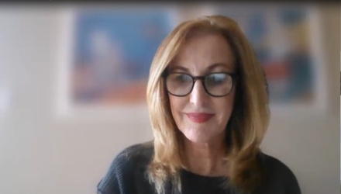
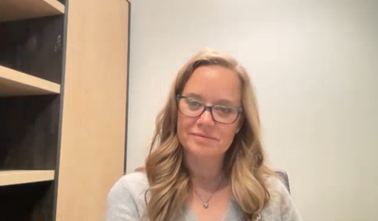
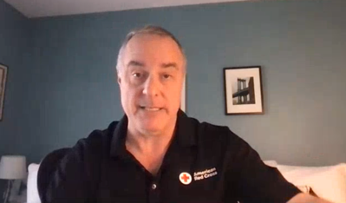
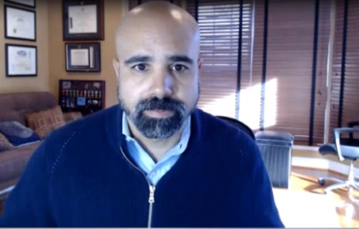
Benefits and Resources
ADGP members were also invited to an exclusive virtual Disaster Leadership Roundtable on March 1 to learn more about the critically important role your investments play in powering our work. The discussion included:
  Reflections on the past year of chronic disaster activity across the country.
  Current and projected future impacts of increasing disasters and climate change on our operations.
  Mission adaptations we’re undertaking to better meet the needs of vulnerable populations and communities in rapidly changing landscapes.
  How the global Red Cross network and the American Red Cross are helping those impacted by the conflict in Ukraine.
HOST
Anne McKeough
Chief Development Officer
Jennifer Pipa
Vice President
Disaster Programs
Brad Kieserman
Vice President
Disaster Operations
and Logistics
View a recording of the dynamic conversation.
Koby Langley
Senior Vice President, Service to Armed Forces and International Services

Slide 19
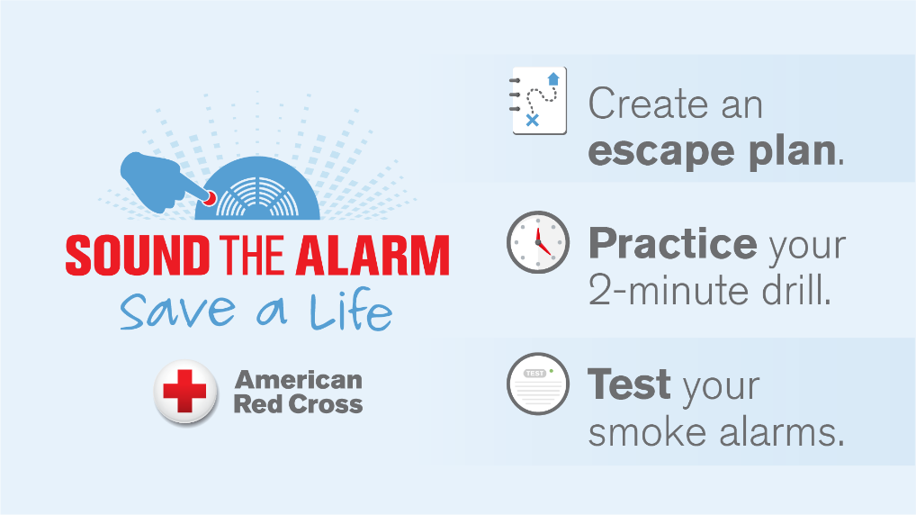
Join Us!
As an ADGP member, you can help Sound the Alarm about home fire safety.
Sound the Alarm is back for 2022! We’ll install 50,000 free smoke alarms this May across high-risk neighborhoods in 50 signature cities.
Unlike other disasters, many home fires can be prevented. By planning ahead, people can minimize home fire risks and be ready in case one occurs.
Access these ADGP Sound the Alarm 2022 Communications Resources for ways to engage employees, customers or social followers with important messages about home fire safety.

Slide 20
