Slide 1
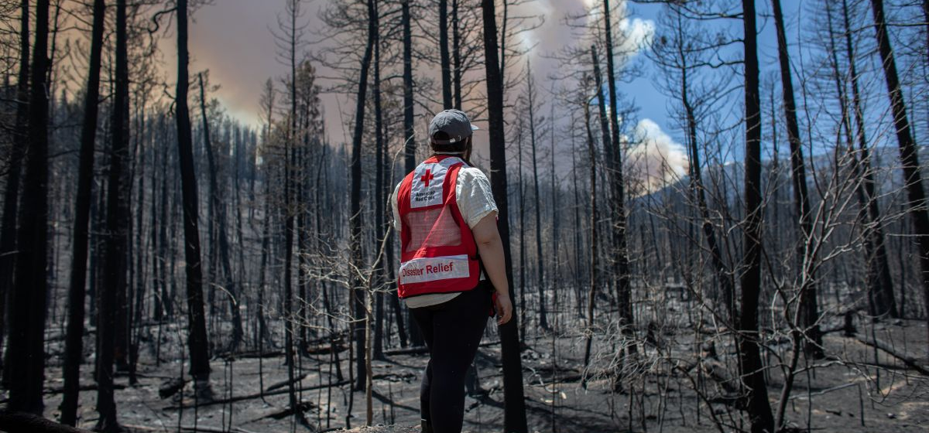
Quarterly Disaster Update
FY22 Q4 (April – June 2022)
Prepared for ADGP Members

Slide 2
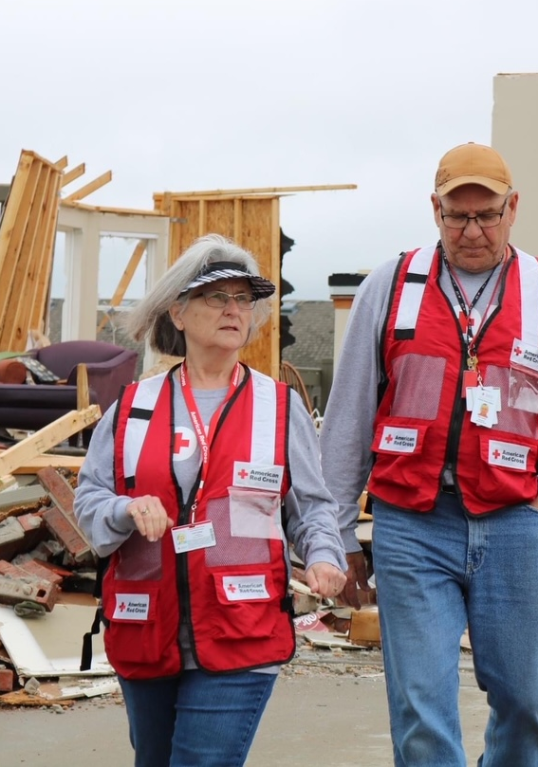
Quarterly Disaster Update
FY22 Q4 (April – June 2022)
CONTENTS
Slide 3 Domestic Response
Slide 8 Home Fire Campaign
Slide 12 International Services
Slide 17 Your Partnership
Slide 21 Looking Ahead: Mission Adaptations

Slide 3
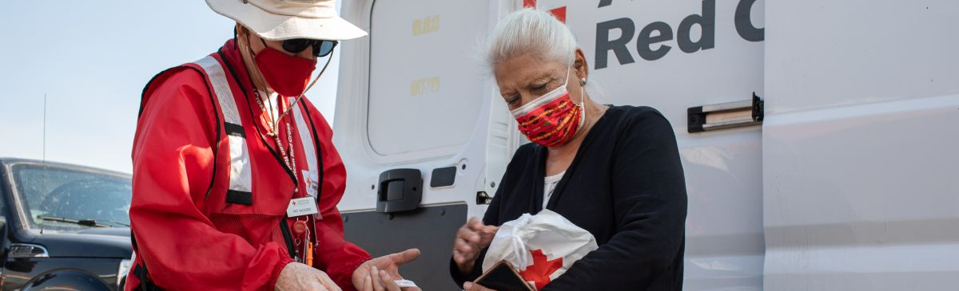
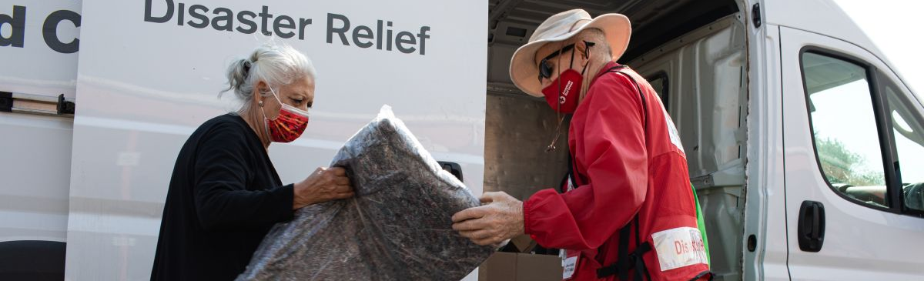
Between April and June 2022, we stood with thousands of families as they faced devastating crises and looked for hope.
American Red Cross teams sprang into action to address emergencies of all kinds, including wildfires and severe weather like storms, tornadoes and flooding that wreaked havoc from coast to coast. ADGP members like you were at the center of it all, preparing people for the worst and standing with them during their darkest hours.

Slide 4
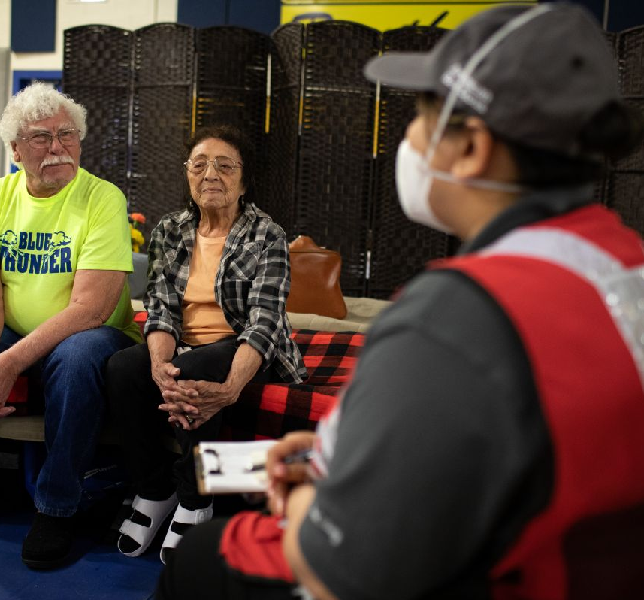
“The shelter has been marvelous. We can’t thank you enough. You may not need the thanks, but we can’t say it enough, or ever repay the kindness.”
Red Cross shelter resident Ethel, who, along with her husband George, stayed at the Peñasco shelter in New Mexico for almost two weeks.
Red Cross teams provided a haven for people like Ethel and George of Peñasco, New Mexico, who evacuated to avoid wildfires raging across the state. For them, and many of their neighbors, shelters became a community where they received warm meals, care, comfort and access to necessities like personal hygiene kits and other critical relief supplies. Our caseworkers also met with those who needed extra help to determine what resources could aid their recovery.

Slide 5
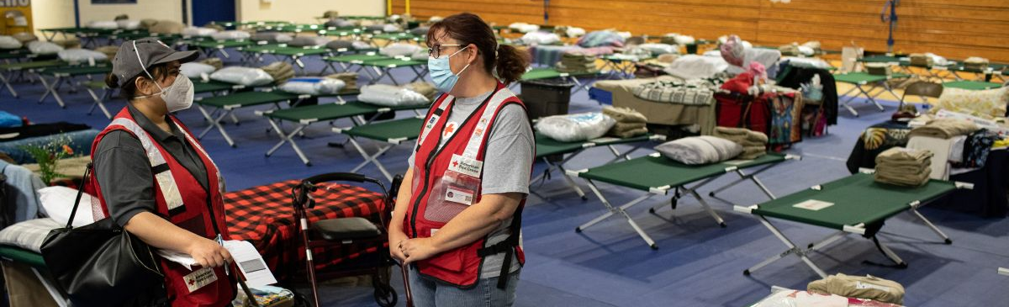
In a shifting disaster landscape, we must be ready to help wherever and whenever we’re needed most.
This quarter, we also readied our people and resources as the country heads into very active wildfire and Atlantic hurricane seasons. When someone is in need, we must be prepared to help, anywhere and anytime. We can only do that with the advance commitment of ADGP members like you.

Slide 6
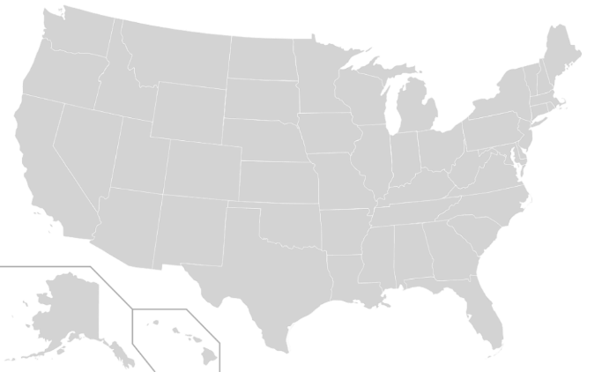
Domestic Response Quarterly Totals
The Red Cross responded to 84 large disasters across the country, including 15 very large events.
GA Storms (Level 3)
Dallas TX Multi-Family Fire (Level 3)
New Mexico Wildfire Command (Level 4)
AL/MS Floods and Tornadoes (Level 3)
KS Tornadoes (Level 3)
OK Tornadoes (Level 4)
Buffalo NY Civil Disturbance (Level 3)
MN Floods (Level 3)
MI Tornadoes (Level 3)
Uvalde TX Civil Disturbance (Level 4)
IL Multi-Family Fire (Level 3)
MN Tornadoes (Level 3)
MT Floods (Level 4)
IN Storms (Level 3)
MO Transportation Incident (Level 3)
13
8
12
9
7
11
14
15
5
3
6
4
1
2
10
“Large” includes domestic disaster operations with costs of $10,000+ (i.e., level 2 and higher).
“Very large” includes domestic disaster operations with costs of $50,000+ (i.e., level 3 and higher).

Slide 7




Domestic Response Quarterly Totals
This quarter, over 2,100 Red Cross disaster workers provided
critical services in lockstep with our partners across the U.S.
58,800
meals and snacks served with partners
15,500
overnight stays in emergency lodging provided with partners
21,800
relief items distributed
4,200
households provided recovery support
FY22 Totals
2.6 million
40,000
2 million
149,400
Includes domestic disaster operations with costs of $10,000+ (i.e., level 2 and higher).

Slide 8
Home Fire Campaign

Slide 9
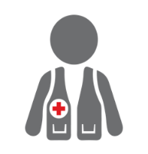



Home Fire Campaign Quarterly Totals
We’re also committed to making families safer from home fires —
and helping when they do happen.
14,900
home fire responses
56,900
individuals received financial assistance
37,200
homes made safer
87,400
smoke alarms installed
52,900
youth reached with preparedness education
FY22 Totals
229,300
77,200
177,600
174,400
60,700
Includes domestic disaster operations with costs under $50,000 (i.e., level 1 and 2 disasters).

Slide 10
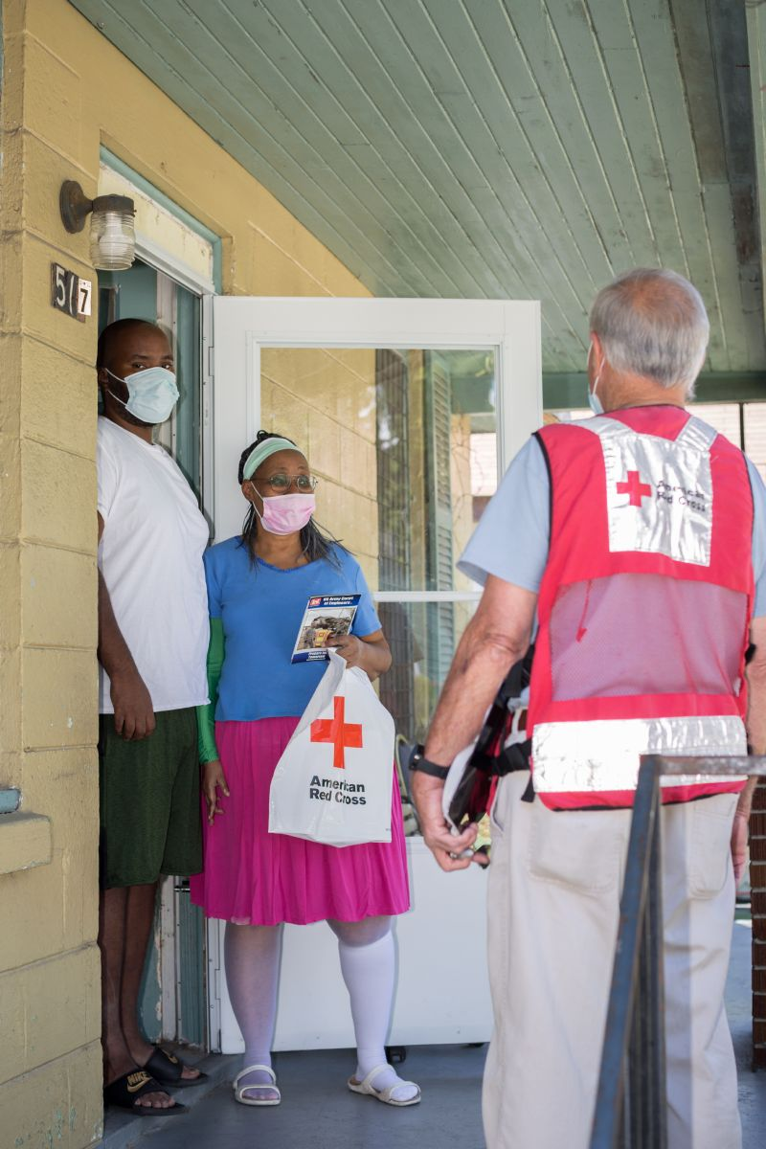
Making Homes Safer, Nationwide
This May, thousands of people learned how to protect themselves against home fires with help from the Red Cross.
Through our Sound the Alarm activities in more than 50 high-risk communities, Red Cross volunteers, local fire departments and other partners met with families. Together, we made more than 20,000 households safer from home fires by installing more than 45,000 free smoke alarms and sharing home fire safety information.
This nationwide Sound the Alarm effort is part of the Red Cross Home Fire Campaign, which has helped save more than 1,350 lives since launching in October 2014.

Slide 11
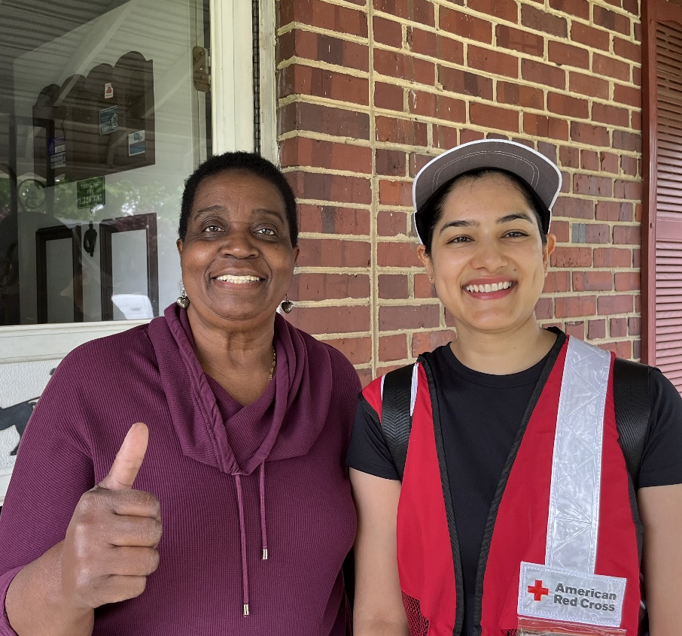
“I’m so happy for this – grateful, really. I feel safer now with my new alarms.”
Maryland resident Emma, after Red Cross volunteers installed three free smoke alarms in her one-story home during May’s Sound the Alarm signature event timeframe.
After experiencing a home fire in the 1960s, Emma knows how much devastation a home fire can cause. Thankfully, Emma was home when Red Cross volunteers knocked on her door this past May and offered to install free smoke alarms and share home fire safety information as part of Sound the Alarm. “After you see one of those fires, and all your belongings burnt and being dragged out in the street, you take this seriously.”

Slide 12
International Services

Slide 13
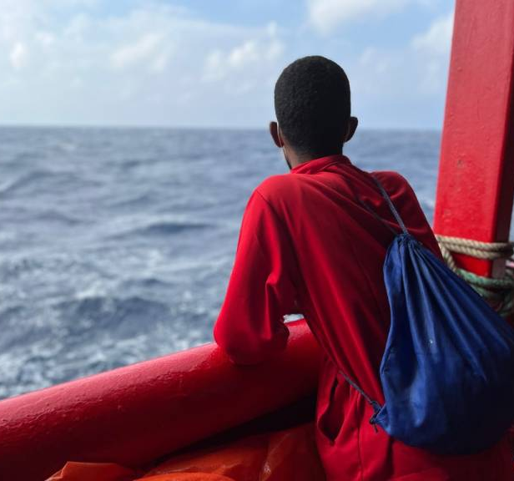
“Really, I am so thankful. You rescued us from the sea. You rescued us from a very dark place. Thank you for being here for people like us.”
Jamal, one of 300 people fleeing conflict in Libya aboard the Ocean Viking, a rescue ship in the Mediterranean Sea operated by the Red Cross Red Crescent and SOS Mediterranean. The American Red Cross deployed four crisis responders to the Ocean Viking to care for families seeking safety.
June 20 marked World Refugee Day, a time to honor refugees and recognize those whose lives have been impacted by war, conflict and persecution. Every day around the world, people like Jamal make the difficult decision to leave their homes – and their countries – in pursuit of a safer place to live and hope for a better future. One person is forcibly displaced every two seconds due to conflict or persecution. And in recent years, the number of children migrating alone, without parents or guardians, has increased.

Slide 14
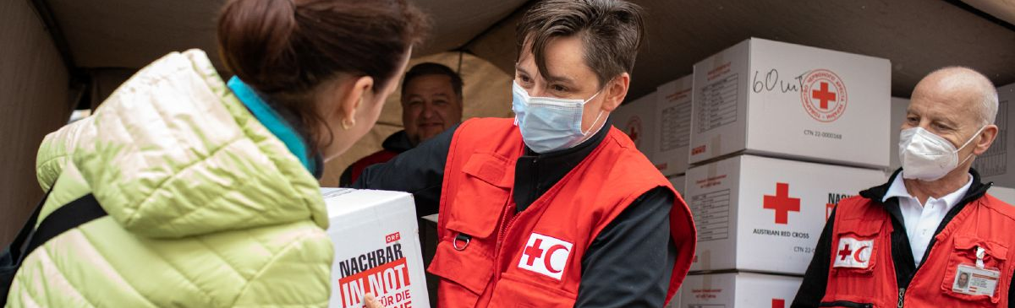
As part of the world’s largest humanitarian network, the American Red Cross plays an important role in ensuring that refugees and asylum seekers feel safe.
Our teams – and our partners in the global Red Cross and Red Crescent movement – are aiding refugees on migratory routes and in their temporary homes all over the globe, from Ukraine and surrounding countries to Europe, Africa and the Middle East. We deliver relief supplies, first aid and medical services, shelter and comfort to families traumatized by conflict.

Slide 15
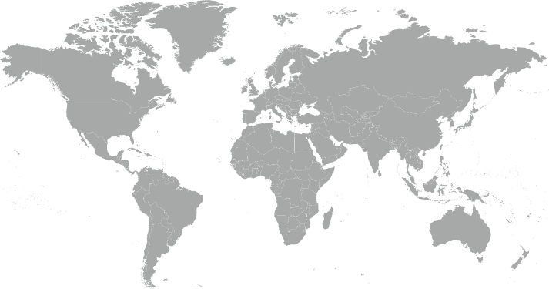
International Services Quarterly Totals
The American Red Cross began or continued responses to 12 major emergencies around the world.
El Salvador Floods & Landslides
Ethiopia Hunger Crisis
Global Coronavirus Outbreak
Haiti Earthquake
Hurricanes Eta & Iota
Kenya Drought/Hunger Crisis
Madagascar Heavy Rains & Tropical Storms
Mediterranean Population Movement
Nigeria Hunger Crisis
Somalia Drought/Hunger Crisis
Tonga Volcano & Tsunami
Ukraine and Impacted Countries Crisis
3
12
8
4
2
1
5
10
9
6
7
11

Slide 16
International Services Quarterly Totals
The American Red Cross actively supported
disaster preparedness, relief and recovery work in 21 countries.
$47 million
donated to Red Cross and Red Crescent efforts*
22
American Red Cross specialists deployed
288
families
reconnected after disasters/conflicts**
17
preparedness/ risk reduction projects
FY22 Totals
$71 million
37
12,700
25
*Reflects funds donated by American Red Cross to the International Federation of Red Cross and Red Crescent Societies, the International Committee of the Red Cross, and Red Cross and Red Crescent national societies following specific disasters.
**This figure is lower than our actuals due to delayed data entry in areas of international conflict and disasters.

Slide 17
Your Partnership

Slide 18
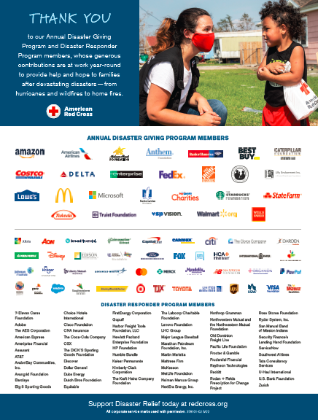
Benefits and Resources
We were pleased to provide valuable recognition and engagement this quarter.
Logo in one full-page ad in TIME Magazine’s TIME100 issue in June, generating more than 1.6 million impressions.
Invitation to a June 6 Donor Briefing to hear latest on how we’re supporting critical humanitarian relief in response to the Ukraine crisis and assisting families and communities impacted by increasing disasters across the U.S.
Template communications materials, including social posts and articles, provided to align partnership with timely messaging around hurricane preparedness, wildfire preparedness, summer safety and blood donations.
  During times of disaster:
  Acknowledgment in five national news stories about disaster response activity on Redcross.org, generating more than 6,300 total page views.
  Recognition in five Disaster Information Update emails shared with Red Cross supporters.

Slide 19
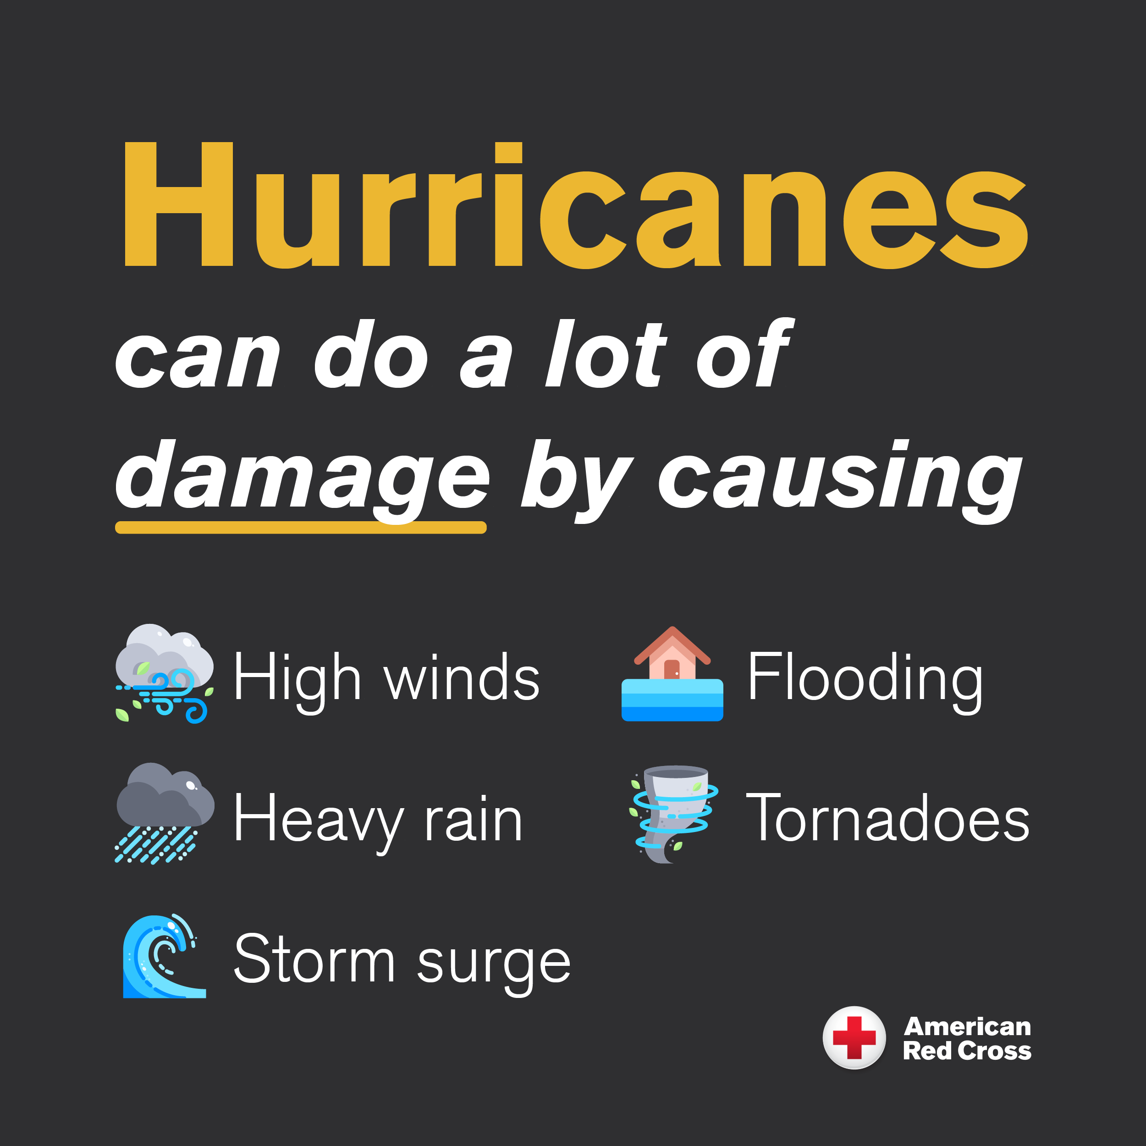
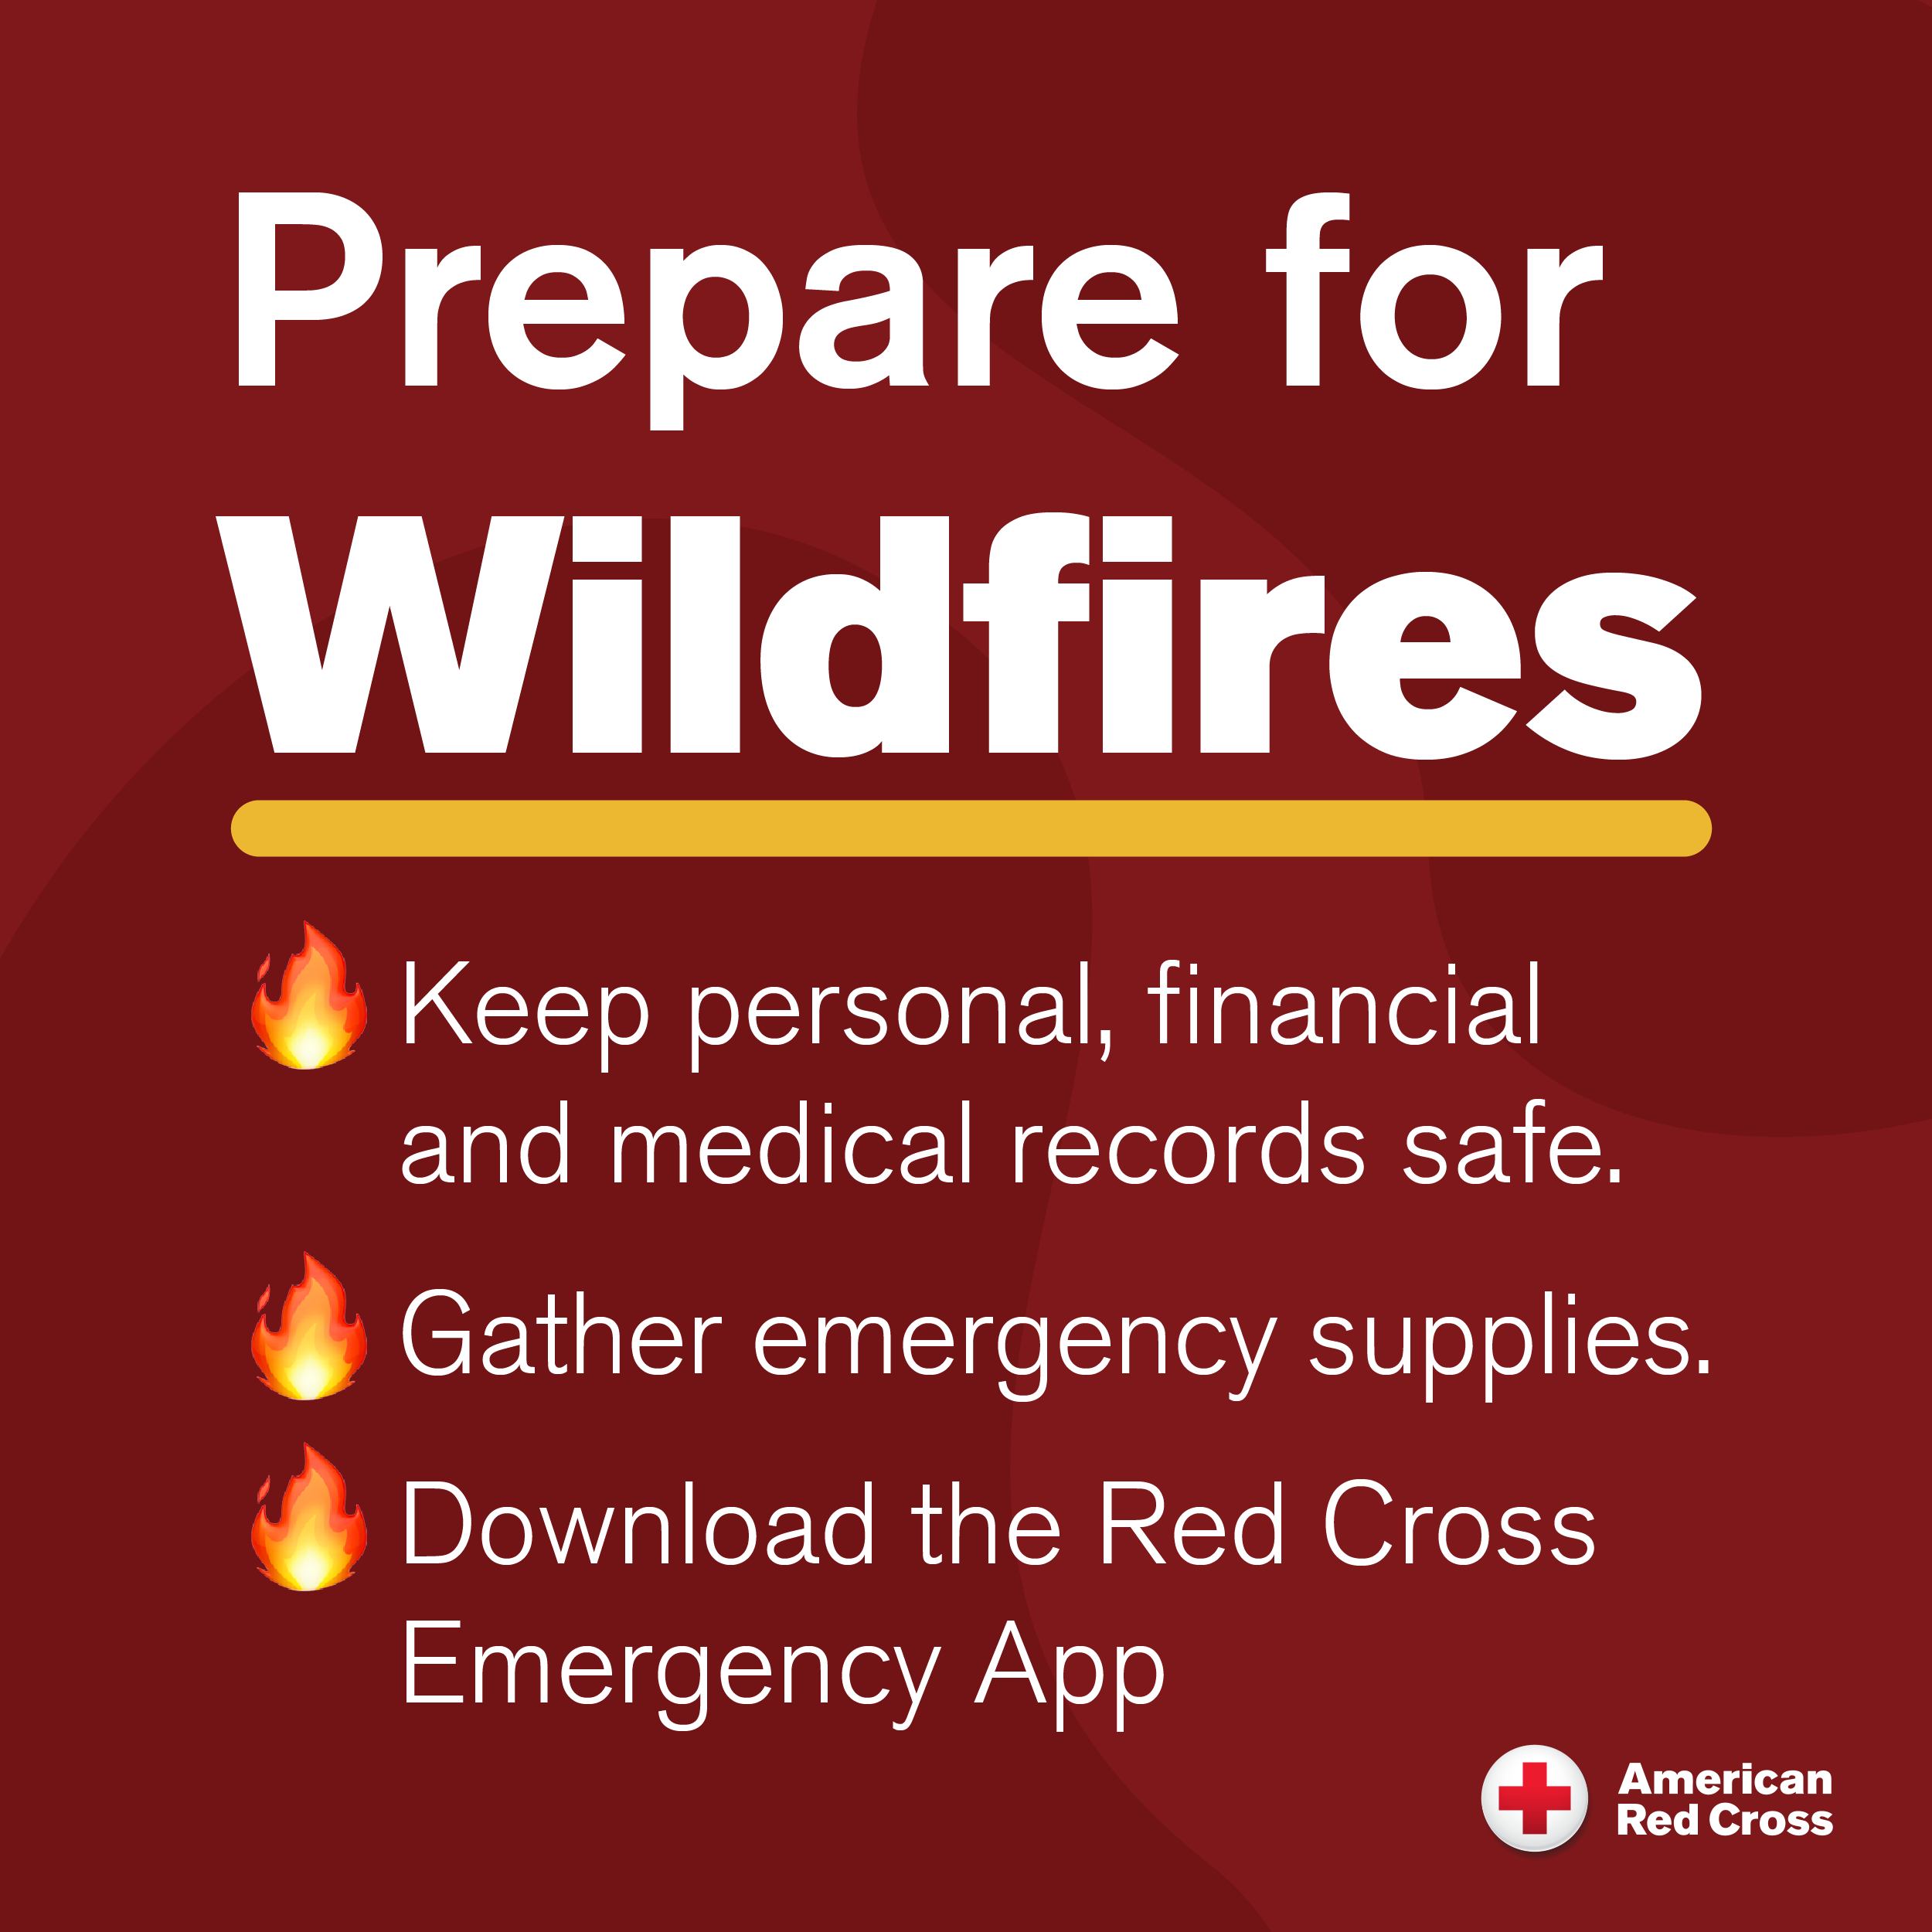
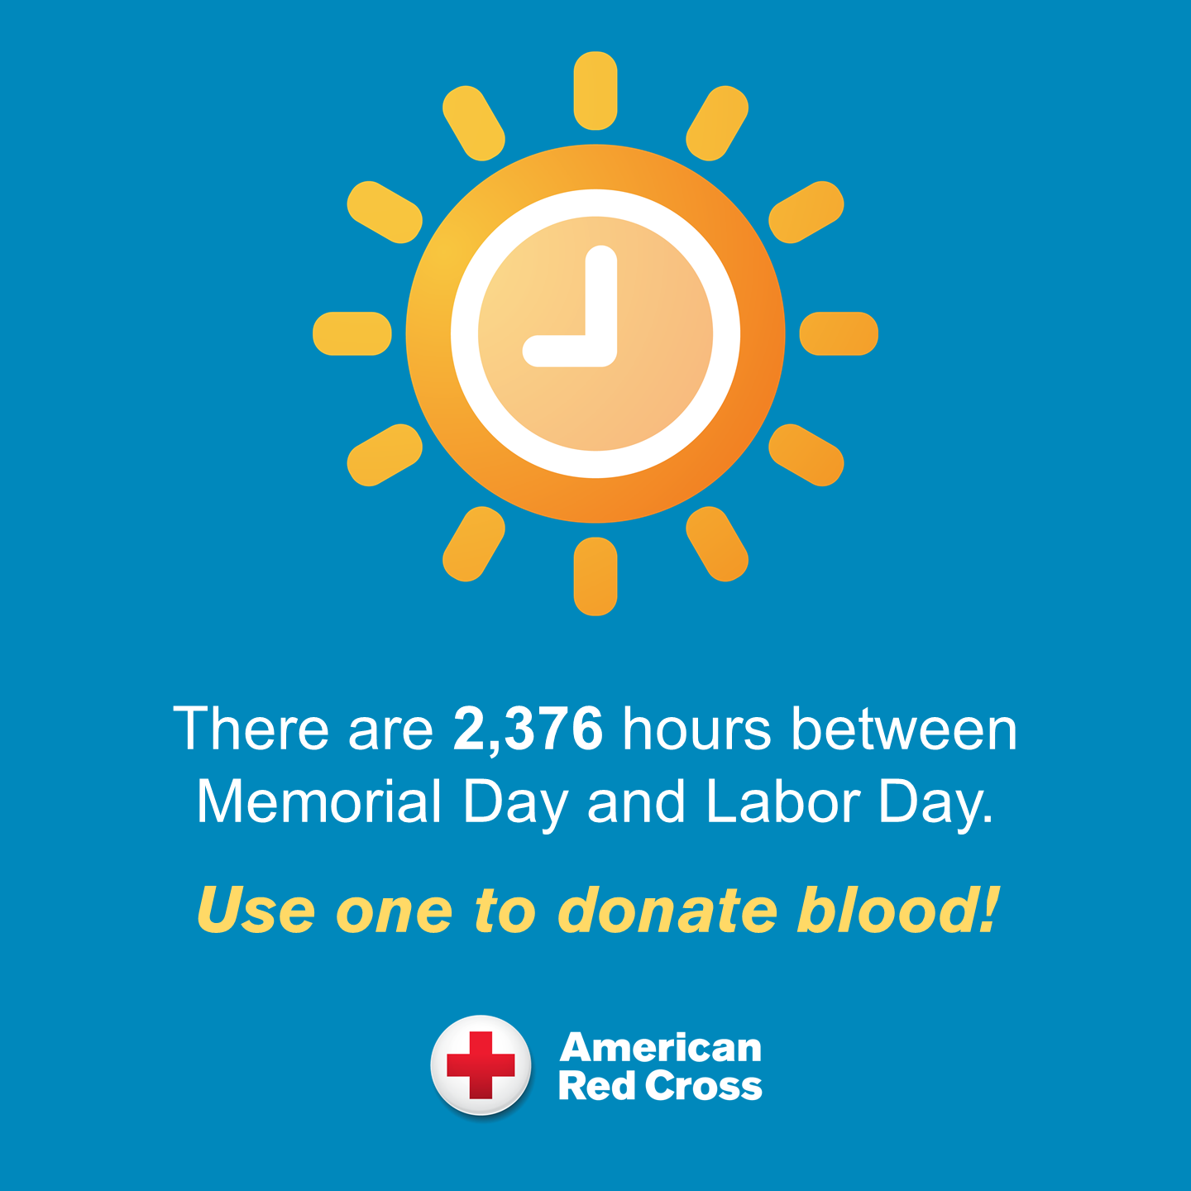
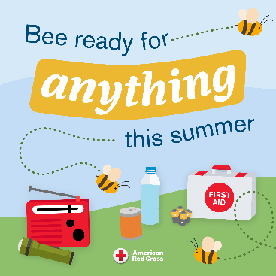
Join Us!
Summer communications resources made just
for you!
Hurricane Preparedness
Communications Resources
Wildfire Preparedness
Communications Resources
With topical tools prepared exclusively for ADGP members, you can help employees, customers and other key groups stay safe this summer.
Summer Blood Donations
Communications Resources
Summer Safety
Communications Resources

Slide 20
Looking Ahead:
Mission Adaptations

Slide 21
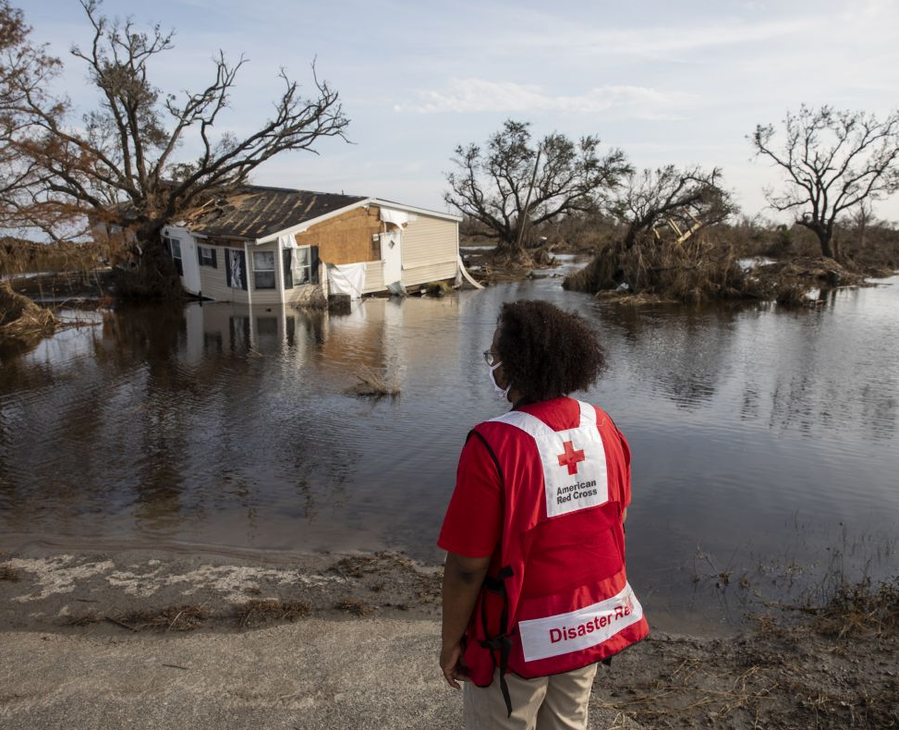
Adapting our Mission to Meet Urgent Needs
The Red Cross is uniquely positioned to help address problems faced by individuals and families impacted by climate change. We are:
Launching new community-based programs
Expanding our financial assistance program
Growing our disaster network
Enhancing some of our sheltering and casework practices
While preserving critical resources in order to respond to disasters 24/7
We look forward to sharing additional information about this commitment in the year ahead!

Slide 22
