Slide 1
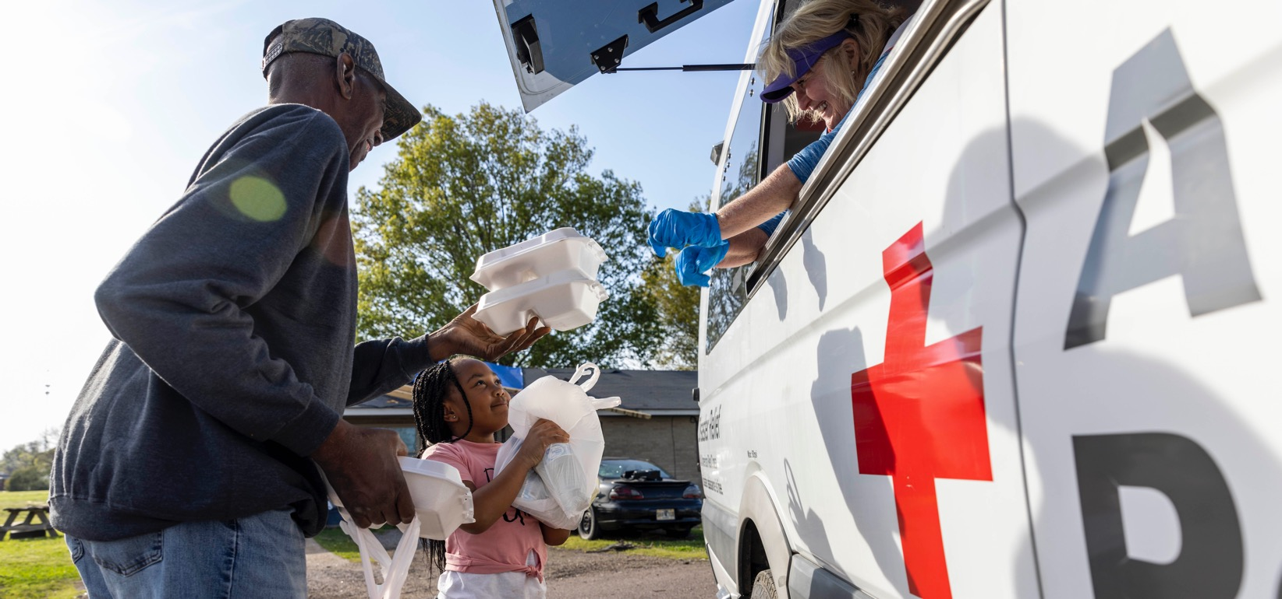
Quarterly Partnership Update
FY23 Q3 (January – March 2023)
Prepared for ADGP Members

Slide 2

Alleviating Suffering
Through Disaster Relief

Slide 3
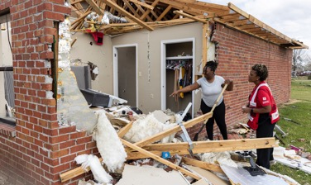
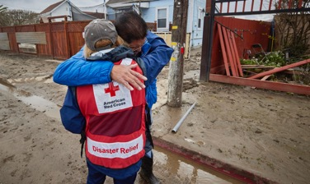
Responding to Current Large Disasters
Thanks to the forward-thinking commitment of ADGP members like you, we were ready to respond immediately to urgent crises across the country when we were needed most.
Following devastating and deadly tornadoes and storms that left communities reeling across the South and Midwest, hundreds of Red Crossers are on the ground in nine affected states. With our partners, we’re providing shelter, meals, relief supplies, physical and mental healthcare, and immediate financial assistance.
Three months of atmospheric rivers have caused unprecedented floods and storms in California, ultimately displacing tens of thousands of people throughout the state. In response, hundreds of Red Crossers from across the country are helping provide shelter, meals, comfort kits and more.

Slide 4
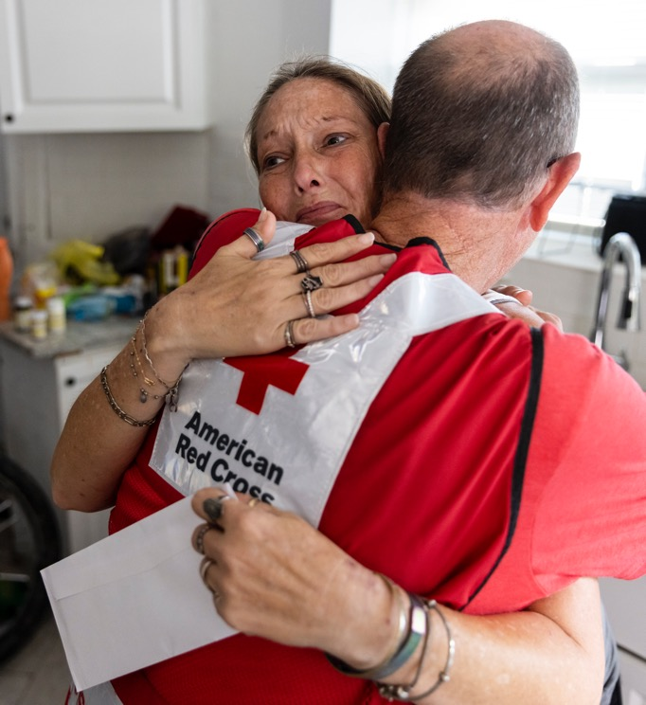
Hurricane Ian: 6-Month Update
After Hurricane Ian devastated communities throughout Florida, the Red Cross provided shelter, relief and more.
For those whose homes suffered major damage – like Terri Lawrence (pictured) — we provided sorely needed financial assistance.
“I still can’t believe they came searching
for me, people I’ve never met giving
me a helping hand.”
Terri Lawrence, after receiving the
pre-loaded debit card with recovery funds.
See our 6-Month Report and Storymap for more on Hurricane Ian recovery.

Slide 5
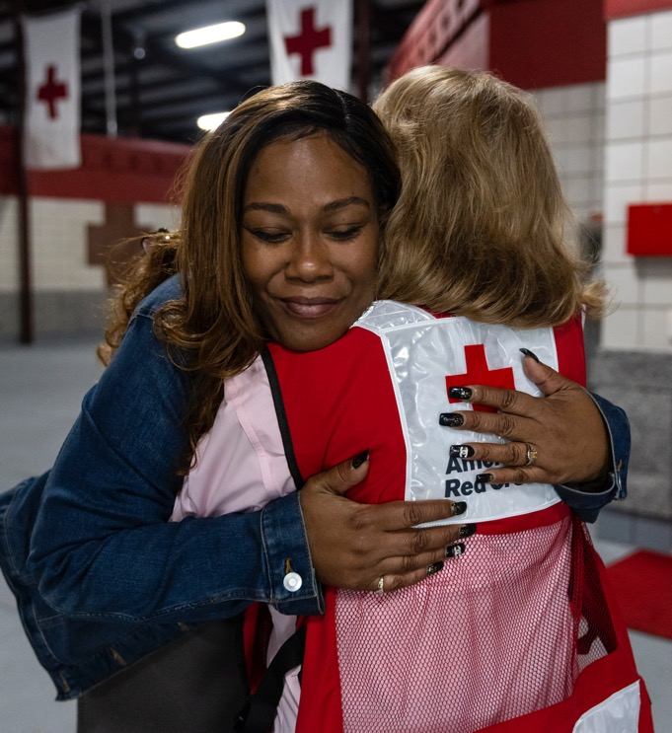
“You guys are like family to me.”
After a series of setback, including Hurricane Ian’s impact, Barbara (pictured) was without a home.
After weeks in a Red Cross shelter, she connected with our Shelter Resident Transition team, who, with extended casework, helped her secure housing and a car.
“You’ve done what family typically tries to do. You made sure I wasn’t homeless for Thanksgiving, Christmas and New Year’s. You made sure
we were safe.”
- Barbara, Hurricane Ian survivor and
Red Cross shelter resident

Slide 6

Red Cross Responded to 81 Large Disasters
Alabama-Mississippi Tornadoes (Level 4)
Georgia Tornadoes (Level 4)
Half Moon Bay, CA Civil Disturbance (Level 3)
Texas Tornadoes (Level 3)
Lake Park, IL Multifamily Fire (Level 3)
Miami Gardens, FL Multifamily Fire (Level 3)
Silver Spring, MD Multifamily Fire (Level 3)
Oklahoma Tornadoes (Level 3)
Southern California Floods (Level 3)
California Atmospheric Rivers (Level 5)
Kentucky Floods (Level 3)
Yonkers, NY Multifamily Fire (Level 3)
Southwest Border Operations (Level 3)
Whippany, NJ Multifamily Fire (Level3)
Southern Tornadoes, AL/MS (Level 6)
Southern Tornadoes, MO/AR (Level 5)
Southern Tornadoes, GA (Level 4)
Southern Tornadoes, TN (Level 4)
Southern & Midwest Tornadoes , IA (Level 3)
Southern & Midwest Tornadoes, IL (Level 3)
Southern & Midwest Tornadoes, IN (Level3)
Oklahoma Wildfires (Level 3)
Including 22 very large domestic disasters
14
12
19
7
10
20
5
3
21
11
9
22
16
18
8
2
13
15
1
17
4
6
Jan. 1 – March 31, 2023
“Large” includes domestic disaster operations with costs of $10,000+ (i.e., level 2 and higher).
“Very large” includes domestic disaster operations with costs of $50,000+ (i.e., level 3 and higher).
Disasters listed chronologically.

Slide 7




Domestic Response Impact
This quarter, nearly 3,050 Red Cross disaster workers provided
critical services in lockstep with our partners across the U.S.
282,800
meals and snacks served with partners
20,700
overnight stays in emergency lodgings provided with partners
18,000
households provided relief items
14,100
households provided recovery support
FY23 Totals
142,500
28,300
3.2 million
130,400
Includes domestic disaster operations with costs of $10,000+ (i.e., level 2 and higher).

Slide 8

Helping People Impacted By Home Fires

Slide 9
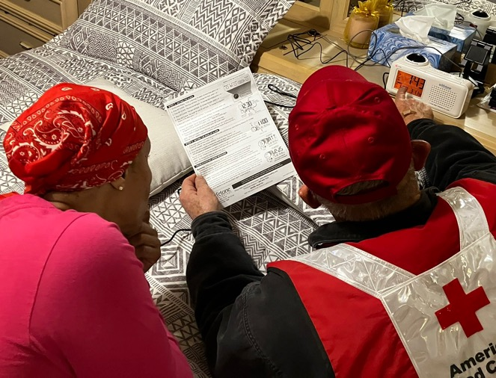
Over 80 Chicago Households Made Safer with Free Smoke Alarms
200+ Smoke Alarms Installed, Many for People Who Are Deaf or Hard of Hearing
In partnership with the Chicago Fire Department and the Ephphatha Lutheran Church of the Deaf, Red Cross volunteers installed more than
200 smoke alarms, including:
20 bed shaker alarms
17 strobe alarms
The deaf or hard of hearing community is particularly vulnerable to home fires because they may not be able to hear a traditional smoke alarm. A specialized alarm, commonly referred to as a “bed shaker,” is installed next to the bed. In case of a fire, the alarm is activated when a traditional smoke alarm sounds. This effort is part of our nationwide Sound the Alarm campaign, which has saved over 1,700 lives and counting.

Slide 10

Meeting the Growing Need for Home Fire Financial Assistance
In the past three months, the Red Cross helped nearly 60,000 individuals with financial assistance following over 22,800 home fires. Families are experiencing greater barriers to recovery, including inflation amidst a national affordable housing shortage. Thanks to your generosity, we have been able to increase the amount of financial assistance
we provide to families recovering from home fires by 2.4% on average.

Slide 11



Home Fire Campaign Impact
This quarter, 6,490 dedicated Red Cross home fire workers provided critical services to help families prepare for and recover from home fires in lockstep with our partners across the U.S.
63,400
smoke alarms installed
25,700
homes made
safer
15,600
home fire
responses
59,800
individuals received financial assistance
55,400
youth reached with preparedness education
FY23 Totals
152,000
60,525
46,000
176,000
148,200
Includes domestic disaster operations with costs under $50,000 (i.e., level 1 and 2 disasters).

Slide 12

Alleviating Suffering
Around the World

Slide 13
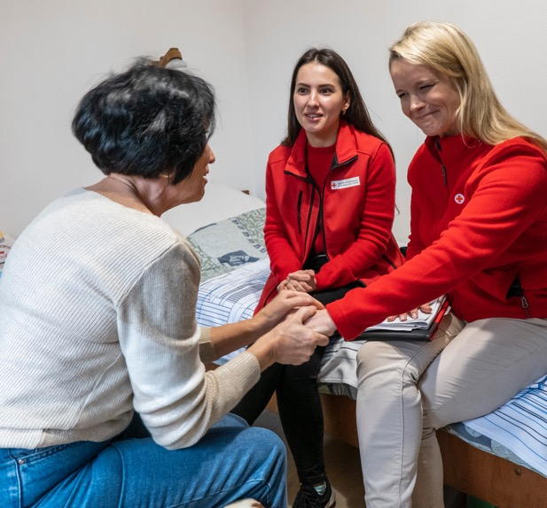
“When I read about this cash assistance, I felt hope. The Red Cross gives me hope.”
Liubov, a resident of a shelter for displaced
Ukrainians in Szeged, Hungary
“I came in July and didn’t have any warm clothes,” Liubov continued. “I bought this sweater that I’m wearing.’
Ukraine Humanitarian Crisis 1-Year Update: One year since the armed conflict in Ukraine escalated, the American Red Cross and our partners in the Red Cross and Red Crescent network continue to provide critical assistance to people in need. Thanks to the generous support of compassionate donors, we have contributed funding, technical expertise and specialists on the ground, both inside Ukraine and in nearby countries where people, like Liubov, fleeing the violence have taken refuge. For more information, including stories of people we have helped and expenses and budget to date, see our Ukraine Humanitarian Crisis 1-Year Update.

Slide 14
Red Cross, Red Crescent Teams Responding to
Earthquakes in Türkiye and Syria
Following deadly and destructive earthquakes in Türkiye and Syria, the global Red Cross and Red Crescent network is focused on helping survivors with essential aid, including hot meals, tents and blankets, physical and mental health, and other relief supplies.
For more details on how the Red Cross and Red Crescent network is helping,
visit redcross.org.
“Some of these people have already been through so much, it’s hard to imagine what this must feel like.”
Birgul, public health specialist
for the Turkish Red Crescent

Slide 15

7 Major Emergencies Around the World
Indonesia Makassar Floods
Chad Floods
Uganda Ebola Outbreak
Türkiye and Syria Earthquakes
Global Coronavirus Outbreak
Nepal Dolakha Fire
Somalia Drought Hunger Crisis
4
6
2
1
5
3
7
Jan. 1 – March 31, 2023
Disasters listed chronologically.

Slide 16
International Services Impact
This quarter, the American Red Cross actively supported
disaster preparedness, relief and recovery work in 25 countries.
$3.6M
donated to Red Cross and Red Crescent efforts*
3
American Red Cross specialists deployed
947
families
reconnected after disasters/conflict/migration
20
preparedness/ risk-reduction projects
FY23 Totals
$21.9M
5
2,834
24
*Reflects funds donated by American Red Cross to the International Federation of Red Cross and Red Crescent Societies, the International Committee of the Red Cross, and Red Cross and Red Crescent national societies following specific disasters.

Slide 17

Saving Lives Through
Blood Services

Slide 18
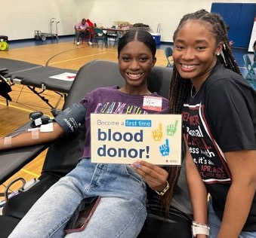
Tyler (left) donated blood for the first time to support her best friend, Shanelle, and others
who are fighting against
sickle cell disease.
Sickle cell disease is the most common genetic blood disorder in the U.S., and blood transfusions help alleviate the disease’s painful symptoms. The Red Cross is committed to providing the most compatible blood for transfusion.
Helping Patients Fight Sickle Cell Disease: As of March 2023, the Red Cross had collected 86,000 blood units from donors who identify as African American, and we are projected to reach our goal of 130,000 units collected by the end of the fiscal year. We have also expanded national partnerships with media personalities and influencers, including Fantasia, Tionne “T-Boz” Watkins and Larenz Tate, and are facilitating the Sickle Cell Fighters High School Scholarship Program at 11 schools and HBCU Ambassador Leadership Programs at 24 schools nationwide.

Slide 19
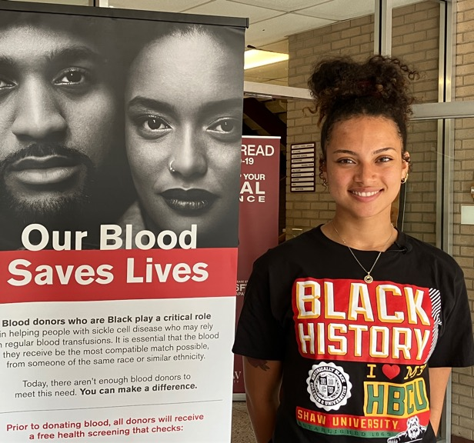
“I especially liked the idea of trying to get my friends to give blood because, as a blood donor myself,
I realize the impact I have.”
Mya Rolinson, Red Cross HBCU Ambassador and sophomore at Shaw University, where she is majoring in exercise science with a concentration in
pre-athletic training
Igniting a new generation of blood donors: Mya Rolinson is passionate about making a difference. As a Red Cross HBCU Leadership Program Ambassador, Mya champions the blood transfusion needs of sickle cell warriors by encouraging students, faculty and community members to donate blood. In its first year, the program focuses on providing scholarships, leadership and mentorship opportunities to HBCU students who promote awareness of sickle cell disease and the vital role blood donors who are Black play in supporting transfusion needs.

Slide 20



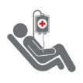
Blood Services Impact
The Red Cross ensures people in need receive safe blood on a remarkable scale. Over the past three months:
984,700 blood donors engaged
46,400
blood drives hosted
1.4 million
units of blood collected
14 million
tests conducted
1.3 million
blood products delivered
FY23 Totals
1.9 million
139,700
4.2 million
42 million
3.8 million

Slide 21

Supporting Military and Veteran Families

Slide 22
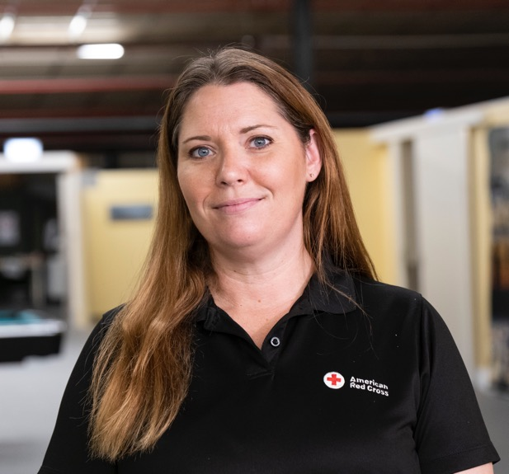
“It’s important that we are there during the worst of times.”
Michelle Hagge, who recently spent four months
deployed with the American Red Cross in Romania
Since the conflict in Ukraine escalated, the Red Cross has deployed 70 trained staff to support U.S. military families by providing emergency communication messages
and morale activities.
While deployed, Michelle received her own emergency message about the death of a loved one. “It now makes me hold so dear what the Red Cross can do for service members when they receive these messages,” she said. “Working with the commands to get leave approved and getting these service members home have taken on a new level of importance for me.” For more stories of Service to the Armed Forces staff and the life-changing impact they make, we invite you to watch this brief video.

Slide 23


Military Support Impact
This quarter, over 8,600 compassionate Red Cross Service to the Armed Forces workers have provided critical services in lockstep with our partners.
11,800
new members and relatives learned about Red Cross services
73,100
care and therapy items distributed at medical facilities
43,300
hospitalized people helped through
rehabilitation and morale programs
18,900
families supported through personal
emergencies
FY23 Totals
42,400
356,500
161,800
54,700
*These are select examples from the wide range of services we provided to military members, veterans and their families from Oct. – Dec. 2022.

Slide 24

Training for the
Moments That Matter

Slide 25
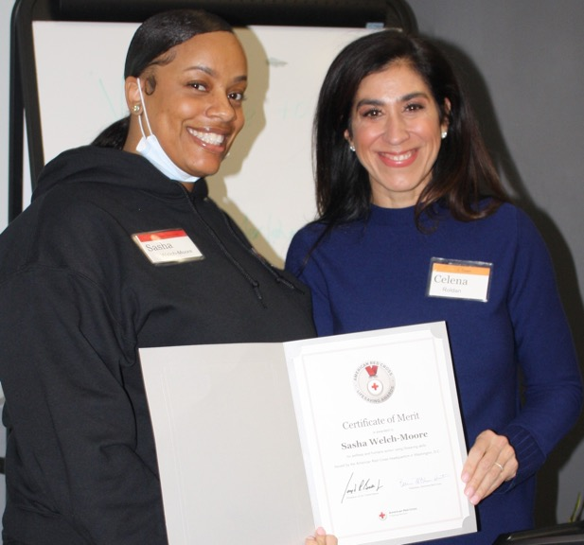
“I’m thankful I had that strength and courage to move forward.”
Sasha Welch-Moore, who performed CPR
on a man at her gym in Peoria, Illinois,
ultimately helping save his life
In January, Sasha (left) received the Red Cross
Certificate of Merit — the highest lifesaving award
from the organization.
CPR Trained Red Crosser Saved a Life: Sasha was all too familiar with the pain of losing a loved one to a medical emergency. Her father died of a heart attack years earlier. Thinking of him, she wanted to do everything she could to help the man at the gym. “Everybody has something to live for,” Sasha continued. “I felt like I owed it to him and maybe his kids or his wife to give it all I got and just to keep going. I feel like that’s what carried me through that situation.”

Slide 26
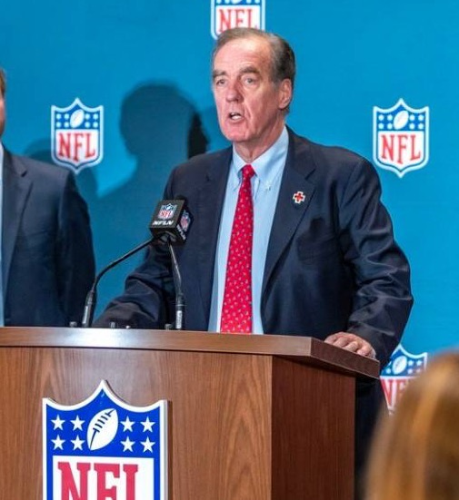
Red Cross Part of NFL’s Coalition to Help Prevent Student Athlete Deaths Due to Cardiac Arrest
The Smart Heart Sports Coalition is advocating for all 50 states to adopt evidence-based policies that will prevent fatal outcomes from sudden cardiac arrest among high school students.
“The American Red Cross is proud to support and promote the NFL’s new national advocacy campaign to highlight the need for safety policies and training to prevent sudden cardiac arrest deaths
among young people.”
- Jack McMaster, president of Red Cross Training Services

Slide 27



Training Services Impact
Over the last quarter, we have equipped nearly 1.5 million community members to help neighbors, friends and family members
with vital skills:
728,000
people trained in First Aid, CPR and AED, making every community safer
739,500
people learned how to be safe in, on and around the water through our Aquatics and Water Safety training
17,600
individuals trained in caregiving courses, empowering participants to provide quality care to people of all ages
FY23 Totals
1.9 million
1 million
52,900

Slide 28
Your Partnership

Slide 29
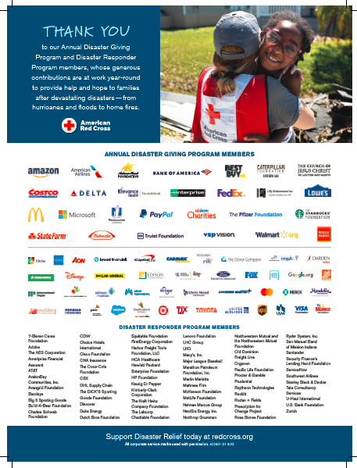
Benefits and Resources
We were pleased to provide valuable recognition and engagement this quarter.
Logo in one full-page ad in Businessweek, generating more than 200,000 impressions.
Acknowledgement in Red Cross FY22 Annual Report, an annual publication shared with our supporters.
Template communications materials, including social posts and articles, provided to align partnership with timely home fire and blood donation messages, as well as Red Cross Giving Day and March Is Red Cross Month.
  During times of disaster:
  Acknowledgment in two national news stories about disaster response activity on redcross.org, generating nearly 9,000 total page views.
  Recognition in 10 Disaster Information Update emails, shared with Red Cross supporters.

Slide 30
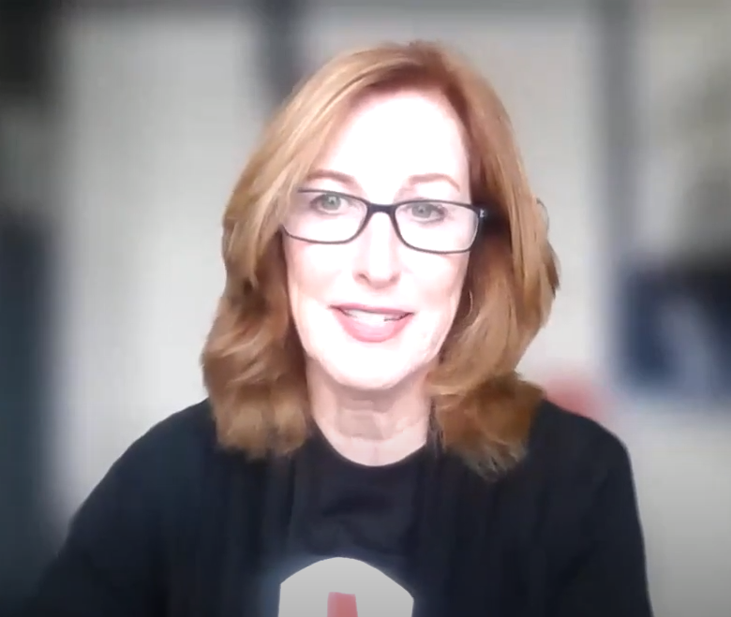
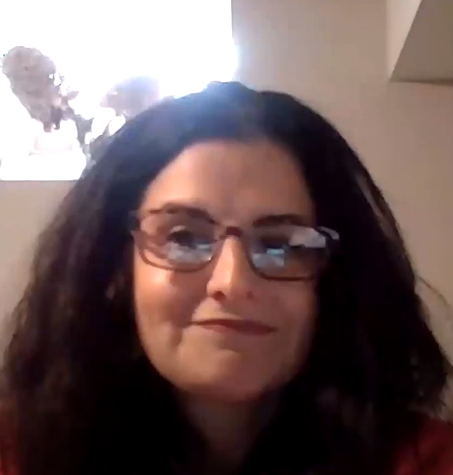
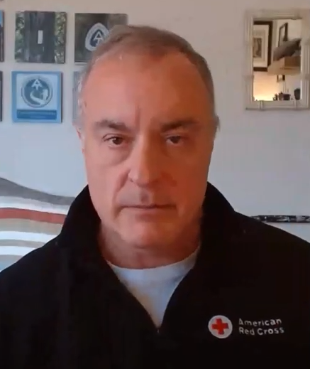
Benefits and Resources
ADGP members were also invited to an exclusive virtual Disaster Leadership Roundtable on March 22 to learn more about the critically important role your investments play in powering our work. The discussion included:
  Reflections on the past year of chronic disaster activity across the country.
  Updates on our disaster operation in response to California Storms and Floods.
  Mission adaptations we’re undertaking to better meet the needs of vulnerable populations and communities in a rapidly changing landscape.
  How the global Red Cross Red Crescent network and the American Red Cross are helping those impacted by the Türkiye Earthquake.
HOST
Anne McKeough,
Chief Development Officer
Becky Streifler,
Executive Director
International Services
Brad Kieserman,
Vice President
Disaster Operations
and Logistics
View a recording of the dynamic conversation.

Slide 31
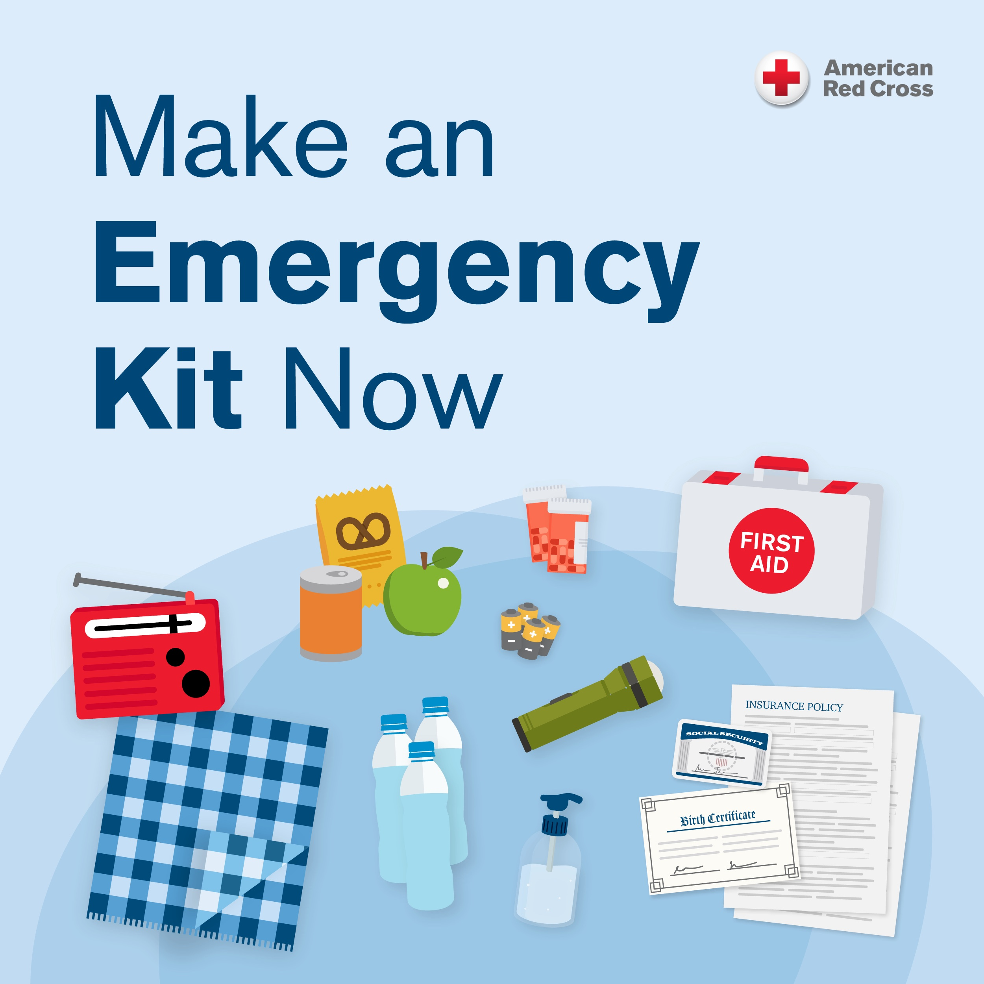
Join Us!
Help your employees, customers and others stay safe this season!
The Atlantic hurricane season runs from June 1 to November 30, and meteorologists are again predicting another active season.
The American Red Cross is readying our teams and resources to ensure help is available to anyone left in need by a disaster – and you can too.
Access these ADGP 2023 Hurricane Preparedness Communications Resources for ways to engage employees, customers or social followers with important messages about preparedness.

Slide 32
