Slide 1
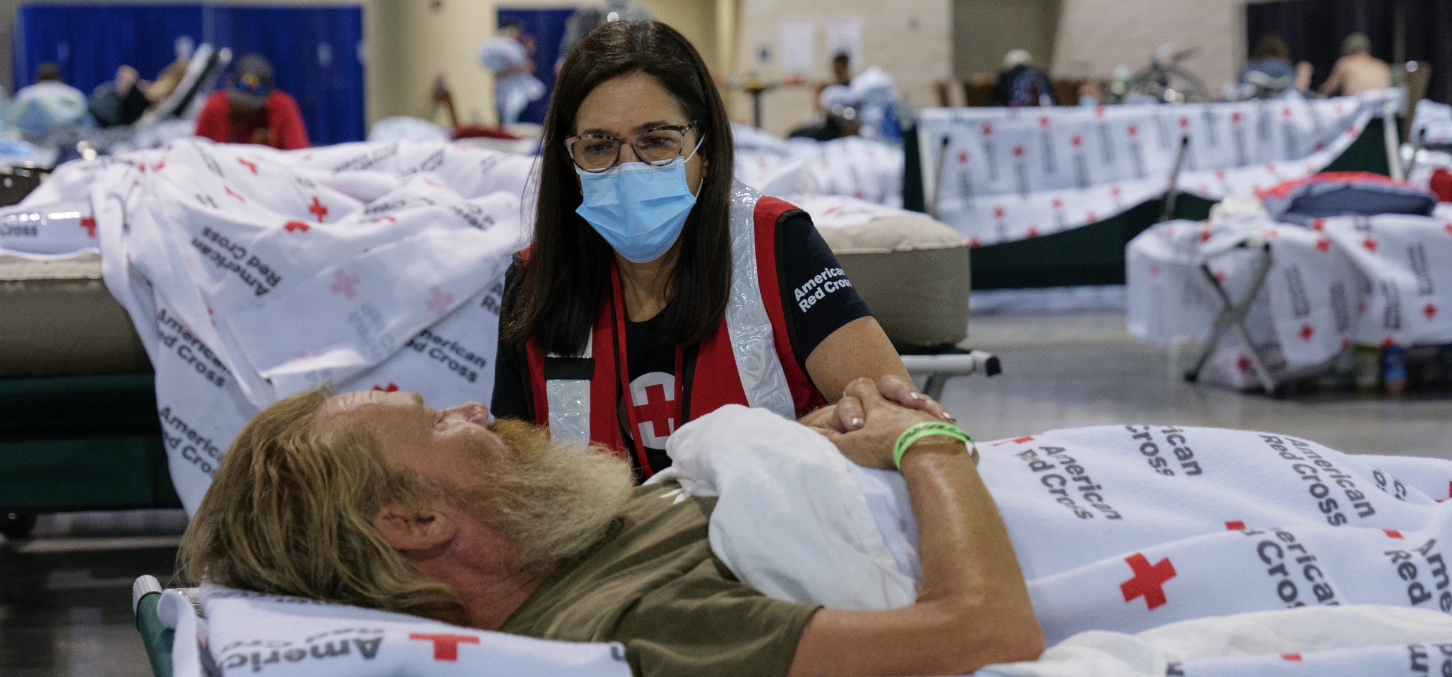
Quarterly Partnership Update
FY23 Q2 (October 2022 – December 2022)
Prepared for Disaster Responder Program Members

Slide 2

Alleviating Suffering
Through Disaster Relief

Slide 3
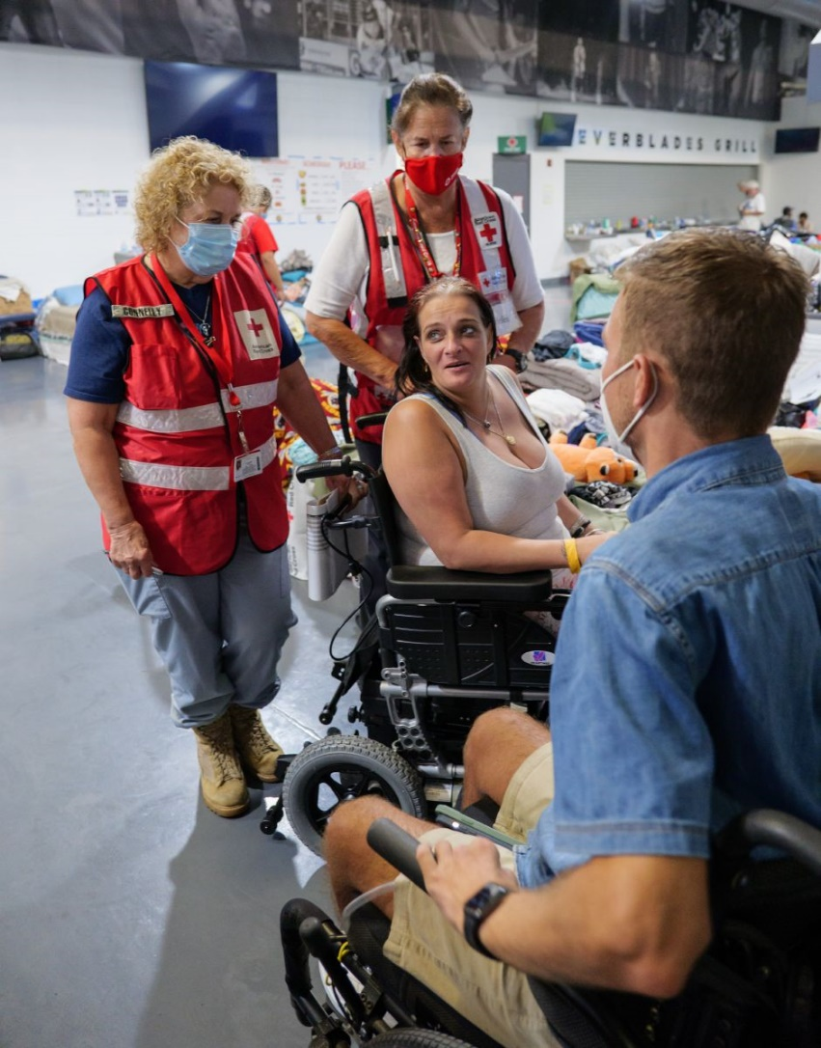
Dedicated Care for a Hurricane Ian Survivor
“This was actually a miracle…what [you] did was phenomenal.”
Meghan Jarosz, who, with the help of a Red Cross nurse and a local partner, received a powered wheelchair after hers was lost during Hurricane Ian. Providing for both her physical and mental health, Red Cross relief made a big impact on Meghan’s whole family.

Slide 4
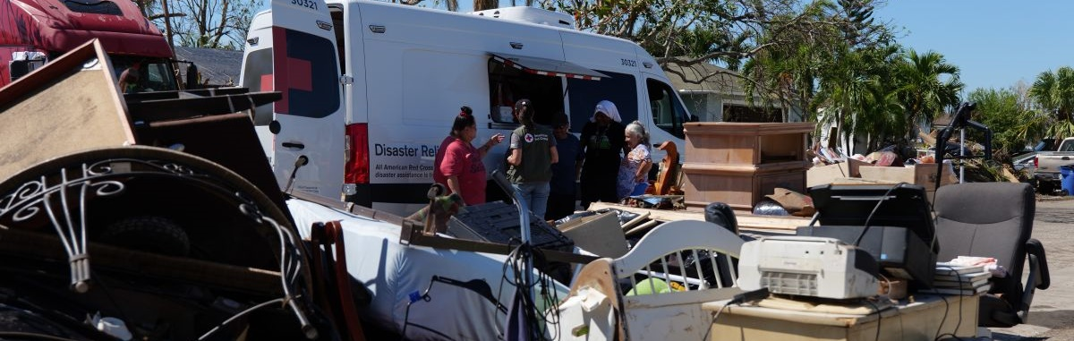
Between October and December 2022, dedicated Red Cross volunteers and staff were hard at work turning heartbreak into hope.
From hurricanes to tornadoes – and everyday disasters like home fires – the Red Cross was there for those who needed us most thanks to the generosity of Disaster Responder members like you. With your help, our teams were hard at work across the country delivering critical care and committing to stand with survivors along their long road to recovery.

Slide 5
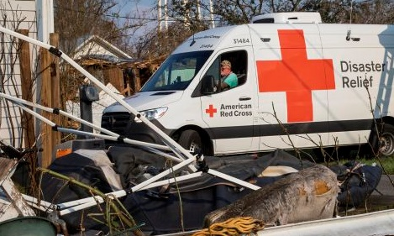
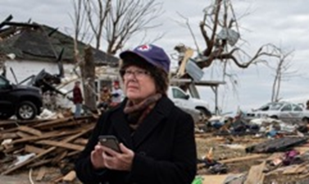
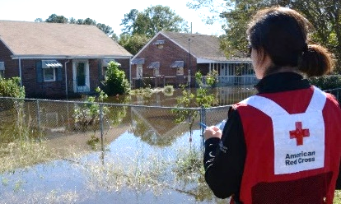
Domestic Responses
Thanks to your commitment, we were ready to respond immediately to urgent crises across the country when we were needed most.
Hurricanes: Following the historic landfall of Hurricane Ian on Florida’s west coast as a powerful Category 4 storm, Hurricane Nicole was the first hurricane to make landfall on Florida's east coast since Katrina in 2005. The Red Cross is still on the ground, providing impacted communities financial aid and hope that recovery is possible.
Tornadoes: Severe winter storms produced tornadoes in Alabama and Mississippi, disabling power for 12 counties across the two states amid freezing temperatures. Red Cross teams supported warming centers for vulnerable populations without access to heat and, with partners, provided meals and snacks to displaced families.
Flooding: Back-to-back storms fed by an atmospheric river in the Pacific Ocean have led to flooding, landslides, roads being washed away, power outages and evacuations across California. The Red Cross is on the ground to provide safe shelter, deliver hot meals and offer critical care during this time of immense need.

Slide 6
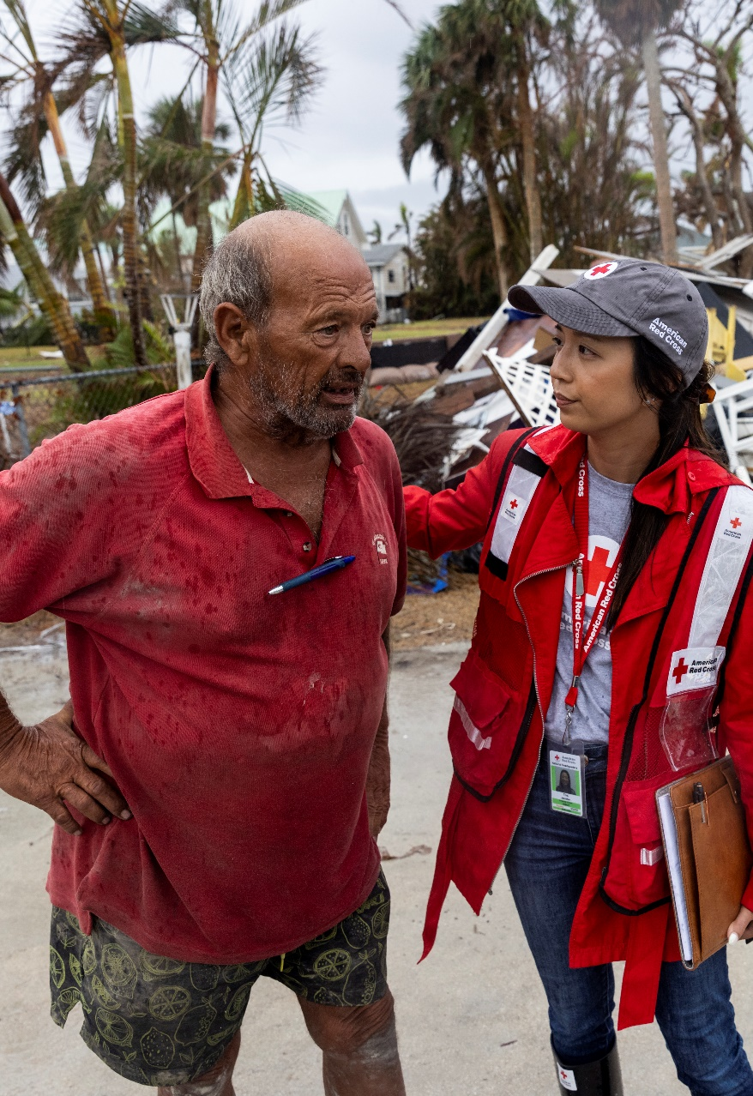
Hurricane Ian 3-Month Update
Last fall, Hurricane Ian devastated Florida communities, spurring widespread devastation and incredible heartbreak.
Months later, the Red Cross remains by the sides of residents impacted by this life-changing disaster. So far, we’ve provided more than 15,100 households with recovery support, including financial assistance.
You can learn more about how we're helping survivors in our 3-Month Report and Story Map.

Slide 7
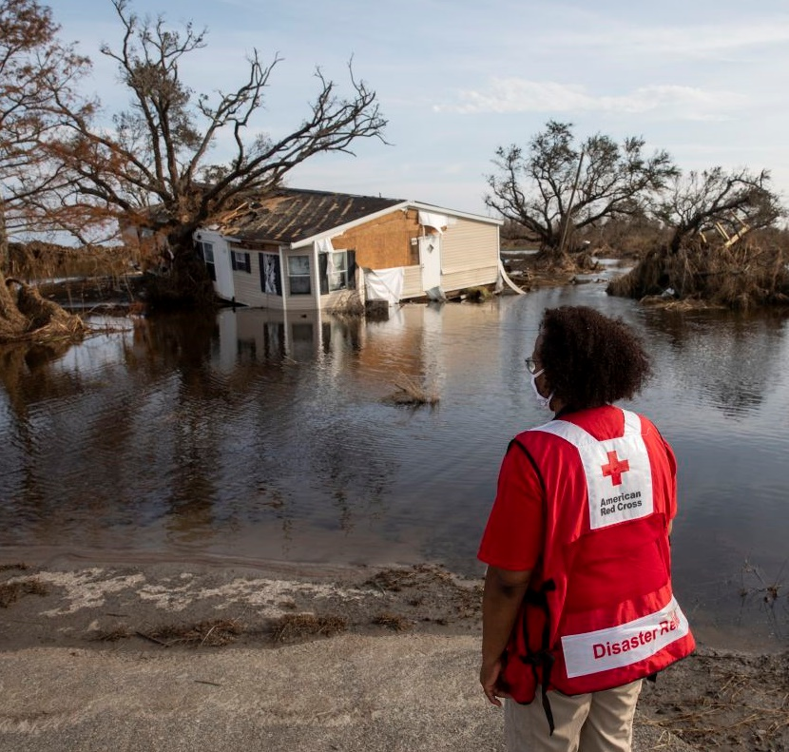




Adapting Our Domestic Disaster Relief
The Red Cross is addressing problems faced by individuals and families impacted by climate change. We are:
Launching community adaptation programs Building community resilience and partner capacity during future disasters
Expanding our financial assistance program Offering more support after disasters to help the most vulnerable families avoid deepened poverty or homelessness
Growing our disaster network
Recruiting more volunteers and employees to enhance our trained disaster workforce
Enhancing client services
Adapting and enhancing our sheltering and casework services for people displaced by major disasters
While preserving critical resources in order to respond to disasters 24/7

Slide 8
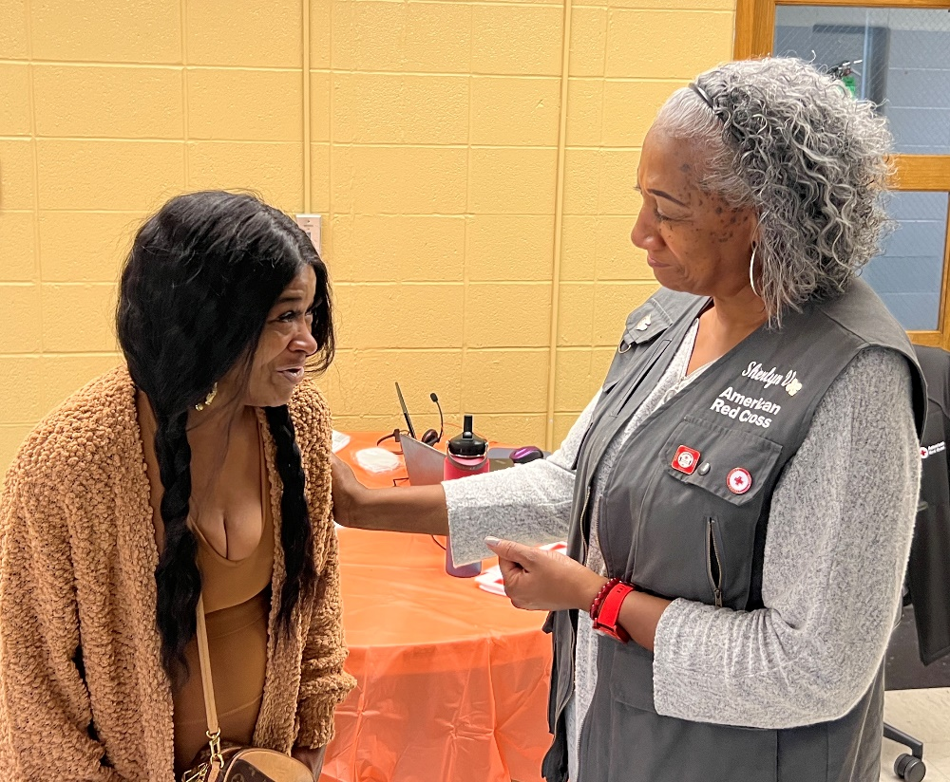
Mission Adaptation Highlight: Expanding Our
Financial Assistance for Disaster Survivors
“The Red Cross has been very supportive throughout our community…this is an organization that goes above and beyond.”
Mirion Rodgers, whose home was devastated during the St. Louis, Missouri, floods. Mirion, who cares for her elderly mother, received financial assistance from the Red Cross this fall to aid her individual recovery efforts.

Slide 9

Red Cross Responded to 73 Large Disasters
Pittsburgh, PA Multi-Family Fire (Level 3)
Arapahoe County, CO Multi-Family Fire (Level 3)
Southeast OK Tornadoes (Level 3)
Northeast TX Tornadoes (Level 3)
Tropical Storm Nicole FL (Level 3)
Tornadoes AL/MS (Level 3)
Pittsburgh, PA Multi-Family Fire (Level 3)
Louisiana Tornadoes (Level 3)
Southwest Border Operations (Level 5)
Including 9 very large domestic disasters
2
1
7
10
3
9
4
6
8
5
“Large” includes domestic disaster operations with costs of $10,000+ (i.e., level 2 and higher).
“Very large” includes domestic disaster operations with costs of $50,000+ (i.e., level 3 and higher).
Disasters listed chronologically.

Slide 10




Domestic Response Impact
This quarter, over 800 Red Cross disaster workers provided
critical services in lockstep with our partners across the U.S.
142,000
meals and snacks served with partners
10,400
overnight stays in emergency lodging provided with partners
3,000
households provided relief items
5,500
households provided recovery support
FY23 Totals
124,500
11,600
1.7 million
55,900
Includes domestic disaster operations with costs of $10,000+ (i.e., level 2 and higher).

Slide 11

Helping People Impacted From Home Fires

Slide 12
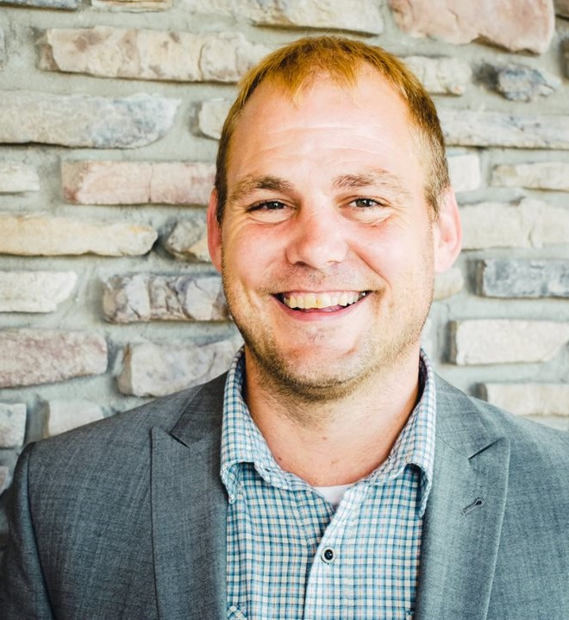
Financial Assistance Helps Longtime Volunteer in
Minnesota Home Fire’s Aftermath
“The outreach has been humbling. Local help has made the devastation a little easier.”
Sterling Molby, a veteran and longtime Red Cross volunteer from Minnesota, suffered the devastation of a home fire last October.
Within 30 minutes of contacting the Red Cross, Sterling received financial assistance to help him and his family secure temporary lodging.

Slide 13
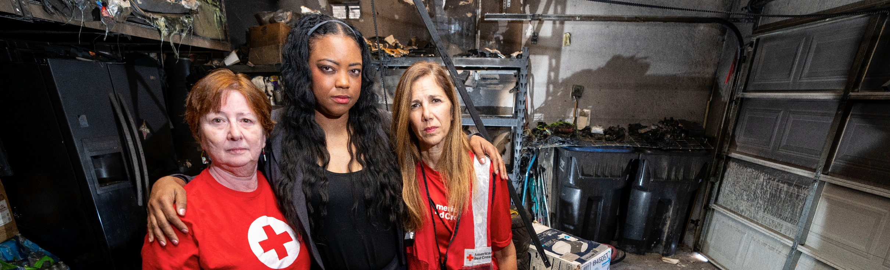
Meeting the Growing Need for Home Fire Financial Assistance
We opened over 24,200 home fire cases in the second quarter of our 2023 fiscal year – a 16% increase compared to the same timeframe last year.
We’re also distributing more financial assistance. We provided $16.1 million in the second quarter this year, up 19% from this time in FY22.

Slide 14



Home Fire Campaign Impact
This quarter, over 6,200 dedicated Red Cross home fire workers provided critical services to help families prepare for and recover from home fires in lockstep with our partners across the U.S.
52,500
smoke alarms installed
20,800
homes made
safer
16,800
home fire
responses
64,600
individuals received financial assistance
64,300
youth reached with preparedness education
FY23 Totals
88,500
34,800
29,800
115,200
87,200
Includes domestic disaster operations with costs under $50,000 (i.e., level 1 and 2 disasters).
Notes:
Only include FY23 totals for Q2, Q3 and Q4.

Slide 15

Alleviating Suffering
Around the World

Slide 16
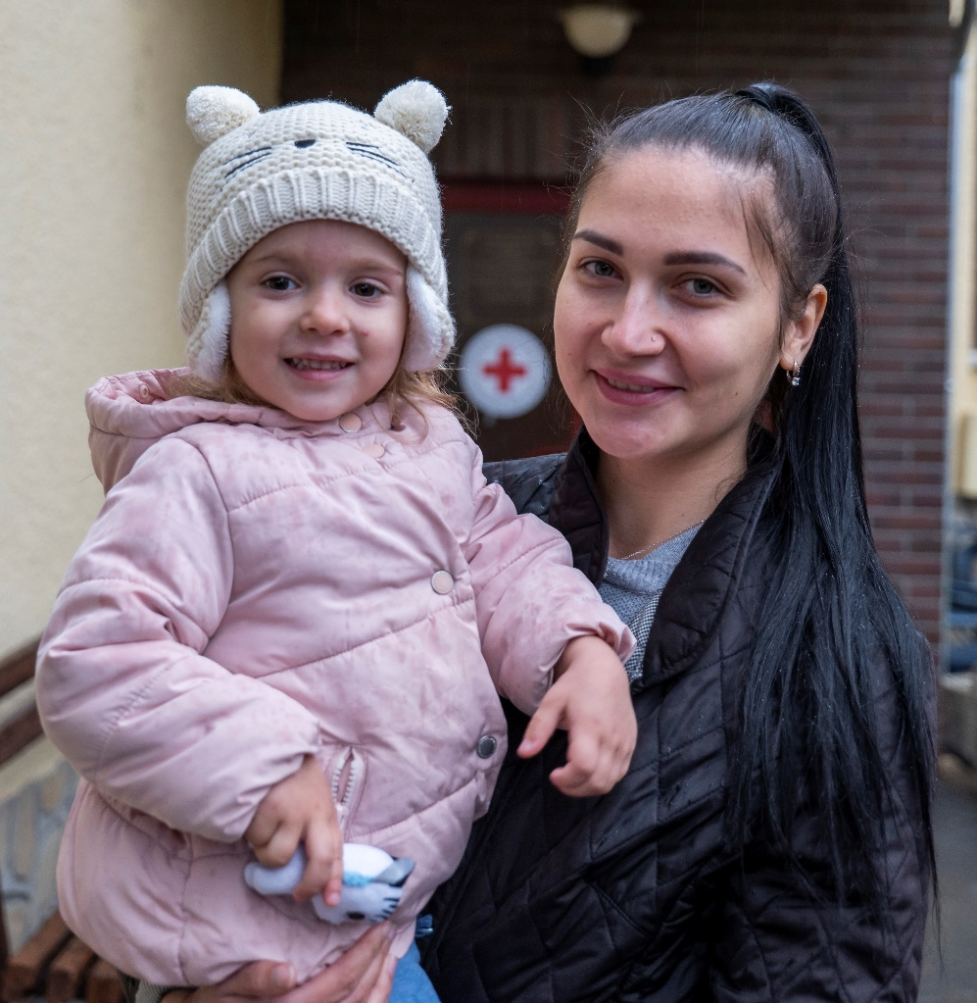
Funds Help Ukrainian Mother and Daughter
“With the funds I received from the Red Cross, I bought winter jackets for us as … we didn’t bring winter clothes with us.”
Alissa,* who fled Ukraine with her daughter at the
start of the Russian invasion of Ukraine. She and her daughter found safe refuge at a Red Cross shelter in Hungary. The family has also received Red Cross financial assistance to help with essentials, like
winter clothing.
*Name changed for privacy

Slide 17
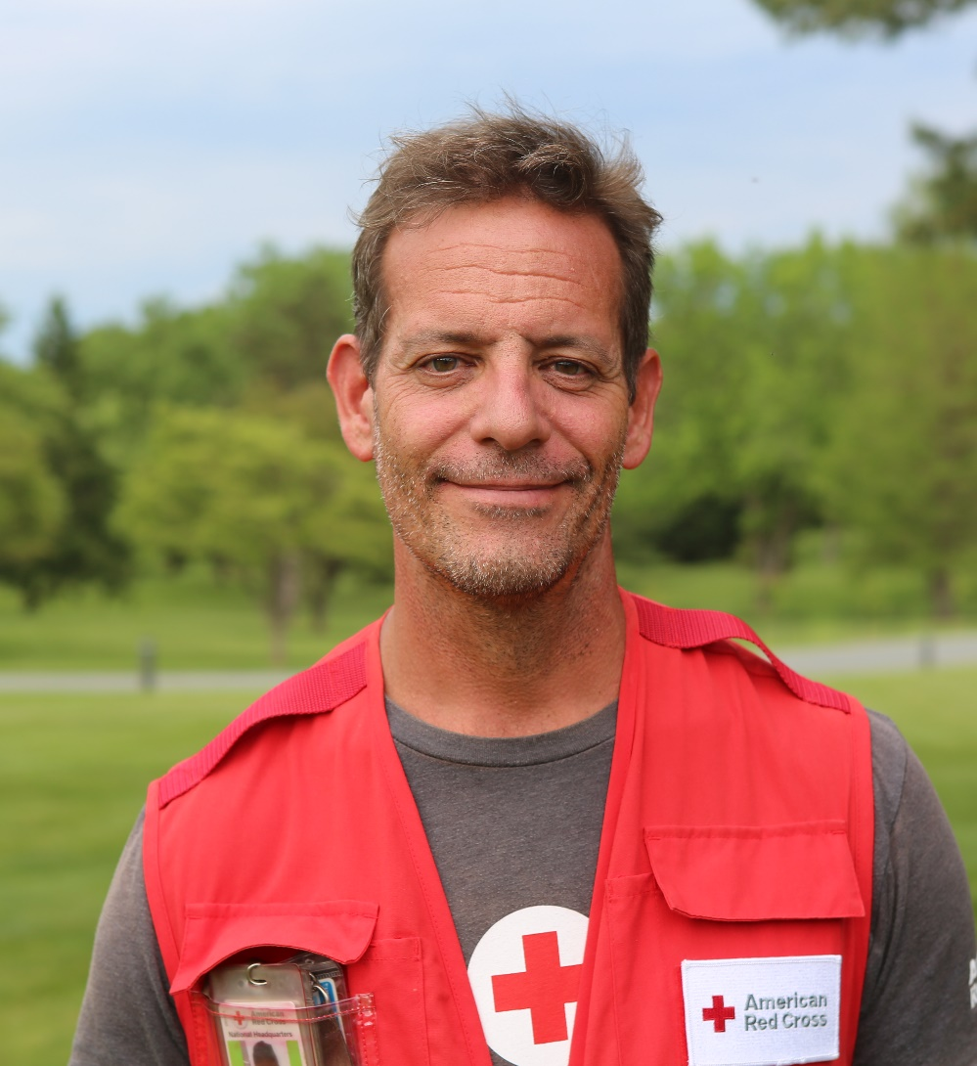
Red Cross Care Helps Migrants on Arduous Journey
Ash Carter deployed to Panama in November to support vital relief services for migrants facing extreme conditions while crossing the Darien Gap – a dangerous stretch between Colombia and Panama.
At neutral points established by the International Federation of the Red Cross, Carter and his colleagues provided first aid, health care, nutrition, water and other essentials. Migrants could also charge their phones to contact loved ones and connect with their families through the Red Cross Restoring Family Links Service.

Slide 18

7 Major Emergencies Around the World
Bangladesh Cyclone Sitrang
El Salvador Floods and Landslides
El Hurricane Ian (Cuba)
Nepal Earthquake
Nigeria Floods
Ukraine and Impacted Countries Crisis
Vietnam Typhoon Sonca
6
4
3
1
7
2
5
Disasters listed chronologically.

Slide 19
International Services Impact
The American Red Cross actively supported
disaster preparedness, relief and recovery work in 23 countries.
$10.7M
donated to Red Cross and Red Crescent efforts*
0
American Red Cross specialists deployed
979
families
reconnected after disasters/conflict migration
13
preparedness/ risk reduction projects
FY23 Totals
$18.3M
3
1,990
31
*Reflects funds donated by American Red Cross to the International Federation of Red Cross and Red Crescent Societies, the International Committee of the Red Cross, and Red Cross and Red Crescent national societies following specific disasters.

Slide 20

Saving Lives Through
Blood Services

Slide 21
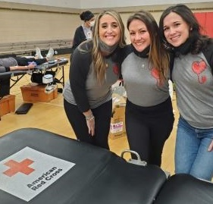
“Blood is the ultimate gift; it helped save my life.”
Liana Albers, blood recipient
Katie Quam, Liana Albers and Annie Sterle (pictured) were brought together by shared traumatic experiences of an amniotic fluid embolism during childbirth. The complications from this condition occur suddenly and can be life-threatening. All three women credit blood donations with helping to save their lives and ensuring they’re still here to raise their children. Together, they needed
over 100 units of lifesaving blood products. To help others, they organized a blood drive.

Slide 22

New Platelet Centers Help Meet Demand
Rising cancer cases and treatments increase need for platelets
This year, we have opened three new platelet donation centers in Wilmington, Delaware, Brentwood, Tennessee, and Waukesha, Wisconsin.
Together, these three centers have supported the collection of more than 8,400 additional
platelet units.*
Platelets are vital to helping people like Charley (pictured) fight cancer. During her treatment for leukemia, Charley had to wait for a transfusion due to a platelet shortage.
*July 1, 2022, through December 31, 2022

Slide 23
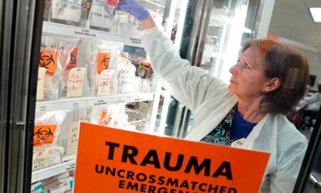

New Equipment Helps Save Lives
Specialized equipment and vehicles are vital to collecting, processing, testing, storing and delivering lifesaving blood, when and where it’s needed. Your financial support helps make these essential investments possible:
A newly purchased platelet incubator in Huntington, West Virginia, will safely store this lifesaving blood product until it is needed by patients fighting cancer, trauma victims or others. This is just one of 11 new pieces of medical equipment acquired this quarter.
This quarter, the Red Cross secured an SUV in Atlanta, Georgia – one of five new Blood Services vehicles – that plays a vital role in transporting staff and equipment to blood drives and bringing blood back to the Red Cross for processing. These vehicles are on the road daily keeping this lifesaving mission move forward.

Slide 24




Blood Services Impact
The Red Cross ensures people in need receive safe blood on a remarkable scale. Over the past three months:
979,800 blood donors engaged
46,700
blood drives hosted
1.4 million
units of blood collected*
14 million
tests conducted
1.5 million
blood products delivered
FY23 Totals
1.9 million
92,700
2.8 million
28 million
3 million
*Note: These numbers include red blood cells and platelets. Additionally, blood products can be split into different components, which are delivered to people in need.

Slide 25
Your Partnership

Slide 26

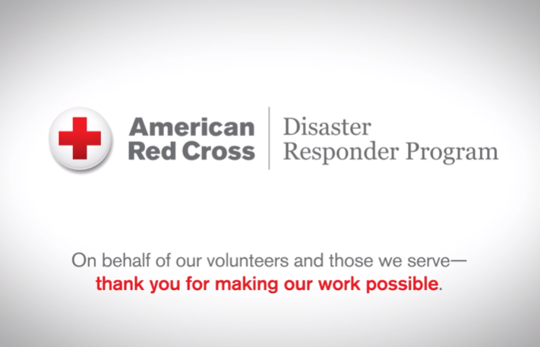
Benefits and Resources
We were pleased to provide valuable recognition and engagement this quarter.
Two videos, highlighting the disaster work your ADGP membership helped power.
Template communications materials, including social posts and articles, provided to align partnership with timely home fire and holiday safety messages.
  During major disaster responses:
  Acknowledgment in four national news stories about disaster response work on redcross.org, generating nearly 90,000 page views.
  Recognition in 10 Disaster Information Update emails shared with Red Cross supporters.

Slide 27

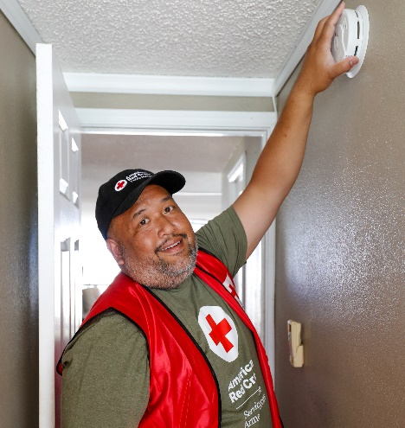
Join Us!
Sound the Alarm is back for 2023. We’ll install 50,000 free smoke alarms across high-risk neighborhoods in 50 signature cities.
As a Disaster Responder program member, we can help you engage your employees through Sound the Alarm.
Invite employees to volunteer to install smoke alarms through your trackable registration page.
Encourage employees to prepare for home fires using a self-guided, co-branded “Pledge to Prepare” page.
Offer Be Red Cross Ready presentations that help employees prepare for and prevent home fires.
Review this resource to learn more and let your relationship manager know which interests you.

Slide 28


