Slide 1
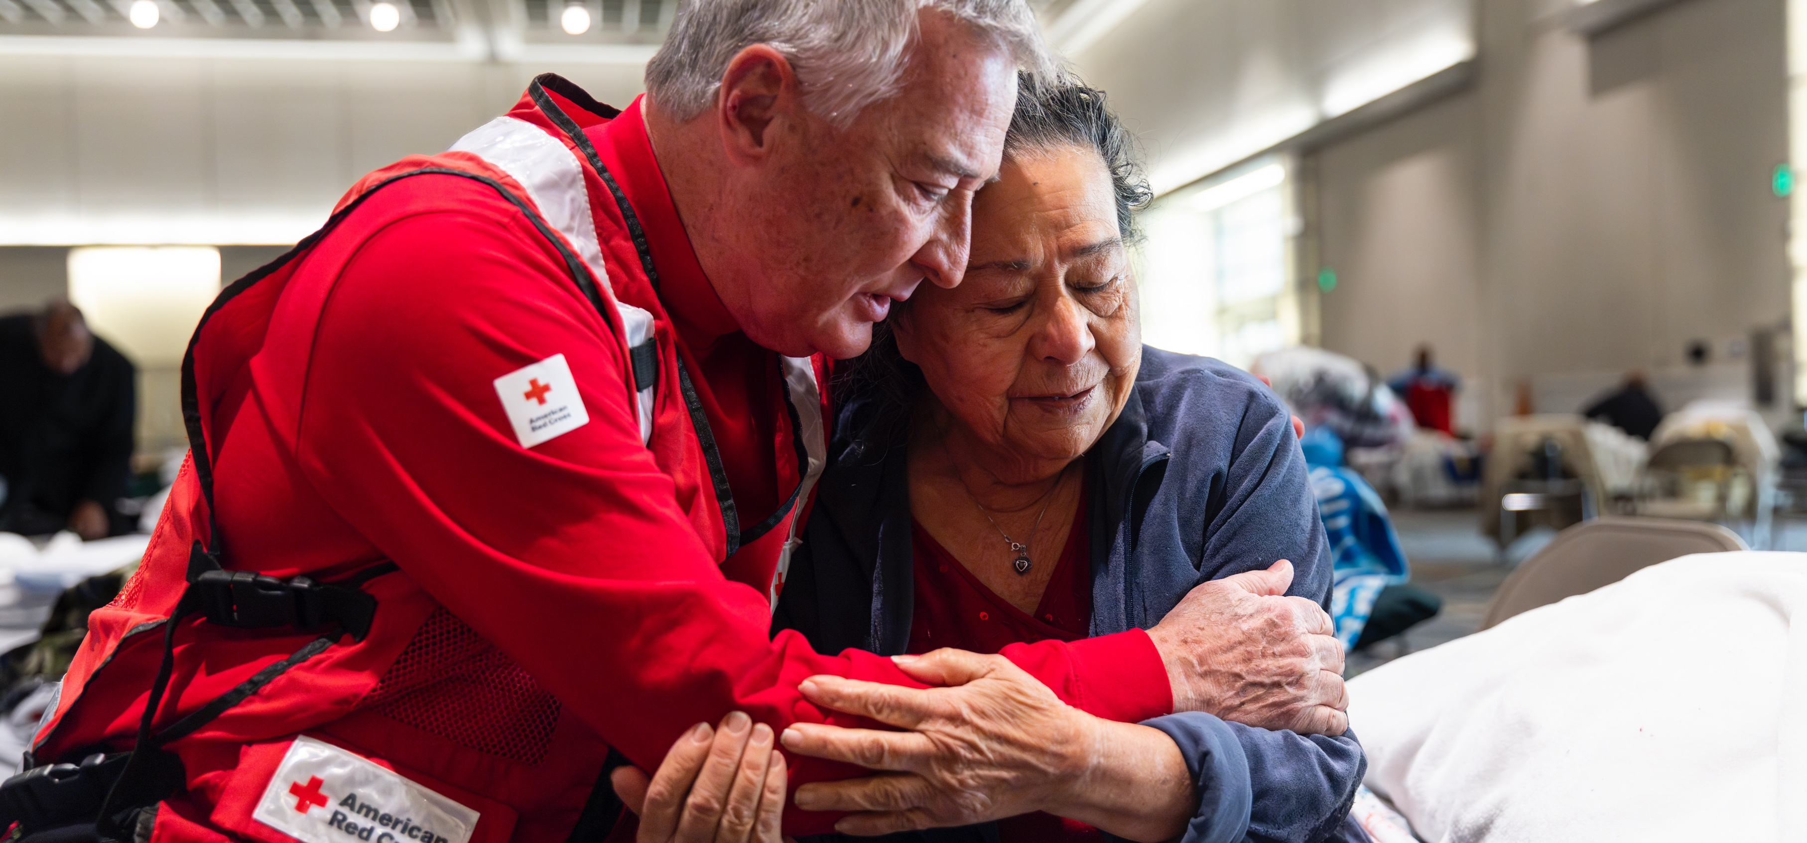
Quarterly Partnership Update
Fundraiser Guidance:
Insert company name and date.
Customize deck content based on donor’s giving history and/or interests.
Delete slides that are not relevant to donor.
If donor has primarily or exclusively supported Blood Saves Lives or Service to the Armed Forces, consider using one of the alternate covers at the back of this deck.
Delete this box.
FY25 Q3 (Jan. – March 2025)

Slide 2

Alleviating Suffering
Through Disaster Relief

Slide 3

Red Cross Responded to 100 Big Disasters
Including 17 large and major responses listed chronologically:
California Wildfires (Level 7)
Louisiana Blizzards (Level 3)
Northern California Atmospheric
Rivers (Level 3)
Alabama & Mississippi Tornado (Level 3)
Arkansas Tornado (Level 3)
Tennessee Floods (Level 3)
Southwest Virginia Floods (Level 3)
Kentucky Floods (Level 5)
Central Appalachia Floods (Level 3)
North Texas Storms (Level 3)
Alabama & Mississippi Tornado (Level 4)
Kansas & Oklahoma Wildfires (Level 4)
Missouri & Arkansas Storms (Level 4)
Oregon Floods (Level 3)
North Carolina Wildfires (Level 3)
South Texas Floods (Level 3)
Harney County, Oregon Flood (Level 3)
14
17
3
1
13
8
7
12
5
6
9
15
4
10
11
2
16
Jan 1 – Mar 31, 2025
“Big” includes domestic disaster operations with costs of $10,000+ (i.e., level 2 and higher).
“Large and major” includes domestic disaster operations with costs of $50,000+ (i.e., level 3 and higher).

Slide 4




Domestic Disaster Response Impact
In FY25-Q3,* more than 3,750 Red Cross disaster workers provided
critical services in lockstep with our partners across the U.S.
366,570
meals and snacks served with partners
34,600​
overnight stays in emergency lodgings provided with partners
38,400
households provided relief items
14,950
households provided recovery support, including financial assistance
FY25 Totals
205,500
32,700
4,600,000
259,100
*Jan 1 – Mar 31, 2025
Includes domestic disaster operations with costs of $10,000+ (i.e., level 2 and higher).

Slide 5
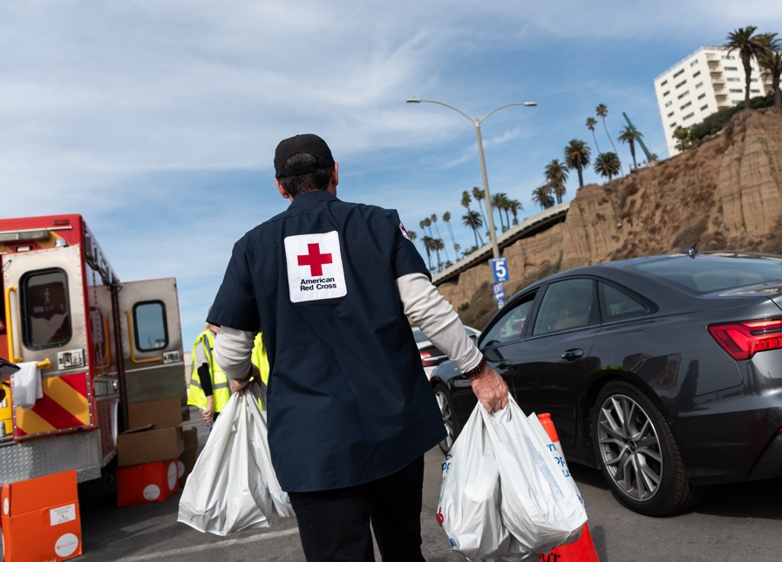
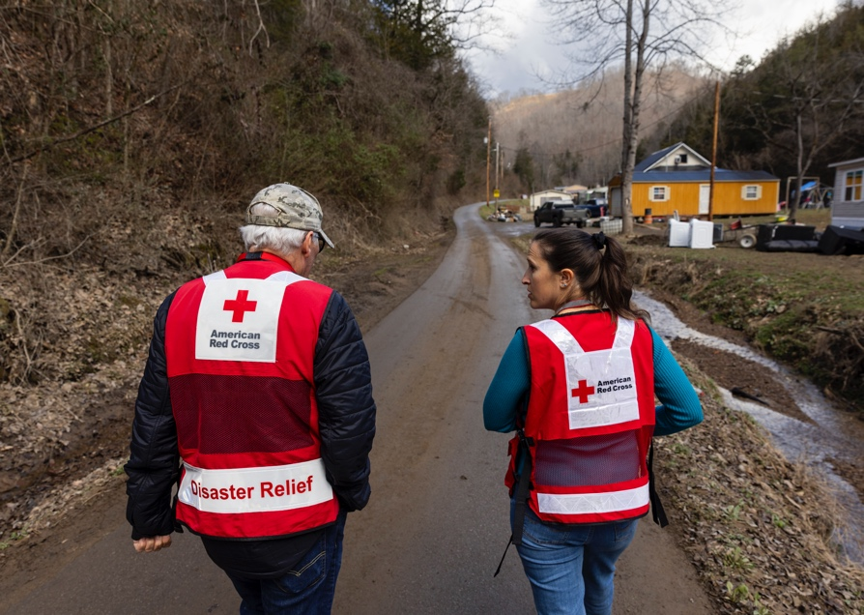
Responding to Large Disasters Across the U.S.
Thanks to your commitment, we were ready to respond immediately to urgent crises across the country when we were needed most.
In January, catastrophic wildfires devoured entire neighborhoods in Southern California. To help hard-hit residents, our teams:
Worked with partners to shelter and feed people forced from their homes.
Reached households with essential relief items and cleanup supplies, as well as recovery services, including financial assistance.
Flash flooding inundated Kentucky communities this February. Many of them were still recovering from prior floods. In response, we have:
Supported safe shelter for displaced individuals and families.
Delivered meals, relief supplies, emotional support and basic health services.
Provided ongoing relief and recovery services, including financial assistance.

Slide 6
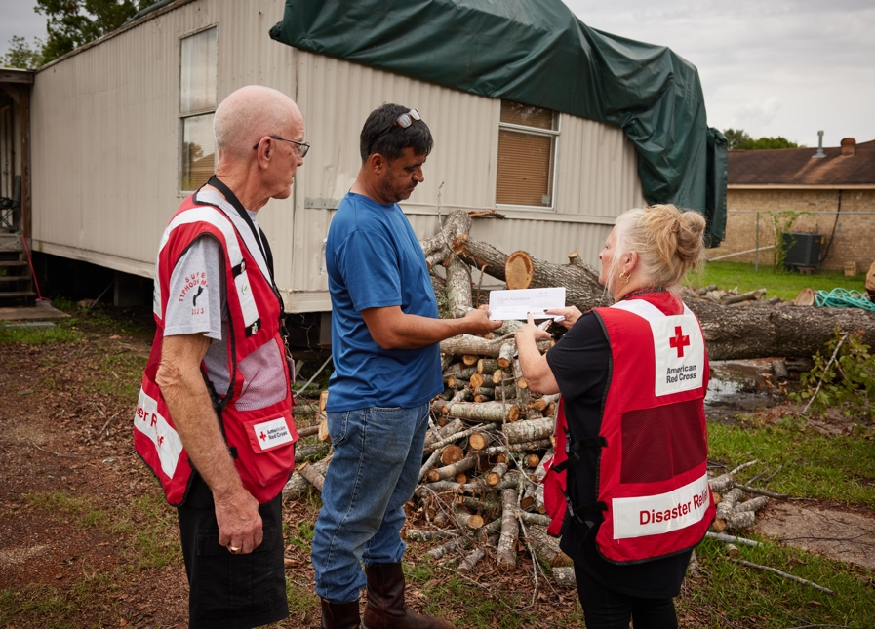
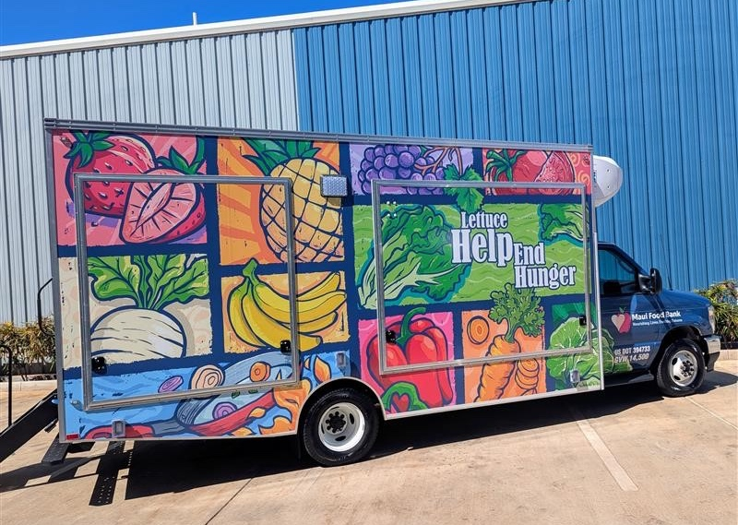
Providing Long-Term Recovery Support
For months — and even years — after the storm ends or the smoke clears, the Red Cross continues to provide critical long-term recovery assistance.
Hurricanes Helene & Milton (Fall 2024): Along with cash assistance to hard-hit families, we have awarded community recovery grants to local partners in Florida, Georgia, N. Carolina, S. Carolina and Tennessee.
Hurricanes Beryl & Francine (Summer 2024): We provided additional financial assistance totaling over $573,000 to hurricane survivors in Louisiana and Texas who continued to face significant recovery obstacles.
Hawaii Wildfires (Summer 2023): In March, we met with community recovery grantees, who have offered critical services to people impacted by the devastating wildfire on Maui. With funding from the Red Cross, these local partners have delivered food to Lahaina elders displaced by the blazes, secured housing for people with unmet needs, provided mental health support to first responders and much more.

Slide 7
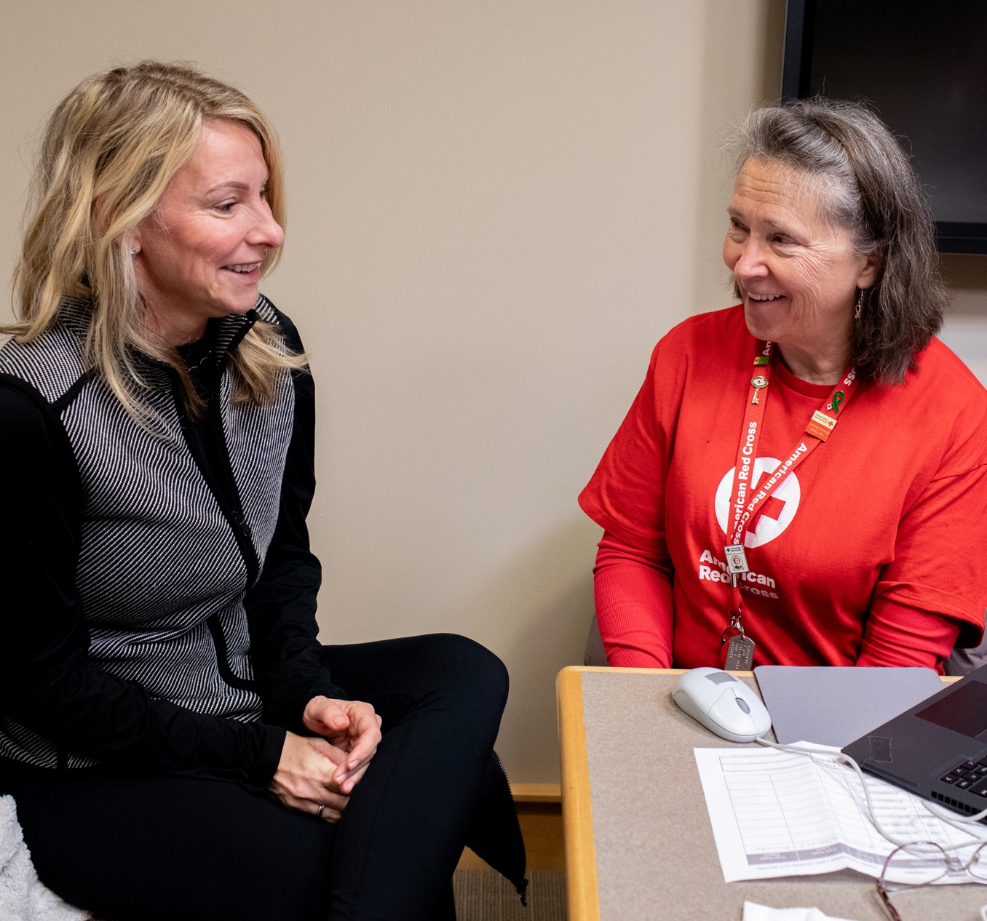
Hurricane Helene Recovery:
Financial Assistance Makes a Big Difference for Displaced Family
“I’m so thankful for the selfless and consistent support of the American Red Cross.”
Helene survivor Melissa McCabe and her family received Bridge Recovery Assistance from the Red Cross. The family had been staying in temporary housing since Helene-caused flash floods destroyed their North Carolina home.
Melissa McCabe, her husband and their family of six lived in temporary housing for months, running through retirement savings to keep everyone afloat. Then the Red Cross reached out. “They quite literally tracked us down by phone, text and email to give us money, which has been helpful to offset our living expenses,” Melissa said. With generous support from our donors, the Red Cross has already provided $10.8 million in financial assistance to help people recover in the wake of this massive storm.
Stay Updated: Hurricane Helene 3-Month Report (6-month report available in early May.)

Slide 8
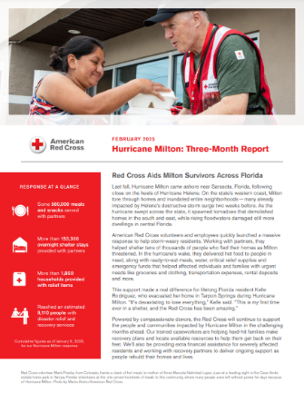
Hurricane Milton 3-Month Report
Hurricane Struck: October 2024
Hurricane Milton came ashore near Sarasota, Florida, with destructive winds and storm surge that battered many communities already impacted by Hurricane Helene. As the hurricane swept across the state, it also spawned tornadoes that demolished homes in the south and east, while rising floodwaters damaged still more dwellings in Central Florida.
Our Response:
To learn more, visit:
As of January 9, 2025, the Red Cross and its partners had supported over 153,300 overnight shelter stays for people who evacuated from their homes as Milton threatened.
With partners, we had also provided some 500,000 meals and snacks to aid storm-weary survivors.
Our response had reached an estimated 9,110 people with disaster relief and recovery services, including financial assistance.
Hurricane Milton 3-Month Report
(6-Month Report available in May.)

Slide 9
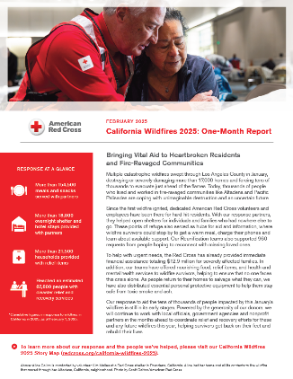
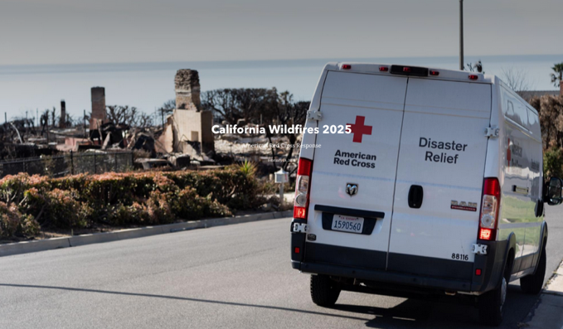
2025 California Wildfires 1-Month Update
Wildfires Started: January 2025
The 2025 California Wildfires: Multiple catastrophic wildfires swept through Los Angeles County in January, destroying or severely damaging more than 17,000 homes and forcing tens of thousands to evacuate just ahead of the flames. In hard-hit communities like Altadena, thousands of wildfire survivors faced devastating losses and an uncertain future.
Our Response:
To learn more, visit:
California Wildfires 1-Month Report
(3-Month report available in May.)
As of February 7, 2025, the Red Cross had reached an estimated 87,800 people with disaster relief and recovery services.
With partners, we had served over 154,500 meals and snacks, and we provided over 21,500 households with relief items and cleanup supplies.
Our Reunification teams had supported 960 requests from people hoping to reconnect with missing loved ones.
The Red Cross had also launched an immediate financial assistance program to aid severely affected families with their most urgent needs.
California Wildfires
Story Map

Slide 10

Helping People Impacted by Home Fires

Slide 11



Home Fire Campaign Impact
In FY25-Q3,* 8,050 dedicated Red Cross home fire workers provided critical services to help families recover from home fires in lockstep with our partners across the U.S.
71,050
smoke alarms installed
25,910
homes made
safer
17,170
home fire
responses
65,070
individuals received financial assistance
30,000
youth reached with preparedness education
FY25 Totals
169,460
61,430
43,220
168,170
88,310
*Jan. 1 – March 31, 2025
Includes domestic disaster operations with costs under $50,000 (i.e., level 1 and 2 disasters).

Slide 12
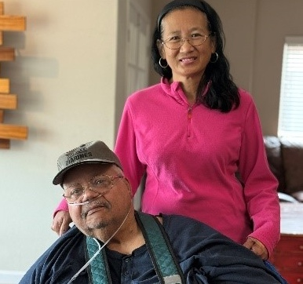
Smoke Alarms and Escape Plans Save 5 More Lives
“I was so thankful that we went through
that training.”
Duane Bennett, home fire survivor,
on the training he received from
our partner through our
Home Fire Campaign
Duane Bennett and his family credit smoke alarms and a fire safety escape plan from the Red Cross and our partners with saving their lives. They are among the 2,300+ people who are with us today, thanks to our Home Fire Campaign. When a fire broke out at their home in Oceanside, California, smoke alarms alerted Duane’s son to the danger. Using the home fire safety plan from the Red Cross and the Burn Institute, Duane’s son and a neighbor carried Duane — who uses a wheelchair — out of the house, while Duane’s wife, Mercy, ushered their grandchildren to safety.

Slide 13

Alleviating Suffering
Around the World

Slide 14
International Services Impact
In FY25-Q3*, the American Red Cross actively supported
disaster preparedness, relief and recovery work in 22 countries.
$5.5M
donated to Red Cross and Red Crescent efforts*
2
American Red Cross specialist deployed
37
families reconnected after disasters/conflict/migration
16
preparedness/risk-reduction projects
FY25 Totals
$20M
13
161
16
*Jan. 1 – March 31, 2025
*Reflects funds programmed by American Red Cross to the International Federation of Red Cross and Red Crescent Societies, the International Committee of the Red Cross, and Red Cross and Red Crescent national societies following specific disasters.

Slide 15

6 Major Emergencies Around the World
Bangladesh Flash Floods
Caribbean Hurricane Beryl
Indonesia Malaria & Dengue Outbreak
Myanmar Cyclone Yagi
Türkiye & Syria Earthquake
Vanuatu Earthquake
5
2
1
4
3
6
Reflects active American Red Cross responses to international disasters from Jan 1 – March 31, 2025
Disasters listed alphabetically.

Slide 16
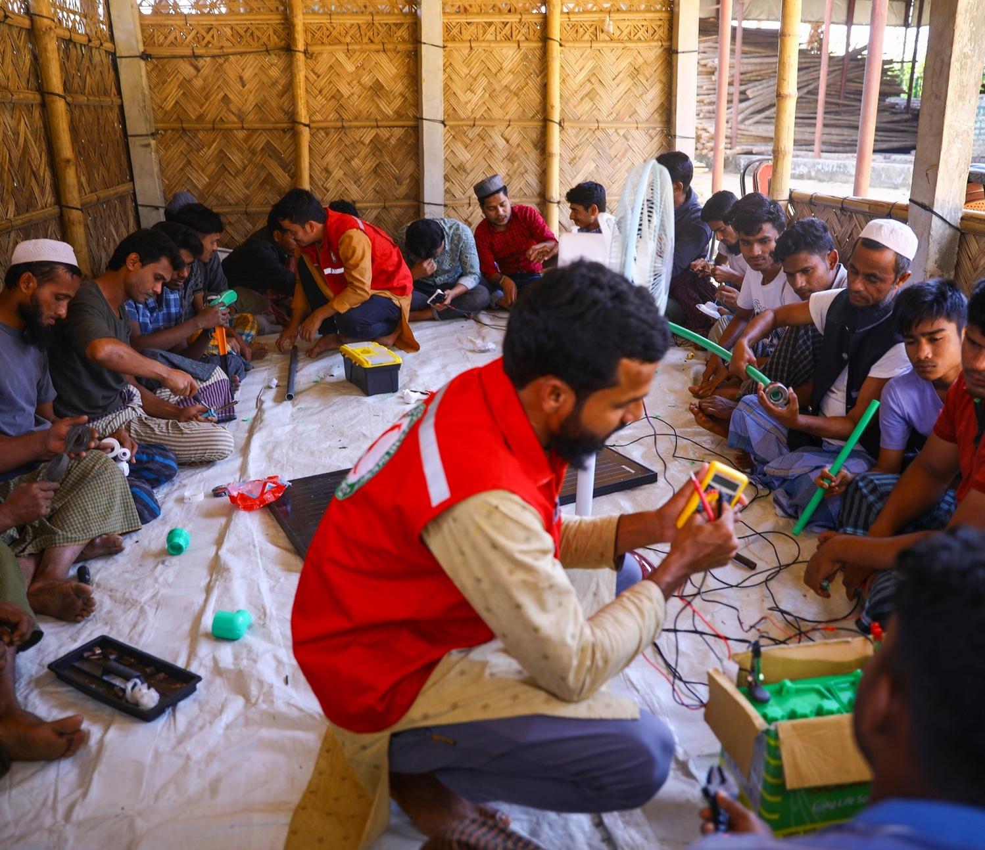
Bangladesh Red Crescent Provides Vocational Training at Cox’s Bazaar Refugee Camp
As part of its work to improve the livelihoods of refugees in Cox’s Bazaar, the Bangladesh Red Crescent is offering vocational training, teaching people how to repair gas stoves, solar panels, plumbing and electrical equipment.
After completing the training, participants go home with a toolbox, equipped with skills to build and maintain infrastructure around the camp.
A member of the Bangladesh Red Crescent trains refugees in repairing different equipment.

Slide 17

Saving Lives Through
Blood Services

Slide 18


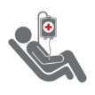
Blood Services Impact
The Red Cross ensures people in need receive safe blood
on a remarkable scale. In FY25-Q3:*
1 million
blood donors engaged
48,100
blood drives hosted
1.5 million
units of blood collected
15 million
tests conducted
1.6 million
blood products delivered
FY25 Totals
2 million
147,600
4.5 million
45 million
4.8 million
*Jan 1 – Mar. 31, 2025

Slide 19

Red Cross Provided Free A1C Testing for Blood Donors in March
“Advancing community health is a natural extension of the
Red Cross mission to alleviate human suffering.”
Dr. Pampee Young, Chief Medical Officer,
American Red Cross
One-third of people lack access to regular primary care in the U.S., where diabetes affects 1 in 10 people and nearly a quarter of those living with it have been undiagnosed.* To help address this gap in access to health care, the Red Cross performed free A1C screening — commonly used to screen for prediabetes and diabetes — on successful blood, platelet and plasma donations in March. Throughout the month, the Red Cross empowered 397,000 blood donors with valuable information to maintain their health, including nearly 72,000 whose tests resulted in diabetic or pre-diabetic levels.
*Centers for Disease Control and Prevention

Slide 20
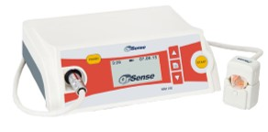
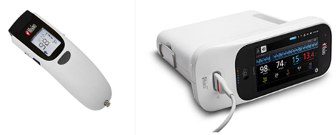
Improving the Blood Donation Experience: Health Screenings
Since January, the Red Cross has begun utilizing new health screening devices, which will be used at all blood drives nationwide by June 2025.
Changes include:
Eliminating the finger stick — a common concern for blood donors — by utilizing an FDA-approved ring-shaped sensor fitted onto a donor’s finger to measure hemoglobin.
Automated devices to measure temperature, blood pressure and pulse rate.
OrSense noninvasive
hemoglobin sensor
Masimo health screening device
The Impact:
Improved blood donor experience by reducing discomfort.
Faster health screening process, from 3 minutes and 34 seconds to just 2 minutes and 19 seconds on average.
Fewer disposable medical supplies.

Slide 21

Celebrating and Supporting Sickle Cell Warriors During Black History Month
“Blood donations save lives…[they] help me to not be in constant pain...We absolutely need blood donations. That is how
we survive.”
Keiosha Pinckey and Erykah Weldon, sickle cell warriors who rely on regular blood donations
During February, Black History Month, the Red Cross highlighted stories of sickle cell warriors like Keiosha Pinckey and her niece, Erykah Weldon, who both live with this painful and life-threatening disease. With the help of blood transfusions, Keiosha and Erykah live fulfilling lives. The Red Cross's Sickle Cell Initiative works to increase blood donations from the Black community, as one in three African American blood donors is a match for people with sickle cell disease. Since the start of Fiscal Year 2025, the Red Cross collected 104,000 units for people with sickle cell disease, which is on target to reach our annual goal of 134,000 units.

Slide 22

Supporting Military and Veteran Families

Slide 23


Military Support Impact
In FY25-Q3*, more than 8,240 compassionate Red Cross Service to the Armed Forces workers have provided critical services in lockstep with our partners.
46,580
new members and relatives learned about Red Cross services
109,210
care and therapy items distributed at medical facilities
102,830
hospitalized people helped through
rehabilitation and morale programs
20,310
military families supported through personal crises
FY25 Totals
171,760
377,970
403,730
67,090
*Jan 1 – Mar 31, 2025

Slide 24
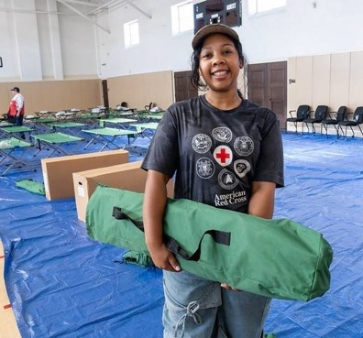
Supporting Veterans During the California Wildfires
“Veterans are easily overlooked, especially in emergencies. We have a significant number that are already experiencing homelessness. Providing a sense of safety and security for them is crucial.”
Aspyn Adams,
Service to the Armed Forces program specialist
When devastating wildfires broke out in Los Angeles, the Red Cross provided special services to meet the needs of impacted veterans, in addition to our typical disaster relief services. To help veterans face the chaos caused by these wildfires, we offered a workshop about building resilience, coping mechanisms and communication skills. We also partnered with Crisis Response Canines to bring in dogs specially trained to comfort people facing stressful situations.

Slide 25

Training for the
Moments That Matter

Slide 26



Training Services Impact
In FY25-Q3,* we have equipped community members to help neighbors, friends and family members with vital skills:
779,420
people trained in First Aid, CPR and AED, making every community safer
745,000
people learned how to be safe in, on and around the water through our Aquatics and Water Safety training
17,390
individuals trained in caregiving courses, empowering participants to provide quality care to people of all ages
FY25 Totals
2,173,440
1,154,730
51,380
*Jan 1 – Mar. 31, 2025

Slide 27
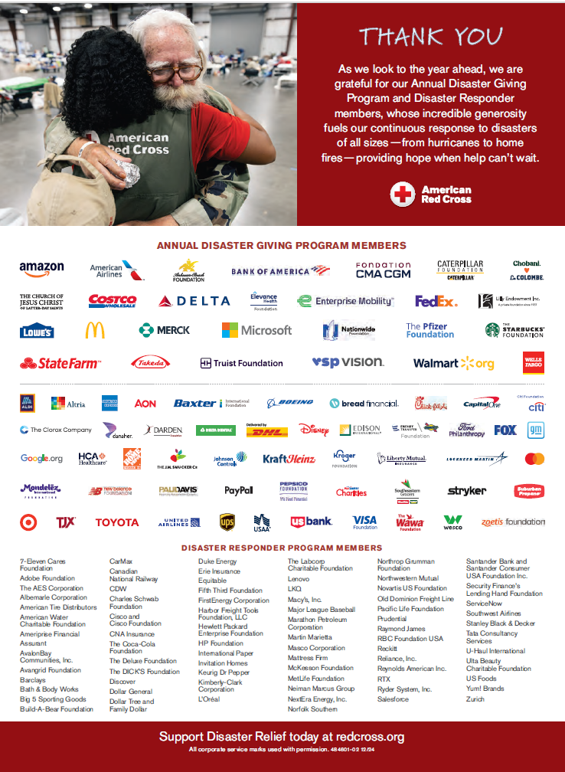
Your Benefits and Resources
We were pleased to provide valuable recognition and engagement this quarter:
Acknowledged in 30 Disaster Information Update emails to key supporters.
Recognized in a full-page Businessweek print ad in January.
Invited to our exclusive Disaster Leadership call sharing our response to the California Wildfires on January 10.
Provided with template communications materials, including social posts and content that aligned with timely messaging around National Blood Donor Month in January and Turn and Test and Red Cross Month in March.
Featured in four Red Cross stories on redcross.org with over 268K pageviews.
Provided with an exclusive ADGP Calendar Year 2024 Partner Update report.

Slide 28
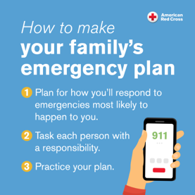
Prepare Today!
In an emergency, every second counts — that’s why it’s essential to be prepared. This is true now more than ever as disasters are becoming more frequent and intense.
Together with partners, the Red Cross stands ready to bring help and hope in times of dire need. And it’s critical that communities and families are prepared to face unexpected crises as well.
As we look toward the busy summer months — including the start of hurricane season on June 1 — we encourage you to prepare for disasters big and small. Visit the ADGP Membership Hub or redcross.org for preparedness communication resources to help you and your loved ones stay safe.

Slide 29


