Slide 1
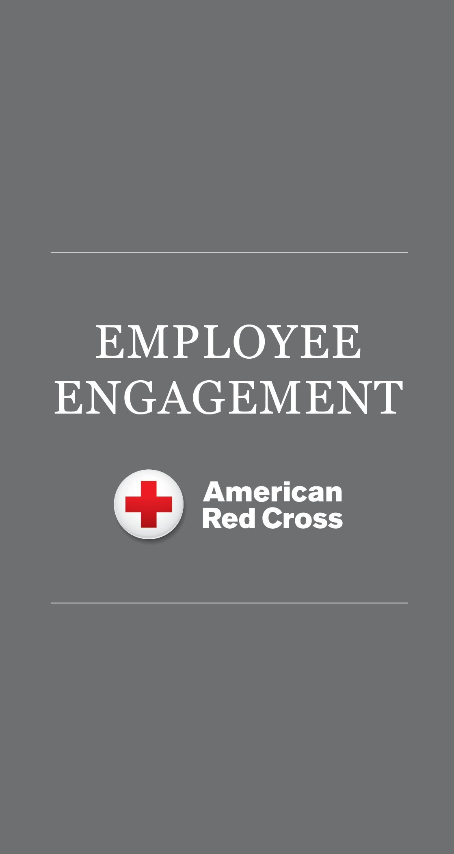
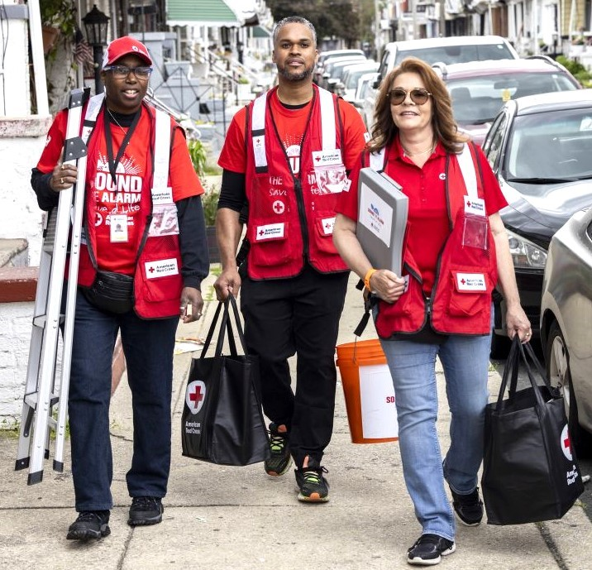

Slide 3
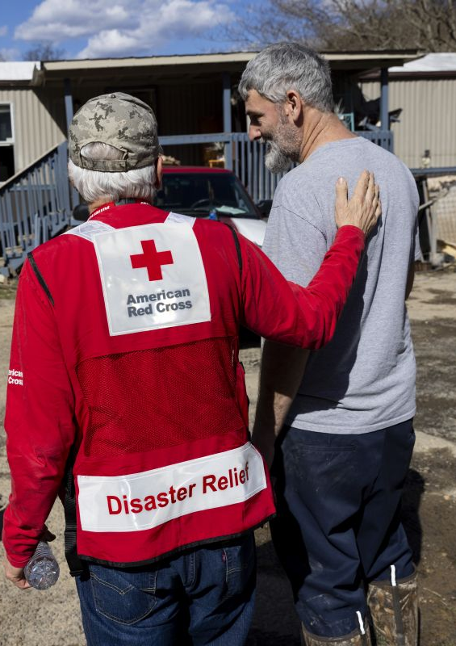





We Alleviate Suffering for Thousands Every Day
Helping a family affected by a home fire or other disaster about 165 times.
Collecting more than 13,000 blood donations to help people facing medical crises.
Providing about 173 emergency communications cases to military members, veterans and their families.
Delivering measles and rubella vaccinations to nearly 350,000 children worldwide.
Training about 16,000 people in lifesaving skills.
90¢
of every dollar we spend delivers care
90%
of our workforce is volunteer

Slide 4

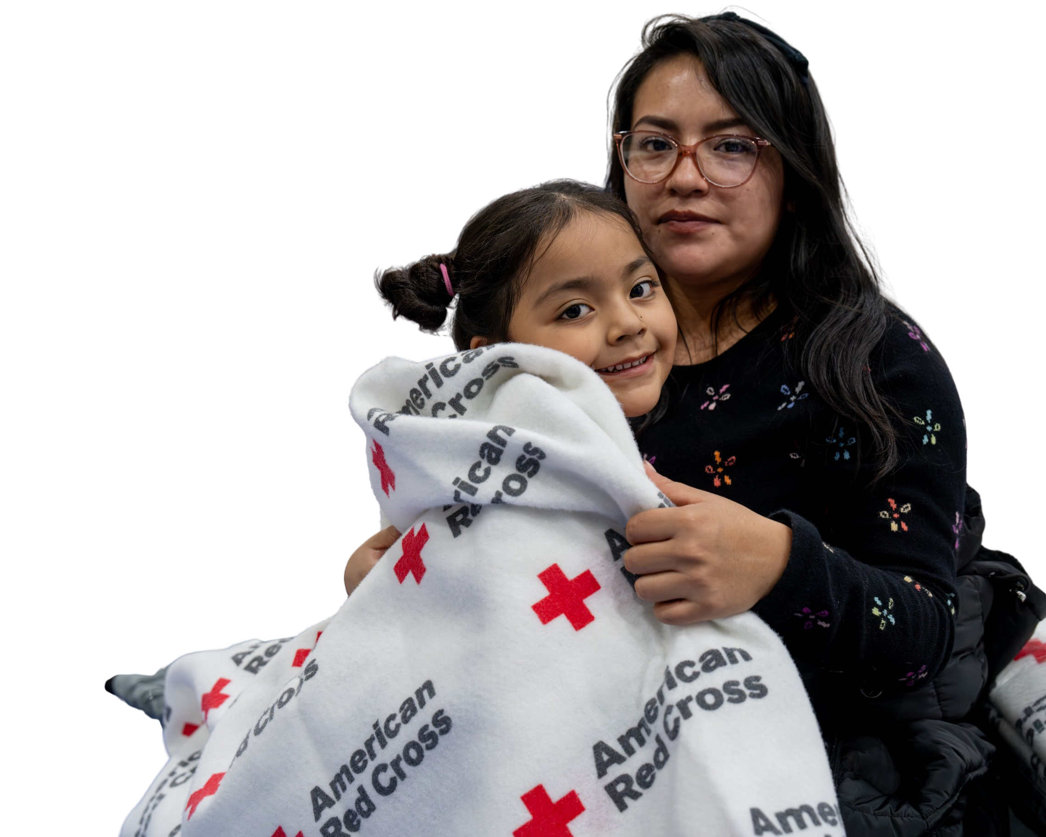

American Red Cross is one of the nation’s most trusted nonprofits.
A top charity in demonstrating community impact.
One of the most favorable brands* among U.S. adults.
Among the nonprofits with the most reported buzz.
*Among nonprofit brands.
Morning Consult, Brand Intelligence Oct-Dec 2025.
Morning Consult “Most Trusted Nonprofits.” Fall 2025.

Slide 5
Employee Engagement Trends and Insights

Slide 6
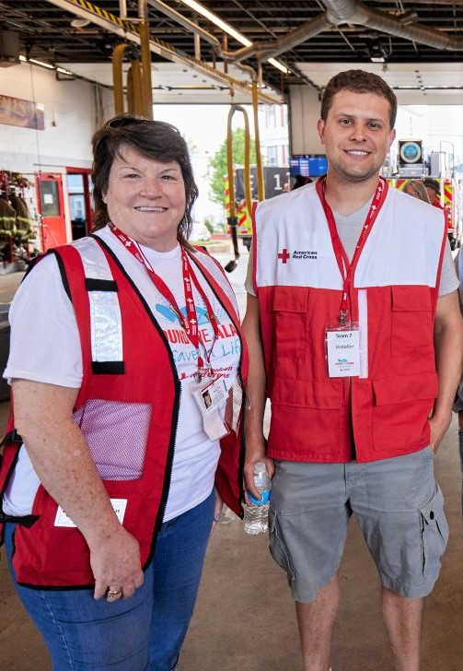
Employee Engagement and Volunteer Trends
Employee volunteering is on the rise, with 77% of companies reporting increased participation in 2024 and 87% of employees saying volunteer opportunities influence their decision to stay or join a company.¹
Employee experience is a primary focus of volunteering and giving, with companies wanting programs to be as engaging as possible.
Personalization drives volunteer participation with skills-based volunteering and personal connections inspiring employees to get involved.
Flexibility and support are critical to employee engagement success.
¹ Benevity: The State of Corporate Volunteering (2024), Deloitte: U.S. Workplace Volunteer Surey, June 2024.

Slide 7
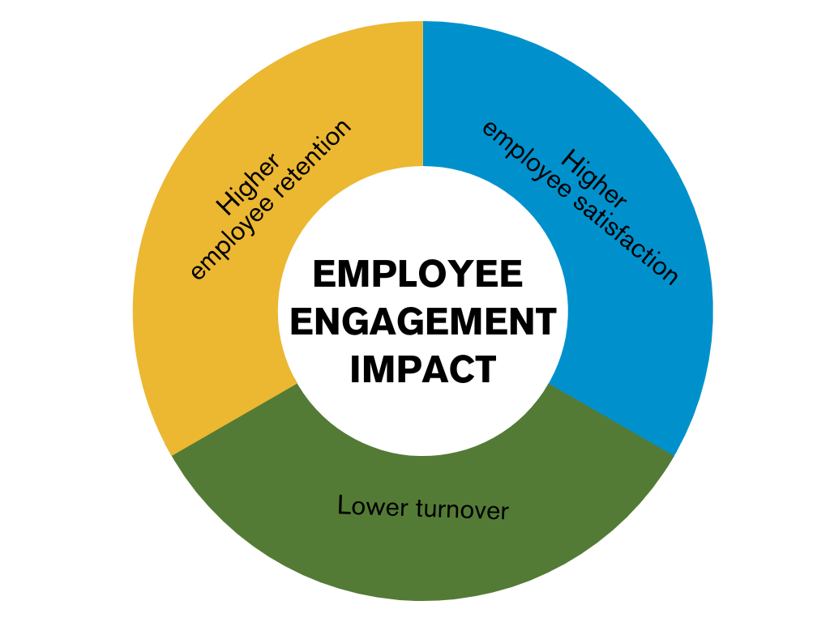
Employee Engagement Matters
Corporate partners that leverage employee engagement with their workforce show higher employee retention, lower turnover and greater employee satisfaction within their workplace.
Among U.S. employees who volunteer:
91% say such opportunities positively affect their work experience and connection to employer.
56% report increased fulfillment
55% stronger community ties
52% higher morale/team cohesion
49% pride in their employer.
The American Red Cross has demonstrated strong employee engagement opportunities. We can work with you to meet your employee engagement objectives.
Philanthropy, Purpose and Professional Development: Why Workplace Volunteer Programs Matter 2023, Ares Management Corporation and Edge Research

Slide 8
Employee Engagement at the Red Cross

Slide 9
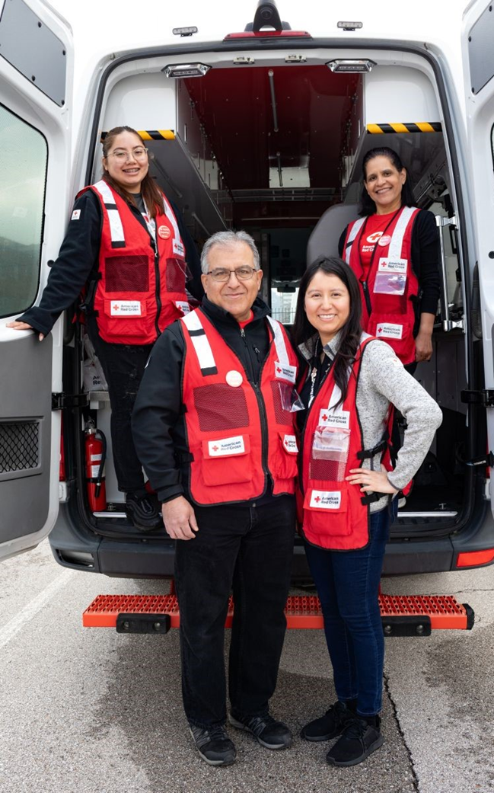
Partner with Us
When you align with us, you show your employees they don’t need to leave their hearts at home. Our employee engagement opportunities help you strengthen your workforce by building camaraderie, inspiring unity and fostering workplace satisfaction.
Our Employee Engagement Program:
Offers educational and volunteer engagement opportunities.
Provides local, national, in-person and virtual options.
Connects you with a dedicated national employee engagement team.
Features approximately 230 chapters and regional volunteer leads to help you navigate local opportunities.

Slide 10
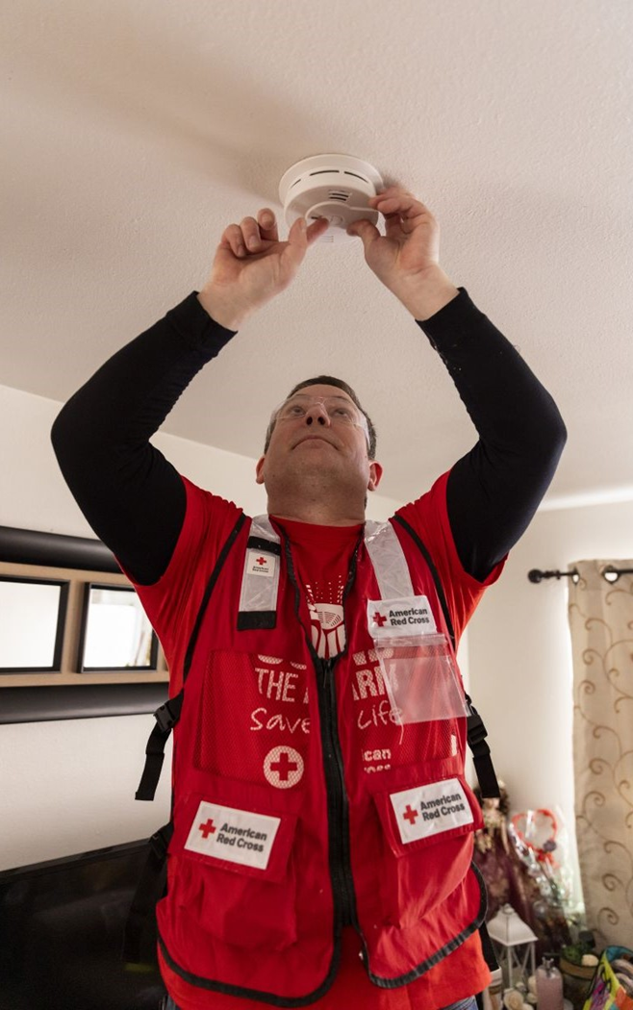
Learn, Volunteer, Make a Life-Changing Difference
Provide your employees with a rewarding educational or volunteer experience that inspires good feelings about your company’s mission and values.
Preparedness Education:
Targeted disaster education and lifesaving training classes for groups of any size.
In-person or virtual sessions led by skilled Red Cross facilitators.
Volunteer Engagement:
Individual or group volunteer opportunities.
In-person or virtual options and accommodations for varying time frames and team sizes.

Slide 11
Employee Engagement Steps to Success*
WEEK 12
WEEK 11
WEEK 10
WEEK 9
WEEK 8
WEEK 7
WEEK 6
WEEK 5
WEEK 4
WEEK 3
WEEK 2
WEEK 1
EVENT
12 Weeks Prior
Connect
with your relationship manager to discuss engagement opportunities at least 12 weeks prior to desired event date.
10 Weeks Prior
Create
invitations, promotional emails and run of show
10 weeks prior to your event.
6 Weeks Prior
Appoint
facilitators and any additional support members six weeks prior to your event.
4 Weeks Prior
Increase
promotion and recruitment four weeks prior to the event to inspire as much interest and participation as possible.
EVENT
Enjoy
watching your team learn and bond as they serve the community through your Red Cross partnership!
*NOTE: This is a sample timeline only. Actual timeline may vary depending upon the engagement selected.

Slide 12
Employee Engagement Opportunities

Slide 13


Disaster Employee Engagement Volunteer Offerings
RED CROSS DISASTER VOLUNTEERISM
EVENT |  | IMPLEMENTATION TIMING | KEY INFORMATION
 | DISASTER EVENT BASED In Person When disasters strike, the Red Cross responds immediately, sending trained volunteers to affected areas. This role primarily supports shelter, mass care and feeding services. | One-time volunteer opportunity limited to large disaster operations. | 4- to 8-hour shifts available within 60 miles of impacted community. Materials provided in advance; training is provided on-site.
 | DISASTER ACTION TEAM In Person or Virtual With training, your employees can serve as a Red Cross Disaster Action Team member, providing immediate services with compassion, comfort and care to those impacted by disaster. | Takes 4 to 6 weeks to implement. | A facilitator will be provided by the Red Cross. Interested volunteers will be directly connected to their region.
 | COORDINATED DISASTER DEPLOYMENT In Person Following a major disaster, if there is significant need, $250k+ members are among the first invited to identify employees to deploy and support the Red Cross by delivering critical services over a weeklong period. | Takes 2 to 3 weeks depending on deployment confirmation. | Opportunity available only to partners at $250K or above. Deployment is dependent on operational need. Volunteers provided with training in advance of deployment.
 | SOUND THE ALARM FOR HOME FIRE* In Person or Virtual Home fires are the nation’s biggest disaster threat. Your employees can volunteer at an in-person smoke alarm installation event. | Connected to already existing events. Opportunity based on event schedule. | Volunteer installation and educational opportunities are available. Installation events accommodate groups of 10 to 15 and take up to four hours to implement. All training and supplies are provided for volunteers on event day.
*Spanish language available.
13

Slide 14
Mission Employee Engagement Offerings
RED CROSS MISSION ENGAGEMENT
EVENT |  | IMPLEMENTATION TIMING | KEY INFORMATION
 | KIT BUILDS** In Person During a kit build session, your employees assemble their own preparedness or first aid kits using provided materials. | Allow at least 4 weeks to submit and complete order. | Accommodates groups of varying size. 3 types of kits are available for purchase: Service to the Armed Forces, First Aid and Emergency.
 | MAPSWIPE In Person or Virtual During MapSwipe missions, employees complete brief tasks to make mapping more efficient and improve the overall data quality in OpenStreetMap (OSM). | Takes 4 to 6 weeks to implement. | Validate completed mapping in vulnerable populations. Requires participants to download app. Easy to navigate and begin.
 | SERVICE TO THE ARMED FORCES In Person or Virtual Engage employees in the Service to Armed Forces mission through educational sessions, behavioral health workshops, kit builds and volunteerism. | 6 weeks to implement. | Align your engagement with education and information through lunch and learns and behavioral health sessions. Kit builds accommodate a varying group size. Regional event and tour opportunities based on chapter need.
 | BLOOD SERVICES In Person or Virtual Engage employees in lifesaving Red Cross Blood Services through in-person or virtual blood drives, lunch and learn educational sessions and volunteerism. | Up to 3 months, depending upon the opportunity. | Align your engagement with in-person or virtual blood drives, education through lunch and learns, and volunteering.
*Spanish language available. ** Cost associated with purchase of kit build materials through our vendor.
14

Slide 15
Health and Safety Employee Education Offerings
RED CROSS HEALTH AND SAFETY EDUCATION
EVENT |  | IMPLEMENTATION TIMING | KEY INFORMATION
 | BE RED CROSS READY* In Person or Virtual Select from modules presented by trained Red Cross instructors to educate your employees on 13 different hazards. | Takes 4 to 6 weeks to implement. | Facilitator provided by Red Cross. Presentation can be completed in 30 to 60 minutes. 15 Disaster Preparedness modules to choose from. Group size can vary from 10 to 1,000.
 | HANDS-ONLY CPR* In Person or Virtual Your employees can learn the “Hands Only” CPR method (no mouth-to-mouth contact or counting involved) during a high-energy 30-minute training that makes everyone in your workplace and community safer. | Takes 4 to 6 weeks to implement. | Facilitator provided by Red Cross (1 facilitator per 25 volunteers needed for this program). Presentation can be completed in 30 to 60 minutes.
 | RED CROSS SPEAKERS In Person or Virtual Host a 30- to 60-minute digital presentation featuring local Red Cross leaders who can speak about our work in your community, across the nation and around the world. | Takes 4 to 6 weeks to implement. | Accommodates groups of varying size. Presentation completed in 45 - 60 minutes. Variety of topics available to engage participants.
*Spanish language available.
15

Slide 16
Preparedness Education

Slide 17
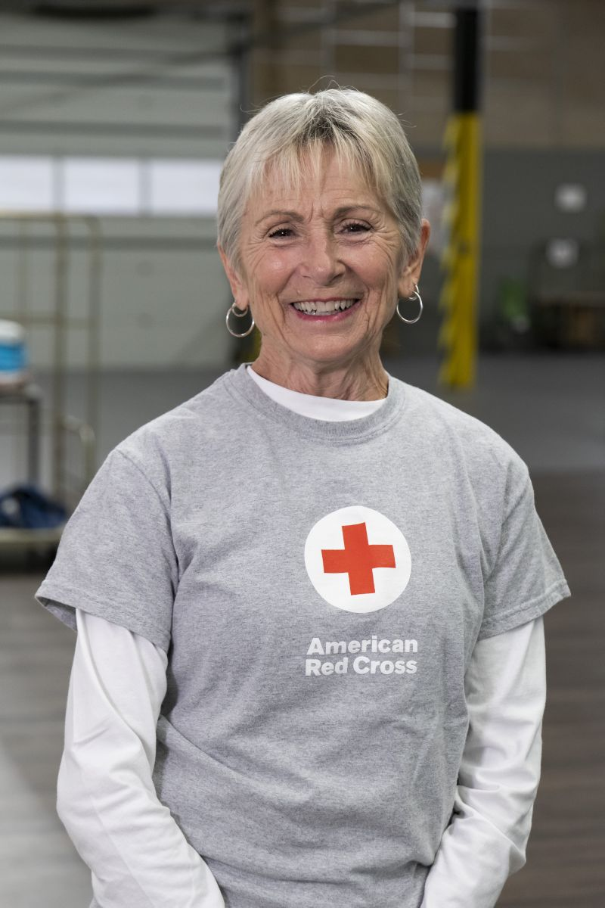
Be Red Cross Ready
Preparing now can make a lifesaving difference when a disaster strikes.
Educational sessions can be in-person or virtual and include information on how to prepare for, respond to and recover from disasters.
Select from 15 different modules presented by trained Red Crossers in 30 - 60 minutes.
Educate your employees on hazards ranging from earthquakes to home fires.
Learn why preparation is critical and build confidence in your ability to navigate emergencies.

Slide 18
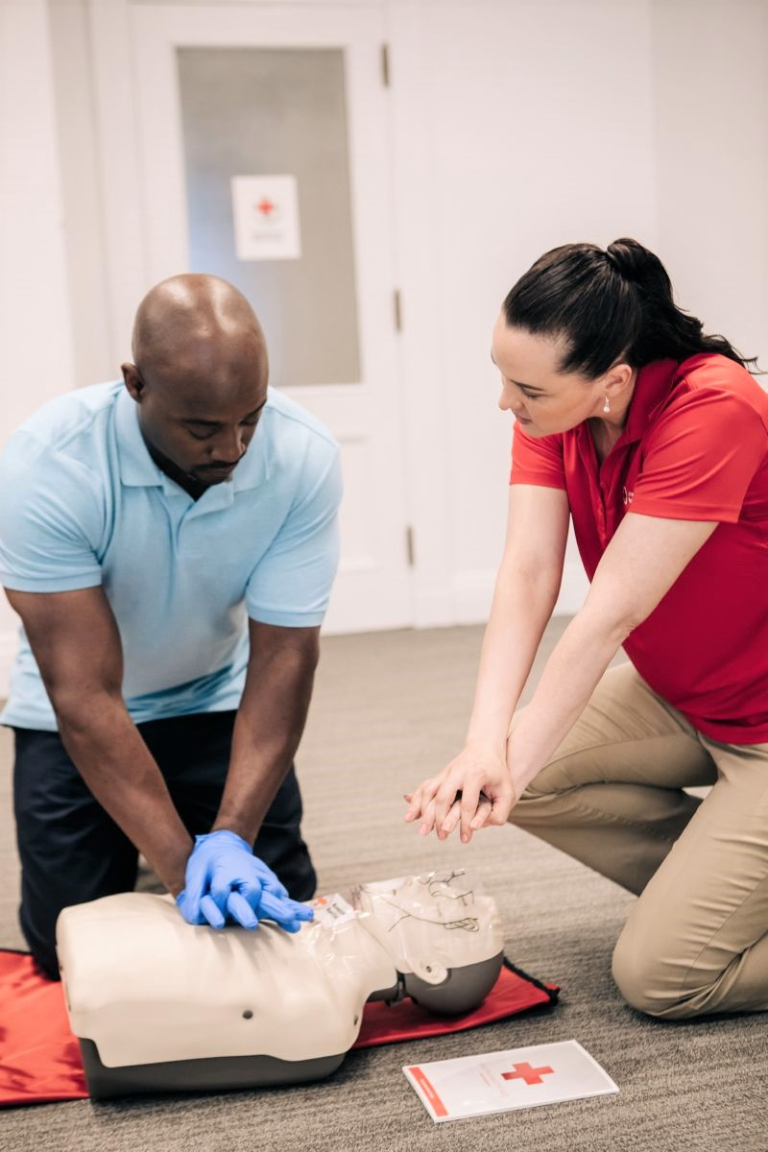
Hands-Only CPR
We all know CPR saves lives, but did you know it’s now easier to do than ever?
With the new hands-only technique, no mouth-to-mouth contact or counting is involved. For employees like yours, this new method provides a high-energy activity that makes everyone in your workplace and community safer.
Training includes:
Live CPR instructional sessions that can be hosted virtually or in-person.
Customizable sessions last between 30 and 60 minutes.

Slide 19
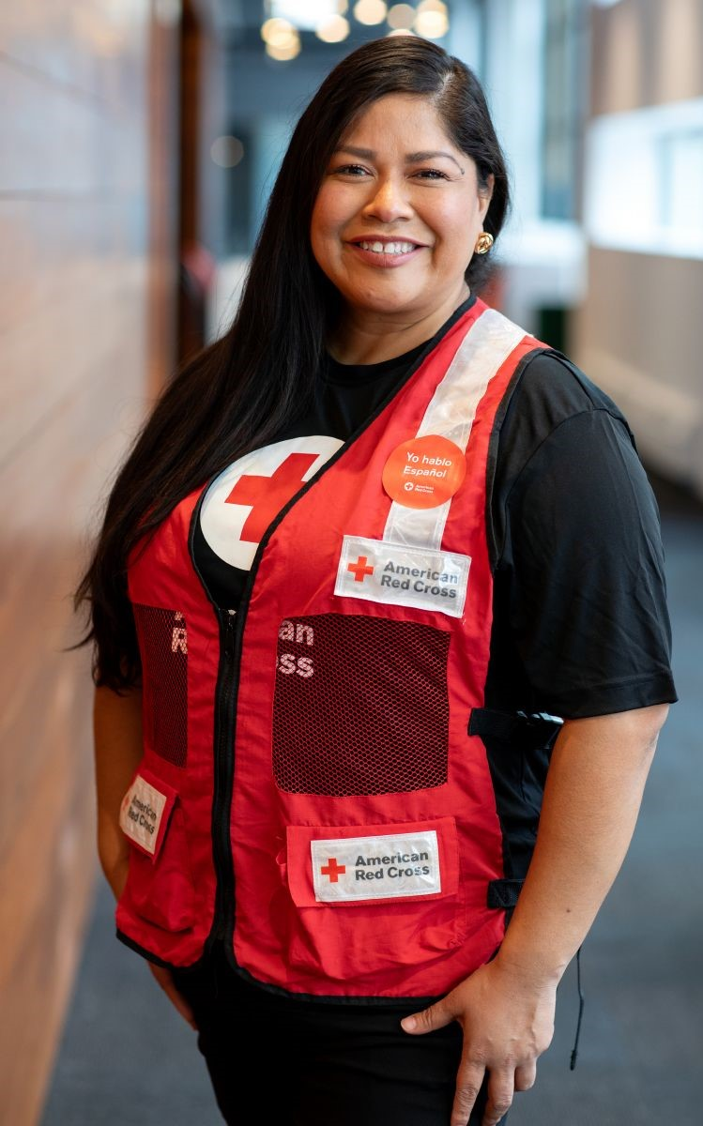
Red Cross Speaker Series
During a live Lunch & Learn session, a Red Cross regional executive, disaster preparedness manager or other leader educates your employees about our lifesaving mission, focusing on local, national or global efforts and events.
Presentations can be:
Held virtually or in-person, with sessions lasting approximately 60 minutes.
Scheduled during lunch hour or appropriate shift changes.
Customized to meet specific employee interests.

Slide 20
Volunteerism

Slide 21
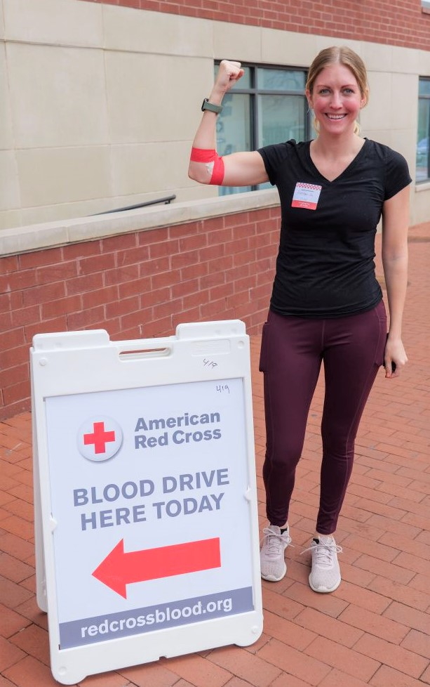
Blood Drives
Every two seconds, someone in the U.S. needs blood and generous blood donors are the only source.
When you sponsor an on-site blood drive, you provide your employees with an act of service that has the potential to save lives.
Host a drive at your facility or coordinate a bloodmobile. This in-person event lasts approximately five hours. However, all it takes to donate blood is 60 minutes.
Increase your impact by inviting your customers or vendors, as well as employees, to participate in or host a blood drive of their own.

Slide 22
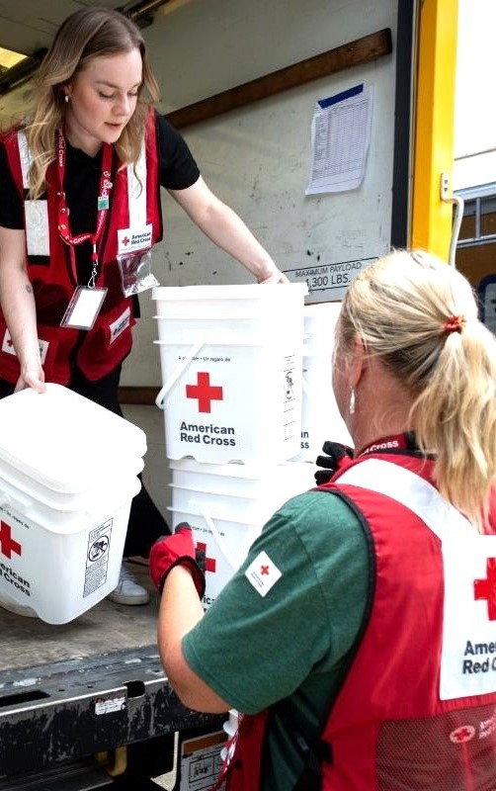
Coordinated Disaster Deployment
NOTE: This opportunity is available ONLY to partners at $250K or above. **Delete this box.**
When disasters strike, the Red Cross responds immediately, sending trained staff and volunteers to affected areas.
If there is significant need, your employees can help deliver critical services by:
Deploying to a major disaster anywhere in the country.*
Committing to a 7- to 14-day experience with an average daily shift of 10 hours.
Providing food, shelter, relief supplies, recovery planning and other assistance.
Training in advance of deployment.
*Deployment is dependent on operational need.

Slide 23
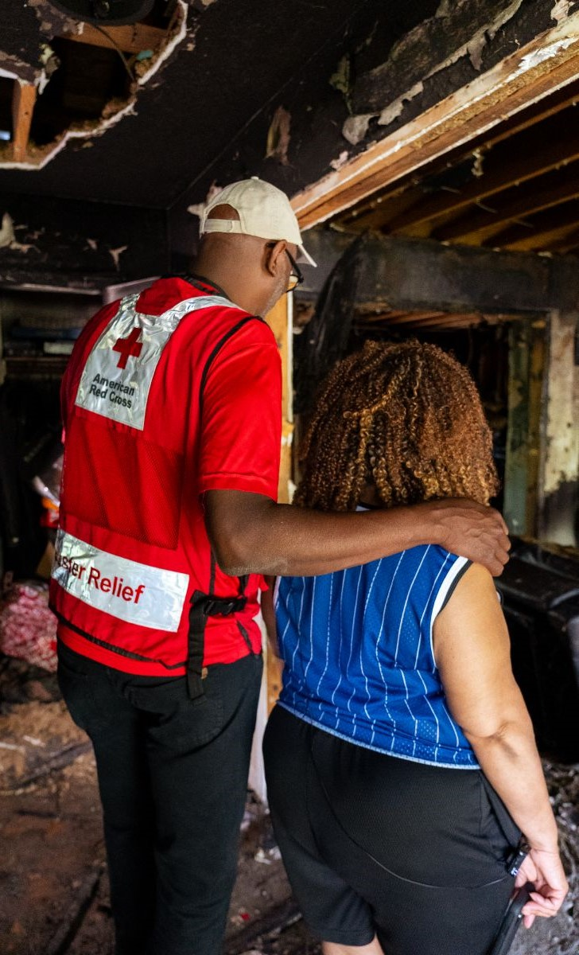
Disaster Action Team
About 165 times a day, the Red Cross responds to disasters of all sizes, including home fires.
As a part of our Disaster Action Team, volunteers provide immediate compassionate support to those in need, including:
Prompt contact and explanation of Red Cross assistance.
Immediate financial assistance for temporary lodging and other disaster-caused needs.
Distribution of relief supplies.
Initial recovery assistance, including referrals for disaster-related health, mental health, spiritual care and disability integration assistance.

Slide 24
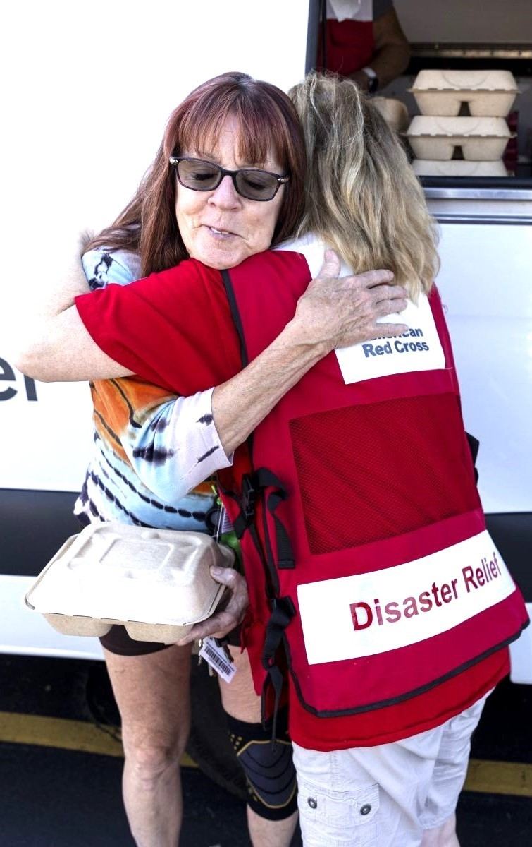
Disaster Event-Based
Disaster deployment offers a unique chance to make a profound impact when communities need it most.
Your employees can turn compassion into action by providing comfort, delivering lifesaving assistance and helping families recover after crises.
Help during large-scale disasters, with travel limited to within 60 miles of impacted area.
Volunteer for shifts of four to eight hours each.
Undergo training on-site.
Support shelter, feeding and mass care operations.

Slide 25
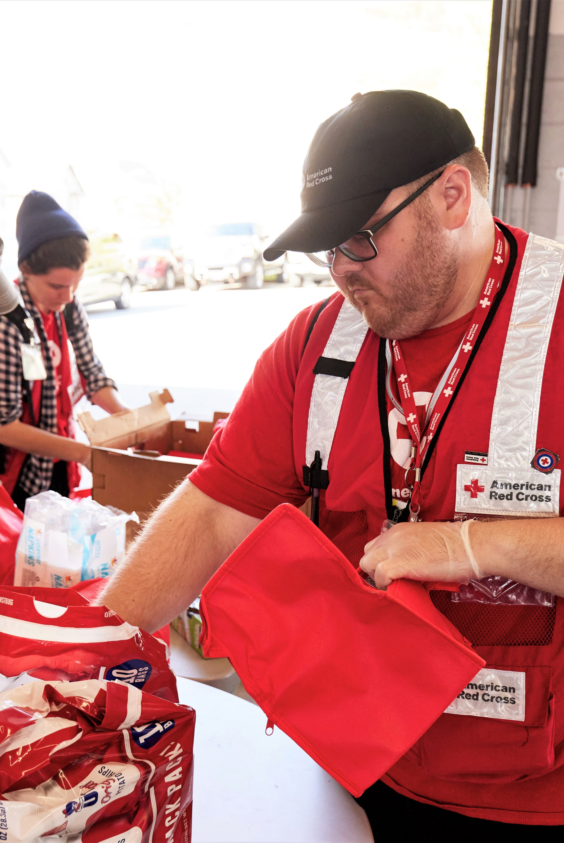
Kit Builds
Emergencies and disasters can strike suddenly — anytime and anywhere — but a preparedness kit can provide essentials needed to aid in a crisis.
During a kit build, your employees construct their own preparedness or first aid kits using provided materials, which they can take home or keep in the workplace.
Builds are in-person and can be hosted on-site or at your local Red Cross.
Sessions last approximately 60 minutes.
Kits can be customized for specific kinds of disasters.
Employees can either keep the kits for their own use or donate them to vulnerable communities.

Slide 26
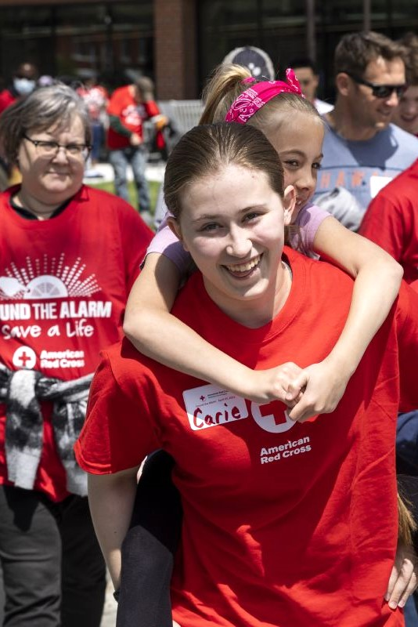
Sound the Alarm
Every day, eight people die in U.S. home fires, most in households that lack working smoke alarms.
The Red Cross implements a year-round canvassing effort called Sound the Alarm, through which we’ve installed millions of alarms nationwide and saved countless lives.
Sound the Alarm engagement activities are held in-person and virtually:
IN-PERSON EVENTS utilize participants to safely install smoke alarms, deliver home fire education and help develop escape plans.
VIRTUAL EVENTS include home fire preparedness education via a webinar and self-guided customizable online Pledge to Prepare.

Slide 27
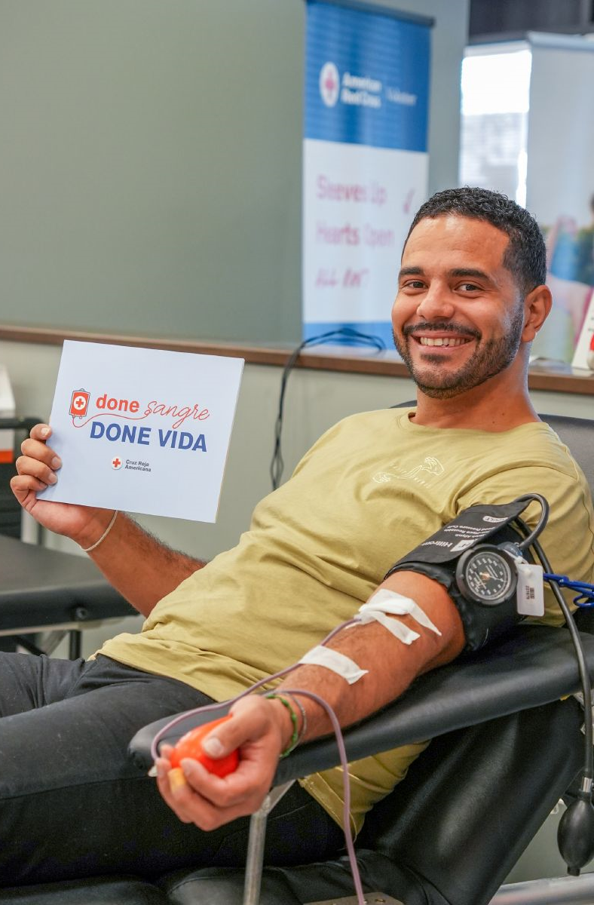
Virtual Blood Drives
For accident victims, people with cancer or genetic disorders like sickle cell, or anyone experiencing a health emergency, it can be a matter of life and death if we don’t have blood on the shelves before a crisis.
You can ensure blood is ready when and where it’s needed by hosting a virtual “Sleeves Up” blood donation campaign.
Our co-branded portal serves as your customized hub.
Length of campaign depends on your goals and needs.
Your employees can make a pledge, post photos of themselves donating blood and share the campaign with others via social media.

Slide 28
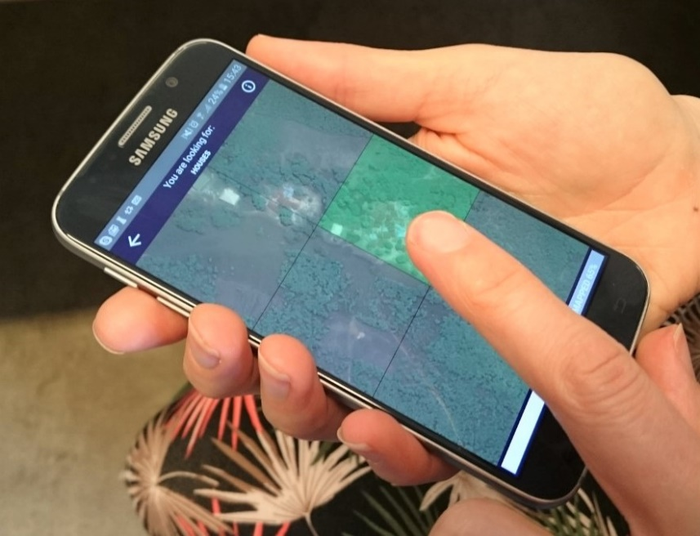
MapSwipe
Accurate maps play a critical role in understanding the disaster risks communities face. Putting in time and effort beforehand helps the Red Cross and other humanitarian organizations prepare and plan so we’re ready to respond when needed.
MapSwipe sessions are:
Held in-person or virtually and last approximately 60 minutes.
Easy to navigate and implement with the provided app.
Important for improving overall data quality in OpenStreetMap (OSM).

Slide 29
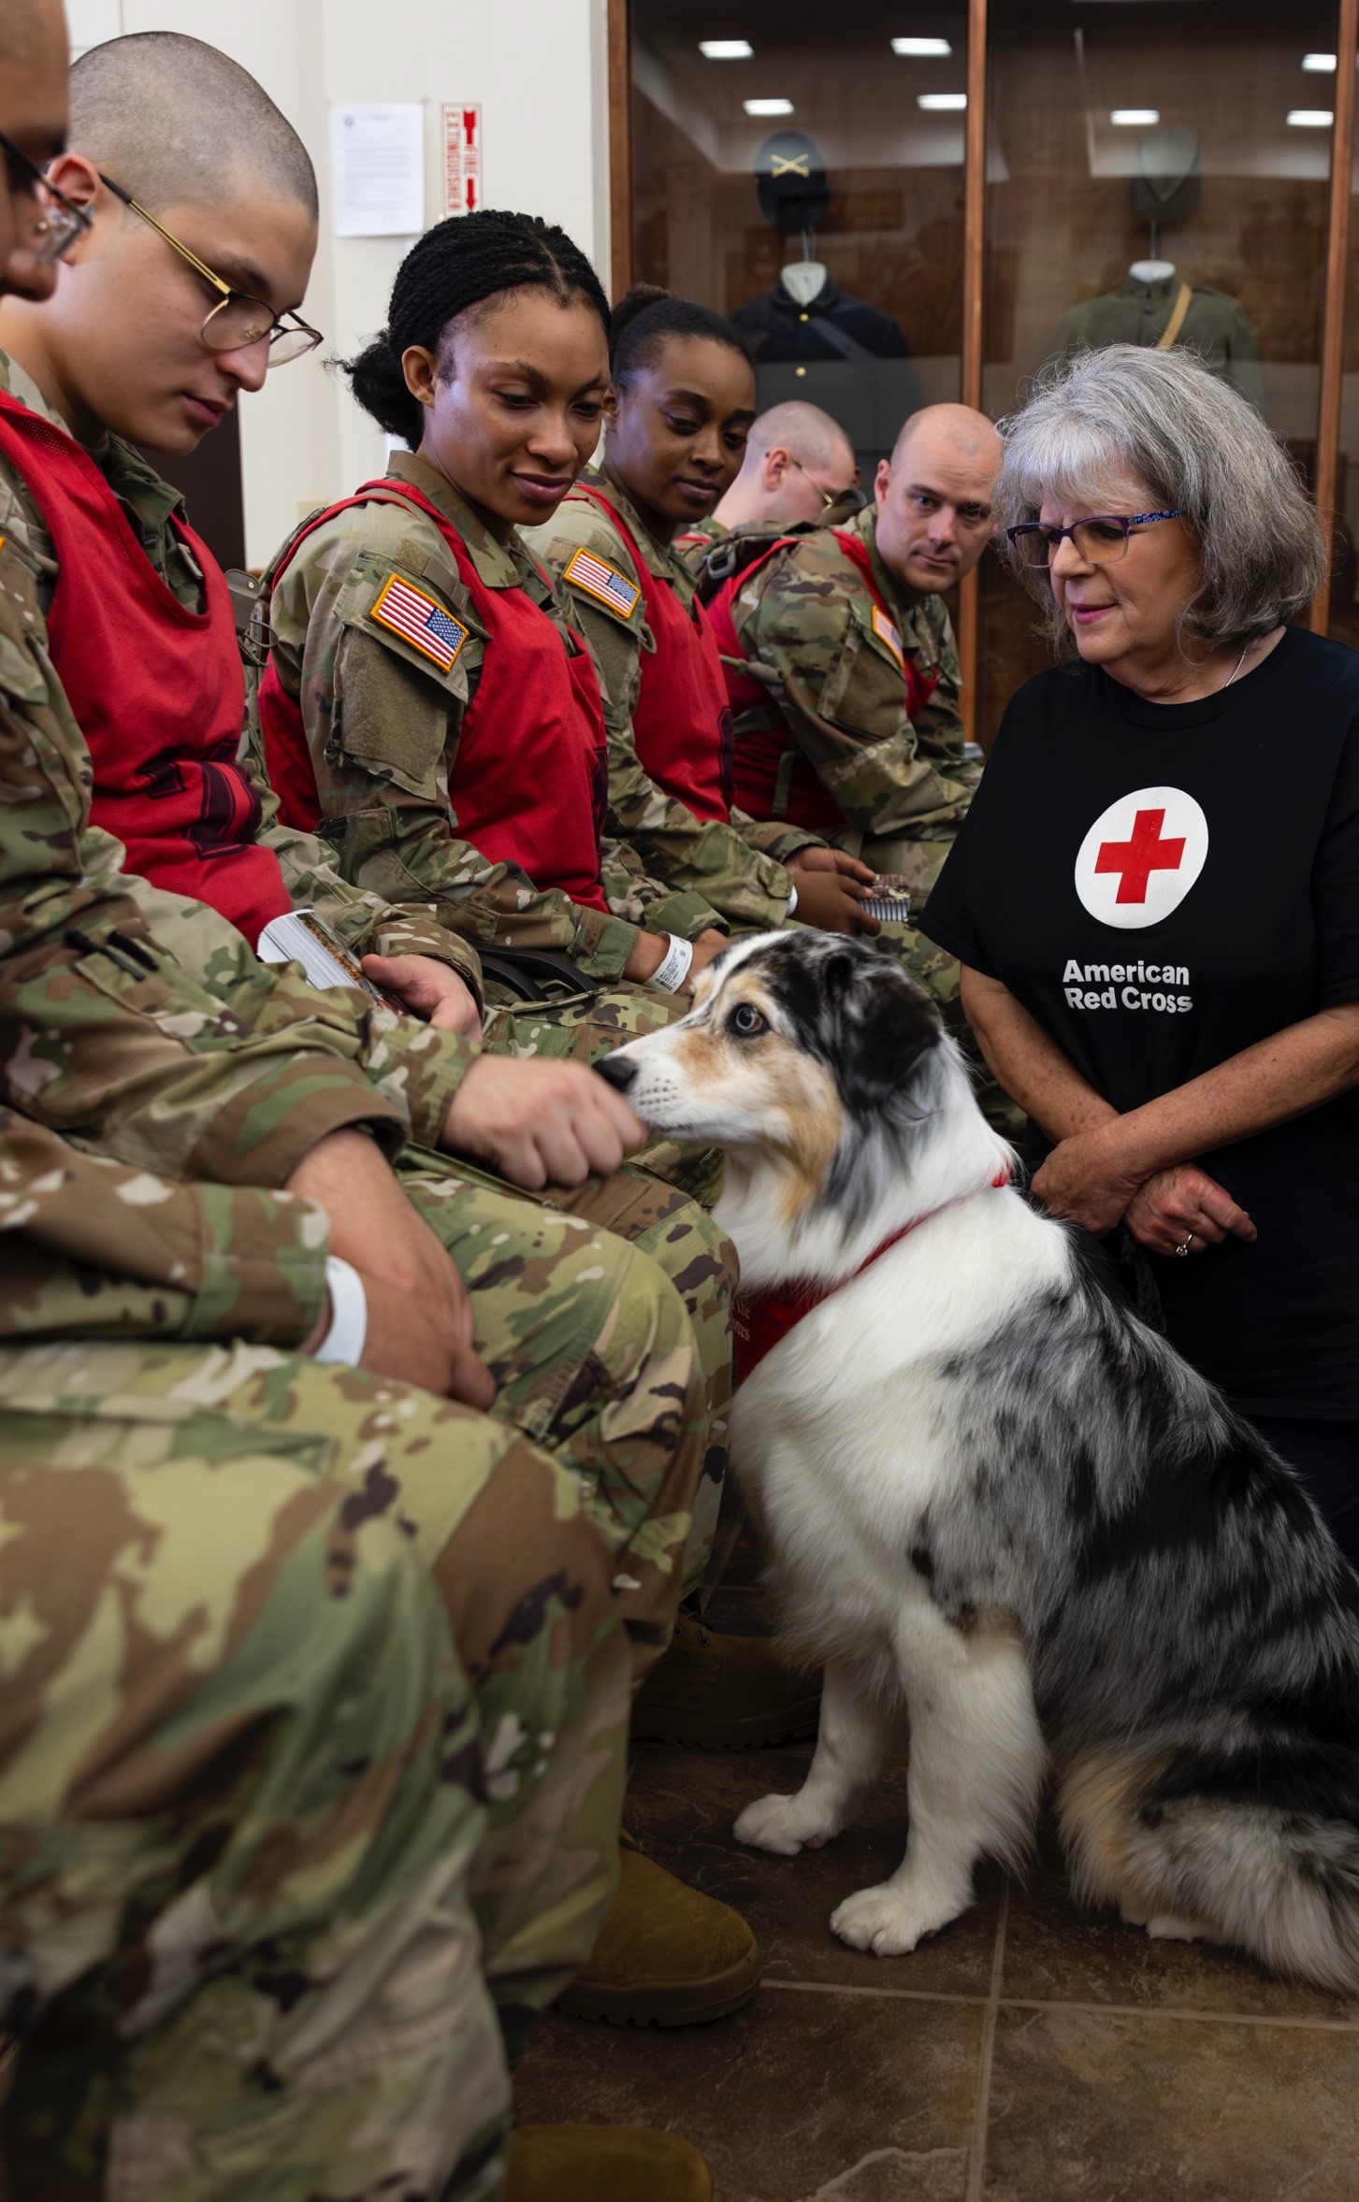
Service to the Armed Forces
The Red Cross Service to the Armed Forces program provides care and comfort to U.S. military members, veterans and their families around the world through the delivery of emergency aid, crisis communications, health support and comfort.
Inform your employees about SAF and engage them through:
Lunch and Learn Sessions
Behavioral Health Workshops
Kit Builds
Together, we can deliver hope, connection and strength when our service members and their families need it most.

Slide 30
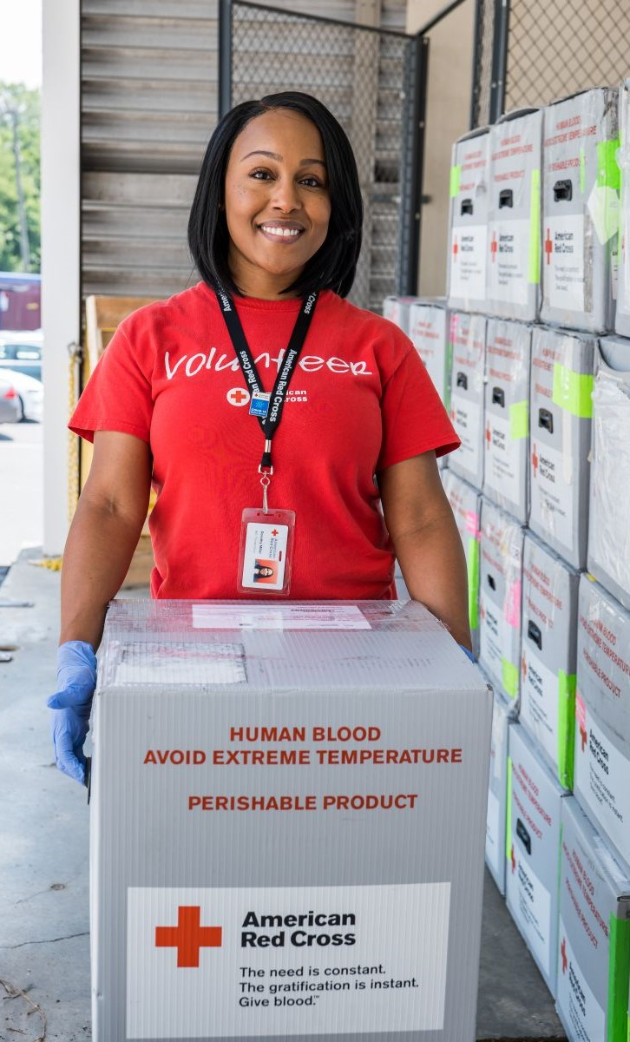
Volunteer Connection
Volunteer Connection is the American Red Cross online volunteer database available to our partners at all giving levels.
Volunteer Connection provides access to:
Opportunities available throughout the country, including one-time, long-term, in-person and virtual options.
Database searchable by zip code, interest, skills and most-needed positions.
Registration and sign-up for various activities.
Explore Red Cross volunteer opportunities or talk with your relationship manager about activities best suited for your team.

Slide 31

Next Steps: Let's Get Started
By implementing a Red Cross employee engagement opportunity, you expand your corporate social responsibility and give your employees an easy way to help one of their favorite charities. In turn, you strengthen your workforce by fostering enthusiasm and inspiring workplace satisfaction.
From blood donation to home fire safety, our employee engagement activities are easy to organize and launch. And, the best part, they save lives!
Ready to schedule a planning session? Connect with your Red Cross relationship manager and let's get started!

