Slide 1
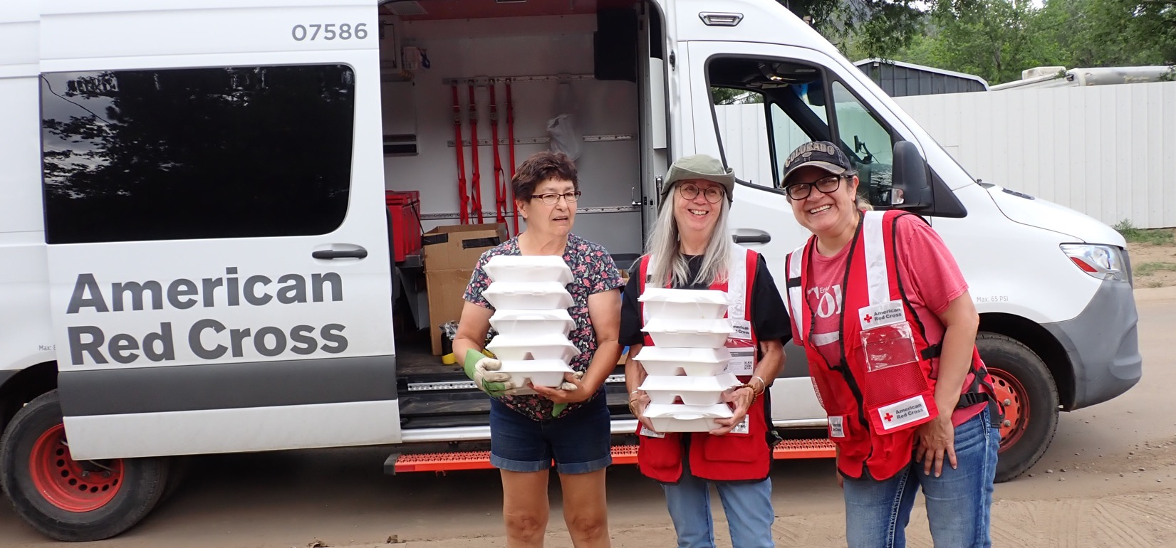
Quarterly Partnership Update
Fundraiser Guidance:
Insert company name and date.
Customize deck content based on donor’s giving history and/or interests.
Delete slides that are not relevant to donor.
If donor has primarily or exclusively supported Blood Saves Lives or Service to the Armed Forces, consider using one of the alternate covers at the back of this deck.
Delete this box.
FY26 Q1 (July – September 2025)

Slide 2

Alleviating Suffering Through Disaster Relief

Slide 3
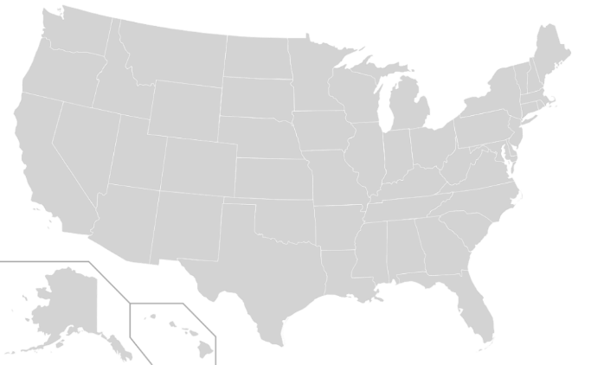
Red Cross Responded to 75 Big Disasters
Including 16 large and major responses listed chronologically:
Texas Floods (Level 5)
Tropical Storm Chantal, North Carolina (Level 3)
New Mexico Floods (Level 4)
Canada Wildfires (Level 3)
New Jersey Floods (Level 3)
Arizona Wildfire (Level 3)
Hawaii Tsunami Watch (Level 3)
Wisconsin Storms (Level 4)
Hurricane Erin, North Carolina (Level 3)
Houston, Texas Multifamily Fire (Level 3)
Hurricane Kiko (Level 3)
Hurricane Imelda, Georgia (Level 3)
Hurricane Imelda, North Carolina (Level 3)
Hurricane Imelda, South Caroline (Level 3)
Hurricane Imelda, Virginia (Level 3)
Hurricane Imelda, Florida (Level 3)
4
8
5
15
9
13
2
6
3
14
12
1
10
16
7
11
July 1 – September 30, 2025
“Big” includes domestic disaster operations with costs of $10,000+ (i.e., level 2 and higher).
“Large and major” includes domestic disaster operations with costs of $50,000+ (i.e., level 3 and higher).

Slide 4


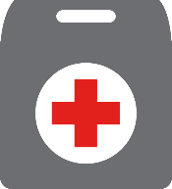

Domestic Disaster Response Impact
In FY26-Q1,* more than 2,700 Red Cross disaster workers provided
critical services in lockstep with our partners across the U.S.
155,700
meals and snacks served with partners
17,300​
overnight stays in emergency lodgings provided with partners
8,700
households provided relief items
3,870
households provided recovery support, including financial assistance
*July 1 – September 30, 2025
Includes domestic disaster operations with costs of $10,000+ (i.e., level 2 and higher).

Slide 5
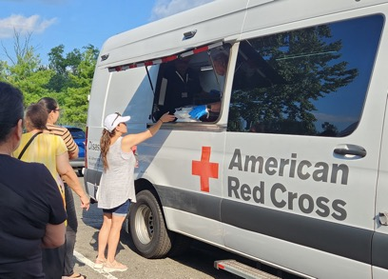
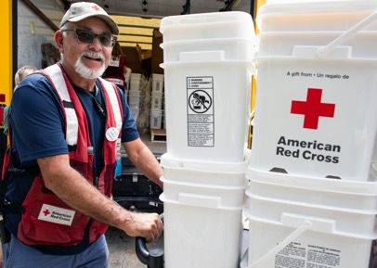
Responding to Large Disasters Across the U.S.
Thanks to your commitment, we could prepare for and respond immediately to urgent crises across the country when we were needed most.
July and August brought catastrophic flooding across urban communities in New Mexico, New Jersey, Texas and Wisconsin.
To help hard-hit residents, our teams:
Worked with partners to shelter and feed people forced from their homes.
Reached impacted residents with food, water, essential relief items and cleanup supplies, as well as recovery services, including financial assistance.
The Atlantic Hurricane Season is well underway. So far, we’ve seen four major hurricanes, but, fortunately, destruction has been limited. When tropical storms threatened communities, we have:
Supported safe shelter for displaced individuals and families.
Delivered meals, relief supplies, emotional support and basic health services.
Prepared for potential major threats by pre-positioning supplies and mobilizing staff.

Slide 6
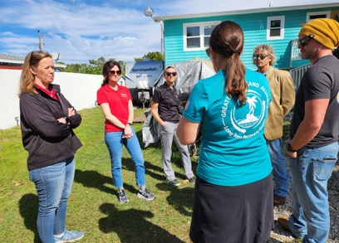
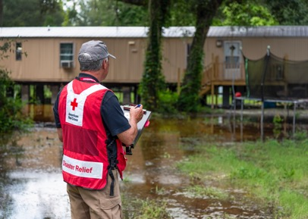
Providing Long-Term Recovery Support
Beyond our immediate response to support urgent needs, we also help communities and families recover in the months — and years — ahead.
Hurricanes Helene and Milton: Over a year since these massive storms struck, grants to community partners are supporting long-term recovery activities like home repair and rebuilding, mental health support, food security projects, debris removal, and much more. And, in addition to immediate assistance offered during the initial response, another $13.2 million in recovery assistance has been provided to more than 6,300 severely impacted households.
Texas Floods: Following tragic and destructive flooding that inundated central Texas on the 4th of July weekend, the Red Cross launched another round of financial assistance to assist Texas families as they continue to recover.

Slide 7
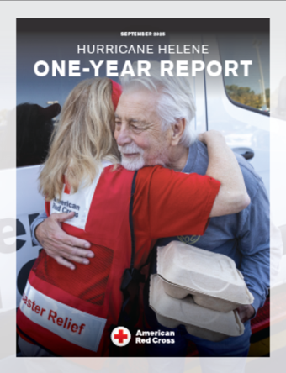
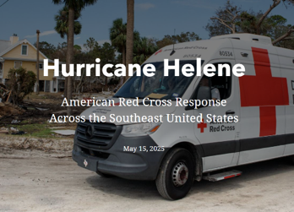
Hurricane Helene 1-Year Report
Hurricane Struck: September 2024
Hurricane Helene inundated homes in Florida and Georgia with high storm surge and torrential rains, while in the Appalachian Mountains of North Carolina and surrounding states, where tropical storm impacts are rare, entire neighborhoods were swept away. Some survivors escaped with little more than the clothes on their backs.
Our Response:
To learn more, visit:
Hurricane
Helene
1-Year Report
&
1-Year Later Video
Hurricane Helene Stewardship Story Map
As of August 26, 2025, the Red Cross had reached an estimated 473,100 people with disaster relief and recovery services in Helene’s wake.
The Red Cross has distributed approximately $10.9 million of financial assistance to help hard-hit residents get back on their feet.
With partners, we also provided more than 3.3 million meals and snacks to aid hurricane survivors.
With partners, we supported nearly 56,500 overnight shelter stays for people who were forced from their homes by Helene.

Slide 8
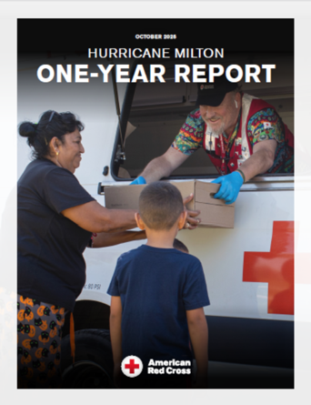
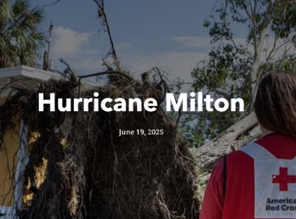
Hurricane Milton 1-Year Report
Hurricane Struck: October 2024
Hurricane Milton came ashore near Sarasota, Florida, on October 9, 2024, battering coastal communities with a punishing storm surge and damaging winds. The hurricane also spawned destructive tornado outbreaks in southern and eastern Florida, and Milton’s torrential rains caused additional local flooding as the storm moved across the state.
Our Response:
To learn more, visit:
Hurricane Milton 1-Year Report
Hurricane Milton Stewardship Story Map
As of September 9, 2025, the Red Cross and its partners had supported over 153,000 overnight shelter stays for people who evacuated from their homes as Milton threatened.
With partners, we had also provided some 500,000 meals and snacks to aid storm-weary survivors.
Our response had reached an estimated 13,000 people with disaster relief and recovery services, including $6.8 million in direct financial assistance.

Slide 9
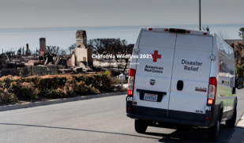
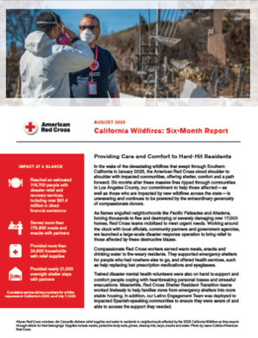
2025 California Wildfires Update
Wildfires Started: January 2025
The 2025 California Wildfires: Catastrophic wildfires devastated Southern California in January, destroying or severely damaging more than 17,000 homes and forcing tens of thousands to evacuate. Along with food, shelter and other relief and recovery support, the Red Cross has provided wildfire survivors with $51.4 million in direct financial assistance — and our work continues.
Our Response:
To learn more, visit:
California Wildfires Stewardship Story Map
As of Sept. 30, 2025, the Red Cross had reached an estimated 118,700 people with disaster relief and recovery services.
We had distributed over $51.4 million in direct financial assistance to help severely affected individuals and families with their most urgent needs.
With partners, we had served over 178,800 meals and snacks, and we provided over 24,800 households with relief items and cleanup supplies.
We had provided $8.4 million to support community recovery and resilience, including Response Impact Grants and Long-Term Recovery grants to community partners.
California Wildfires 6-Month Report

Slide 10
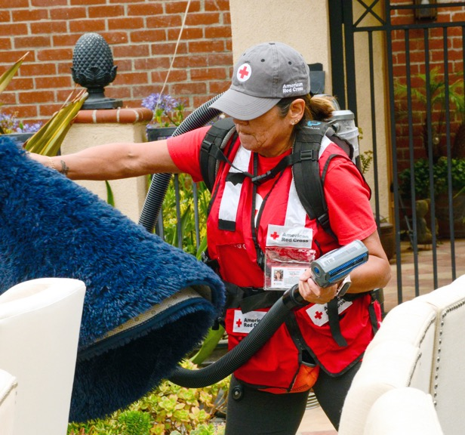
California Wildfires 2025 Recovery: Helping Families With Home Repair
“We had a lot of repairs to tackle …. In a time of complete overwhelm, the Red Cross came through.”
Tara Connon, whose home in Pacific Palisades was badly damaged by wildfires earlier this year
To help people impacted by the 2025 California Wildfires, the Red Cross has funded Response Impact Grants to local partners, which help accelerate local initiatives and expand capacity for critical community services. One grantee, the Hope Crisis Response Network, is providing smoke and ash remediation and roof repair for homes in the Palisades and Eaton Fire burn zones, prioritizing households with limited recovery resources. Local Red Cross volunteers are supporting this work, too. Volunteers helped Tara Connon — along with other families — over several weekends, pulling up carpet and hauling furniture.

Slide 11
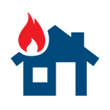
Helping People Impacted by Home Fires

Slide 12



Home Fire Campaign Impact
In FY26-Q1,* 8,920 dedicated Red Cross workers provided critical services to help families recover from home fires in lockstep with our partners across the U.S.
50,340
smoke alarms installed
17,840
homes made
safer
11,350
home fire
responses
47,000
individuals received financial assistance
32,100
youth reached with preparedness education
*July 1 – September 30, 2025 Includes domestic disaster operations with costs under $50,000 (i.e., level 1 and 2 disasters).

Slide 13
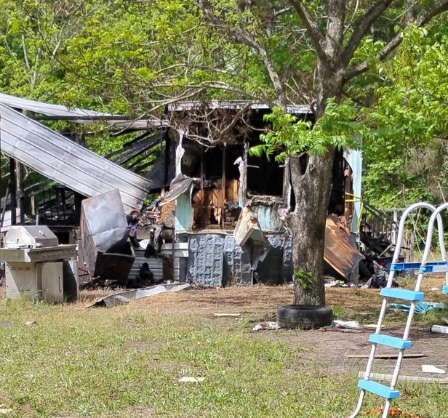
Red Cross Helps Family Recover After House Fire
“The first relief that I got … was when I met with the Red Cross representative.”
Zevon Denmark, home fire survivor
Zevon Denmark and her three children escaped a fire in their home, but sadly, lost everything to the blazes in a matter of minutes. In the disaster’s aftermath, the Red Cross served as a lifeline for the family, providing them with emergency financial assistance to cover essentials like food, clothing and a place to stay. Along with helping the family afford these essentials, the Red Cross offered Zevon a caring shoulder to lean on and sorely needed emotional support. “My Red Cross person – she held me up because I kind of passed out. But she really kept me strong,” Zevon said.

Slide 14
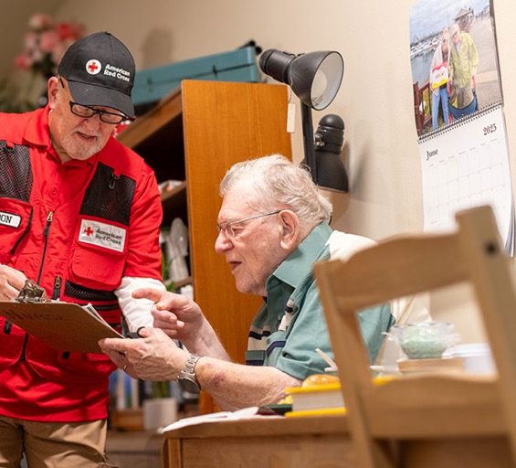
Home Fire Campaign: Over 2,500 Lives Saved Since Inception
In the last quarter alone, we’ve helped save 46 lives — 12 of them children — from this tragic and all-too-common disaster.
Powered by our generous donors and dedicated volunteers, since 2014, we have:
Reached over 3.4 million people through home visits.
Made more than 1.3 million homes safer.
Educated over 2.9 million youth through age-appropriate programming.
Since the start of the Home Fire Campaign, 787 of the 2,500 lives saved were children.
Volunteer Don Lederer speaks with Navy veteran Clinton Gallagher about fire safety at the Scriber Gardens retirement community. Red Cross volunteers went door to door to door, offering information about evacuation planning, household hazards and general preparedness.
Data as of September 30, 2025

Slide 15

Alleviating Suffering Around the World

Slide 16
International Services Impact
In FY26-Q1*, the American Red Cross actively supported disaster preparedness, relief and recovery work in 23 countries.
$2.4M
donated to Red Cross and Red Crescent efforts*
8
American Red Cross specialists deployed
21
families reconnected after disasters/conflict/migration
13
preparedness/risk-reduction projects
*July 1 – Sept 30, 2025
*Reflects funds programmed by American Red Cross to the International Federation of Red Cross and Red Crescent Societies, the International Committee of the Red Cross, and Red Cross and Red Crescent national societies following specific disasters.

Slide 17
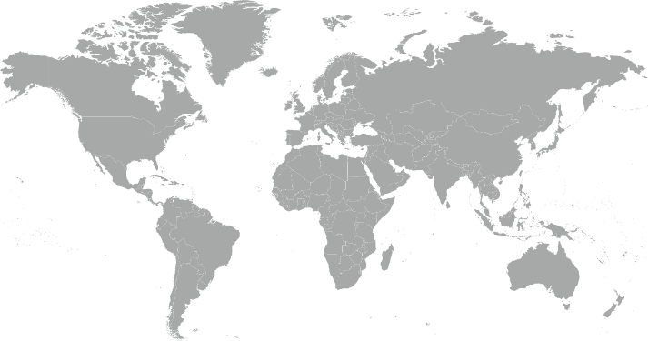
9 Major Emergencies Around the World
Canada – Wildfires
Democratic Republic of Congo (DRC) – Ebola Outbreak
Ecuador – Floods & Environmental Contamination
Middle East Humanitarian Crisis
El Salvador – Earthquake
Guatemala – Earthquake
Myanmar – Earthquake
Philippines – Typhoon Ragasa & Tropical Storm Wipha
Vanuatu – Earthquake
1
4
6
7
5
8
3
2
9
Reflects active American Red Cross responses to international disasters from July 1 – September 30, 2025
Disasters listed alphabetically.

Slide 18
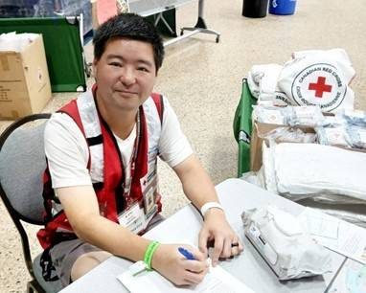
American Red Cross Volunteers Support Canadian Red Cross Wildfire Responses
When Canada experienced one of its worst wildfire seasons in 30 years this summer, some 115 volunteers from the American Red Cross deployed to lend a helping hand.
These volunteers joined more than 800 Canadian Red Cross volunteers to support sheltering equipped to house thousands. Their work included assisting at a mega-shelter in Winnipeg, Manitoba.
As part of the global Red Cross and Red Crescent movement, national societies often support disaster response in neighboring countries. The American and Canadian Red Cross have a long history of this kind of collaboration, including sending volunteers to support sheltering and other disaster response work.
American Red Cross volunteer Vince Ford helps with the Canadian Red Cross response to wildfires in Canada.

Slide 19

Strengthening America’s Blood Supply

Slide 20


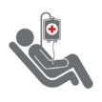
Blood Services Impact
The Red Cross ensures people in need receive safe blood on a remarkable scale. In FY26-Q1:*
1 million
blood donors engaged
50,500
blood drives hosted
1.5 million
units of blood collected
15 million
tests conducted
1.7 million
blood products delivered
*July 1 – Sep. 30, 2025

Slide 21
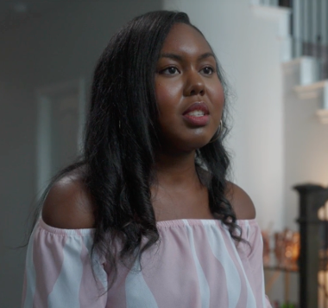
Celebrating New African American Blood Donors
“I wouldn't be alive without transfusions. Once I receive the blood, I feel re-energized and rejuvenated. I call it ‘getting my refill.’”
Kelly Bernard-Igwe, a Sickle Cell Warrior
During Sickle Cell Awareness Month, this September, the Red Cross celebrated a rebound in blood donations from Black Americans, allowing us to better help people with sickle cell disease. One in three African Americans is a match for those with this painful and life-threatening disease. Since launching in 2021, the Red Cross Sickle Cell Initiative has achieved several transformative milestones with your support:
Inspired more than 140,000 first-time African American donors to roll up a sleeve.
Provided more than 300,000 sickle cell trait screenings to increase sickle cell trait awareness.
Collected over 7,300 units of lifesaving blood at more than 320 blood drives on Historically Black College and University (HBCU) campuses.
Notes:
Since launching in 2021, the Red Cross Sickle Cell Initiative has achieved several transformative milestones with your support:
Provided more than 300,000 sickle cell trait screenings to increase sickle cell trait awareness
Invested $205,000 in 41 future leaders through the Red Cross Sickle Cell Fighter High School Scholarship Program
Collected over 7,300 pints of lifesaving blood at more than 320 blood drives on HBCU campuses
To ensure enough of the right type of blood is on the shelves, the Red Cross is focused on attracting and retaining critical type donors, including African American and Latino donors, as the population’s demographics shift.
. s many of whom depend on blood donations to relieve their painful and life-threatening symptoms.
One in three. …

Slide 22
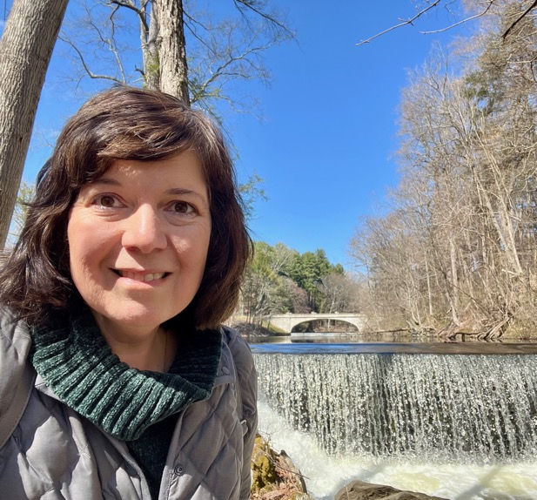
Blood Donor Health Screening Helped Detect Colon Cancer
“I feel truly blessed! The surgeon was amazed how early the colon cancer was detected. He said, ‘You gave blood regularly, and in turn, your cancer was caught early.’”
Margaret Kelly, blood donor and colon cancer survivor, whose cancer was detected early, thanks to a low hemoglobin count noted at a blood donation appointment and subsequent follow-up with her doctor
In addition to testing hemoglobin levels, the Red Cross provides a mini-physical to all presenting blood donors. This provides valuable health insights to donors and helps fill some public health gaps. In response to the increasing number of people developing hypertension and diabetes in the U.S., the Red Cross now screens all blood donors for hypertension at every donation, and A1C tests — commonly used for diabetes and pre-diabetes — are conducted at different intervals, including in March, August and November this year. In March and August combined, 691,575 donors were screened for A1C.

Slide 23
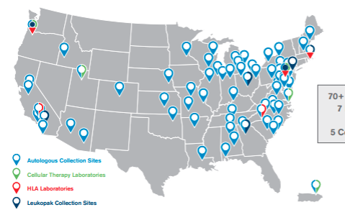
Improving the Fight Against Cancer: Supporting Cutting-Edge Emerging Cell and Gene Therapy
The American Red Cross plays a vital role in advancing cell and gene therapies by collecting patients’ white blood cells (T-cells)—the critical starting material used in both clinical trials and FDA-approved treatments for late-stage cancers and other serious conditions.
This quarter alone, 4,815 specialized collection procedures were performed, supporting health care providers and research partners in delivering lifesaving immunotherapies like CAR T-cell treatments and newly approved gene therapies for sickle cell disease.
As the nation’s largest provider of T-cell collection and processing, the Red Cross has a growing nationwide network and quality standards that ensure timely, consistent support for every FDA-approved T-cell therapy.
“True to the Red Cross’s mission, we provide blood collection expertise used by our health care partners for the most advanced cancer treatments and research trials to help save lives.”
Michael Wolter, Vice President, Cell and Gene Therapy Solutions

Slide 24

Supporting Military and Veteran Families

Slide 25




Military Support Impact
In FY26-Q1*, more than 41 Red Cross Service to the Armed Forces workers have deployed to 19 locations abroad to provided critical services to military heroes.
82,800
participants in Red Cross-hosted social events for service members and families
700
families provided with financial assistance that we distribute with military aid societies
134,740
hospitalized people helped through
rehabilitation and morale programs
19,590
military families supported through personal crises
*July 1 – September 30, 2025

Slide 26
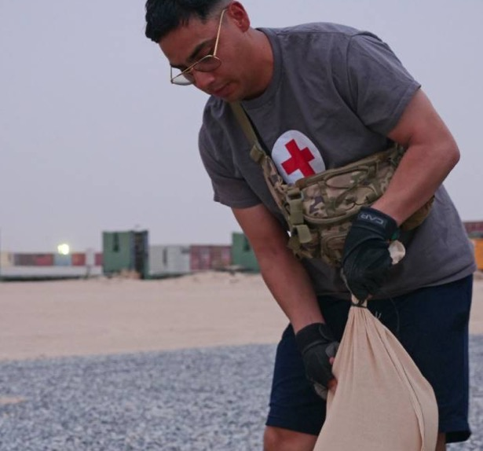
Red Cross Eases Burden of Important Base Fortification Project
“This is a small example of the huge impact of our partnership with the Red Cross.”
Lieutenant Colonel Elliot S. Grant, Base Commander of Camp Buehring, Kuwait
This summer, leaders on Camp Buehring in Kuwait faced a challenge: Get residents to volunteer their time to fill 85,000 sandbags in the grueling heat to fortify the base against potential attacks. To make the job more manageable—and even enticing—First Lieutenant James D. Glass knew he could turn to the Red Crossers on base for help, citing our “ability to transform tasks into moments of connection and purpose.” Sure enough, the Red Cross showed up, helping liven the mood during the shifts with music, cold water and ice pops. Specialist Heather Trenthan said the livened-up exercise offered not only cross training, but also team building.

Slide 27

Training for the Moments That Matter

Slide 28



Training Services Impact
In FY26-Q1,* we have equipped community members to help neighbors, friends and family members with vital skills:
865,290
people trained in First Aid, CPR and AED, making every community safer
89,850 people learned how to be safe in, on and around the water through our Aquatics and Water Safety training
18,310 individuals trained in caregiving courses, empowering participants to provide quality care to people of all ages
*July 1 – Sept . 30, 2025
Notes:
Product
Q1
FA/CPR/AED
865,290
Water Safety
89,851
Caregiving
18,313

Slide 29
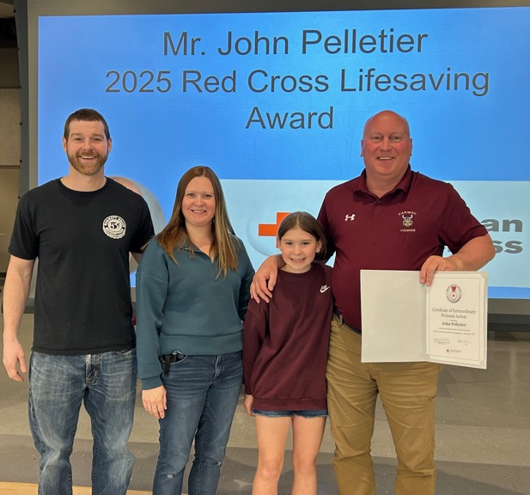
Red Cross-Trained Educator Saves Student’s Life
“I never imagined that I would save the life of a student during my lunch duty, but I did because the situation presented itself.”
John Pelletier, who saved a student’s life when she was choking
During a routine lunch duty at Caribou Community School, educator John Pelletier saved a student’s life by performing abdominal thrusts when she began choking. His quick thinking and Red Cross-trained response recently earned him the Certificate of Extraordinary Personal Action, the national lifesaving award presented to those who use any lifesaving skill taught by the American Red Cross during an incident. The student’s parents expressed profound gratitude, emphasizing the peace of mind that comes from knowing staff are trained to act when moments matter.

Slide 30
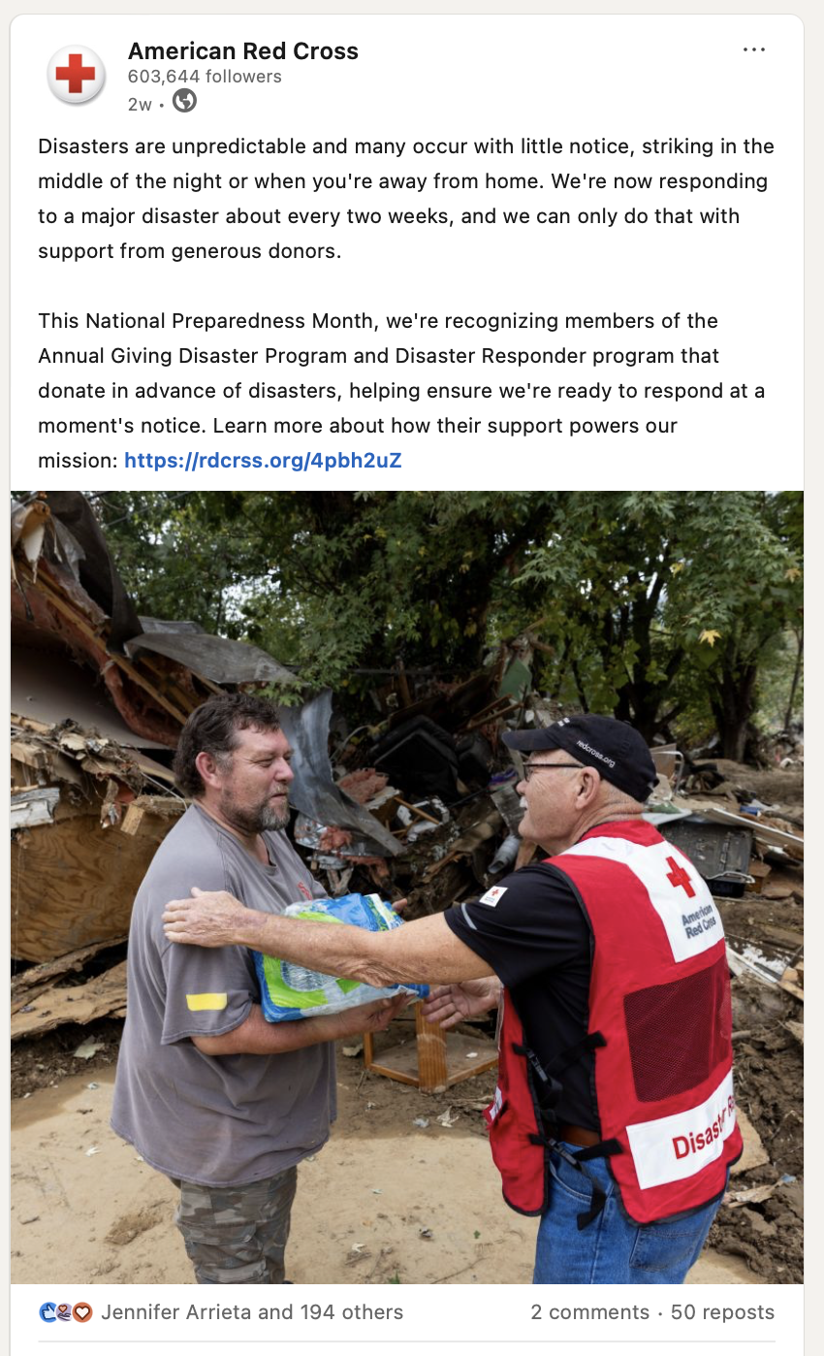
Your Benefits and Resources
We were pleased to recognize you and offer engagement opportunities this quarter.
Provided with template communications materials, including social posts and content that aligned with timely messaging around National Preparedness Month.
Featured in the annual member press release sent via PR Newswire and posted on redcross.org with a potential audience of more than 117 million.
Recognized in a LinkedIn post thanking members with more than 7,400 impressions and 351 engagements.
Invitation to our exclusive Disaster Leadership call sharing updates on our response to the Texas Floods on July 10.​

Slide 31
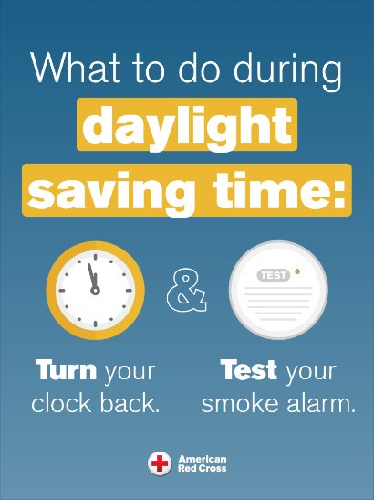
Prepare Today!
As we prepare to turn our clocks back on Sunday, November 2, we encourage people to TEST their smoke alarms when they TURN their clocks.​
​
Please consider sharing home fire safety messages with your employees, customers and other key groups.
Visit the Disaster Responder Membership Hub or redcross.org for preparedness communication resources to help you and your loved ones stay safe.

Slide 32
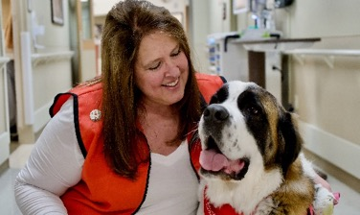
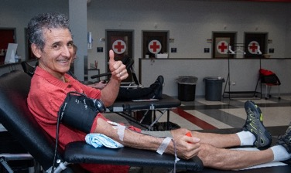
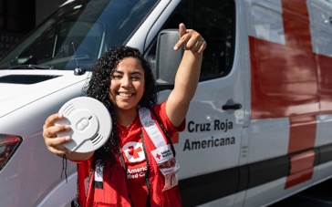
Deepen Your Engagement
Help your employees, customers and others stay engaged and safe this season!
Find Your Perfect Fit as a Volunteer
Volunteers represent 90% of the Red Cross workforce. To ensure we can be there for people in their darkest moments, we need more volunteers who are trained and ready to help. Join us to provide relief and hope when they matter most! Find your opportunity today.
Give Blood, Help Save Lives!
Every two seconds, someone in the U.S. needs blood. Blood products are essential for surgeries, cancer treatment, chronic illnesses and traumatic injuries. Schedule your lifesaving blood donation appointment today!
Help Sound the Alarm for Home Fire Safety
Home fires claim seven lives daily, but working smoke alarms can cut the risk of death by half. Join the Red Cross to install free smoke alarms as part of our Sound the Alarm events, now in our 10th year. Use the zip code finder to support a local event this spring.

Slide 33
