Slide 1
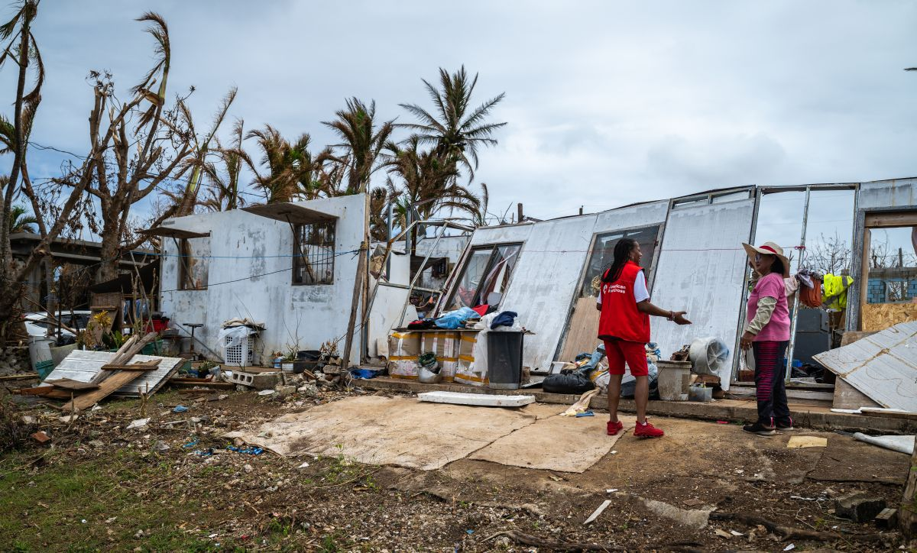

Quarterly Impact Update for ADGP Members
FY26 Q4
(APR – JUNE 2026)

Slide 2

Alleviating Suffering
Through Disaster Relief

Slide 3
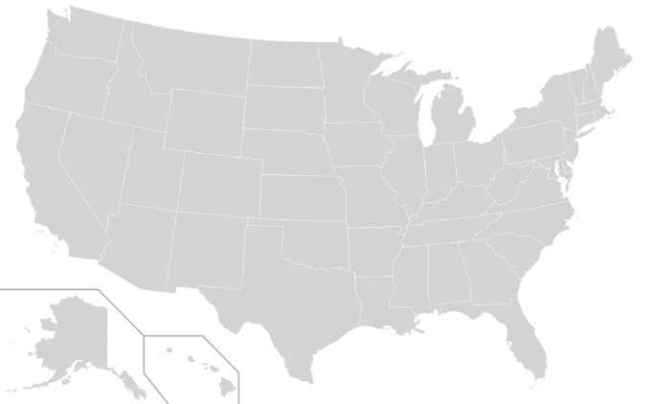
Red Cross Responded to 102 Big Disasters
DISASTER RELIEF
Including 20 large and major responses listed chronologically:
Kona Low Pressure System (Level 3)
Super Typhoon Sinlaku (Level 6)
Michigan Floods (Level 3)
Wisconsin Storms (Level 3)
Georgia Wildfires (Level 3)
North Texas Tornadoes (Level 3)
Alabama-Mississippi Tornadoes (Level 3)
Southern California Hazardous Materials Incident (Level 3)
Illinois Storms (Level 4)
Indiana Tornadoes (Level 4)
Queens, New York Multi-Family Fire (Level 3)
Tropical Storm Arthur - Louisiana (Level 3)
Washington Wildfires (Level 3)
Oregon Wildfires (Level 3)
California Gold Country Wildfires (Level 3)
Idaho, Montana & East Oregon Wildfires (Level 3)
Los Angeles Wildfires (Level 3)
Northern California Wildfires (Level 3)
Southern California Wildfires (Level 3)
Mississippi Floods (Level 3)
13
14
16
4
15
3
11
9
10
8
2
6
7
5
12
1
April 1 – June 30, 2026
“Big” includes domestic disaster operations with costs of $10,000+ (i.e., level 2 and higher).
“Major” includes domestic disaster operations with costs of $50,000+ (i.e., level 3 and higher).

Slide 4

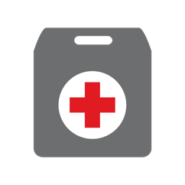


Domestic Disaster Response Impact
DISASTER RELIEF
In FY26-Q4, some 2,750 Red Cross disaster workers provided critical services in lockstep with our partners across the U.S.
309,000
meals and snacks served with partners
24,000
overnight stays in emergency lodgings provided with partners
15,700
households provided relief items
5,700
households provided recovery support, including financial assistance
FY26
Totals
955,660
72,750
43,160
15,100
April 1, 2026 – June 30, 2026
Includes domestic disaster operations with costs of $10,000+ (i.e., level 2 and higher).

Slide 5
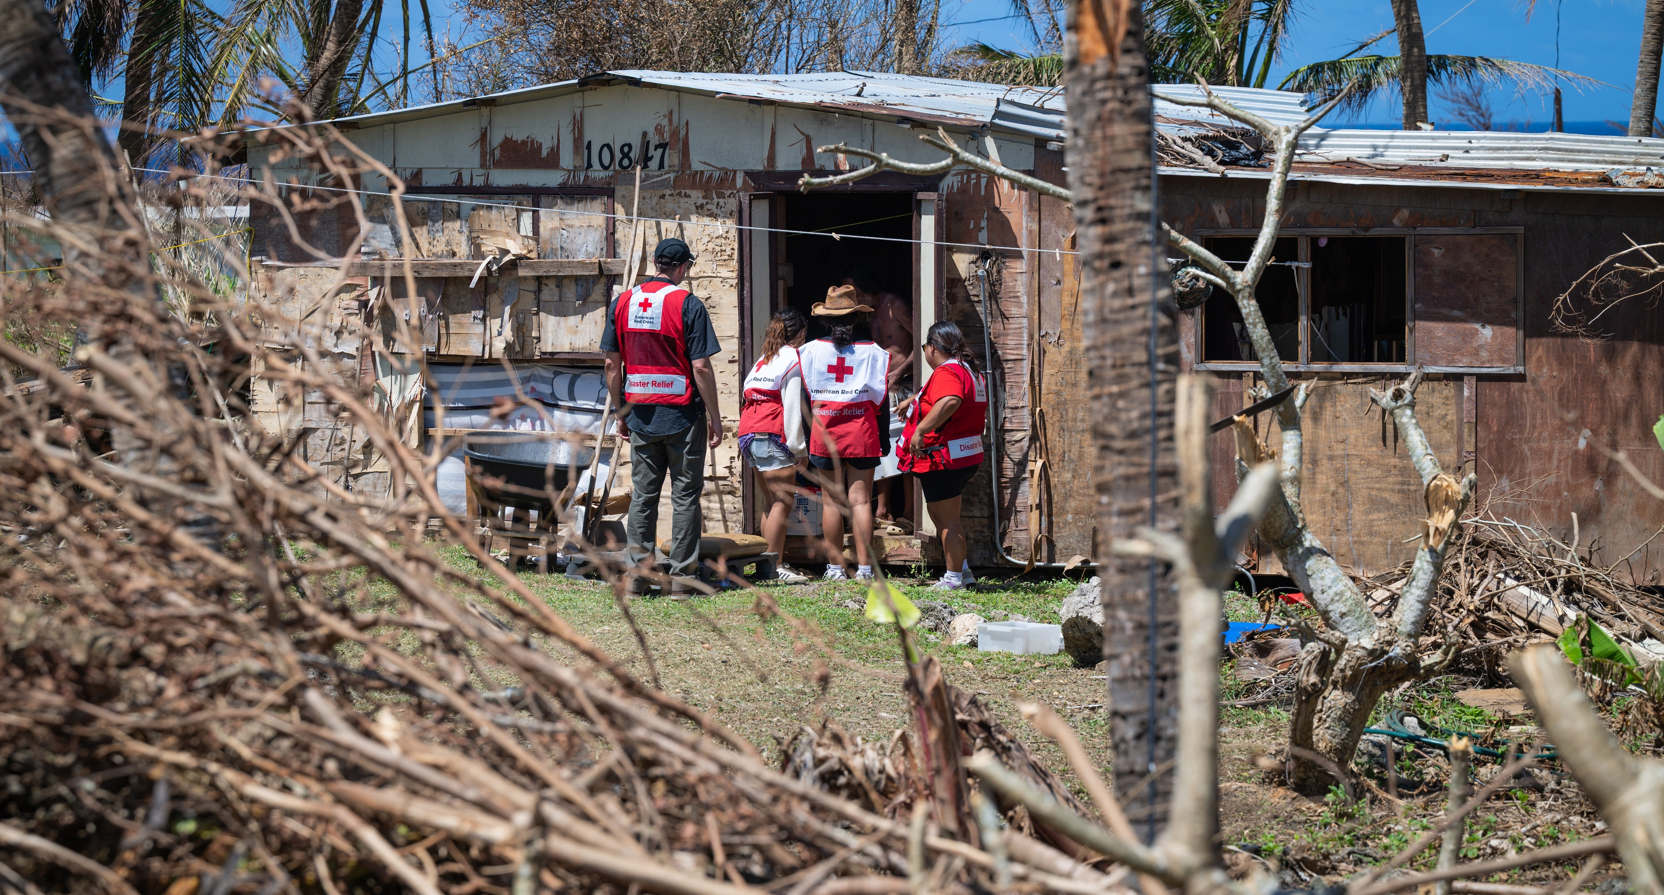
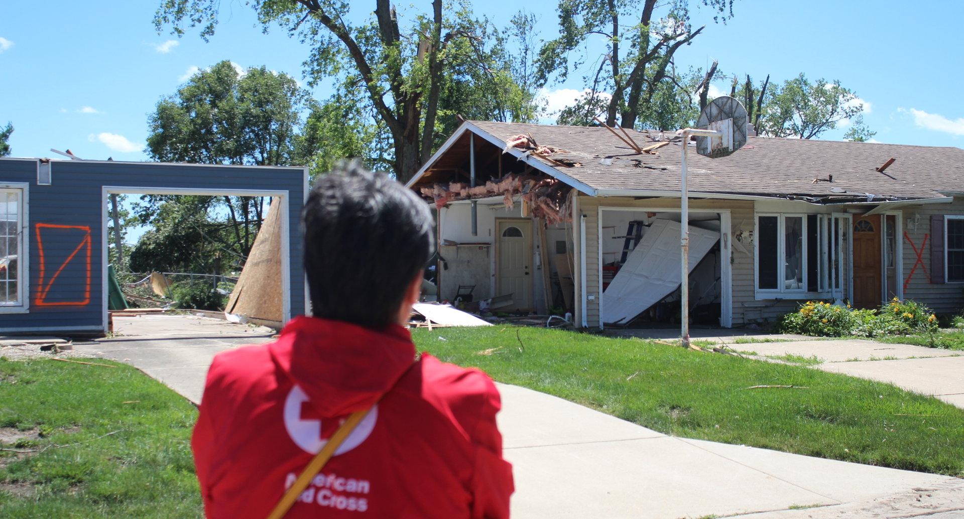
Responding to Large Disasters Across the U.S.
DISASTER RELIEF
Thanks to your commitment, we could prepare for and respond immediately to urgent crises across the country when we were needed most.
After Super Typhoon Sinlaku devastated U.S. residents of Guam and the Northern Mariana Islands, we:
Supported immediate needs for food, shelter and clean water amid long-lasting power outages.
Distributed financial assistance, helping people get back on their feet.
When June’s tornadoes and storms upended lives in Illinois and Indiana, the Red Cross and our partners:
Supported safe shelter for displaced individuals and families.
Delivered meals, relief supplies, emotional support and basic health services.
Distributed financial assistance to help with urgent needs.

Slide 6
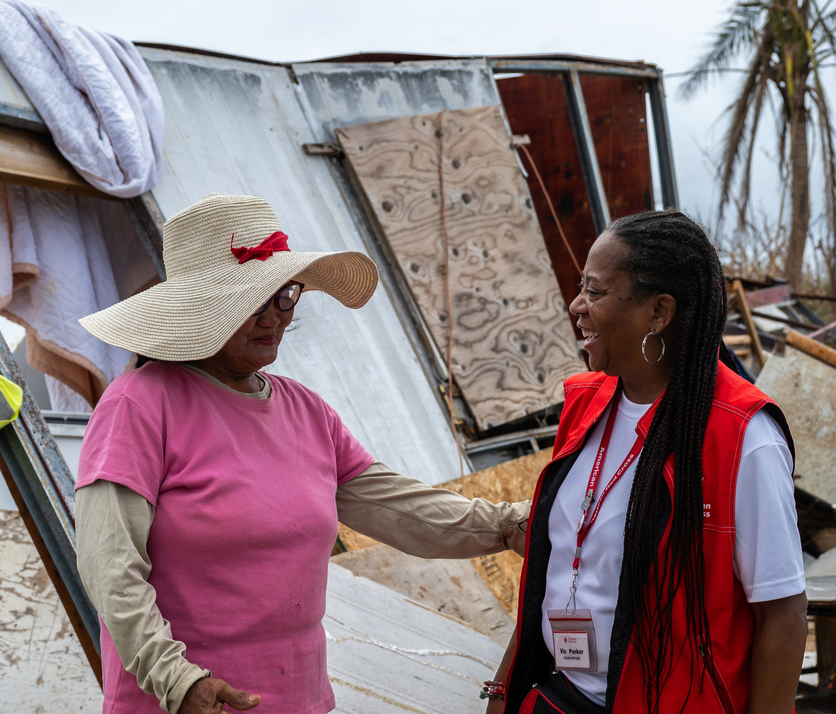
Helping Super Typhoon Sinlaku Survivors
DISASTER RELIEF
STORIES FROM THE FIELD
“I am alive, at least I am alive.”
Nida Amansec,
a Northern Mariana Islands resident whose home was destroyed by Typhoon Sinlaku
Nida Amansec lives in the Northern Mariana Islands, a U.S. territory where thousands of Americans’ lives were upended by Super Typhoon Sinlaku’s devastating strike in April. Nida lost her home to the storm, but she was grateful to be alive after her ordeal.
Red Crossers like Vic Parker deployed thousands of miles to join local responders — including many volunteers who’d been impacted themselves — to support survivors like Nida with shelter, feeding, relief supplies, financial assistance and other essentials.

Slide 7
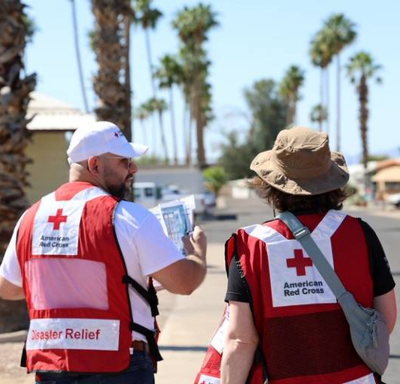
Heat Walks Help Communities Prepare, Stay Connected
DISASTER RELIEF
STORIES FROM THE FIELD
“Staying connected can save a life — and not just from heat.”
Jacqui Basserman (below right),
Red Cross employee and extreme heat safety advocate
Extreme temperatures continue to impact communities across the U.S. In Spring 2026, we addressed this growing threat with community Heat Walks. Through this initiative, led by our Arizona and New Mexico regions, volunteers went door-to-door in vulnerable communities, performing wellness checks and offering resources and education on staying safe during extreme heat.
Red Cross worker and heat safety advocate Jacqui Basserman shared another often-overlooked risk factor during extreme heat: loneliness and social isolation. “Sadly, many people are at risk because nobody is checking in on them. That’s one of the reasons the Red Cross is showing up at their doors – to check on them,” she said.

Slide 8
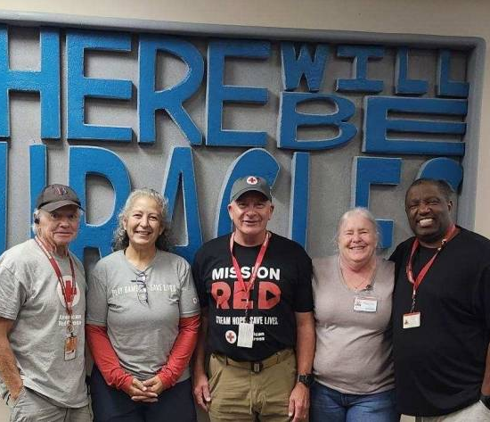
Financial Assistance Helps Survivors Get Back on Their Feet
DISASTER RELIEF
STORIES FROM THE FIELD
“It’s all about seeing what we can do for the people.”
A Long-Term Recovery program provided an additional round of financial assistance to individuals and families whose homes sustained major damage or were destroyed by the devastating July 2025 flooding in Texas.
Immediately following the disaster, we provided shelter, feeding, and health and mental health services. But recovery does not end when the shelters close, and impacted residents may still face ongoing challenges, such as living in temporary housing.
Through our Long-Term Recovery program, we provided more than $1 million in direct financial assistance to more than 720 individuals, giving recipients the dignity and autonomy to address their most pressing needs.
Maria Corral,
a local Texas resident and long-term recovery volunteer, pictured (second from left) with Red Cross caseworkers Tom Bethke, Rick Rosen, Patricia Haas and Gary Roane

Slide 9
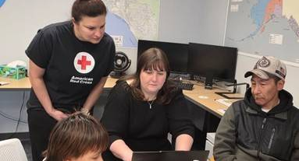
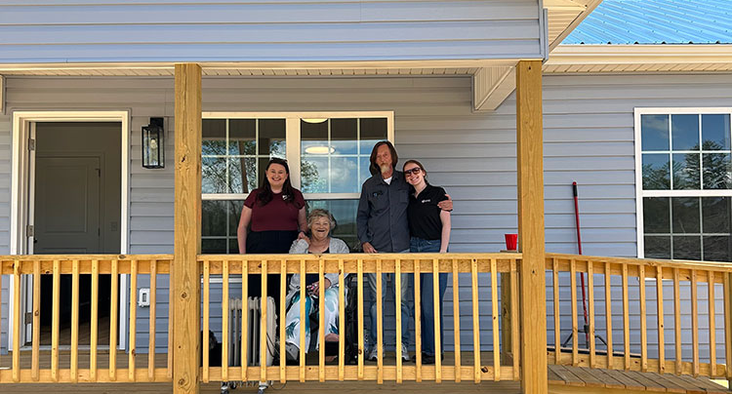
Providing Long-Term Recovery Support
DISASTER RELIEF
Beyond our immediate response to support urgent needs, we also help communities and families recover in the months — and years — ahead.
Alaska and Washington Floods: In June, the Red Cross completed additional financial assistance programs in Washington State and Alaska, supporting residents still getting back on their feet after destructive floods last fall and winter. This additional assistance helped families cover overcome barriers to recovery. "This will really help as we decide what we are going to do," said Harvey Dock, whose family lived in the rural Alaskan community of Nightmute.
Hurricane Helene: Eddie and Darlene lost their Avery County, North Carolina, home when Hurricane Helene moved through the area in 2024. Dozens of trees crashed onto their house, trapping them until a neighbor with an excavator cleared the debris hours later. This May, Eddie and Darlene received the keys to a newly rebuilt home through Appalachian Service Project, supported by a Red Cross recovery grant. “All the people were very special people,” Eddie said. “All the groups that came to our aid were tremendous people, [a] tremendous help.”

Slide 10
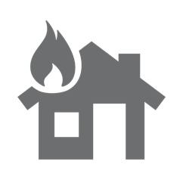
Helping People
Impacted by Home Fires

Slide 11





Home Fire Campaign Impact
HOME FIRE
In FY26-Q4, 7,330 dedicated Red Cross workers provided critical services to help families recover from home fires in lockstep with our partners across the U.S.
75,930
smoke alarms installed
28,710
homes made
safer
13,340
home fire
responses
56,320
individuals received financial assistance
25,400
youth reached with preparedness education
FY26 TOTALS
262,200
94,830
57,750
230,760
107,410
*April 1 – June 30, 2026
Includes domestic disaster operations with costs under $50,000 (i.e., level 1 and 2 disasters).

Slide 12
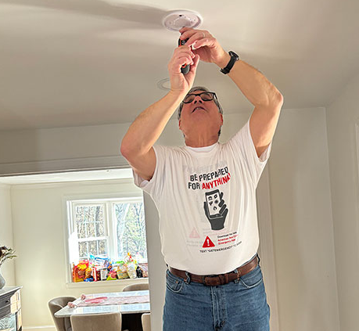
Alarms, Escape Plan Help Family Survive Home Fire
HOME FIRE
STORIES FROM THE FIELD
“I remember you. You were the one who put the alarms in my house.”
When a fire broke out in Drupatti Phulbas’ home, her family was alerted to the danger by a smoke alarm installed by the Red Cross just two years earlier. Thanks to the alarm as well as an escape plan they learned during that Red Cross visit, the family made it out quickly and safely.
Firefighters arrived to extinguish the blaze, followed soon by Red Cross volunteers. Drupatti didn’t initially notice the Red Cross emblem right away, but she recognized a familiar face. When he introduced himself, it clicked: It was one of the volunteers who’d installed her smoke alarm, Larry Berman. Larry and fellow volunteer Andy Williams connected them with immediate financial assistance, a place to stay and support for the days ahead.
Drupatti Phulbas, whose family escaped a home fire thanks to an alarm Larry Berman (pictured below) installed two years earlier. Larry also responded when Drupatti's house caught fire.

Slide 13
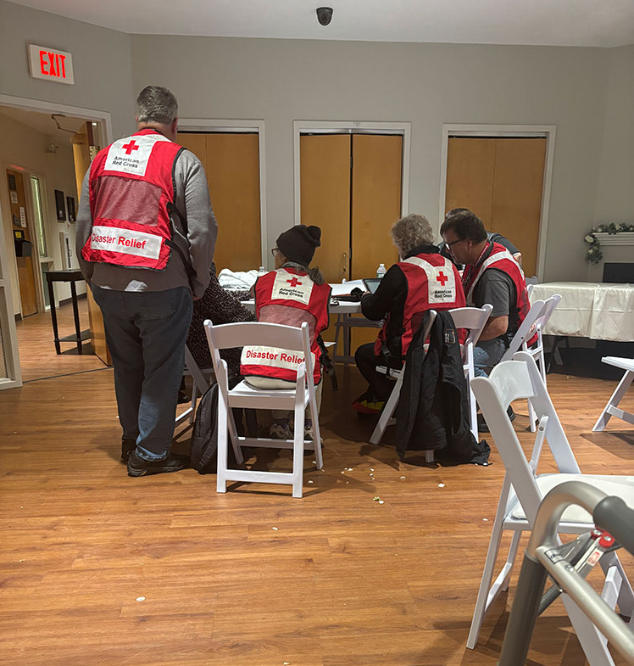
Red Cross Helps Dozens Recover From Apartment Fire
HOME FIRE
STORIES FROM THE FIELD
When a fast-moving fire broke out in an apartment complex in Manchester, New Hampshire, the Red Cross responded within minutes, ultimately helping about 40 people.
More than 20 Red Crossers provided survivors with immediate financial assistance, emotional and mental health support, and recovery planning in partnership with local agencies. To help the children cope with this deeply distressing experience, volunteers gave out teddy bears.
The Red Cross was also in close coordination with the housing authority and the property management company, which worked to identify longer-term housing options for displaced residents.
Red Cross volunteers support residents displaced from their Manchester, New Hampshire, apartment complex by a home fire.

Slide 14
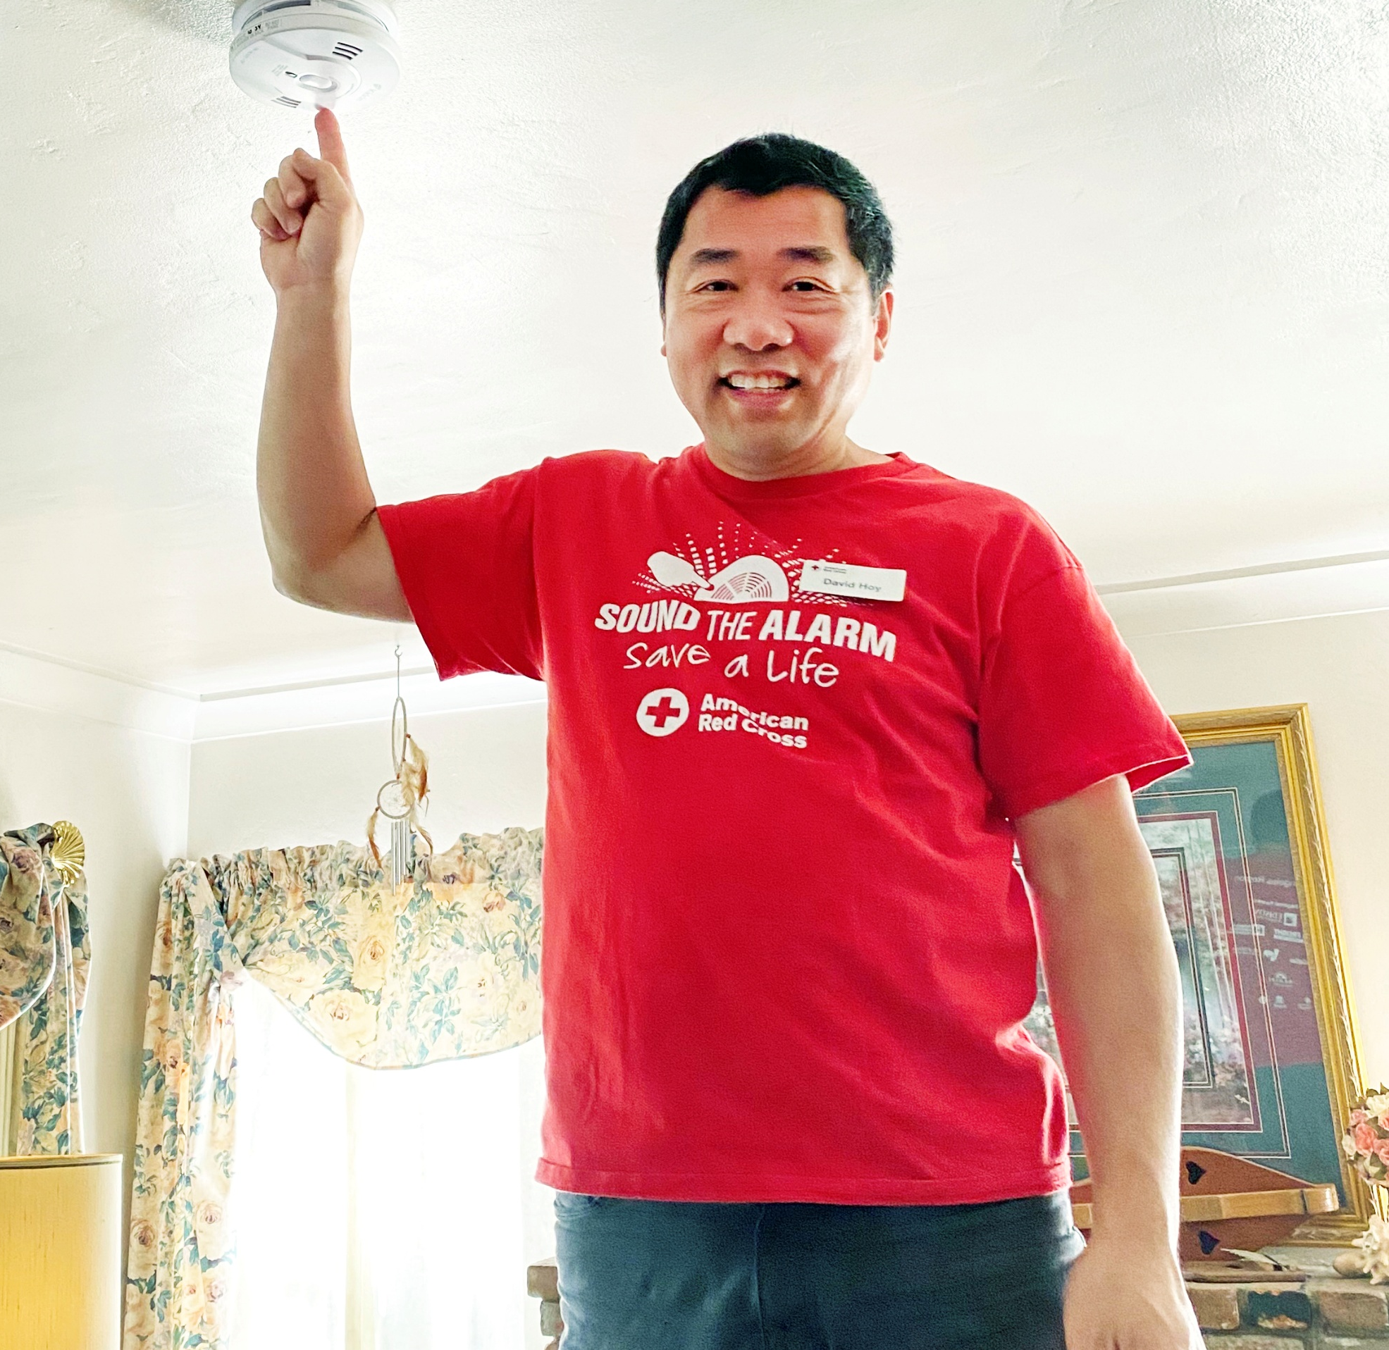
Over 2,690 Lives Saved
From Home Fires Since 2014
HOME FIRE
“It’s the difference between life and death.”
Of those, 825 were children.
Volunteer David Hoy, a Sound the Alarm volunteer,
who has installed over 2,000 smoke alarms in Southern California!
Together with our volunteers, partners and donors we have:
Reached nearly 3.6 million people through home visits.
Made more than 1.3 million homes
safer.
Educated nearly 2.5 million youth through age-appropriate programming.
  Lives saved as of June 30, 2026
  Other data points as of May 31, 2026

Slide 15

Alleviating Suffering
Around the World

Slide 16
International Services Impact
INTERNATIONAL
In FY26-Q4, the American Red Cross actively supported disaster preparedness, relief and recovery work in 26 countries.
$3.21M
donated to Red Cross and Red Crescent efforts*
3
American Red Cross specialists deployed
11
families reconnected after disasters/
conflict/migration
16
preparedness/
risk-reduction projects
FY26 TOTALS
$12.70M
31
74
16
April 1 – June 30, 2026
*Reflects funds programmed by American Red Cross to the International Federation of Red Cross and Red Crescent Societies, the
International Committee of the Red Cross, and Red Cross and Red Crescent national societies following specific disasters.

Slide 17
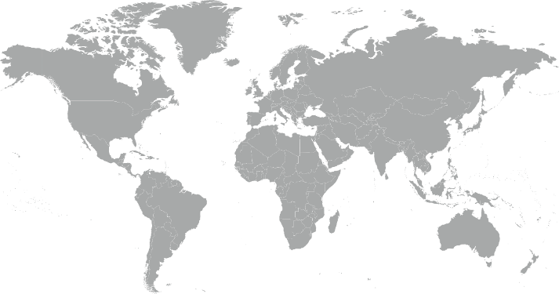
17 Major Emergencies Around the World
INTERNATIONAL
Africa Regional Ebola Epidemic (DRC)
Cameroon Food Insecurity
El Salvador Drought
Guatemala Drought
Hong Kong Tai Po Fire
Indonesia Central Sulawesi Earthquake
Lebanon Complex Emergency
Micronesia Super Typhoon Sinlaku
Middle East Humanitarian Crisis
Mozambique Floods
Palau Water Crisis
Philippines Earthquake & Typhoons
Somalia Complex Emergency
Southeast Asia Floods (Thailand)
Sri Lanka Cyclone Ditwah
Timor-Leste Dengue Outbreak
Venezuela Earthquakes
9
7
4
5
14
12
3
17
2
13
15
11
1
6
16
10
8
Reflects active American Red Cross responses to international disasters from April 1 – June 30, 2026
Disasters listed alphabetically.

Slide 18
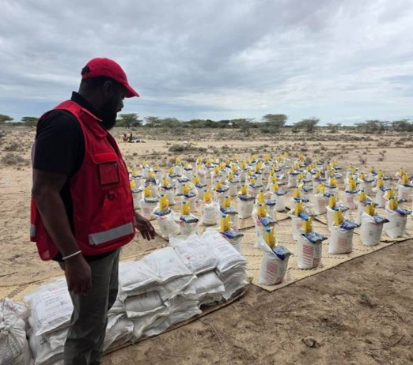
Across Borders, Cultures and Crises, American Red Crosser Finds a Shared Humanity
INTERNATIONAL
STORIES FROM THE FIELD
“Working across cultures … there’s a Red Cross and Red Crescent DNA in all of our work. ”
While supporting the International Federation of the Red Cross and Red Crescent Societies (IFRC) amid humanitarian crises in Somalia and Kenya, American Red Crosser Patrick Cheah witnessed how shared principles unify response efforts.
As Roving Operations Manager for the IFRC, Patrick supported large, multi-country operations. He helped facilitate cross-border cooperation between the Somali Red Crescent Society and Kenya Red Cross Society, enabling them to share best practices as they dealt with escalating humanitarian crises caused by drought.
“It's been very easy to work with the team because once you understand the shared Red Cross seven fundamental principles, you see that in play in all engagements. All of our interactions encompass all these principles, and it stresses collaboration and teamwork,” said Patrick.
Patrick Cheah, in Kenya,
Serving as a roving operations manager for the IFRC Nairobi cluster across Kenya and Somalia.

Slide 19

Strengthening
America’s Blood Supply

Slide 20
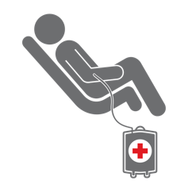
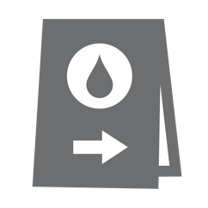

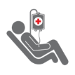
Delivering Lifesaving Blood Products
BLOOD SERVICES
The Red Cross ensures people in need receive blood. In FY26-Q4, the Red Cross impacted about 423,090 lives, thanks to 1.18 million red blood cell units delivered to hospitals for transfusions.
1 million
blood donors engaged
50,080
blood drives hosted
1.2 million
units of blood collected
11.8 million
tests conducted
1.7 million
blood products delivered
FY26 TOTALS
2.3 million
198,100
4.8 million
47.8 million
6.7 million
April 1 – June 30, 2026

Slide 21
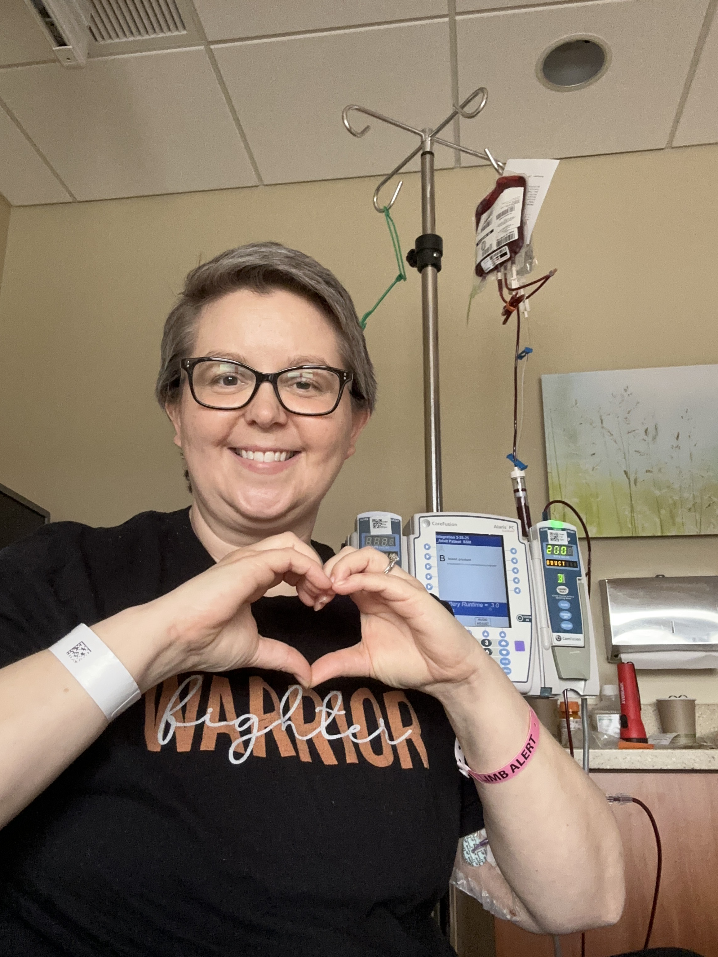
Record Blood Collection Growth Fuels Lifesaving Impact in FY26
BLOOD SERVICES
STORIES FROM THE FIELD
“There’s really no way to describe the feeling of receiving such a gift. …Without those donors, I wouldn’t be here.”
This fiscal year marked one of the largest collection growth years in recent Red Cross history, impacting over 1.69 million lives. With generous support, we collected:
4.78 million red blood cell products, over 100,000 units more than the prior fiscal year.
58,000 more platelet units, representing 4.99% year-over-year growth.
These results reflect strong donor engagement and team dedication nationwide and set a solid foundation as we move into the new fiscal year with continued focus on rising patient needs.
Jodie Lasco, of Wisconsin, who received 183 units of blood products during her cancer treatment

Slide 22
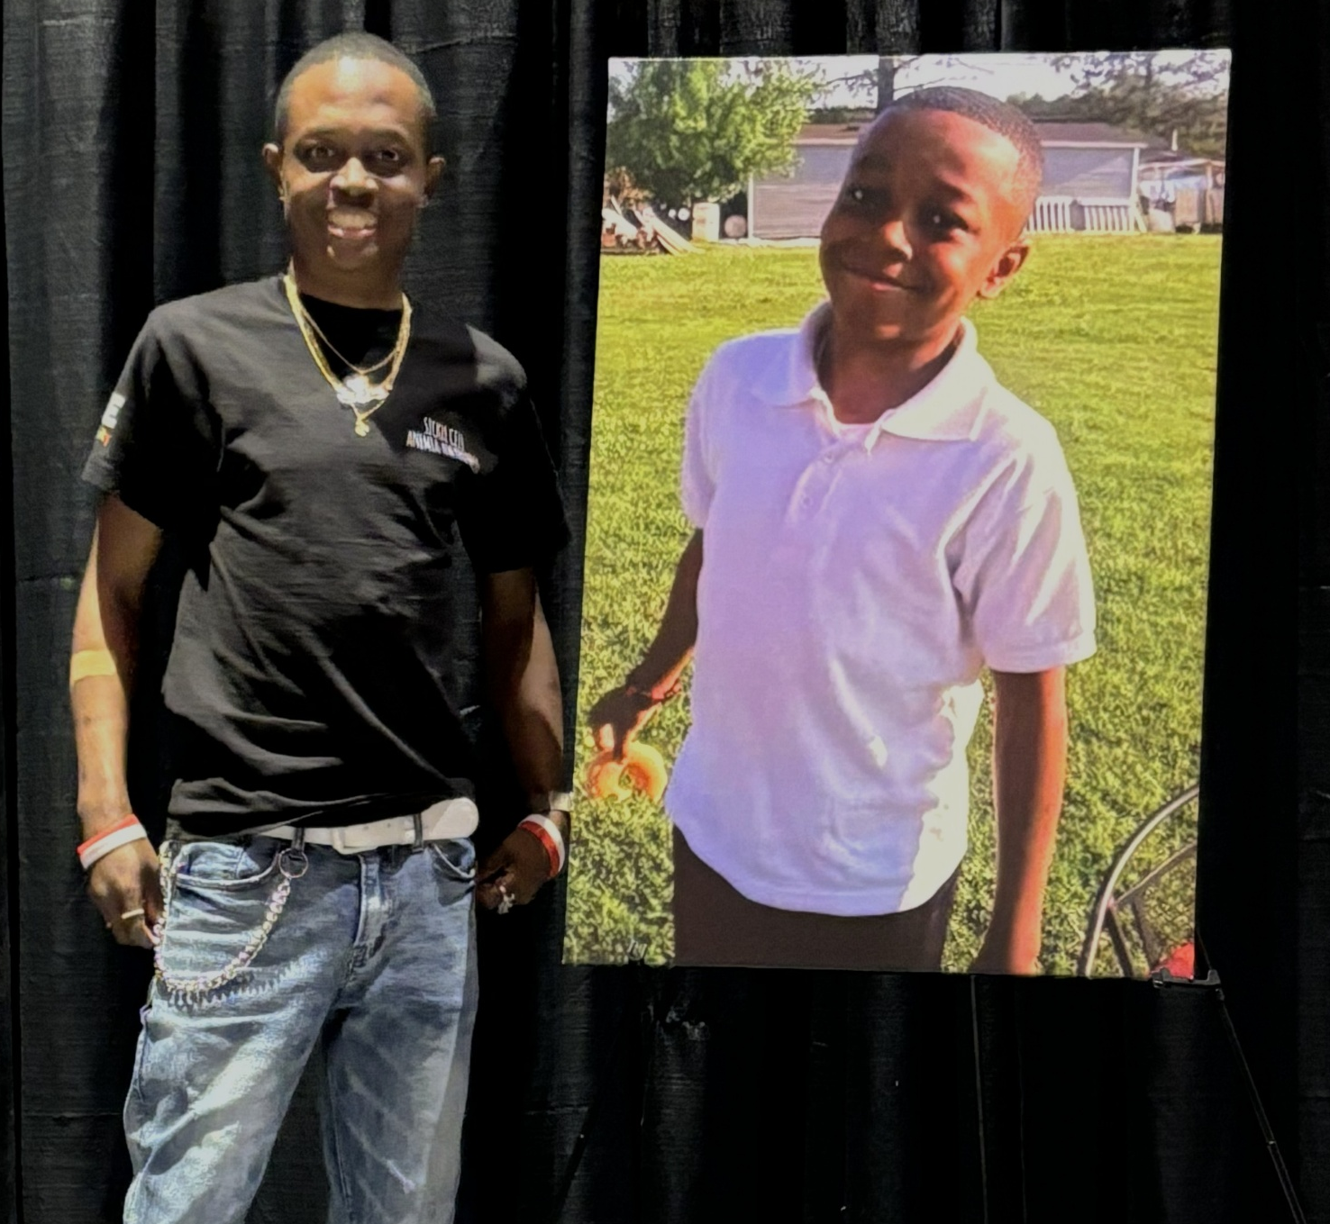
Sickle Cell Warrior Advocates for Blood Donation on World Sickle Cell Day
BLOOD SERVICES
STORIES FROM THE FIELD
“[Blood transfusions] help decrease the pain…increase the oxygen, bring your color and energy back.”
Travis Robinson, a nurse and sickle cell disease advocate, has lived with the condition for 39 years. After losing his younger brother, Ti’Rell, to the disease at age 14, Robinson dedicated himself to educating others about sickle cell disease and the lifesaving impact of blood donation.
People with sickle cell disease often need recurring transfusions of closely matched blood to manage pain and improve quality of life, making donors essential to their care.
On World Sickle Cell Day, June 19, the Red Cross recognized advocates like Robinson. In FY26, the Red Cross collected 85,000 sickle cell-compatible units from African American donors.
Travis Robinson, of North Carolina, a sickle cell warrior and advocate who lost his 14-year-old brother Ti’Rell (picture right) to sickle cell disease.

Slide 23
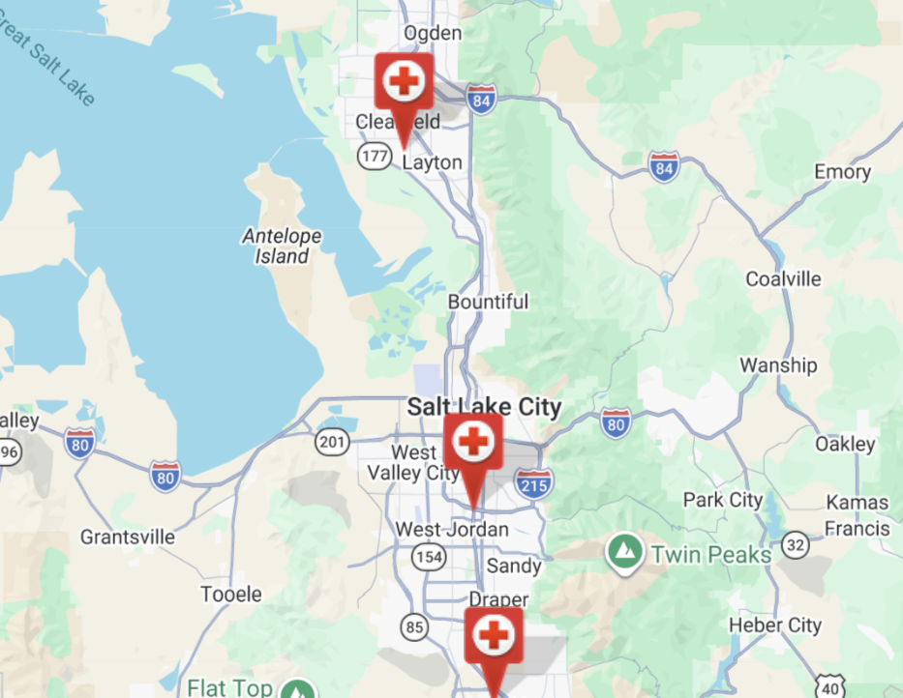
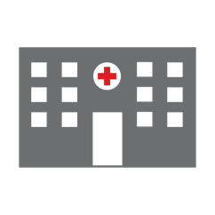
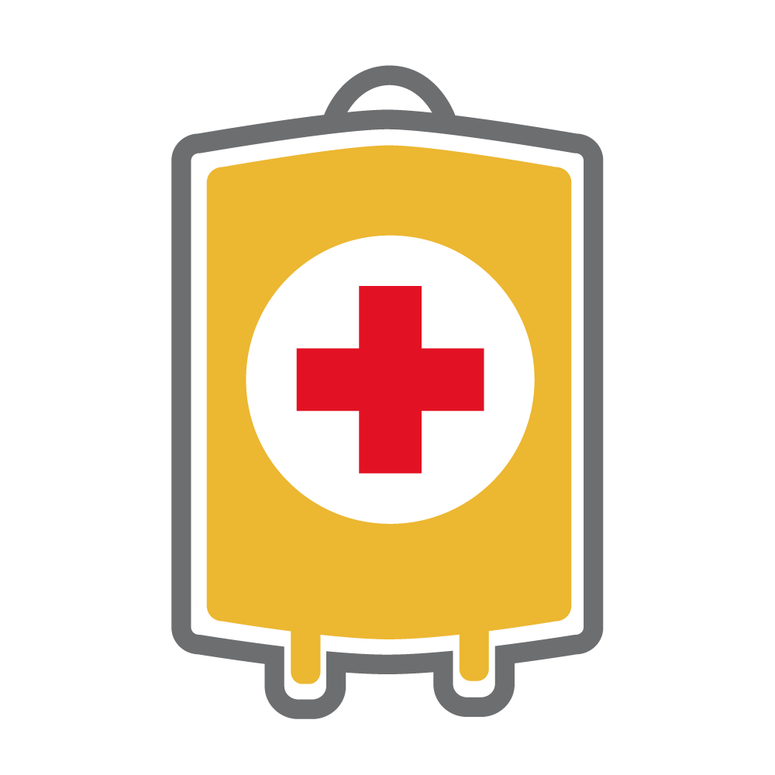
Expanding Blood Collections Capacity: 7 New Centers Opened
BLOOD SERVICES
To help meet the mounting need for blood products in the U.S., the Red Cross is growing the number of Blood Donation Centers by up to 100 sites through 2030. During FY26, we reconfigured nine facilities and built seven brand-new Blood Donation Centers!
Center opened in FY26
This March, the Salt Lake City area opened its third Blood Donation Center in West Valley City.
In its first three months of operation,
the West Valley City facility has been collecting 108% to goal!
FY26 Totals
7
new sites
opened
14,180
red cell
units collected
20,453
platelet units collected

Slide 24

Supporting Military and Veteran Families

Slide 25




Supporting Military Heroes
SAF
In FY26-Q4*, 18 Red Cross Service to the Armed Forces workers have been deployed to 11 locations abroad to provide critical services to military heroes.
143,740
participants in Red Cross-hosted social events for service members and families
1,350
families provided with financial assistance that we distribute with military aid societies
119,510
hospitalized people helped through rehabilitation and morale programs
19,480
military families supported through personal crises
FY26 TOTALS
606,630
6,510
699,890
75,070
April 1 – June 30, 2026
Numbers over 1,000 are rounded to the nearest 10.

Slide 26
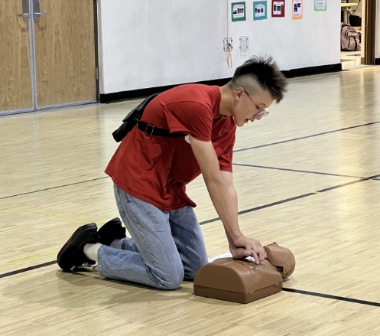
Red Cross Supports Children in Military Families
SAF
STORIES FROM THE FIELD
“The Red Cross didn’t just give me volunteer hours. It gave me opportunities.”
April is Month of the Military Child, and during April and all year long, the Red Cross provides support to children in military families through our Service to the Armed Forces program.
Teenage years are a difficult time for most people, but living on an overseas military base brings a whole new set of challenges. For Gyan Park, a teen living on a U.S. military base in Korea, volunteering with the Red Cross youth group has helped him build skills and confidence. In the youth group, Park earned free certification in First Aid/CPR/AED, led presentations and, he said, “developed skills that will benefit me for life.”
Gyan Park,
whose family is stationed in South Korea,
on the benefits of joining the Red Cross youth club on base

Slide 27

Training for the
Moments That Matter

Slide 28


Training Services Impact
TRAINING SERVICES
In FY26-Q4,* we equipped community members with vital skills to help neighbors, friends and family members save lives.
899,750
people trained in First Aid, CPR and AED, making every community safer
454,530
people learned how to be safe in, on and around the water through our Aquatics and Water Safety training
24,420
individuals trained in caregiving courses, empowering participants to provide quality care to people of all ages
FY26 TOTALS
3.2 million
1.5 million
68,940
*April 1 – June 30, 2026

Slide 29
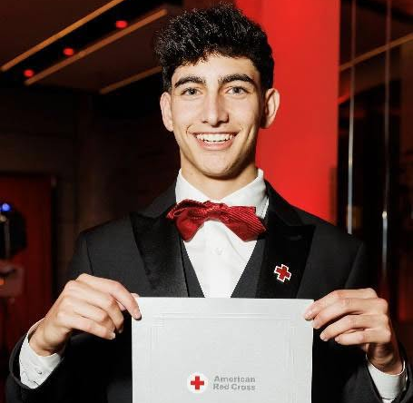
Young Lifeguard Saves a Life
TRAINING SERVICES
STORIES FROM THE FIELD
“I was just in the right place at the right time, with the right preparation. That preparation exists because of the work the Red Cross does every day to educate and empower people in our communities.”
Malik Osman, a high school senior, was recently honored with the Red Cross Lifesaving Award for Professional Responders. Trained in Red Cross Lifeguarding with CPR/AED for Professional Rescuers, First Aid and Administering Emergency Oxygen, he put his skills into action when he spotted a young child struggling in the deep end of the pool. Malik acted without hesitation, jumping in, extracting the child, instructing someone to call 911 and administering CPR. He continued this lifesaving until help arrived. His calm, skilled response shows how training can empower young people to make an extraordinary difference.
Malik Osman,
a lifeguard who utilized his Red Cross training to save the life of a young boy struggling at the deep end of the pool

Slide 30


Our Partnership
Your employees have contributed their valuable time to support [LOS/ACTIVITY] so far this year.
[YOU/EMPLOYEES/CUSTOMERS] have donated more than $#### to the Red Cross this year.
Your employees have donated lifesaving blood to patients in need more than #### times so far this year.

Slide 31
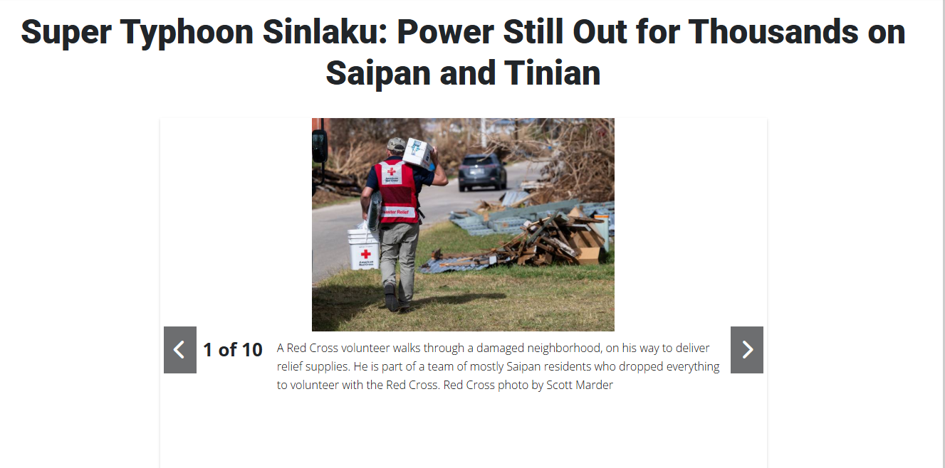
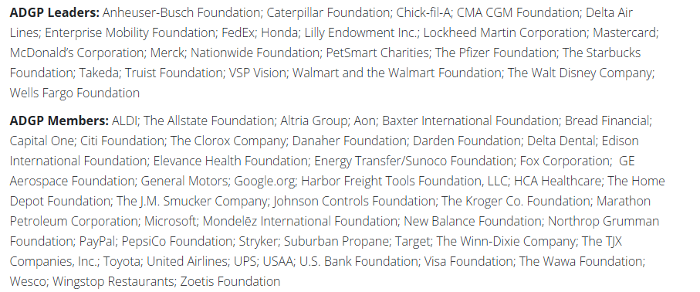
Your Benefits and Resources
We were pleased to recognize you and offer engagement opportunities this quarter.
Acknowledged in seven Disaster Information Update emails to key supporters.
Provided with templated communication materials, including social media posts and content aligned with key messaging moments such as National Volunteer Week (April 19-25), hurricane and wildfire preparedness and summer blood donations.
Featured in four Red Cross stories with more than 11,750 page views.
Recognition in social media digital ads in May including Meta with 17,736,895 views and LinkedIn with 1,537,725 views, highlighting all ADGP Leaders and ADGP Members.
Invited to participate in our Annual Member Satisfaction Survey.

Slide 32
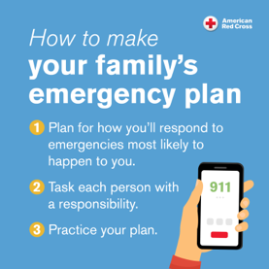
Prepare Today!
In an emergency, every second counts — that’s why it’s essential to be prepared. This is true now more than ever as disasters are becoming more frequent and intense.
Together with partners, the Red Cross stands ready to bring help and hope in times of dire need. And it’s critical that communities and families are prepared to face unexpected crises as well.
The summer months bring conditions conducive to hurricanes and wildfires, and we encourage you to prepare now for disasters big and small.
Visit the Membership Hub or redcross.org for preparedness communication resources to help you and your loved ones stay safe.

Slide 33
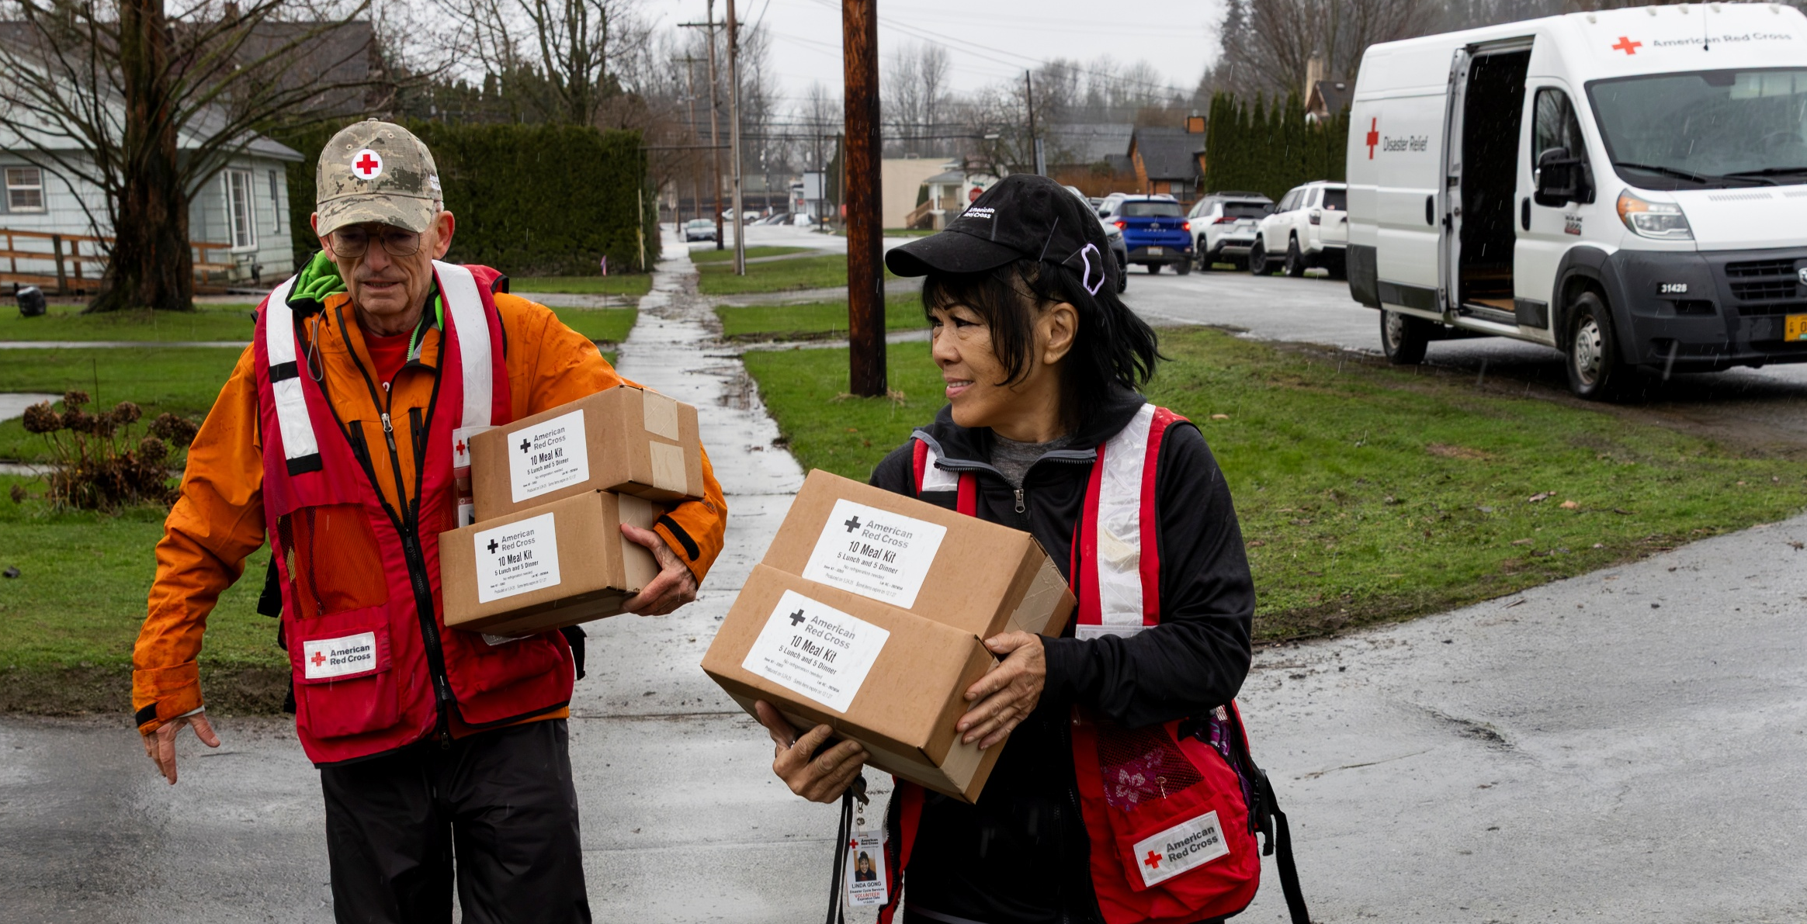
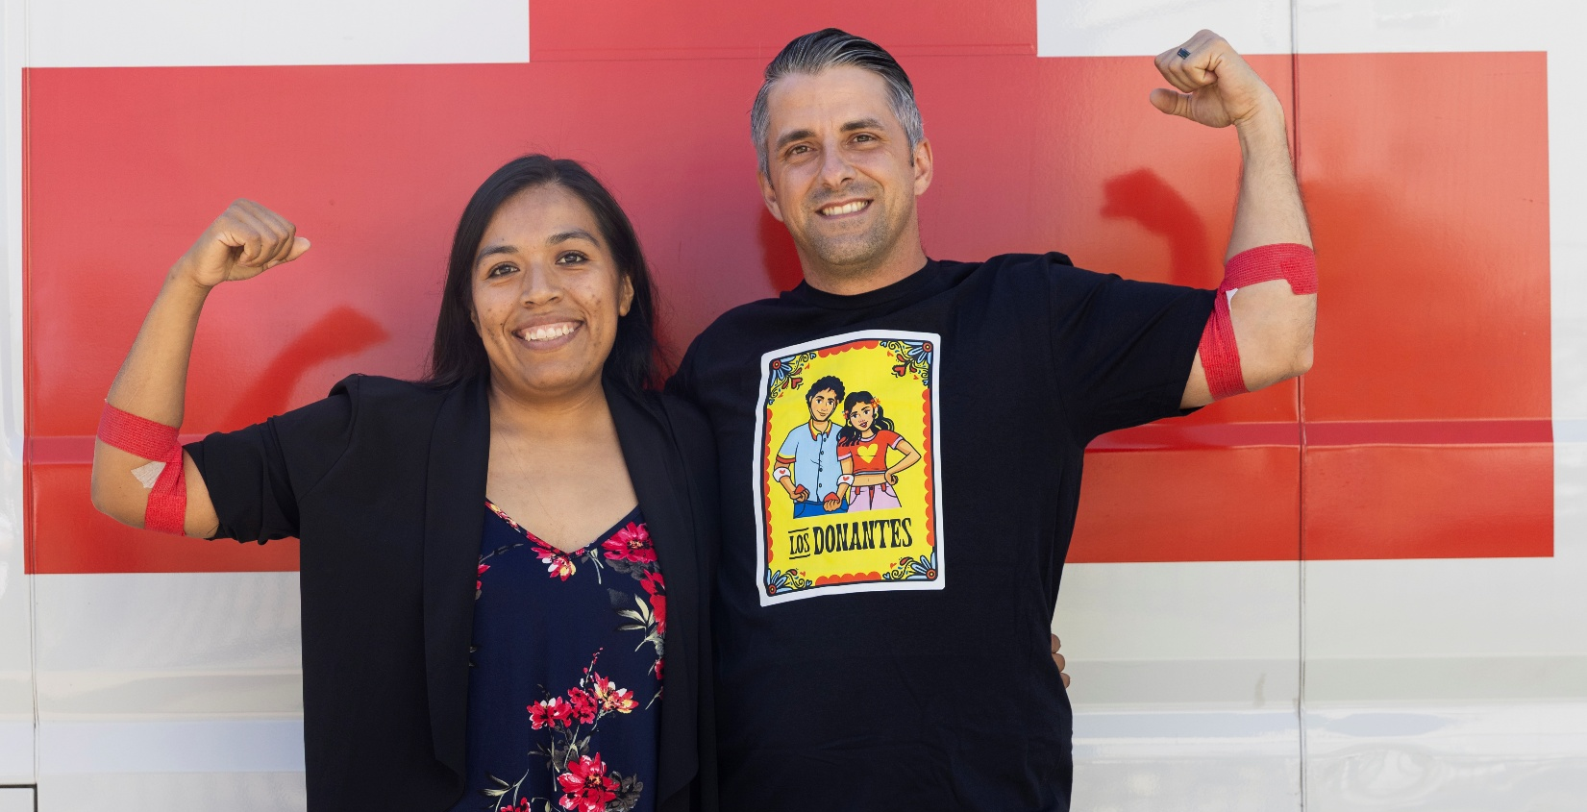
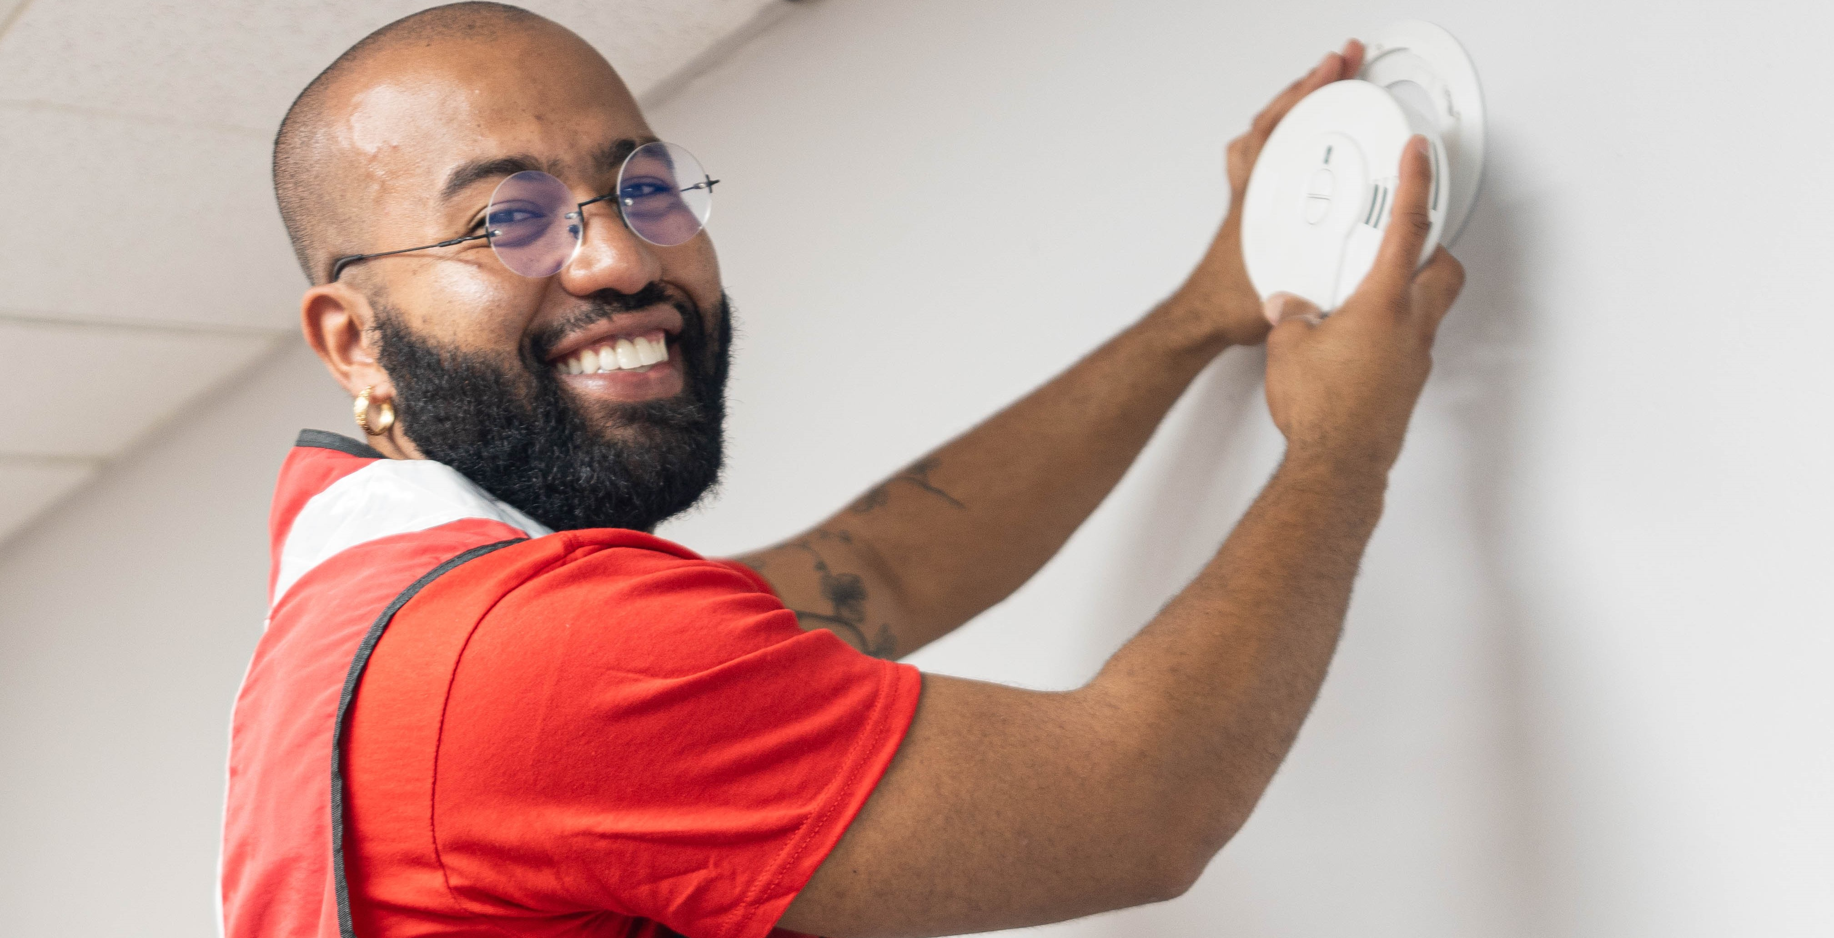
Deepen Your Engagement
Help your employees, customers and others stay engaged and safe this season!
Find Your Perfect
Fit as a Volunteer
Volunteers represent 90% of the Red Cross workforce. To ensure
we can be there for people in their darkest moments, we need more volunteers who are trained and ready to help. Join us to provide relief and hope when they matter most! Find your opportunity today.
Give Blood, Help Save Lives!
Every two seconds, someone in the U.S. needs blood. Blood products are essential for surgeries, cancer treatment, chronic illnesses and traumatic injuries. Schedule your lifesaving blood donation appointment today!
Help Sound the Alarm
for Home Fire Safety
Home fires claim seven lives daily, but working smoke alarms can cut the risk of death by half. Join the Red Cross to install free smoke alarms as part of our Sound the Alarm events. Use the zip code finder to support a local event this spring.

Slide 34
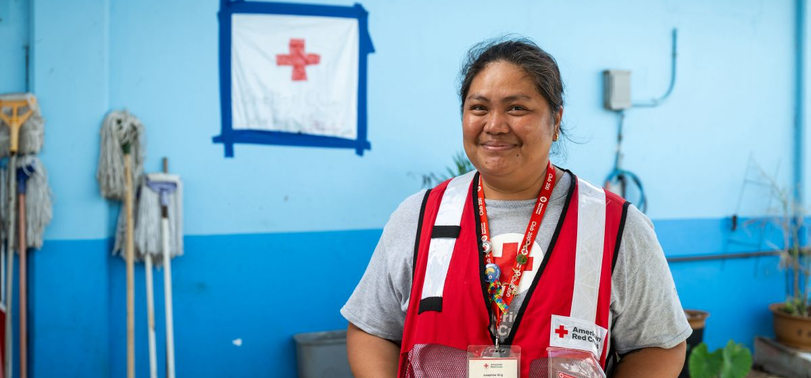

Slide 35
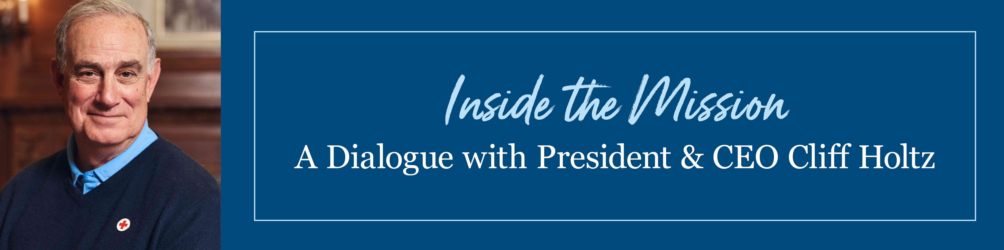
As one of our most generous partners, you are invited to:
Inside the Mission: A Dialogue with American Red Cross President & CEO Cliff Holtz
hosted by Cliff Holtz, President and CEO, American Red Cross
with Trevor Riggen, President, Humanitarian Services
Patti Nagle, Vice President, Donor Services, Biomedical Services
Dialogue will be moderated by Anne McKeough, Chief Development Officer
Wednesday, August 19, 2026
3 p.m. EDT | 2 p.m. CDT | 1 p.m. MDT | 12 p.m. PDT | 11 a.m. AKDT | 9 a.m. HST
Register at redcross.org/augdonorcall

Slide 36
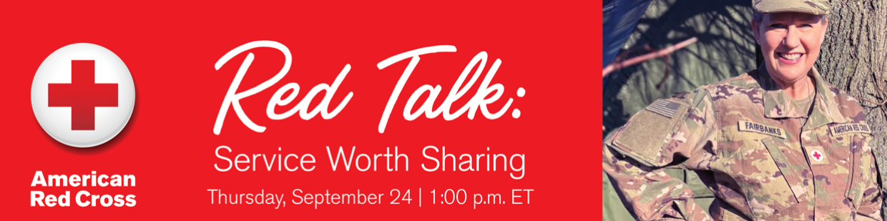
Join Us for Our Next Red Talk!
Beyond the Front Lines: Supporting Those Who Serve—and Those Who Love Them
Featured speakers:
Josett Valdez, Division Fundraising Vice President
Rebecca Streifler, Vice President, International Services/Service to the Armed Forces
Melissa Fairbanks, Tiffany Circle Member & Service to the Armed Forces mobile Teams Reservist, Indiana Region
Michelle Hagge, Senior Service to the Armed Forces Regional Program Specialist
Thursday, September 24
1 p.m. ET | 12 p.m. CT | 11 a.m. MT | 10 a.m. PT
Register Now for the September Red Talk

