Slide 1
QUARTERLY DISASTER UPDATE: FY20 Q3 (Jan.–Mar. 2020)
FOR ADGP MEMBERS

Slide 2
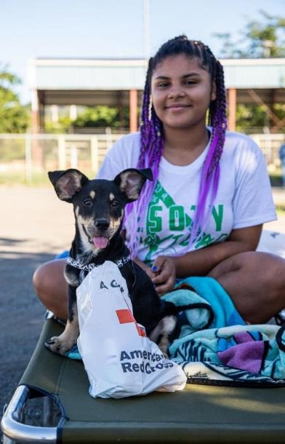
Quarterly Disaster Update
FY20 Q3 (Jan.-Mar. 2020)
CONTENTS
Slide 3: Domestic Disaster Response
Slide 7: International Disaster Response
Slide 10: Your Benefits and Resources
Slide 11: Additional Ways to Join Us

Slide 3
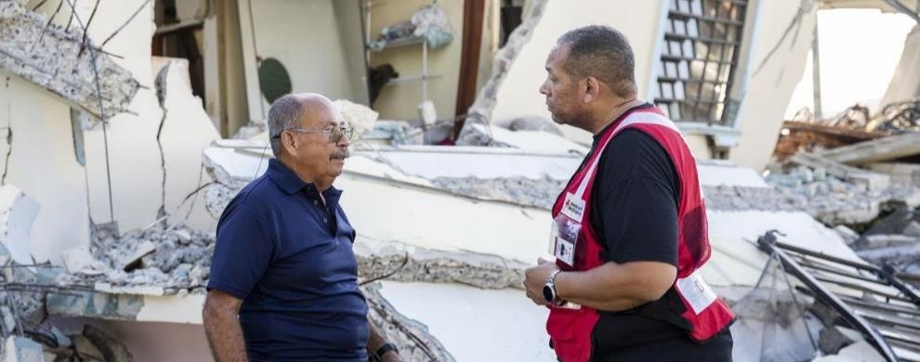
Between January and March 2020, the American Red Cross responded to multiple disasters, including a severe earthquake in Puerto Rico and deadly tornadoes in the Southeast. Your Annual Disaster Giving Program (ADGP) commitment helped us meet immediate needs like food and shelter. At the same time, we’ve pivoted our operations in the face of coronavirus, taking key steps to protect the people we serve and Red Cross disaster workers from this new threat.

Slide 4
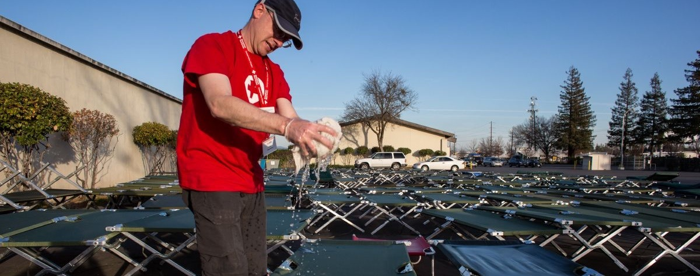
When a tornado destroys a town or a home catches fire, the Red Cross will help, pandemic or not. Working in lockstep with public health officials, we’ve quickly adapted our disaster work in the face of COVID-19—providing more support virtually, securing disinfectants for our shelters and, in many cases, providing hotel rooms rather than shelters to disaster survivors. We’re also supporting quarantine efforts with cots and other supplies.

Slide 5
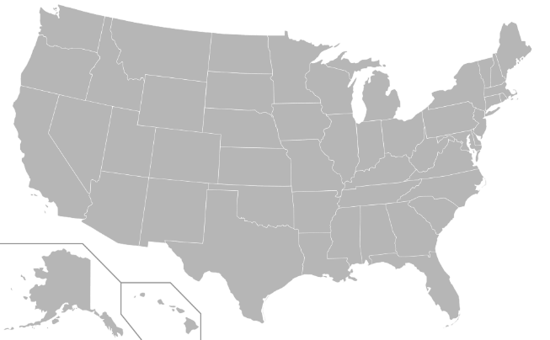
During this quarter, the Red Cross responded to 55 significant U.S. disasters, including 16 very large ones. At the same time, we responded to thousands of everyday disasters, like home fires.
9
Puerto Rico Earthquake (level 4)
AR/MO Floods and Tornadoes (level 3)
Mississippi Storms (level 3)
82 Airborne Support (level 3)
Houston TX Explosion (level 3)
Central MS Floods and Tornadoes (level 4)
Western NC Storms (level 3)
Kentucky Floods (level 3)
Oregon Floods (level 3)
American Samoa Monsoon (level 3)
Tennessee Tornadoes (level 4)
UT Earthquake (level 4)
Central OH Floods (level 3)
Jonesboro AR Tornado (level 3)
Coronavirus Outbreak (level 5)
Coronavirus Outbreak Support for Biomedical Services (level 3)
12
13
8
4
2
11
7
3
14
10
5
6
1
Includes domestic disasters with costs of $10,000+ (i.e. level 2 and higher).
Level 3 disasters have costs of $50,000-$250,000.
Level 4 and higher disasters have costs of $250,000+.

Slide 6




Q3 Domestic Response Totals
More than 2,300 American Red Cross disaster workers and our partners provided critical services to families across the country.
190,100
meals and snacks served with partners
5,200
overnight shelter stays provided with partners
150,400
relief items distributed
20,300
individual care contacts made
7,600
cases opened to provide recovery support
FY20
Totals
738,500
67,200
449,500
77,500
20,800
Includes domestic disasters with costs of $10,000+ (i.e., level 2 and higher).
*Individual care contacts support people’s physical and mental health, including accommodations for disabilities and their spiritual needs during disasters.

Slide 7
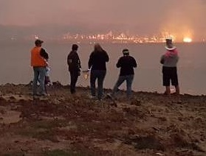

Meanwhile, fires raged in Australia. The world watched, horrified, as uncontrollable bushfires burned more than 40 million acres, an area roughly the size of Florida. The Australian Red Cross offered relief services, distributing essential food, water and hygiene items to more than 60,000 people in need. The American Red Cross provided financial support to help our sister Red Cross respond to the crisis.
International Red Cross and Red Crescent teams also began responding to coronavirus through community-based health and hygiene promotion and access to basic services, as well as expanding case detection and other mitigation activities. Along with funding support, the American Red Cross is contributing data and technical expertise.

Slide 8
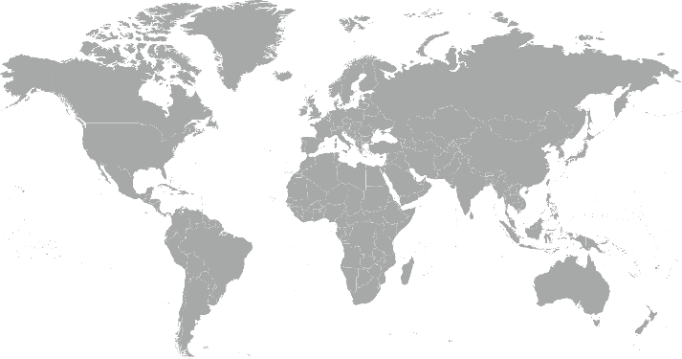
During this quarter, the American Red Cross responded to or continued to respond to 9 major emergencies around the world.
Bahamas Hurricane Dorian
Central African Republic Floods
Americas Population Movement
Samoa Measles Outbreak
Indonesia Jakarta Floods
Philippines Typhoon Phanfone
Albania Earthquake
Australia Wildfires
Global Coronavirus Outbreak
7
1
6
3
2
5
4
8

Slide 9



The American Red Cross actively supported disaster preparedness, relief and recovery work in 16 countries.
Q3 International Response Totals
$9,314,024
funds donated*
9
people deployed
19
preparedness and risk reduction projects
FY20
Totals
$26,450,129
57
26
*Reflects funds donated by American Red Cross to the International Federation of Red Cross and Red Crescent Societies, the International Committee of the Red Cross or Red Cross Red Crescent national societies following specific disasters.

Slide 10
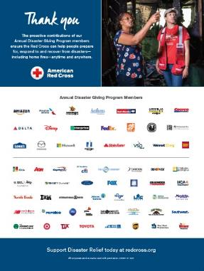
Your Benefits and Resources
We were pleased to provide the following recognition and engagement opportunities during this quarter.
Logo in one full-page ad in Businessweek, on newsstands beginning Mar. 30 for two weeks and generating 600,000 impressions
Acknowledgement in Red Cross FY19 Annual Report and FY19 Disaster Update, annual publications shared with our supporters
Template communications materials provided, including social posts and article content that aligned with “Turn and Test” smoke alarms for Daylight Saving Time and coronavirus messaging
Invitation to exclusive bi-annual members-only update call with Disaster Services leadership on Feb. 13 to discuss The Future State of Disaster Response
  During episodic responses:
  Invitation to two disaster leadership update calls, followed by call summaries
  Recognition in two redcross.org disaster news stories, achieving 27,500 page views
  Recognition in five disaster Information Update emails shared with Red Cross supporters

Slide 11
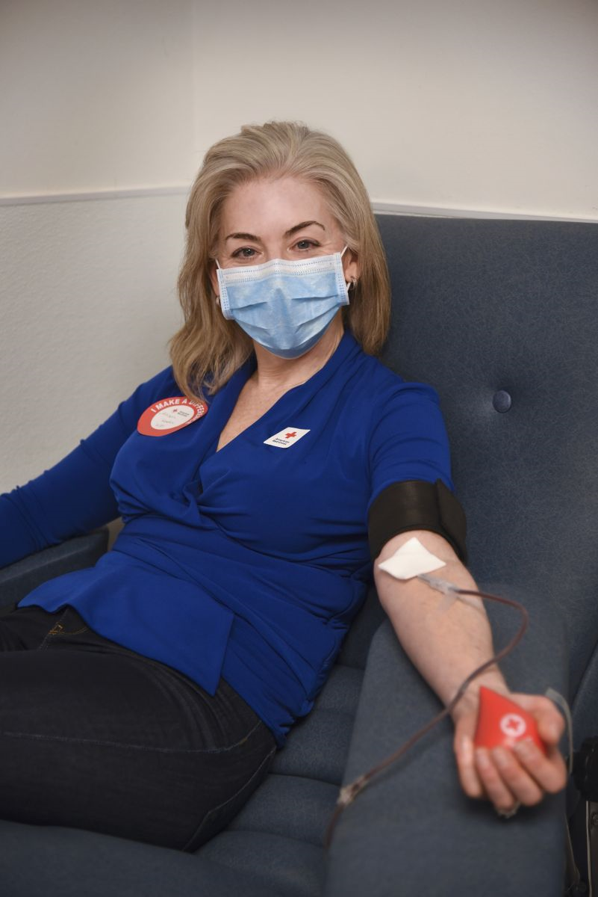
Join Us!
You can help people stay safe and give back during this uncertain time.
Your employees can:
Volunteer with many positions now done remotely
Donate blood if they are feeling healthy and well
Your organization can:
Host a Red Cross-led virtual presentation on COVID-19
Host a blood drive
Launch a SleevesUp virtual blood drive
Contact your relationship manager to learn more.

Slide 12
THANK YOU
FOR YOUR LIFESAVING SUPPORT
During this public health emergency— and year-round— we are so grateful for the advance contributions you make that power our mission to help people prepare for, respond to and recover from disasters big and small.

