Slide 1
QUARTERLY DISASTER UPDATE: FY20 Q4 (April–June 2020)
FOR ADGP MEMBERS

Slide 2
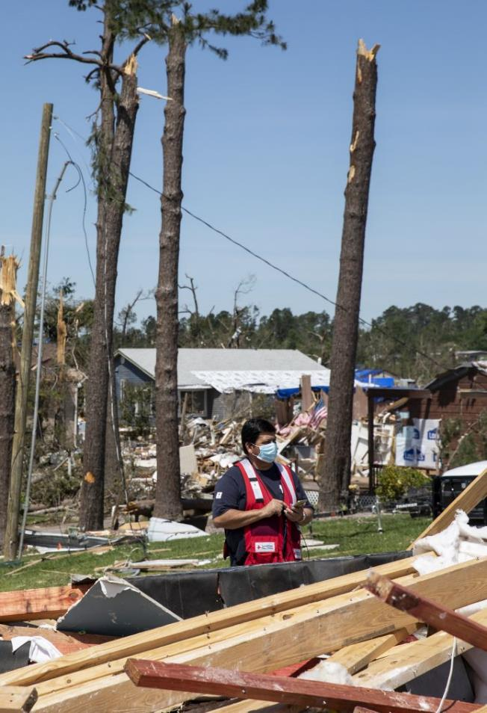
Quarterly Disaster Update
FY20 Q4 (April–June 2020)
CONTENTS
Slide 3: Domestic Disaster Response
Slide 9: International Disaster Response
Slide 11: Your Benefits and Resources
Slide 12: Additional Ways to Join Us

Slide 3
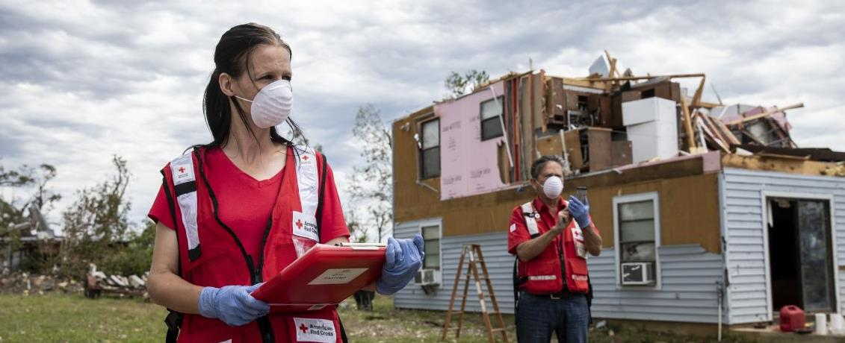
Emergencies don’t stop, even during a pandemic. The American Red Cross steps up during our country’s darkest hours, bringing hope and help when people need it most. While the nation has simultaneously grappled with coronavirus, civil unrest, tornadoes, wildfires, floods and home fires, one thing has remained constant—the Red Cross has been there, meeting critical needs every day and alleviating suffering wherever we see it.

Slide 4
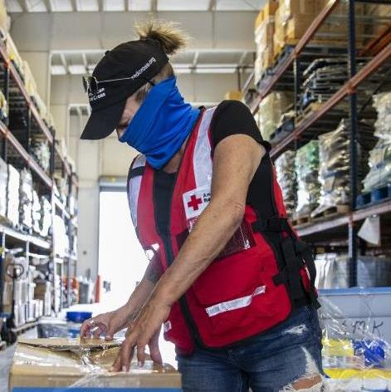
The coronavirus pandemic has demonstrated that operational readiness is more important than ever. So are advance commitments to disaster relief through the Annual Disaster Giving Program (ADGP). Thanks to you and other ADGP members, we were able to pivot quickly in the face of an unprecedented challenge, taking immediate steps to protect disaster survivors and also our workers.

Slide 5
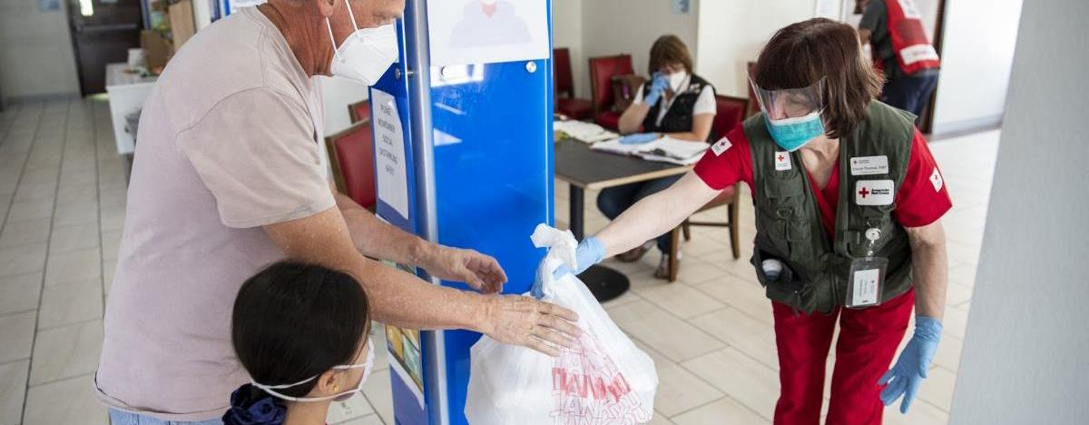
These are some of the changes you helped make possible:
Launching a Virtual Family Assistance Center for people who’ve lost loved ones to COVID-19
Housing many disaster survivors in hotels rather than shelters depending on the circumstances of the disaster
Creating social distancing protocols and deploying them to thousands of workers nationwide
Pivoting to virtual care wherever possible

Slide 6
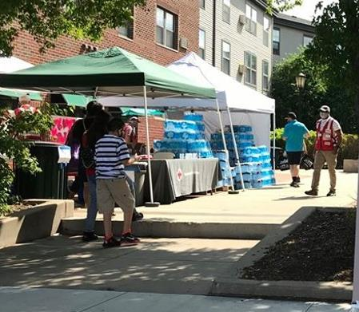
As our nation experienced civil unrest in response to the tragic killing of George Floyd, Red Crossers provided comfort, hope, nourishment and counseling to protestors and community members across the U.S. Our services included respite centers for those unable to return to their homes, feeding at community clean-up efforts, hotel stays for those directly impacted by damage and support for protests, vigils and memorials.

Slide 7
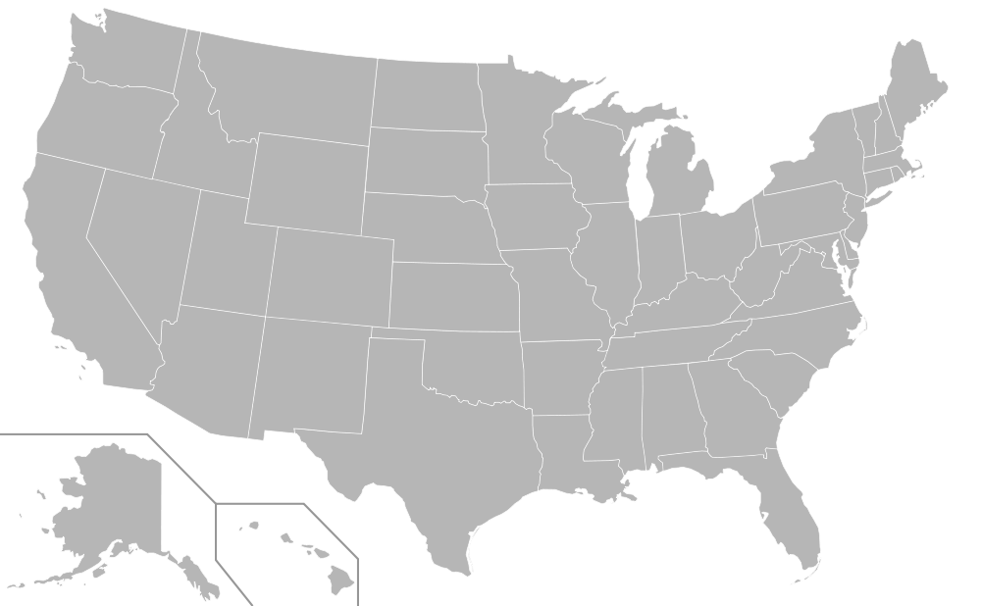
During this quarter, the Red Cross responded to 91 significant disasters across the country, including 16 very large events. At the same time, we responded to thousands of everyday disasters, like home fires.
6
LA Storms (Level 4)
AL/MS Tornadoes (Level 4)
TN Storms (Level 4)
GA Storms (Level 3)
SC Tornadoes (Level 4)
MN Multi-Family Fire (Level 3)
Onalaska TX Tornadoes (Level 4)
Holyoke MA Building Collapse (Level 3)
MI Dam Failure/Floods (Level 4)
OH Floods (Level 3)
FL Floods (Level 3)
MN Civil Disturbance (Level 3)
NM/AZ Forest Fire (Level 3
TS Cristobal LA (Level 3)
TS Cristobal TX (Level 3)
CA Forest Fire (Level 3)
12
9
8
10
16
13
3
5
2
4
7
1
15
14
11
Includes domestic disasters with costs of $10,000+ (i.e. level 2 and higher).
Level 3 disasters have costs of $50,000-$250,000.
Level 4 and higher disasters have costs of $250,000+.

Slide 8




Q4 Domestic Response Totals
Over 3,300 Red Cross disaster workers and partners provided critical services across the country.
152,000
meals and snacks served with partners
39,600
overnight shelter and hotel stays provided with partners
31,900
relief items distributed
21,200
individual care contacts made
5,400
cases opened to provide recovery support
FY20
Totals
900,100
106,800
488,500
99,200
23,800
Includes domestic disasters with costs of $10,000+ (i.e., level 2 and higher).

Slide 9
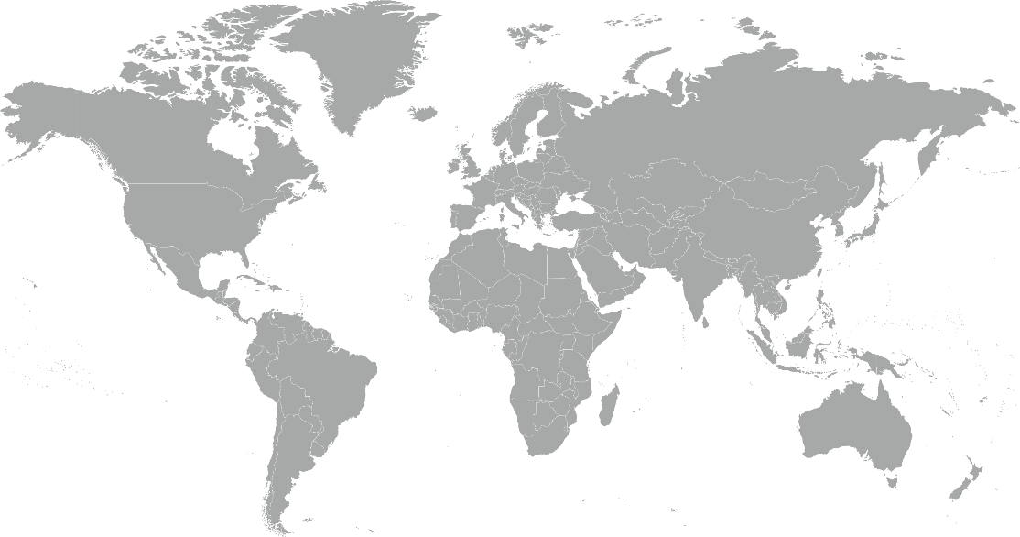
During the quarter, the American Red Cross responded to or continued to respond to 5 major emergencies around the world.
Australia Wildfires
Kenya Floods
Global Coronavirus Outbreak
Bangladesh Tropical Cyclone Amphan
Southern African Drought and Flood
3
4
2
5
1

Slide 10



The American Red Cross actively supported disaster preparedness, relief and recovery work in 17 countries.
Q4 International Response Totals
$7,974,956
funds donated*
3
people deployed
18
preparedness and risk reduction projects
FY20
Totals
$34,425,085
61
26
*Reflects funds donated by American Red Cross to the International Federation of Red Cross and Red Crescent Societies, the International Committee of the Red Cross or Red Cross Red Crescent national societies following specific disasters.
Notes:
I

Slide 11
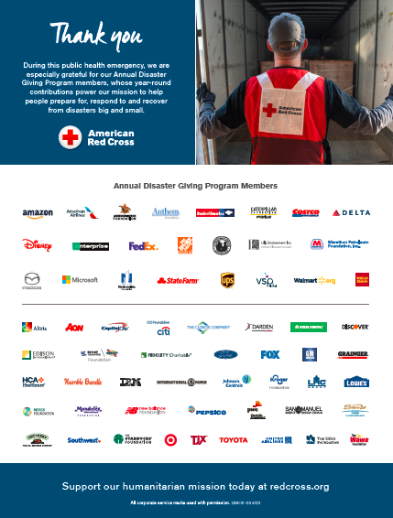
Your Benefits and Resources
We were pleased to provide the following recognition and engagement opportunities during this quarter.
Logo in two full-page ads in national publications, generating a combined 2.3 million impressions:
  TIME Magazine (dated April 27, 2020)
  Fortune Magazine (Fortune 500 issue, dated June 1, 2020)
Template communications materials provided, including social posts and article content. These aligned with timely coronavirus safety, hurricane preparedness and blood donations messaging.
During episodic responses:
Acknowledgment in four disaster news stories on redcross.org, generating a combined 7,500 page views.
Recognition in six disaster Information Update emails shared with Red Cross supporters.
Invitation to leadership update call with president and CEO, Gail McGovern, about how we are adapting our mission during the coronavirus.

Slide 12
Join Us!
The Red Cross has many resources to help people stay safe, get support and help others during these uncertain times.
Safety Tips
Coronavirus Safety Resources
Caring for Pets During COVID-19
Seasonal Disaster Preparedness
Activities & Online Wellness Courses
COVID-19 Kids Activity Kit
Psychological First Aid: Supporting Yourself and Others During COVID-19 Course
Returning to Work During COVID-19 Course
First Aid/CPR/AED During COVID-19 Course
Get Support When You’ve Lost a Loved One
Virtual Family Assistance Center
If you or a loved one lacks internet access, please call 833-492-0094 for help.
Helping Others
Volunteer to help meet urgent needs
Donate blood if they are feeling healthy and well
Download the free Emergency App from the Apple App Store or Google Play.
Access turnkey promotional content here to share these resources with your employees, social followers and even customers.

Slide 13
THANK YOU
FOR YOUR LIFESAVING SUPPORT
In times of crisis and uncertainty, it’s more important than ever to reach people in need. Your Red Cross contribution helps deliver food, shelter, care and comfort during some of life’s darkest moments. Together, we can help the nation through these trying times, serving as a beacon of hope that makes everyone feel safe and welcome.

