Slide 1
QUARTERLY DISASTER UPDATE: FY21 Q2 (Oct. – Dec. 2020)
FOR ADGP MEMBERS

Slide 2
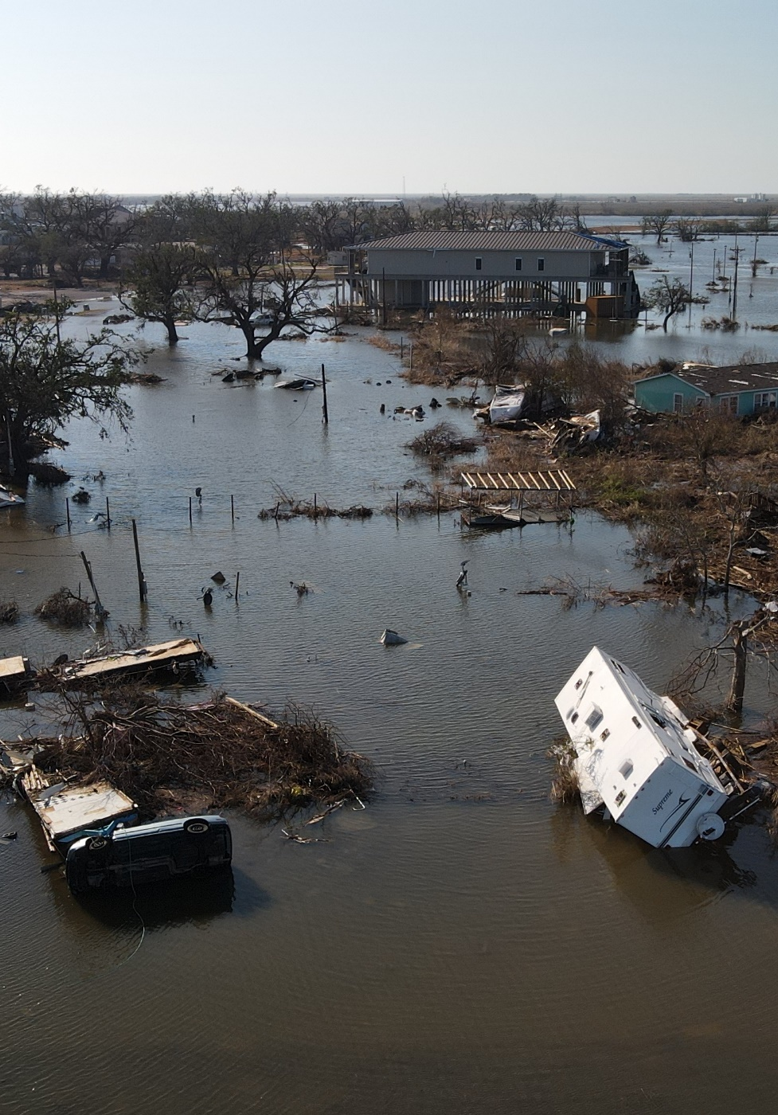
Quarterly Disaster Update
FY21 Q2 (Oct. – Dec. 2020)
CONTENTS
Slide 3:
Slide 9:
Slide 11:
Slide 12:
Domestic Disaster Response
International Disaster Response
Your Benefits and Resources
Additional Ways to Join Us
Notes:
Photo 12804-195

Slide 3
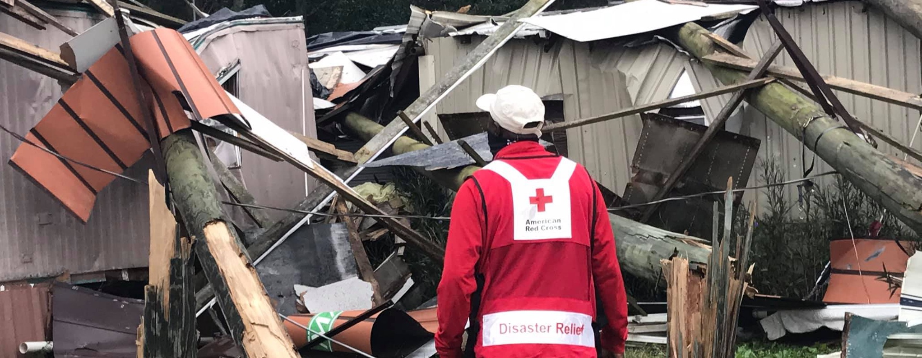
This quarter, amid the COVID-19 pandemic, the Red Cross continued responding to major disasters from coast to coast. Primarily wildfires and hurricanes, they included Hurricane Delta, which devastated Louisiana communities that had just begun rebuilding from Hurricane Laura. Before any of these disasters struck, we were ready to mobilize supplies, equipment and trained workers thanks to Annual Disaster Giving Program (ADGP) members like you.

Slide 4
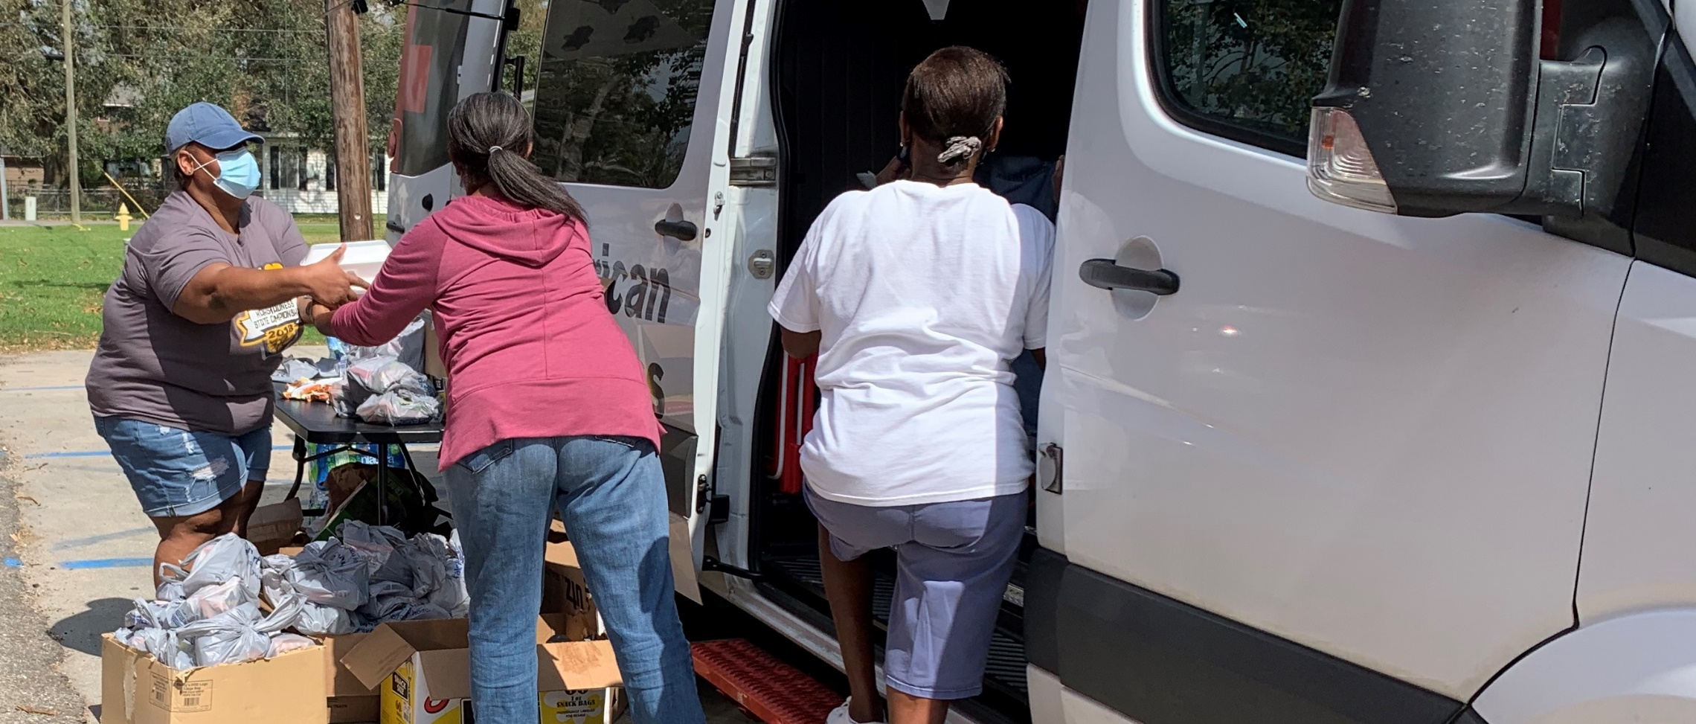
Red Cross aid meant everything to families seeking refuge, nourishing meals and emotional support after disasters. Fall hurricanes and wildfires had a lingering impact, leaving thousands of residents in dire circumstances. They continued to count on the Red Cross for emergency lodging and other basics through December. Their needs were, of course, exacerbated by the pandemic.

Slide 5
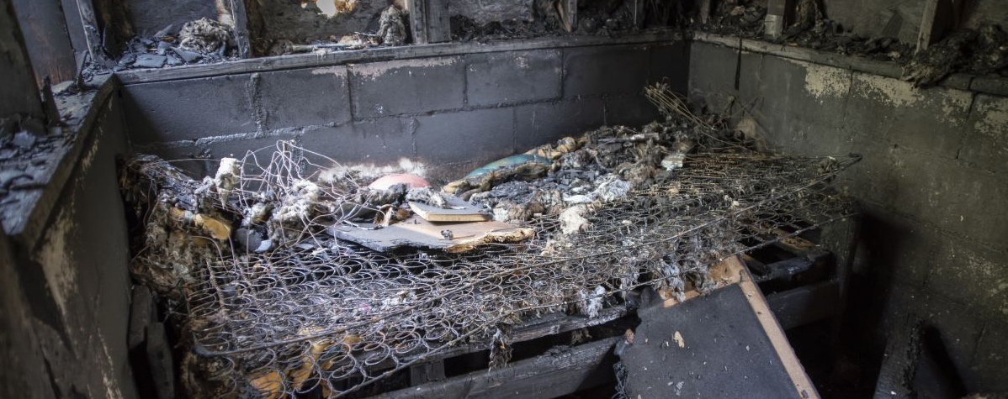
Home fires continued to impact families every single day, including over 10,000 that destroyed lives over the holidays. More home fires occur in the winter than other season. In December alone, we responded to nearly 30% more fires than our monthly average. Trained Red Cross volunteers provided affected families with immediate essentials — everything from nourishing meals to warm places to sleep. They even stuck by survivors as they began the long-term recovery process.
Notes:
Photo 12521-047

Slide 6
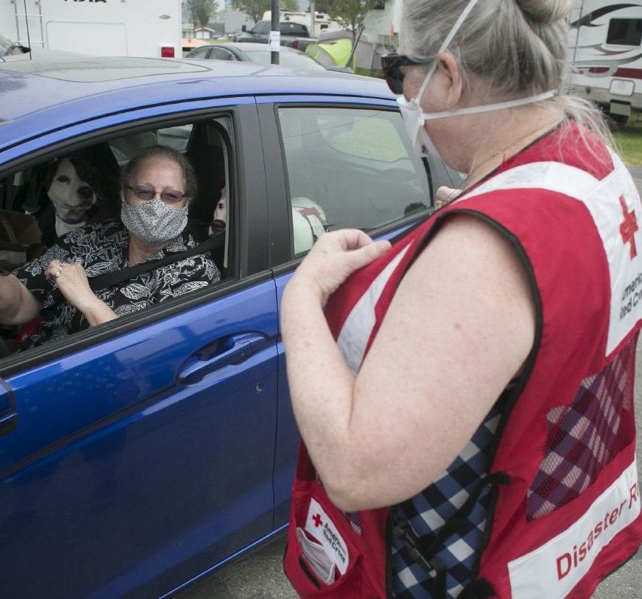
With demand for our services growing, the Red Cross must be ready to help on a larger scale and faster than ever. In December, we launched RC Care, our new client management system, which serves as a central database for all of our recovery support. It’s helping us…
Reach more people
Deliver aid faster
Strengthen partner collaboration
Improve the client experience

Slide 7
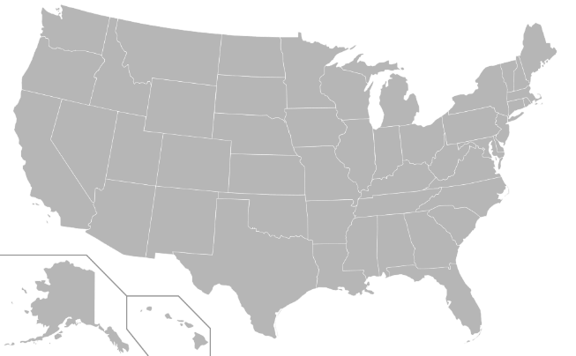
During this quarter, the Red Cross responded to 51 significant disasters across the country, including 13 very large events. At the same time, we responded to thousands of everyday disasters, like home fires.
LA Hurricane Delta (Level 5)
AL/MS Hurricane Delta (Level 4)
LA Hurricane Zeta (Level 4)
AL/MS Hurricane Zeta (Level 4)
Southern CA Forest Fire (Level 3)
NC Hurricane Zeta (Level 3)
GA Hurricane Zeta (Level 3)
FL Tropical Storm Eta (Level 3)
Carolinas Storm (Level 3)
CA Mountain View Fire (Level 3)
Arlington TX Storm (Level 3)
Southeast AK Winter Storm (Level 3)
Orange County CA Fire (Level 3)
10
13
5
6
9
7
11
2
1
3
4
12
8
Includes domestic disasters with costs of $10,000+ (i.e., level 2 and higher).
Level 3 disasters have costs of $50,000-$250,000.
Level 4 and higher disasters have costs of $250,000+.
Notes:
Disaster Fundraising to update

Slide 8




FY21 Q2 Domestic Response Totals
This quarter, over 3,300 Red Cross disaster workers provided critical services across the U.S. During 2020, families spent more nights in emergency lodging than any other year in a decade.
175,200
meals and snacks served with partners
549,800
overnight stays in emergency lodging provided with partners
40,000
relief items distributed
6,500
individual care contacts made
15,100
households provided recovery support
FY21
Totals
3.3 million
1.4 million
400,600
149,500
23,400
Includes domestic disasters with costs of $10,000+ (i.e., level 2 and higher).

Slide 9
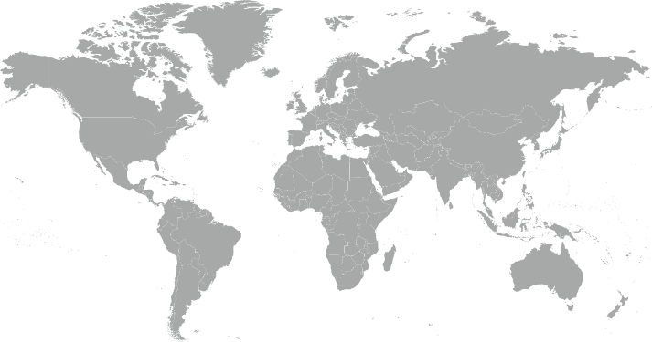
During the quarter, the American Red Cross responded to or continued to respond to 3 major emergencies around the world.
1
Global Coronavirus Outbreak
Hurricanes Eta and Iota
Sudan Floods
2
3
Notes:
International Team to update

Slide 10



The American Red Cross actively supported disaster preparedness, relief and recovery work in 13 countries.
Q2 International Response Totals
$885,000
funds donated*
2
people deployed
20
preparedness and risk reduction projects
FY21
Totals
$9,097,660
4
20
*Reflects funds donated by American Red Cross to the International Federation of Red Cross and Red Crescent Societies, the International Committee of the Red Cross or Red Cross Red Crescent national societies following specific disasters.
Notes:
International team to update

Slide 11
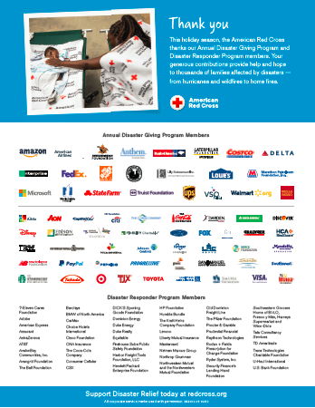
Your Benefits and Resources
We were pleased to provide the following recognition and engagement opportunities during this quarter.
Logo in one full-page ad in Businessweek on Nov. 23, generating more than 500,000 impressions
Video with ADGP end-slate highlighting the disaster work your investment helped us deliver throughout 2020
Acknowledgement in 2020 Red Cross response recap news story on redcross.org posted Dec. 8
Template communications materials, including social posts and articles, provided to align partnership with timely home fire and holiday safety messages
  During major disaster responses:
  Acknowledgment in two disaster news stories on redcross.org, generating more than 6,000 total page views
  Recognition in seven disaster Information Update emails shared with Red Cross supporters
  Invitation to two disaster leadership update calls, followed by detailed call summary

Slide 12
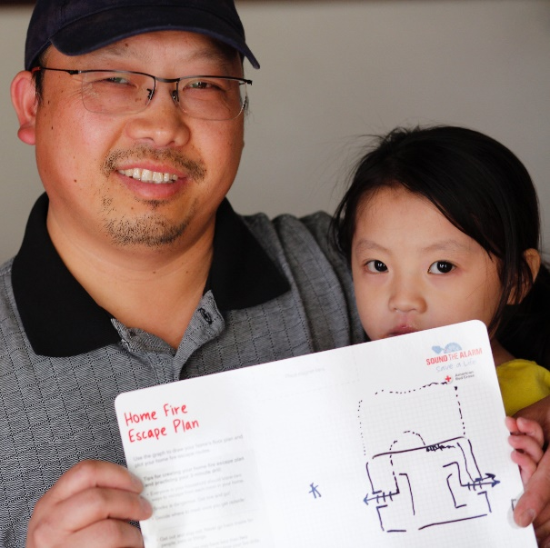
Sound the Alarm 2021
We’re again preparing families against home fires
through our reimagined Sound the Alarm initiative.
Our 2021 goal: Prepare 100,000 people for home fires.
Through virtual education and digital engagement, we’re teaching families about fire
safety and helping them develop escape plans. With fire departments and home rehabilitation programs, we’re also selectively installing smoke alarms.
These activities will be amplified in 50+ signature cities on May 8, 2021, our national Day of Action. Our volunteers plan to visit at-risk families outdoors — masked and from a safe distance — to discuss home fire safety.*
*Plans will be adapted at the community level in line with public health guidance.

Slide 13

Join Us!
As an ADGP member, you can
engage your employees through Sound the Alarm.
Invite employees to prepare for home fires using a self-guided, co-branded “Pledge to Prepare” webpage. Your page will feature a custom introduction and trackable URL, making it easy to target your messaging and see participation rates.
Go a step further by offering live, virtual Be Red Cross Ready presentations. During them, we’ll help your employees prepare for and prevent home fires.
Limited opportunities in our signature cities will be available for employees to volunteer for either doorstep home fire education or telephone follow-up with residents who’ve had alarms installed.
By February 15: More information about these opportunities and identified signature cities will be shared with you.
By March 1: Please let your relationship manager know which interest you.

Slide 14
THANK YOU
FOR YOUR LIFESAVING SUPPORT
2020 was unprecedented in so many ways. While we couldn’t control the challenges faced by our nation and communities, we were prepared to serve people when they needed us most — thanks to generous ADGP members like you.
Notes:
Photo 12776-009

