Slide 1
QUARTERLY DISASTER UPDATE: FY20 Q2 (Oct.-Dec. 2019)
FOR DISASTER RESPONDER PROGRAM MEMBERS
Notes:
Photo 12708-027
October 31, 2019. Santa Rosa, California. Santa Rosa resident Dawnell Binkley was surprised to learn that there was a shelter where she could sleep with her 3 quails and two Weimaraner dogs. She and Red Cross volunteer Tim Stoll take a moment to enjoy the animals.

Slide 2
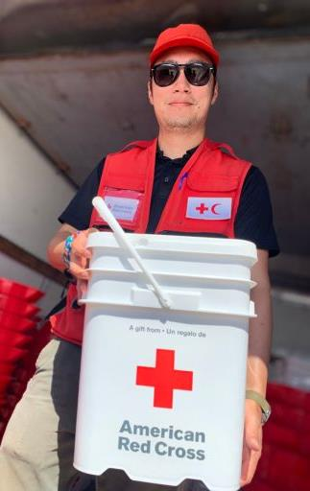
Quarterly Disaster Update
FY20 Q2 (Oct.-Dec. 2019)
CONTENTS
Page 3: Domestic Disaster Response
Page 8: Home Fire Campaign
Page 9: International Disaster Response
Page 11: Your Benefits and Resources
Page 12: Additional Ways to Join Us

Slide 3
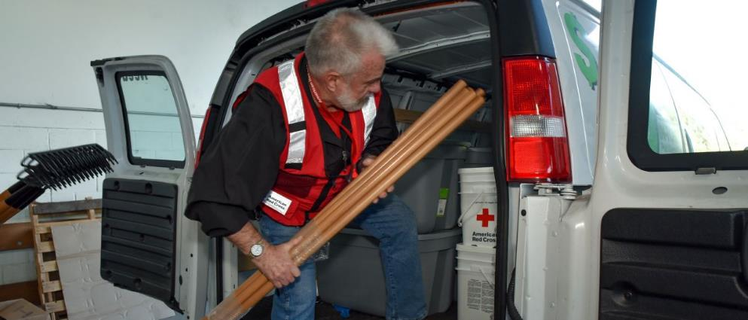
As 2019 came to a close, American Red Cross volunteers helped people impacted by disasters across the country—from back-to-back wildfires in California, severe storms across the Southeast, flooding and tornadoes in Texas and everyday disasters like home fires. Because of your Disaster Responder Program commitment and the generous donations given in anticipation of disaster, we were able to provide immediate relief and comfort to disaster survivors.
Notes:
Photo 12707-071
November 3, 2019. Windsor, California. Red Cross volunteer Kelly Broomall loads a van with rakes and cleanup supplies. These items will be distributed free of charge to families affected by the Kincade Fire.

Slide 4
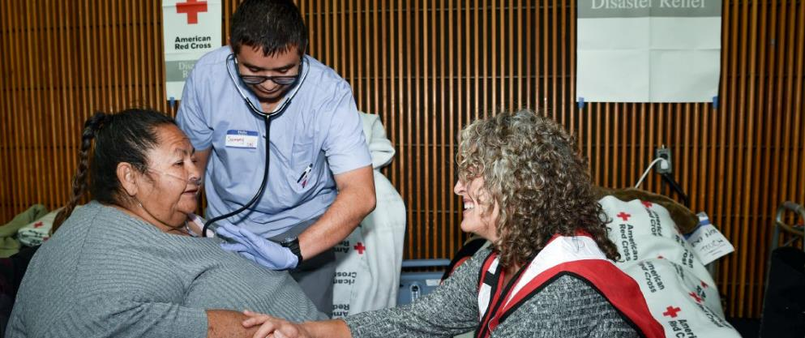
The Red Cross provided vital care to people like Elva Valdespino, of Santa Rosa, CA. After evacuating from a wildfire, Elva wasn’t sure how she would monitor her heart and blood pressure like she was supposed to do. “I was surprised when I found out there was medical staff at the shelter that could help me!”
Notes:
Photo 12707-065
October 31, 2019. Santa Rosa, California. Medical Student Samuel Goana provided medical assistance to Santa Rosa resident Elva Valdespino. Red Cross nurse and volunteer Lori Benevanto comforted Elva as she had her vitals taken.

Slide 5
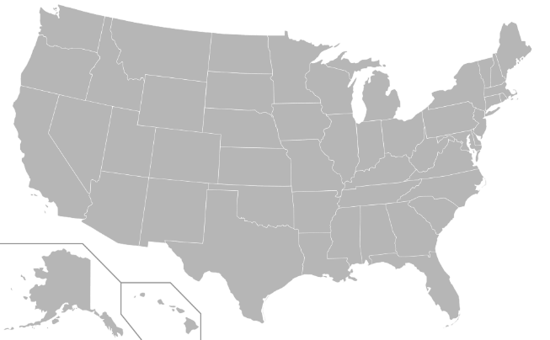
During this quarter, the Red Cross responded to 50 significant disasters across the country, including 10 very large events. At the same time, we responded to thousands of everyday disasters, like home fires.
10
6
Sandalwood, CA Wildfire (level 3)
Dallas, TX Tornado (level 3)
TN Storms (level 3)
CA Kincade Wildfire (level 4)
TN Storms (level 3)
NY Floods (level 3)
TX Explosion (level 3)
NY Sewage Flooding (level 3)
MS Storms (level 3)
Minneapolis, MN Drake Hotel Fire (level 3)
8
1
4
3
5
2
9
7
Includes domestic disasters with costs of $10,000+ (i.e. level 2 and higher).
Level 3 disasters have costs of $50,000-$250,000.
Level 4 and higher disasters have costs of $250,000+.

Slide 6




Q2 Domestic Response Totals
More than 2,200 American Red Cross disaster workers and our partners provided critical services to families across the country.
146,600
meals and snacks served with partners
14,300
overnight shelter stays provided with partners
26,100
relief items distributed
9,200
individual care contacts made
7,400
cases opened to provide recovery support
FY20
Totals
540,600
61,500
117,500
55,400
13,800
Includes domestic disasters with costs of $10,000+ (i.e., level 2 and higher).

Slide 7
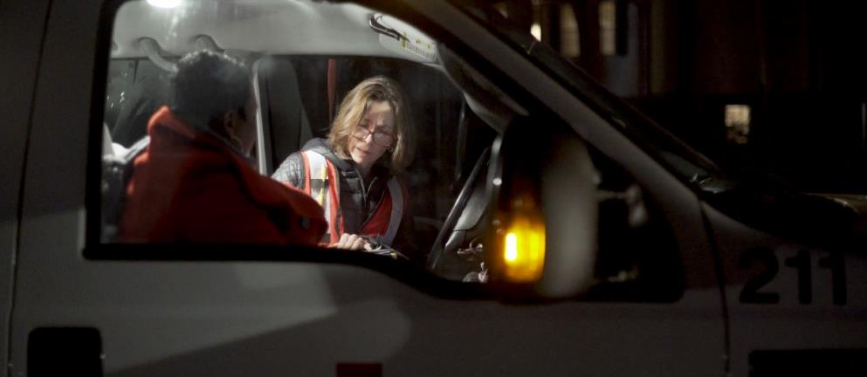
The Red Cross provided shelter and comfort for families impacted by home fires, including one in Minneapolis, Minnesota that displaced more than 250 people on Christmas Day. Winter is the worst season for home fires—with a dramatic spike of 30% during November and December. Volunteers also installed the 2 millionth free smoke alarm through our Home Fire Campaign, which has saved hundreds of lives over the past five years.
Notes:
Photo 12521-047

Slide 8




The Red Cross also supported preparedness and education efforts to combat the nation’s biggest disaster threat – home fires. To date, 699 lives, including those of 227 children, have been saved through campaign efforts.
Q2 Home Fire Campaign Totals
112,500
new smoke alarms installed
3,400
batteries replaced in existing smoke alarms
40,300
escape plans made
46,200
homes made safer
FY20
Totals
187,000
5,400
66,300
76,800

Slide 9
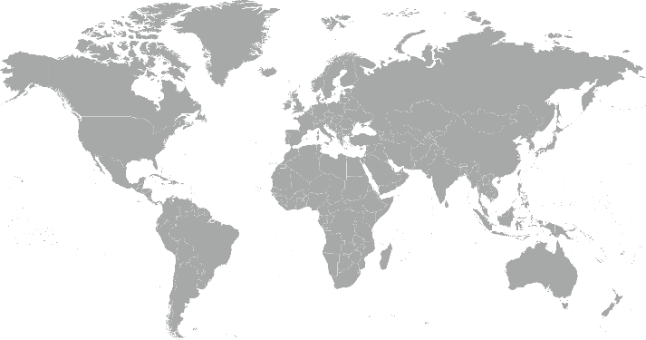
During the quarter, the American Red Cross responded to or continued to respond to 4 major emergencies around the world.
Bahamas Hurricane Dorian
Central America Dengue Outbreak
Zambia Drought
Philippines Mindanao Earthquakes
1
4
2
3

Slide 10



The American Red Cross actively supported disaster preparedness, relief and recovery work in 13 countries.
Q2 International Response Totals
$7,506,500
funds donated*
22
people deployed
18
preparedness and risk reduction projects
FY20
Totals
$17,136,100
51
19
*Reflects funds donated by American Red Cross to the International Federation of Red Cross and Red Crescent Societies, the International Committee of the Red Cross or Red Cross Red Crescent national societies following specific disasters.

Slide 11
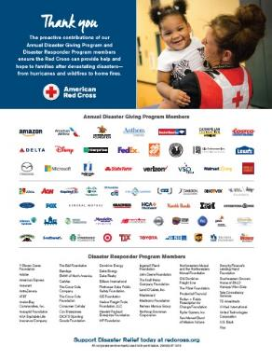
Your Benefits and Resources
We were pleased to provide the following recognition and engagement opportunities during this quarter.
Logo in one full-page ad in Businessweek, on newsstands for two weeks beginning Nov. 18 and generating 600,000 impressions
Acknowledgement in holiday safety news story on redcross.org, published on Nov. 20
One-minute video highlighting the disaster work your investment helped us deliver throughout 2019
Acknowledgement in 2019 Disaster Year in Review press release, which was issued on Dec.10 and picked up by 137 broadcast and print outlets
Template communications materials, including social posts and articles, provided to align partnership with timely home fire and holiday safety messages
  During major disaster responses:
  Acknowledgment in two disaster news stories on redcross.org, generating more than 5,500 total page views
  Recognition in seven disaster Information Update emails shared with Red Cross supporters
  Invitation to one disaster leadership update call, followed by detailed call summary

Slide 12
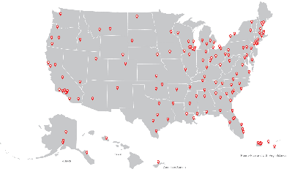
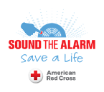
Sound the Alarm to Save Lives from Home Fires
April 18—May 3, 2020
Join Us!
Help us install 100,000 smoke alarms.
On average, seven people die every day from a home fire. But you can help protect families against these tragedies. Join us as we Sound the Alarm this spring and make homes safer in 100+ at-risk communities nationwide.
We’ll work with you—as a Disaster Responder member—to engage your employees as Red Cross volunteers in multiple markets.
By February 14:
Let us know if you’re interested in engaging your employees for Sound the Alarm.
Contact your relationship manager to learn more.

Slide 13
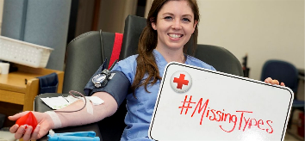

Missing Types Blood Campaign
June 9—June 30, 2020
Join Us!
Help us address a different type of emergency—the need for blood.
The Red Cross and leading companies will again remove the letters A, B and O from their brands and invite the public to fill the need for missing blood types.
Disaster Responder members can receive robust Lead Partner benefits without an additional donation. Simply remove the A, B and O letter(s) from your logo, share that logo through your channels and engage in your choice of several other activations.
By March 1:
Commit to Lead Partner to appear in campaign media pitching.
Contact your relationship manager to learn more.

Slide 14
THANK YOU
FOR YOUR LIFESAVING SUPPORT
Disaster Responder Program members ensure that that Red Cross is ready to deliver dependable aid and help that can’t wait. With your support, we can provide safe shelter, nourishing food, comfort and more to disaster survivors.
Notes:
Photo 12547-065

