Slide 1
FY18 DISASTER UPDATE: Q1 (July-Sept. 2017)
FOR DISASTER RESPONDER MEMBERS

Slide 2
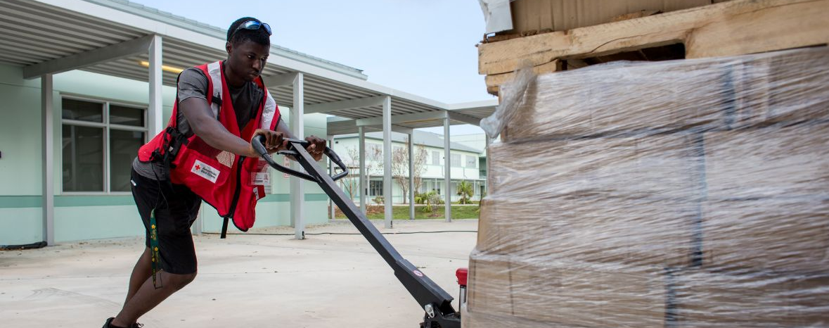
Between July and September 2017, Red Cross volunteers have sprung into action to respond to a string of crises—from major hurricanes impacting eight states and two U.S. territories to wildfires in the West and flooding in the Midwest. Support from Disaster Responder members enabled the Red Cross to mobilize and respond immediately to the needs of hundreds of thousands of people whose lives were upended.

Slide 3
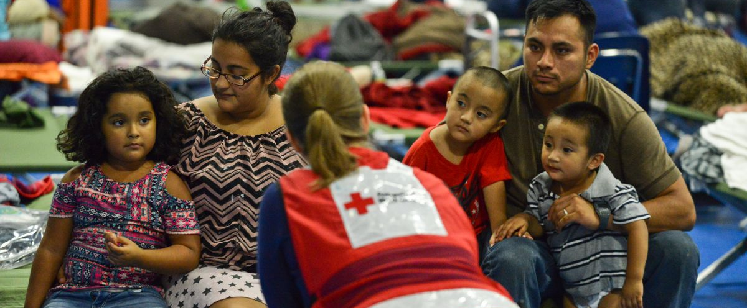
Thousands of Red Cross workers tirelessly delivered relief and comfort for disaster survivors – people like Luisa and Rene, who evacuated their home in Victoria, Texas for the safety of a Red Cross shelter following Hurricane Harvey. Throughout these disasters, the Red Cross has stood with survivors in their darkest hours, just as we do every day in small towns and big cities across the country for home fires and countless other crises.
Notes:
May 2017, Missouri.

Slide 4
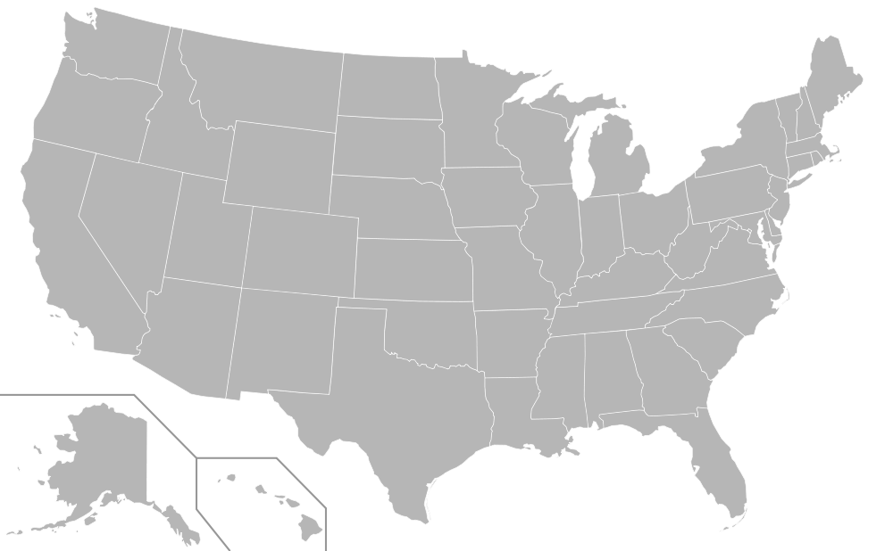
During the quarter, the American Red Cross responded to 80 large-scale disasters across the country, including 25 sizable events. At the same time, we continued to respond to thousands of everyday disasters, like home fires.
9
2
7
25
IL Floods (level 4)
WI Floods (level 4)
CA Wildfires (level 4)
IA Floods (level 3)
MO/KS Severe Storms (level 3)
WV Floods (level 3)
MI Multi-Family Fire (level 3)
Eclipse Readiness (level 3)
OR Wildfires (level 4)
MO/KS Floods (level 3)
TX Hurricane Harvey (level 7)
LA Hurricane Harvey (level 4)
CA Wildfires (level 3)
PR Hurricane Irma (level 5)
USVI Hurricane Irma (level 7)
FL Hurricane Irma (level 7)
GA Hurricane Irma (level 5)
SC Hurricane Irma (level 5)
NC Hurricane Irma (level 5)
VA Hurricane Irma (level 3)
4
13
21
1
6
8
3
5
10
20
19
24
18
22
17
12
11
16
15
14
MD Hurricane Irma (level 3)
AL Hurricane Irma (level 3)
PR Hurricane Maria (level 7)
GA Hurricane Maria (level 3)
NY Multi-Family Fire (level 3)
23
Includes domestic disasters with costs of $10,000+ (i.e. level 2 and higher)

Slide 5




Q1 Domestic Response Totals
In just three months, the American Red Cross provided
more services than our entire last fiscal year.
5,288,000
meals and snacks served
519,000
overnight shelter stays provided in 833 shelters*
2,200,000
relief items distributed
160,000
health and mental health contacts
423,000
households provided recovery assistance
FY18
Totals
5,288,000
519,000
2,200,000
160,000
423,000
Includes domestic disasters with costs of $10,000+ (i.e. level 2 and higher)
*An estimated additional 500,000 overnight shelter stays were provided by Red Cross partners.

Slide 6
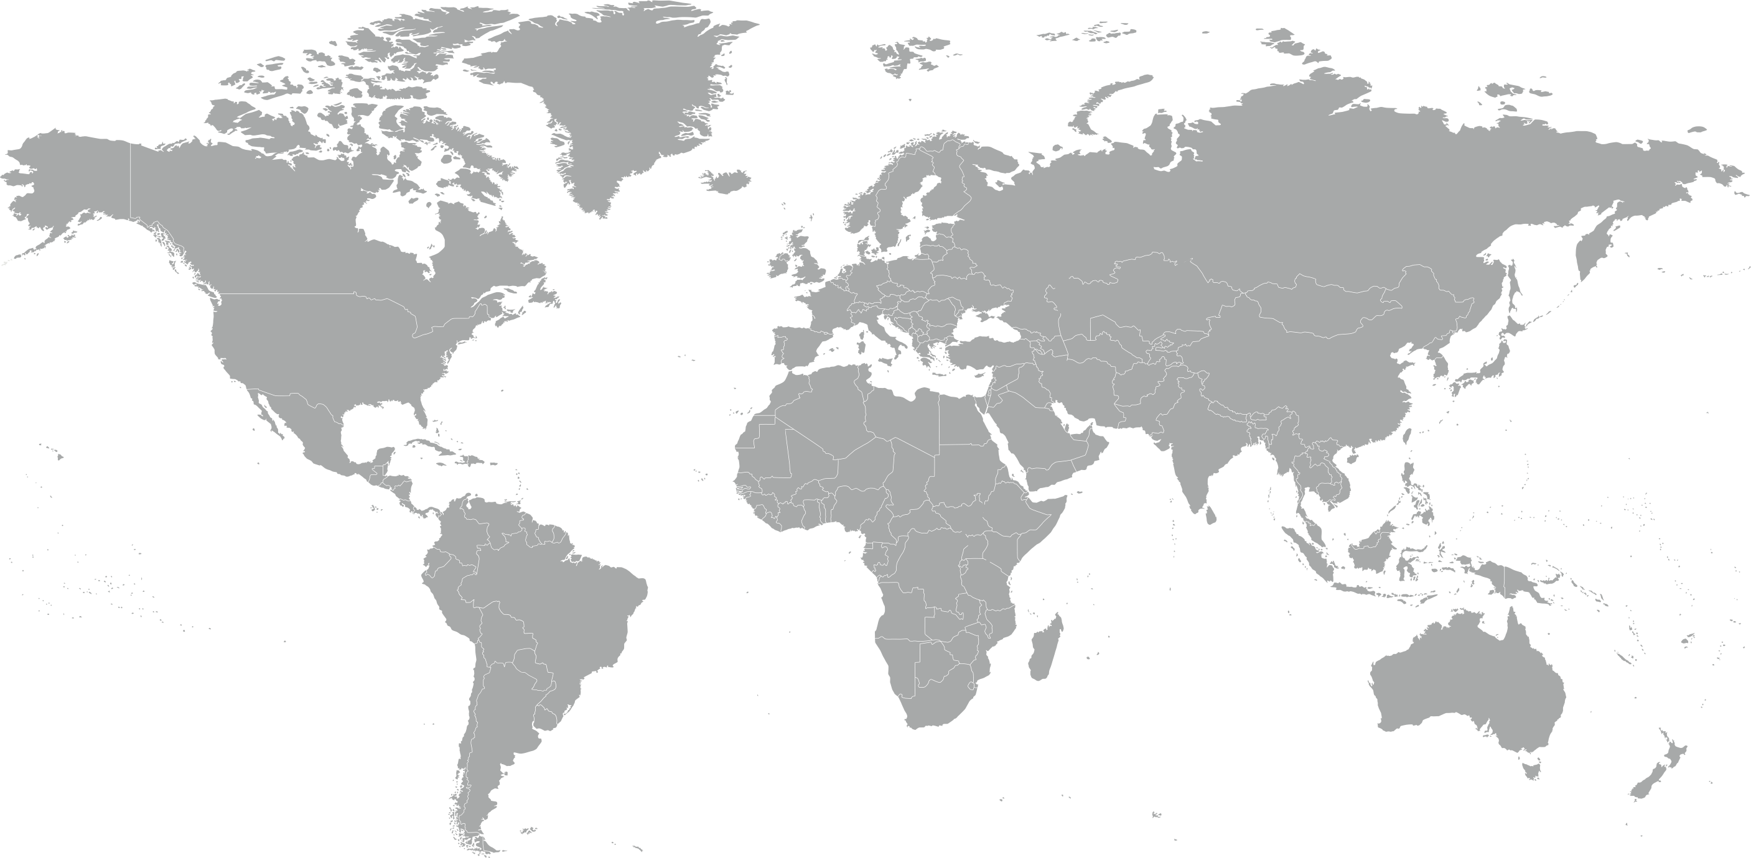
During the quarter, the American Red Cross responded to, and continued responses to, 12 major emergencies around the world.
Africa Drought and Food Crisis
Bangladesh Floods
Colombia Mudslide
Bangladesh Cyclone Mora
Europe Population Movement
Hurricane Irma (Cuba, St. Kitts & Nevis, Antigua & Barbuda)
Hurricane Maria (Dominica)
Mexico Earthquake
Nepal Floods and Landslides
Peru Floods
Syria Crisis and Population Movement
Bangladesh Population Movement
5
11
9
8
6
7
2
3
1
12
4
10

Slide 7

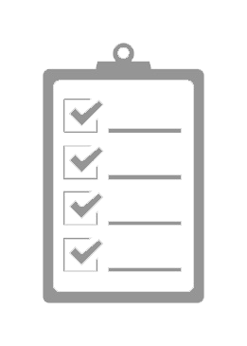


The American Red Cross actively supported disaster preparedness, relief and recovery work in 27 countries.
Q1 International Response Totals
$2,344,700
funds donated*
10
people deployed
25,000
supplies provided
30
preparedness and risk reduction projects**
FY18
Totals
$2,344,700
10
25,000
30
*Reflects funds donated by American Red Cross to IFRC, ICRC or Red Cross. Red Crescent national societies following specific disasters
**Does not include ongoing recovery projects in Haiti.

Slide 8
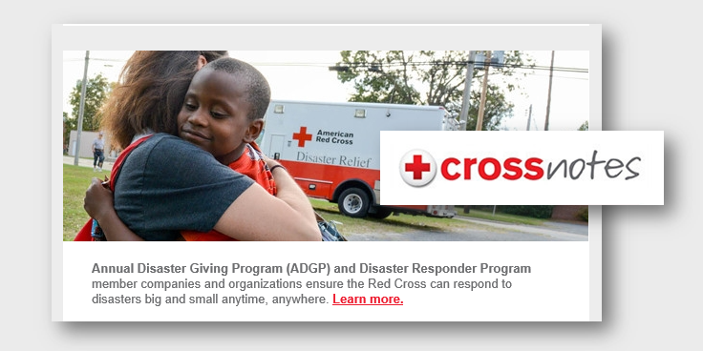
Your Benefits and Resources
We were pleased to provide you with the following recognition and engagement opportunities during this quarter.
  Program acknowledgement in July Crossnotes e-newsletter, received by 1.2 million loyal Red Cross supporters
  Template communications materials to align with home fire safety
  During major disaster responses:
    Acknowledgment in 7 disaster press releases distributed nationwide, each picked up by an average of 242 online news outlets (including Markets Insider, MarketWatch, TheStreet.com, as well as Business Journals and ABC, CBS, Fox and NBC websites in a variety of markets across the U.S.)
    Recognition in 6 redcross.org disaster news stories, achieving more than 65,000 page views
    Recognition in 36 disaster Information Update emails shared with Red Cross supporters
    Invitation to 4 disaster leadership update calls, followed by call summaries and promotional resources

Slide 9


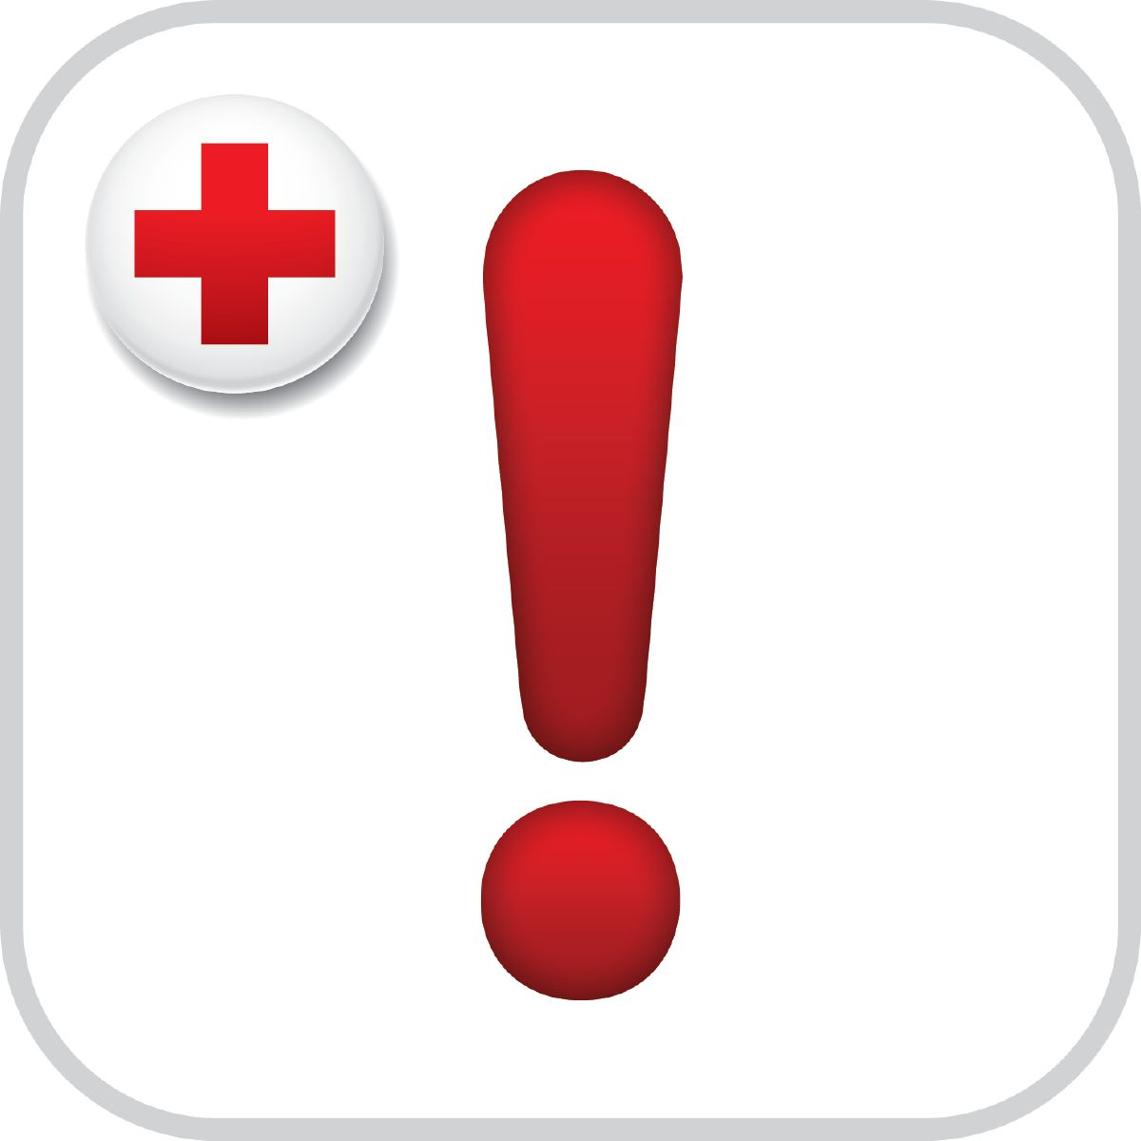
Join Us!
You, your employees and even your customers can get involved with the Red Cross in these timely ways.
Blood emergency.
The U.S. blood supply is dangerously low. Schedule an appointment to donate today.
Become a volunteer.
Your time and talent can make a real difference in people’s lives. Join us at redcross.org/volunteer.
Be disaster ready.
Download the Red Cross Emergency App by texting "GETEMERGENCY" to 90999 and keep your families safe.

Slide 10
THANK YOU
FOR YOUR LIFESAVING SUPPORT
Whether it provides warm meals to people forced from their homes, cleanup supplies to hurricane survivors or caseworkers to help families put life back together, your Disaster Responder donation is at work every day, turning despair into hope.

