Slide 1
FY18 DISASTER UPDATE: Q2 (Oct.-Dec. 2017)
FOR DISASTER RESPONDER MEMBERS

Slide 2
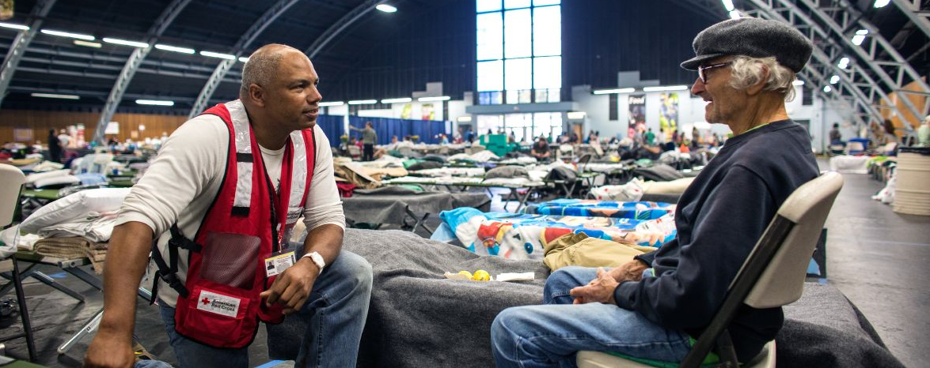
Between October and December 2017, the American Red Cross continued to break records. We led ongoing response and recovery efforts around three historic, back-to-back hurricanes; we helped after the deadliest mass shooting in modern U.S. history; and we supported families devastated by California wildfires—all while addressing everyday disasters, like home fires, in communities across the country.
Notes:
Photo 12276-022

Slide 3
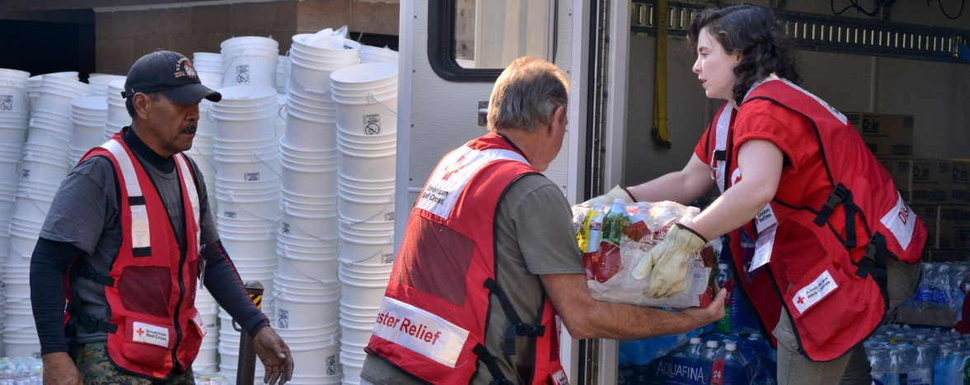
Red Cross volunteers delivered relief and comfort in countless places, including Ventura, California, where workers unloaded water, food and face masks to protect residents from day after day of smoke filled air. Support from Disaster Responder members enabled the Red Cross to mobilize and respond immediately to the needs of thousands of people whose lives were upended.
Notes:
May 2017, Missouri.

Slide 4
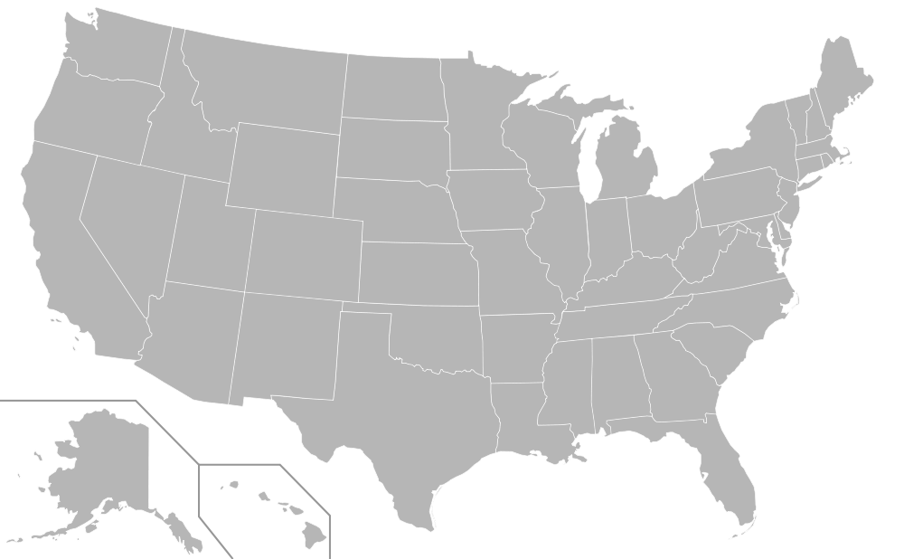
During the quarter, the American Red Cross responded to 50 large-scale disasters across the country, including 12 sizable events. At the same time, we continued to respond to thousands of everyday disasters, like home fires.
9
10
FL Hurricane Maria Evacuation (level 3)
Las Vegas, NV Mass Shooting (level 4)
LA Hurricane Nate (level 3)
MS Hurricane Nate (level 3)
AL Hurricane Nate (level 3)
GA Hurricane Nate (level 3)
FL Hurricane Nate (level 3)
TN Hurricane Nate (level 3)
Northern CA Wildfires (level 6)
NY Hurricane Maria Evacuation (level 3)
TX Mass Shooting (level 3)
Southern CA Wildfires (level 4)
2
12
8
5
6
3
4
7
11
1
Includes domestic disasters with costs of $10,000+ (i.e. level 2 and higher)

Slide 5

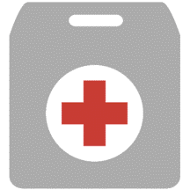


Q2 Domestic Response Totals
More than 7,300 American Red Cross disaster workers provided critical services to families across the country.
11,543,600
meals and snacks served
128,100
overnight shelter stays provided in 117 shelters
5,726,800
relief items distributed
100,900
health and mental health contacts
179,200
households provided recovery assistance
FY18
Totals
16,831,800
647,500
7,926,700
260,600
602,500
Includes domestic disasters with costs of $10,000+ (i.e. level 2 and higher)

Slide 6
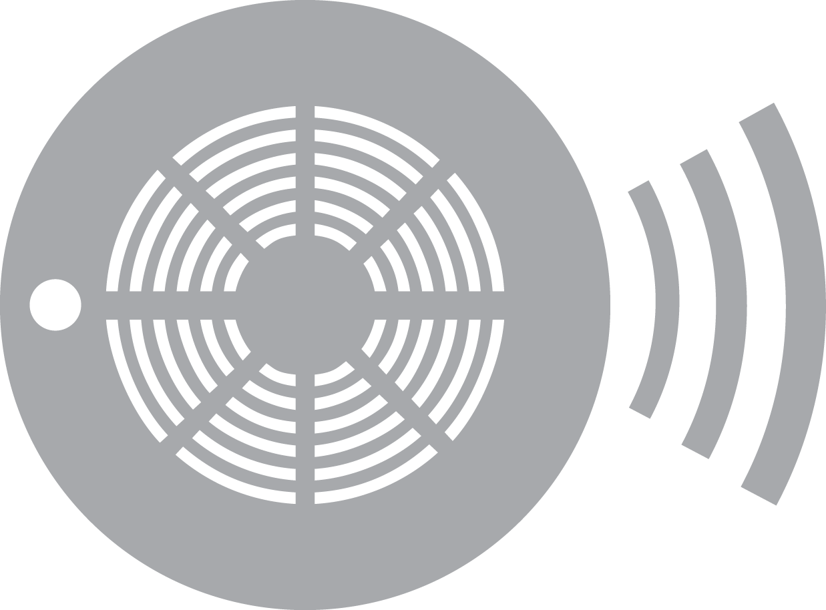
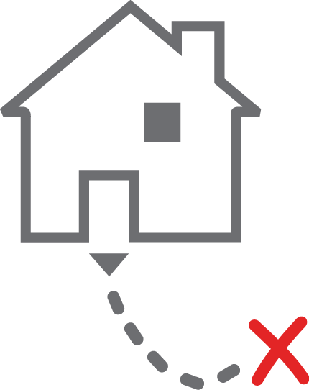
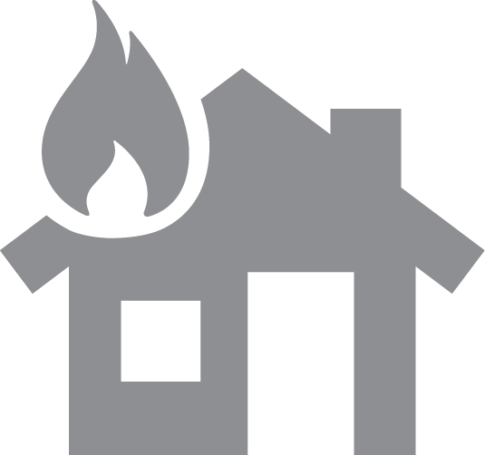

The American Red Cross also supported preparedness and education efforts to combat the nation’s biggest disaster threat – home fires.
Q2 Home Fire Campaign Totals
99,900
New smoke alarms installed
3,700
Batteries replaced in existing smoke alarms
34,400
Escape plans made
41,600
Homes made safer
FY18
Totals
161,100
6,200
56,700
67,700

Slide 7
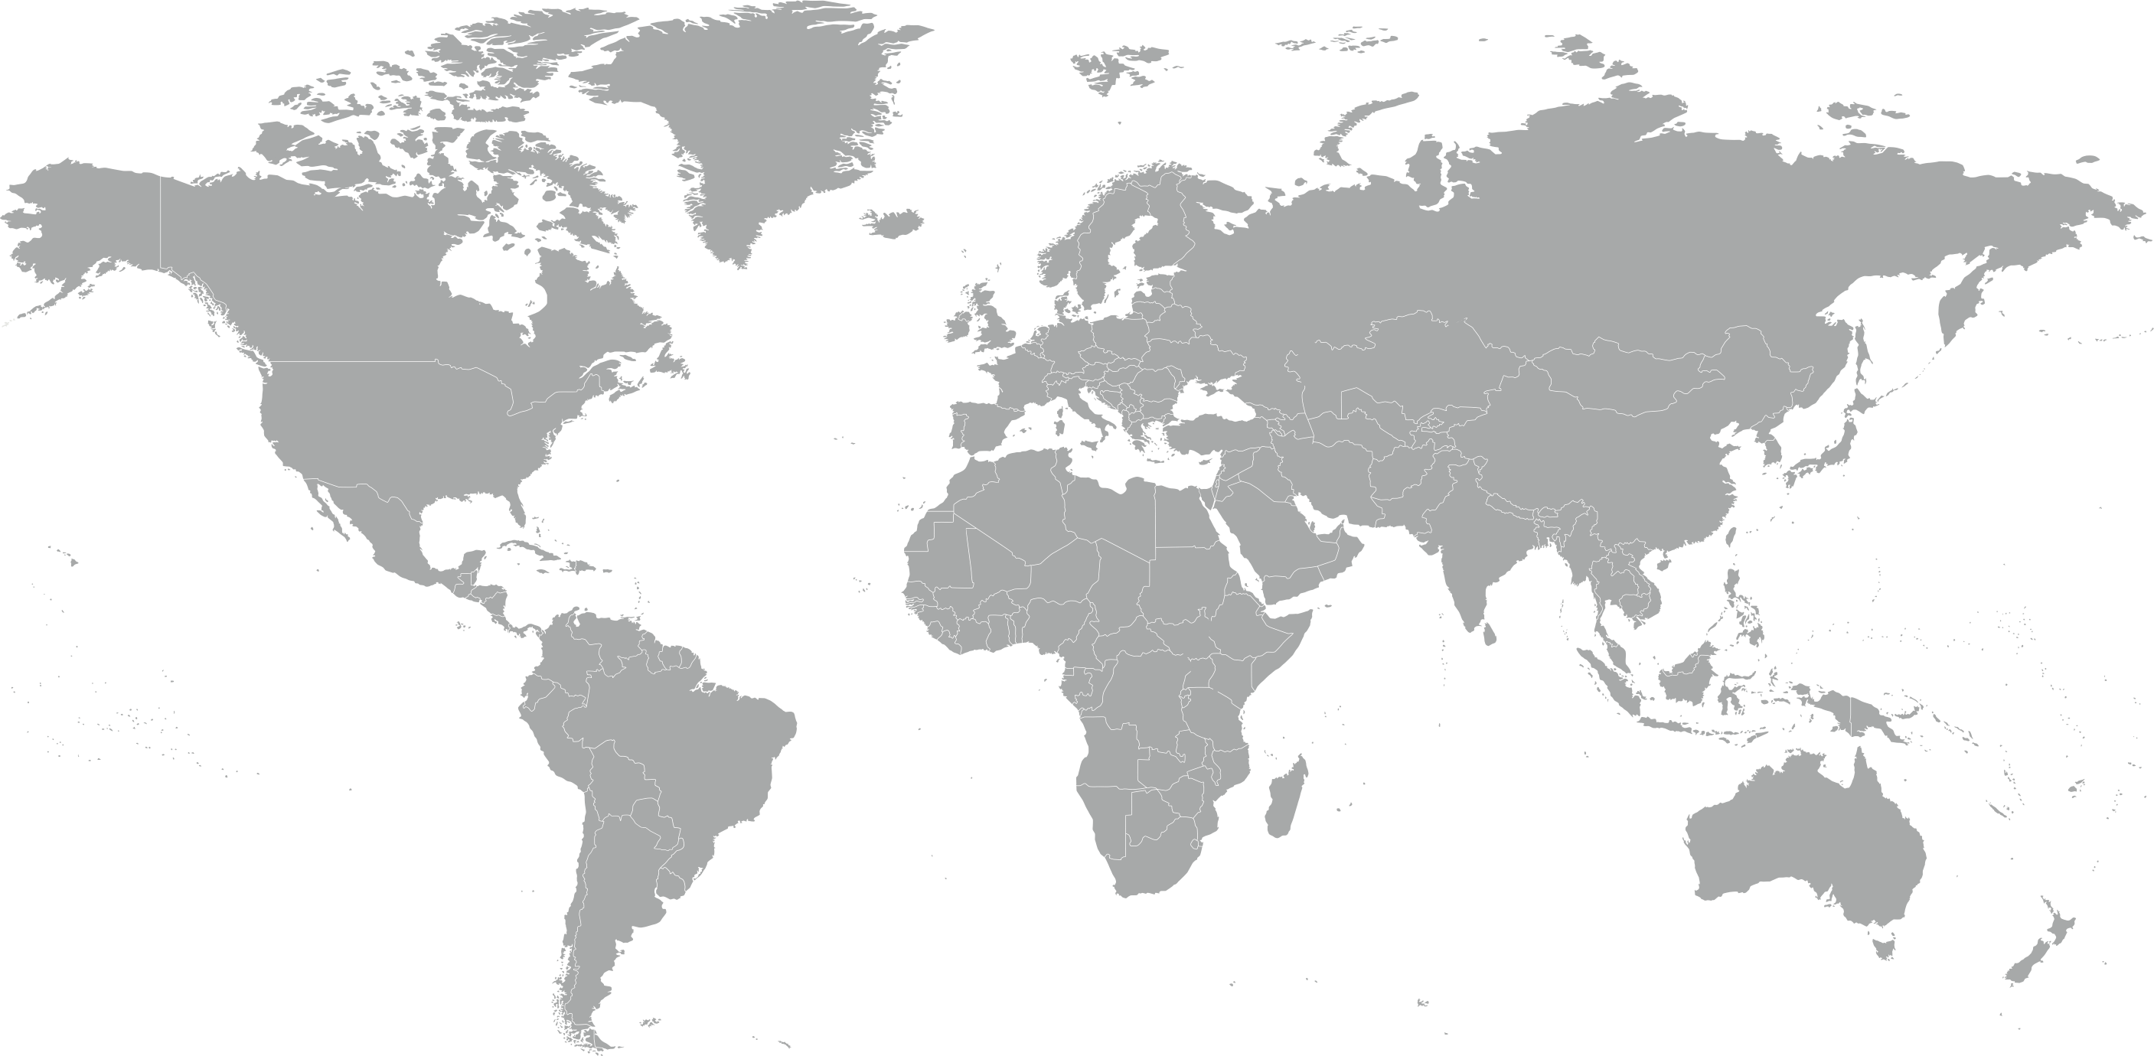
During the quarter, the American Red Cross responded to, and continued responses to, 9 major emergencies around the world.
Bangladesh Floods
Bangladesh Population Movement
Costa Rica Floods
Europe Population Movement
Hurricane Maria
Madagascar Plague
Mexico Earthquake
Nepal Floods and Landslides
Sierra Leone Mudslide
4
8
7
5
3
9
1
2
6

Slide 8

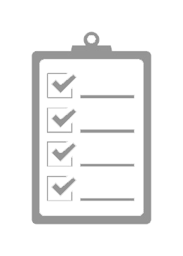

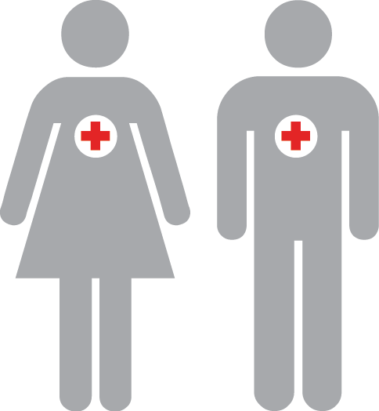
The American Red Cross actively supported disaster preparedness, relief and recovery work in 22 countries.
Q2 International Response Totals
$3,985,100
funds donated*
9
people deployed
0
supplies provided
28
preparedness and risk reduction projects**
FY18
Totals
$6,329,800
20
25,000
33
*Reflects funds donated by American Red Cross to IFRC, ICRC or Red Cross Red Crescent national societies following specific disasters.
**Does not include ongoing recovery projects in Haiti.

Slide 9
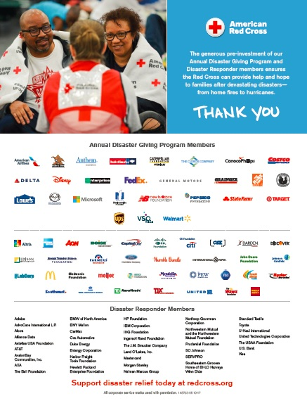
Your Benefits and Resources
We were pleased to provide you with the following recognition and engagement opportunities during this quarter.
Acknowledgement in annual program recognition national press release issued on Oct. 18, picked up by 238 broadcast and print websites
Name in full-page national print advertisement in Businessweek Nov. 6 issue, generating 600,000 impressions
Timely communications materials – including social posts/graphics and article content – to align partnership with holiday safety and giving
Acknowledgement in 2017 Disaster Year in Review national press release issued on Dec. 7, picked up by 237 broadcast and print websites
  During major disaster responses:
  Acknowledgment in 2 disaster national press releases, each picked up by an average of 242 broadcast and print websites
  Recognition in 3 disaster redcross.org news stories, achieving a combined 28,000 page views
  Listing in 19 disaster Information Update emails shared with Red Cross supporters
  Invitations to 2 disaster leadership update calls, followed by detailed call summaries

Slide 10
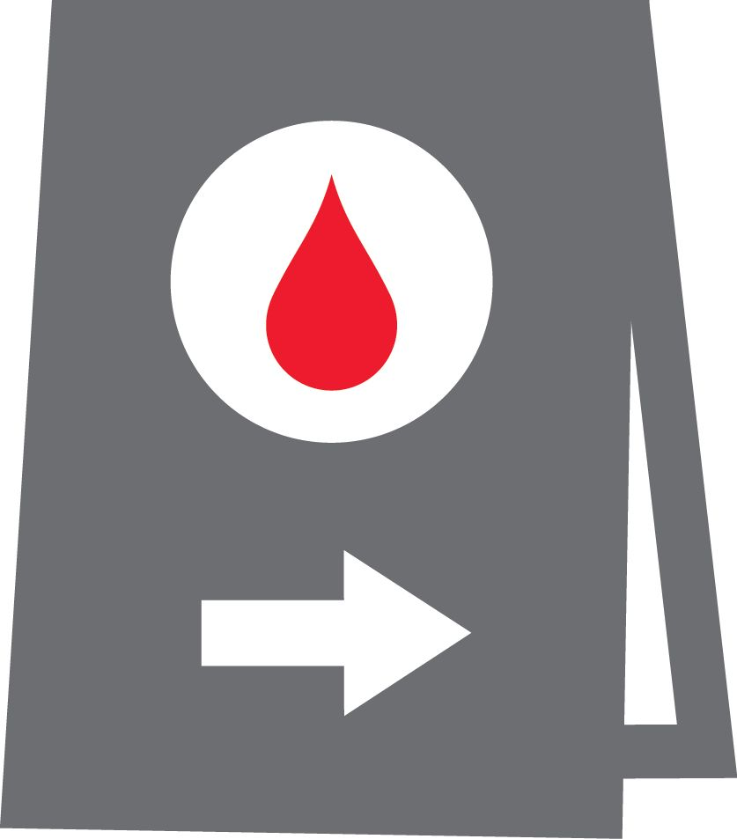

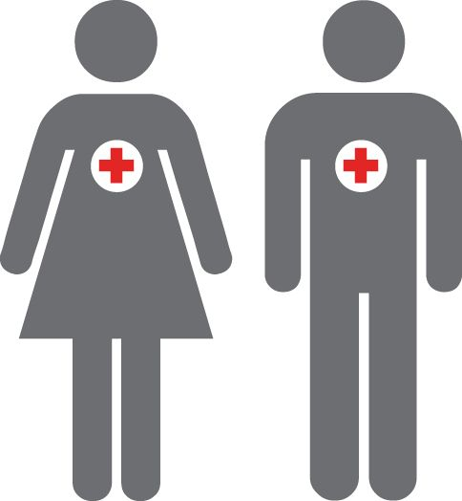
Join Us!
You, your employees and even your customers can get involved with the Red Cross in these timely ways.
Urgent blood needs.
There is an immediate need for all blood types. Schedule an appointment to donate today.
Sound the
Alarm.
Help save lives in your community. Join us to Sound the Alarm about home fire safety.
Be disaster
ready.
Put safety first this New Year – learn simple steps you can take right now to be prepared in the event of a home fire.

Slide 11
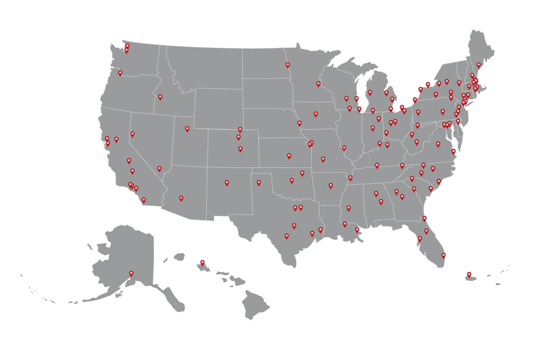



Join Us!
Looking ahead to Sound the Alarm events this spring.
Together, we can help prevent home fire tragedies.
On average, 7 people die every day from a home fire. You can help change that. From April 28 to May 13, the Red Cross will hold fire safety and smoke alarm installation events in 100 at-risk communities nationwide.
Install
100,000 alarms
Reach
40,000 households
Rally
35,000 volunteers
Disaster Responder members can help save lives by inviting employees to volunteer, making a gift or helping us spread the word!

Slide 12
THANK YOU
FOR YOUR LIFESAVING SUPPORT
Your Disaster Responder donations are at work every day, helping us respond immediately in times of crisis and ensuring that we can be there to assist with ongoing emergency relief and recovery needs. We simply could not do the work that we do without your continued investment in our mission.

