Slide 1
FY19 DISASTER UPDATE: Q2 (Oct.-Dec. 2018)
FOR DISASTER RESPONDER PROGRAM MEMBERS

Slide 2
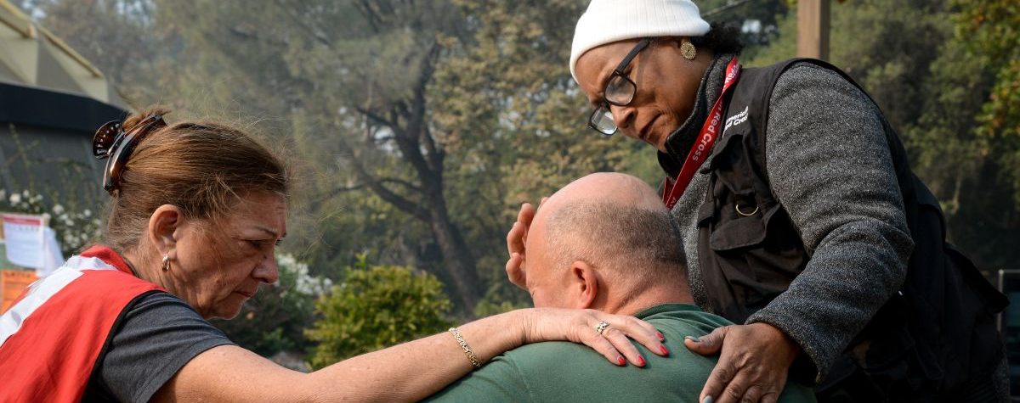
NEW PHOTO/COPY
As 2018 came to a close, the American Red Cross helped people following record-breaking disasters—deadly wildfires in California; both Hurricane Michael in the Southeast coast and Typhoon Yutu on the Mariana Islands; and the earthquake and ongoing aftershocks in Alaska. We provided relief to hundreds of thousands of major disaster survivors, all while addressing home fires, winter storms and other everyday disasters in communities nationwide.
Notes:
Photo 12276-022

Slide 3
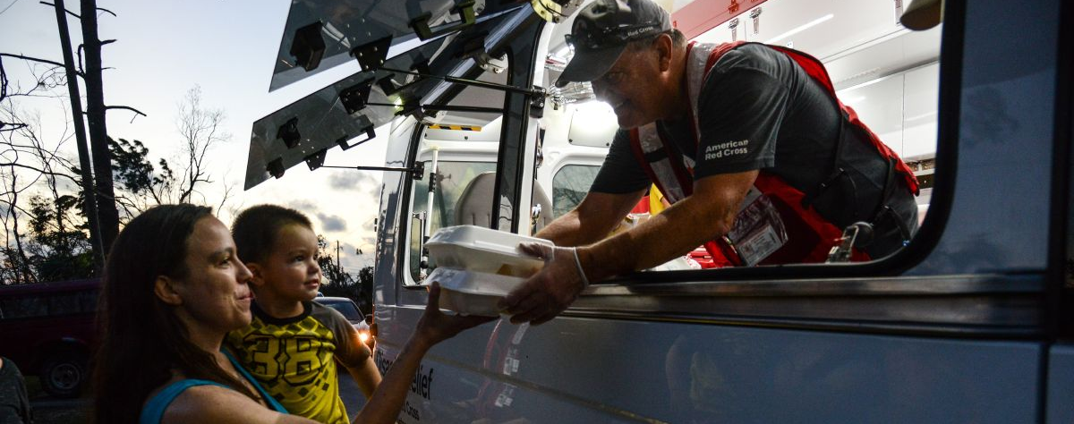
Red Cross volunteers delivered help and hope to people like Jenna and her son Leo. Five days after Hurricane Michael made landfall, they received hot chicken fajitas, snacks and water from a Red Cross vehicle. We can only provide this kind of immediate help—meeting basic needs like food and shelter and providing small comforts like toothbrushes—with support from Disaster Responder members like you.
Notes:
Clifton W. Hall of Spring Lake, North Carolina evacuated his house before Hurricane Florence came barreling through his town. He came home to find four feet of water inside his house. Two weeks later the water is going down but a permanent water line stretches across his house more than halfway up from the ground to his roof, showing the height of the damage. He is still staying somewhere else because his house is not safe but he comes back every day to try and fix what he can. He was thankful the Red Cross drove up with clean up kits to help him continue cleaning up what the storm has taken from him

Slide 4
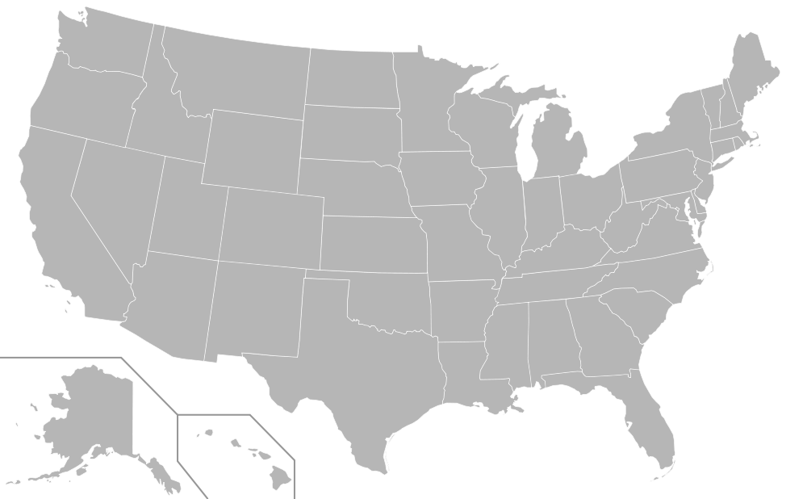
During this quarter, the American Red Cross responded to 47 significant disasters across the country, including 12 very large events. At the same time, we continued to respond to thousands of everyday disasters, like home fires.
1
8
NY Transportation Incident (level 3)
FL Hurricane Michael (level 7)
GA Hurricane Michael (level 5)
AL Hurricane Michael (level 4)
VA Hurricane Michael (level 3)
TX Floods (level 4)
NMI Typhoon Yutu (level 6)
CA Camp Fire (level 7)
Southern CA Wildfires (level 4)
AK Earthquake (level 3)
Central IL Tornado (level 3)
MS Severe Storms (level 3)
11
5
9
12
4
3
6
2
10
7
Includes domestic disasters with costs of $10,000+ (i.e. level 2 and higher)

Slide 5

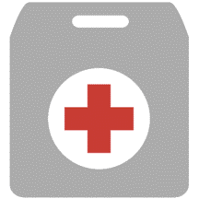


Q2 Domestic Response Totals
More than 8,000 American Red Cross disaster workers provided critical services with partners to families across the country.
2,469,100
meals and snacks served
86,800
overnight shelter stays provided in 153 shelters
455,900
relief items distributed
79,800
health and mental health contacts
8,800
Households provided recovery assistance
FY19
Totals
4,399,900
227,100
931,400
155,000
15,300
Includes domestic disasters with costs of $10,000+ (i.e. level 2 and higher)

Slide 6
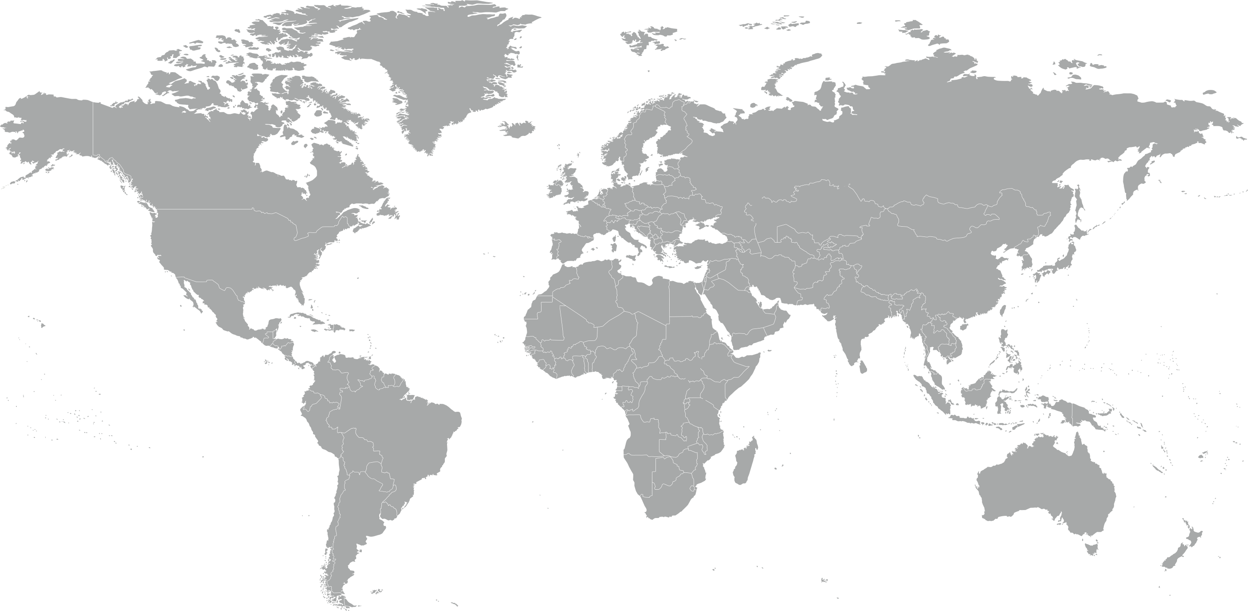
During the quarter, the American Red Cross responded to or continued to respond to 7 major emergencies around the world.
Indonesia Earthquakes and Tsunami
Nigeria Floods
Democratic Republic of the Congo Ebola Outbreak
Haiti Earthquake
Guatemala Volcano
Typhoon Mangkhut
Greece Wildfires
7
4
6
5
2
3
1

Slide 7


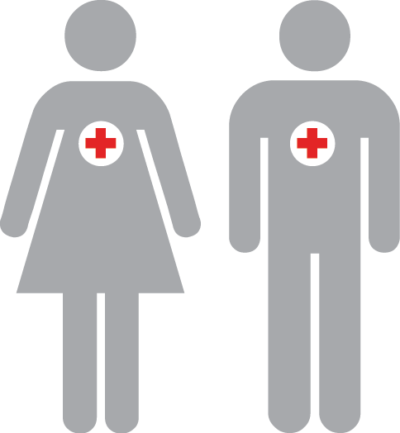
The American Red Cross actively supported disaster preparedness, relief and recovery work in 19 countries.
Q2 International Response Totals
$1,933,923
funds donated*
8
people deployed
25
preparedness and risk reduction projects
FY19
Totals
$3,272,641
12
26
*Reflects funds donated by American Red Cross to IFRC, ICRC or Red Cross Red Crescent national societies following specific disasters.

Slide 8


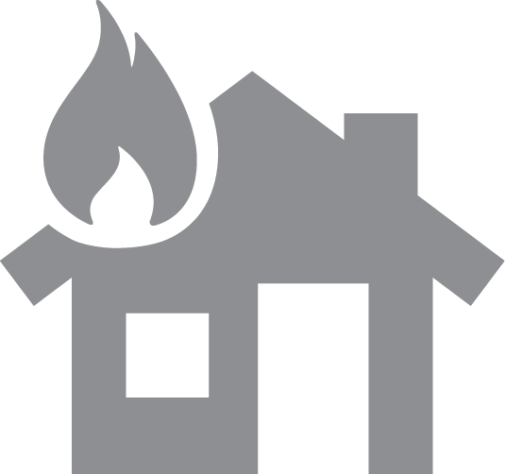

The American Red Cross also supported preparedness and education efforts to combat the nation’s biggest disaster threat – home fires. To date,
511 lives—including 177 children—have been saved through campaign efforts.
Q2 Home Fire Campaign Totals
87,400
New smoke alarms installed
3,100
Batteries replaced in existing smoke alarms
31,700
Escape plans made
36,700
Homes made safer
FY19
Totals
153,700
5,100
55,200
63,400

Slide 9
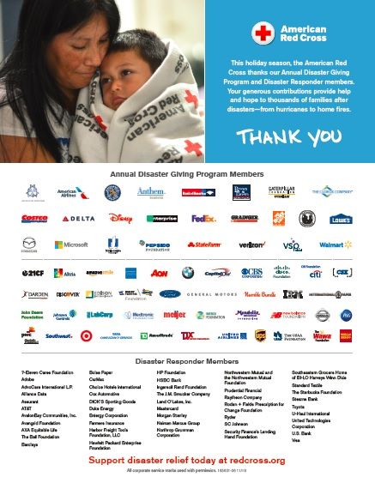
Your Benefits and Resources
We were pleased to provide the following recognition and engagement opportunities during this quarter.
Name in one full-page ad in Businessweek, which was on newsstands Nov. 26 for two weeks and generating 600,000 million impressions.
One-minute video highlighting the disaster work that your investment helped us deliver throughout 2018.
Acknowledgement in 2018 Disaster Year in Review press release, which was issued on Dec. 6 and picked up by 131 broadcast and print outlets.
Template communications materials provided, including social posts and article content. These aligned with timely “Turn and Test” smoke alarms messaging for the holidays.
  During major disaster responses:
  Acknowledgment in three disaster press releases distributed nationwide, each picked up by an average of 168 broadcast and print outlets. The release was also viewed 16,400 times on redcross.org.
  Recognition in five redcross.org disaster news stories, achieving a combined 97,600 page views.
  Recognition in 27 disaster Information Update emails shared with Red Cross supporters.
  Invitation to two disaster leadership update calls, followed by detailed call summaries.

Slide 10
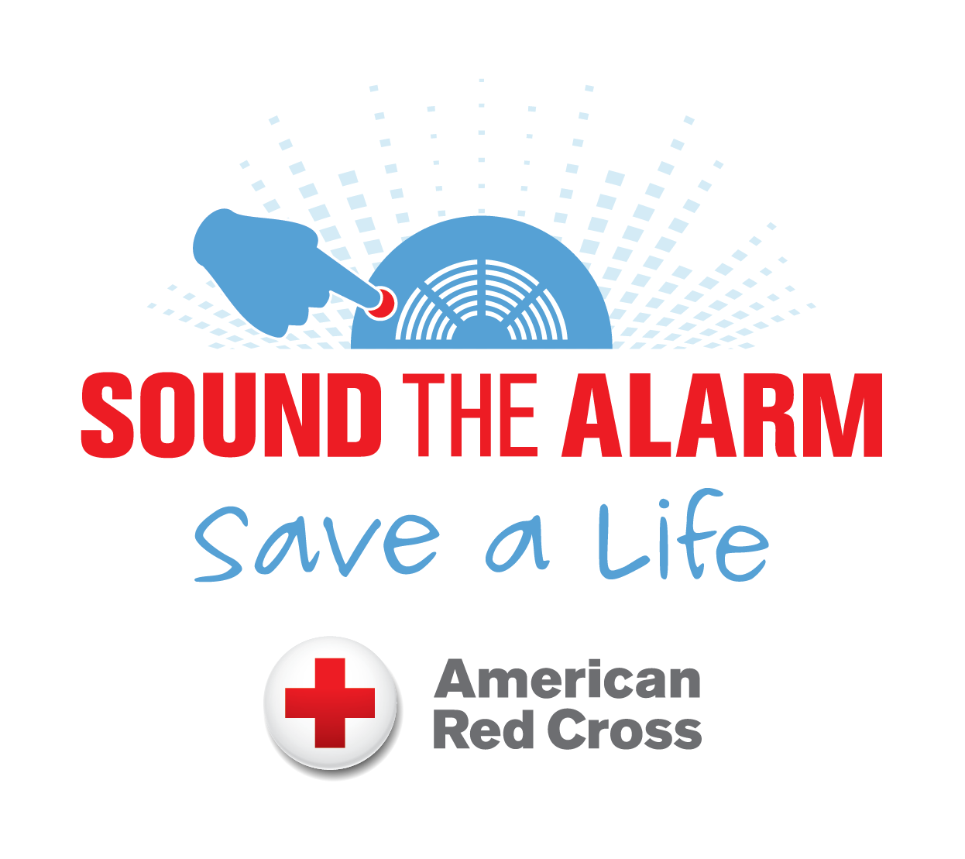

Join Us!
You can also deepen your partnership and help save more lives by aligning with these highly-visible campaigns.
Sound the Alarm
April 27 to May 12, 2019
The Red Cross will again install 100,000 smoke alarms and provide fire safety education in 100 communities nationwide and raise awareness through a major media push.
Missing Types
June 11 to June 30, 2019
The Red Cross will again draw attention to the missing types of blood (A, B and O) and invite the public to fill the “missing types,” with a goal of inspiring 50,000 new blood donors.
Draw attention to the missing blood types by removing the A, B and O letter(s) from your logo and other brand assets.
Invite your employees to volunteer and/or serve as a regional sponsor in your hometown market.
Contact your relationship manager to learn more!

Slide 11
THANK YOU
FOR YOUR LIFESAVING SUPPORT
Your Disaster Responder donation is at work every day, helping us respond immediately in times of crisis and ensuring that we can be there to assist with ongoing emergency relief and recovery needs. We simply could not do this work without your continued investment in our mission.
.

