Slide 1
FY19 DISASTER UPDATE: Q4 (April–June 2019)
FOR DISASTER RESPONDER MEMBERS

Slide 2
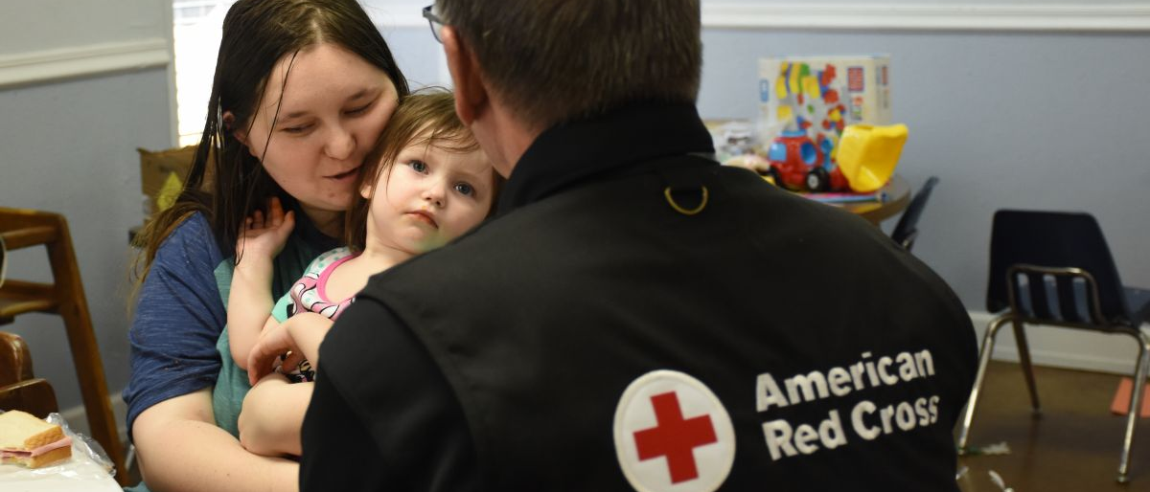
Between April and June 2019, the Red Cross responded to record-breaking floods and tornadoes, all while addressing everyday disasters like home fires. Beyond response, we also made thousands of households safer from homes fires through our second annual Sound the Alarm spring canvassing events and awareness push. Disaster Responder Program members were at the center of it all, preparing people for the worst and standing with them during their darkest hours.
Notes:
Photo 12276-022

Slide 3
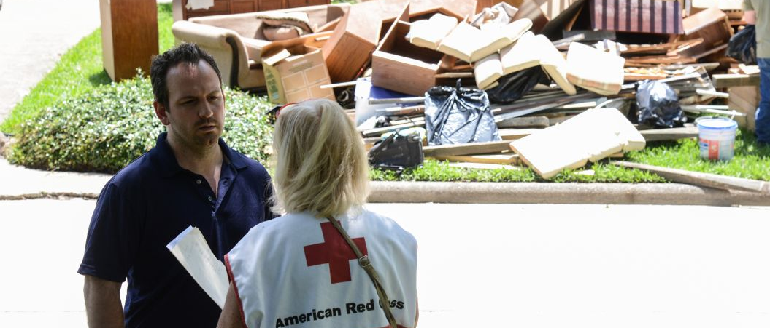
“It’s reassuring to know that I have the tools I need to help my daughter understand the changes that are happening with our home because of the flood. I’m so glad you knocked on my door.” – Adam Laurie
Red Cross workers delivered help and hope to people like Adam Laurie, whose family received emotional support and resources following flooding in Houston, Texas. Thanks to Disaster Responder Program members like you, the Red Cross mobilized immediately—from Texas to Michigan—responding to the needs of thousands of people whose lives were upended by disasters.
Notes:
Clifton W. Hall of Spring Lake, North Carolina evacuated his house before Hurricane Florence came barreling through his town. He came home to find four feet of water inside his house. Two weeks later the water is going down but a permanent water line stretches across his house more than halfway up from the ground to his roof, showing the height of the damage. He is still staying somewhere else because his house is not safe but he comes back every day to try and fix what he can. He was thankful the Red Cross drove up with clean up kits to help him continue cleaning up what the storm has taken from him

Slide 4
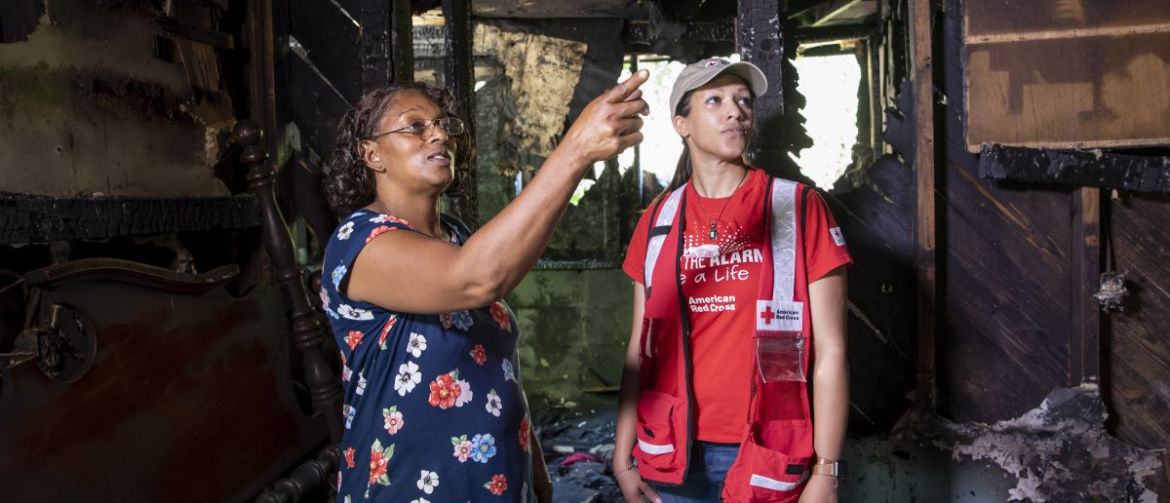
“If I didn’t hear that smoke alarm, we probably wouldn’t be with each other right now.” – Jackie Sturdivant
Smoke alarms installed this spring have already saved lives. Birmingham, Alabama, resident Jackie Sturdivant and her children survived an electrical fire in May—thanks to smoke alarms installed by Sound the Alarm volunteers just three days before.
Notes:
Clifton W. Hall of Spring Lake, North Carolina evacuated his house before Hurricane Florence came barreling through his town. He came home to find four feet of water inside his house. Two weeks later the water is going down but a permanent water line stretches across his house more than halfway up from the ground to his roof, showing the height of the damage. He is still staying somewhere else because his house is not safe but he comes back every day to try and fix what he can. He was thankful the Red Cross drove up with clean up kits to help him continue cleaning up what the storm has taken from him

Slide 5
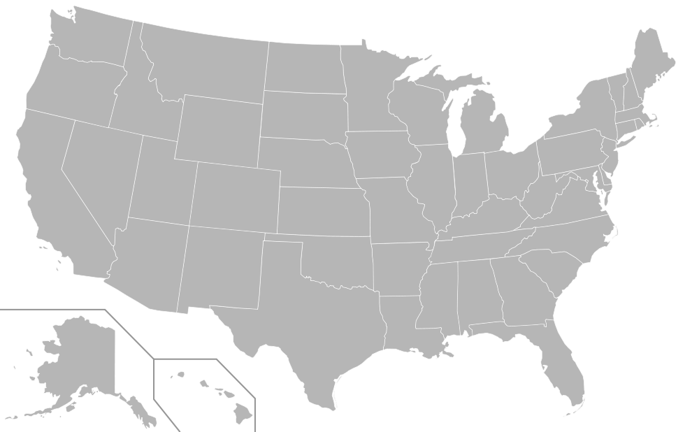
During this quarter, the Red Cross responded to 58 significant disasters across the country, including 12 very large events. At the same time, we responded to thousands of everyday disasters, like home fires.
10
Central OK Flood and Tornadoes (level 4)
MO Flood and Tornadoes (level 4)
KS Flood and Tornadoes (level 4)
OH Tornadoes (level 4)
AR Floods (level 4)
Southeast TX Floods (level 3)
Rio Grande Valley TX Flood and Tornadoes (level 4)
MS Flood and Tornadoes (level 3)
OK Flood and Tornadoes (level 3)
MI Floods (level 3)
TX Storms (level 4)
MS Floods (level 3)
4
3
2
1
9
5
12
8
6
11
7
Includes domestic disasters with costs of $10,000+ (i.e. level 2 and higher)

Slide 6

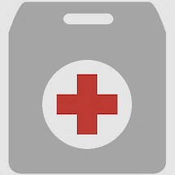


Q4 Domestic Response Totals
More than 3,300 American Red Cross disaster workers and our partners provided critical services to families across the country.
167,700
meals and snacks served
9,500
overnight shelter stays provided in 111 shelters
19,200
relief items distributed
13,300
health and mental health contacts provided
23,200
households provided recovery assistance
FY19
Totals
4,818,800
248,200
1,063,100
186,700
97,300
Includes domestic disasters with costs of $10,000+ (i.e. level 2 and higher)

Slide 7




The Red Cross also supported preparedness and education efforts to combat the nation’s biggest disaster threat – home fires. To date, 610 lives, including those of 205 children, have been saved through campaign efforts.
Q4 Home Fire Campaign Totals
217,000
new smoke alarms installed
6,200
batteries replaced in existing smoke alarms
80,400
escape plans made
89,800
homes made safer
FY19
Totals
458,700
14,300
166,600
188,600

Slide 8
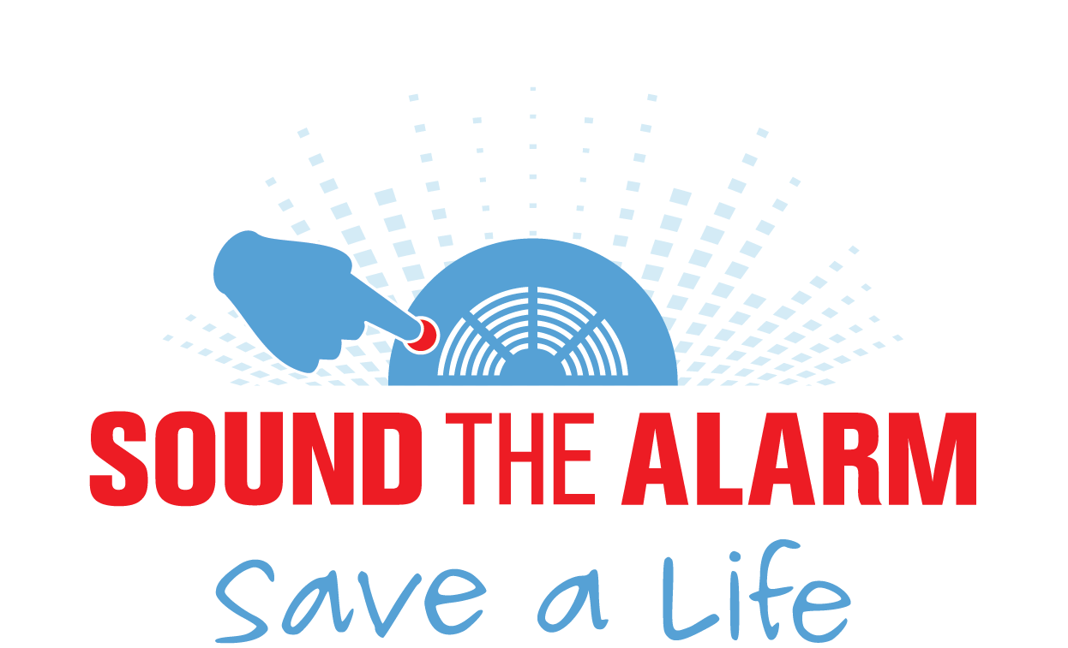

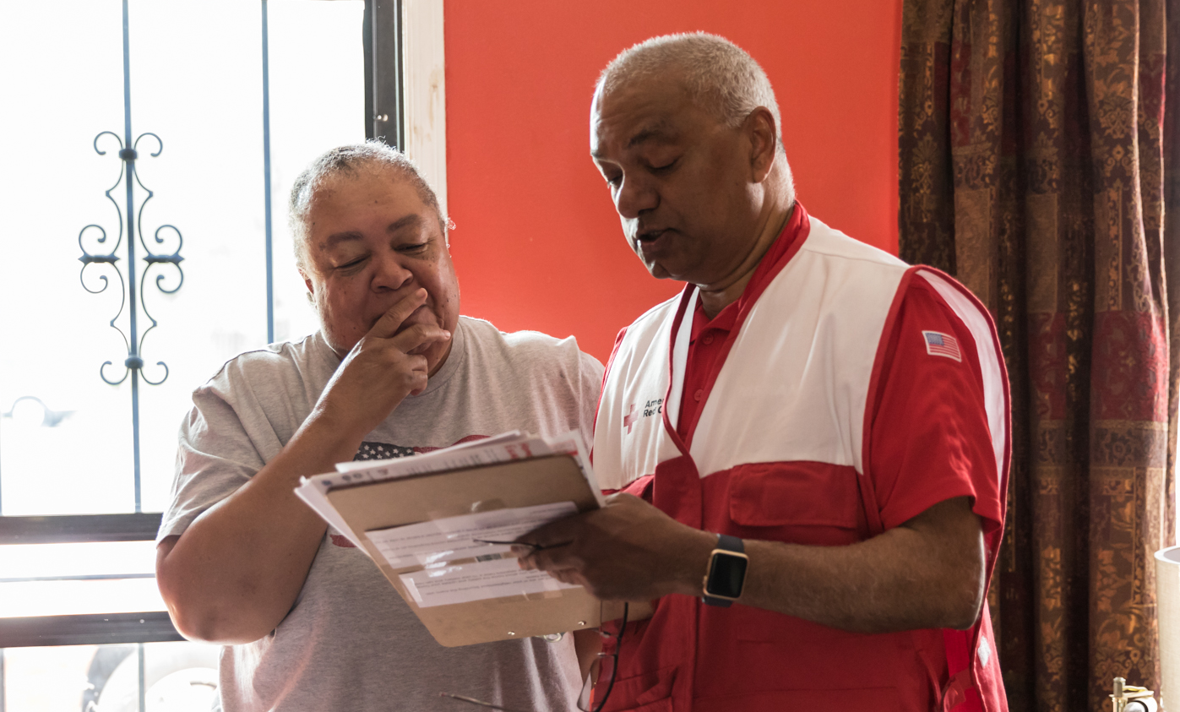
Making Homes Safer,
Nationwide
From April 27-May 12, we hosted 500+ Sound the Alarm events in 146 signature cities.
123,000
new smoke alarms installed
51,000
homes made safer
29,000
volunteers engaged
Thank you for helping save lives across the country.

Slide 9

During the quarter, the American Red Cross responded to or continued to respond to 4 major emergencies around the world.
Afghanistan Drought and Flash Floods
Democratic Republic of the Congo Ebola Outbreak
Malawi Floods
Mozambique Tropical Cyclone Idai
1
2
3
4

Slide 10
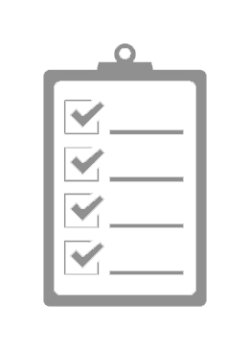

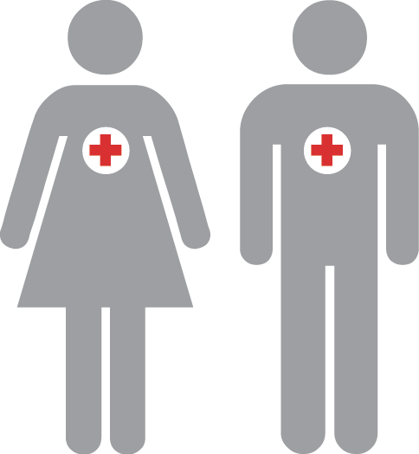
The American Red Cross actively supported disaster preparedness, relief and recovery work in 18 countries.
Q4 International Response Totals
$600,000
funds donated*
4
people deployed
22
preparedness and risk reduction projects
FY19
Totals
$6,182,007
29
31
*Reflects funds donated by American Red Cross to IFRC, ICRC or Red Cross Red Crescent national societies following specific disasters.

Slide 11





Missing Types
Addressing a different type of emergency—the need for blood.
Iconic brands, celebrities and locations removed As, Bs and Os from their names or logos, inspiring people across the country to give blood.
Nearly 300,000
blood donation appointments
20
days
195 million
impressions for #MIssingTypes

Slide 12
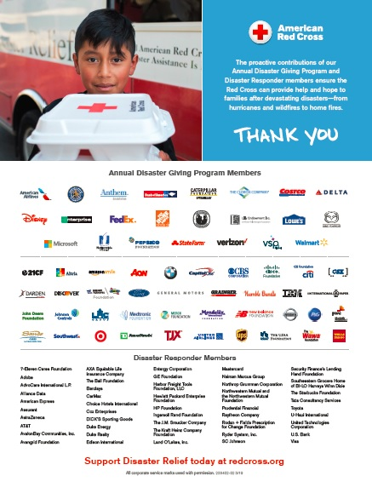
Your Benefits and Resources
We were pleased to provide the following recognition and engagement opportunities during this quarter.
Name in full-page ad in TIME 100 issue of TIME Magazine, generating 2 million impressions.
Template communications materials provided, including social posts and article content. These aligned with timely Sound the Alarm and Missing Types messaging.
During major disaster responses:
Acknowledgment in two disaster press releases and two disaster news stories on redcross.org, generating a combined 12,700 page views.
Recognition in six disaster Information Update emails shared with Red Cross supporters.
Invitation to one disaster leadership update call about our response to floods and tornadoes, followed by detailed call summary.

Slide 13

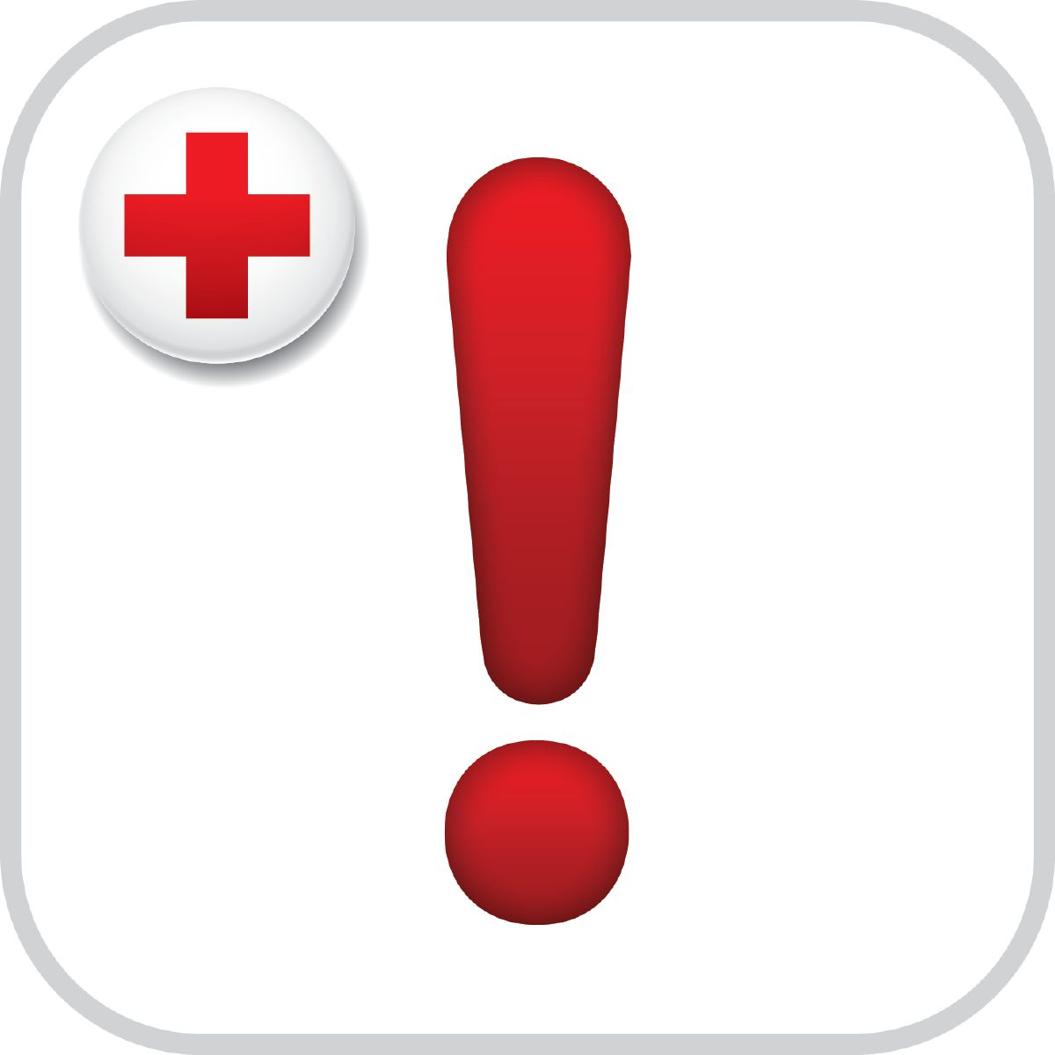
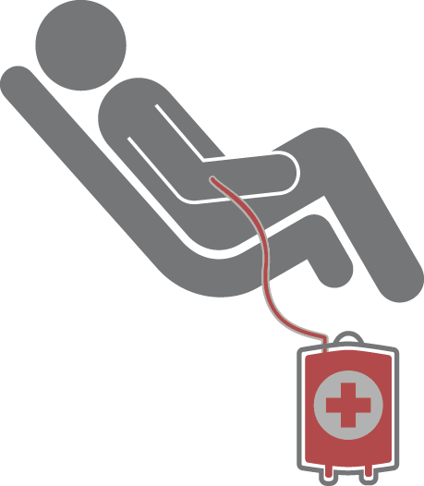
Join Us!
You, your employees and even your customers can get involved with the Red Cross in these timely ways.
Beat the
heat.
Stay safe as the temperatures soar! Check out these heat safety tips.
Be disaster
ready.
Prepare for hurricane season! Download the free Red Cross Emergency App by texting "GETEMERGENCY" to 90999.
Summer blood shortage.
All blood types are urgently needed. Schedule an appointment to donate today.

Slide 14
THANK YOU
FOR YOUR LIFESAVING SUPPORT
Thanks to your forward-thinking contribution, the Red Cross can prepare for crises yet to come and respond immediately when disasters do strike. We thank you for your incredible generosity.

